Slide 1
Reduced Testicular Steroidogenesis and Increased Semen Oxidative Stress in Male Partners as Novel Markers of Recurrent Miscarriage
C.N. Jayasena, U.K. Radia, M. Figueiredo, L. Franklin Revill, A. Dimakopoulou, M. Osagie, W. Vessey, L. Regan, R. Rai, & W.S. Dhillo
January 2019
www.clinchem.org/content/65/1/161.full
© Copyright 2018 by the American Association for Clinical Chemistry

Slide 2
Introduction
Recurrent pregnancy loss (RPL)
  … loss of 3 or more consecutive pregnancies before 20 weeks’ gestation
  … idiopathic in approximately 50% of cases
  … female (but not male) partner routinely undergoes investigation for cause
Sperm and RPL
  … paternally inherited genes implicated in placentation
  … sperm defects and sperm DNA fragmentation previously reported in male partners affected by RPL
  … semen reactive oxygen species (ROS) linked to sperm DNA fragmentation in men with infertility, but no reports in RPL to date

Slide 3
Question 1
What investigations are routinely performed in couples with recurrent miscarriage?

Slide 4
Materials & Methods
Patient Population
  Case-control design.
  RPL cases were defined according to Royal College of Obstetrics and Gynaecology (UK) criteria
  Men unaffected by RPL were recruited as controls.
Measurement of Seminal ROS and DNA Fragmentation
  WHO 2010 microscopic semen analysis was performed according in a lab with UK NEQAS accreditation.
  Seminal ROS levels were measured chemiluminescence assay using luminol (Vessey et al. 2014)
  Sperm DNA fragmentation was measured with the Halosperm G2 kit (Fernández et al. in 2005)

Slide 5
Question 2
Why was a case-control rather than cohort design chosen in the current study, and what are the relative merits of each design?

Slide 6
Results
Patient characteristics
  Similar clinical characteristics between control and RPL groups
  Nine of control group and eighteen of RPL group had fathered children previously
Reproductive profile and sperm function
  Mean + SE morning serum testosterone (nmol/L) was 15% lower in RPL than in controls (controls, 19.0 + 1.0; RPL, 16.0 + 0.8; P < 0.05).
  Total sperm motility, progressive sperm motility, and normal morphology were all reduced in the RPL group vs controls.

Slide 7
Baseline characteristics
Table 1. Clinical characteristics of participants.
Data for age and body mass index presented as mean ± SE.
^{b} RPL, recurrent pregnancy loss; BMI, body mass index.
^{c} P < 0.05, vs with healthy controls, with unpaired Student t test or Wilcoxon ranksum test.
^{d} Alcohol intake presented as mean.

Slide 8
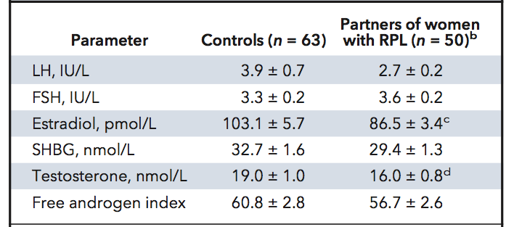
Endocrine Parameters
Table 2. Endocrine parameters of participants.
Data presented as mean + SEM.
ª Free Androgen Index (FAI) calculated as: FAI = (serum testosterone x 100 ) / SHBG.
^{b} RPL, recurrent pregnancy loss; LH, luteinizing hormone; FSH, follicle stimulating hormone; SHBG, sex hormone binding globulin
^{c} P<0.01
^{d} P<0.05

Slide 9
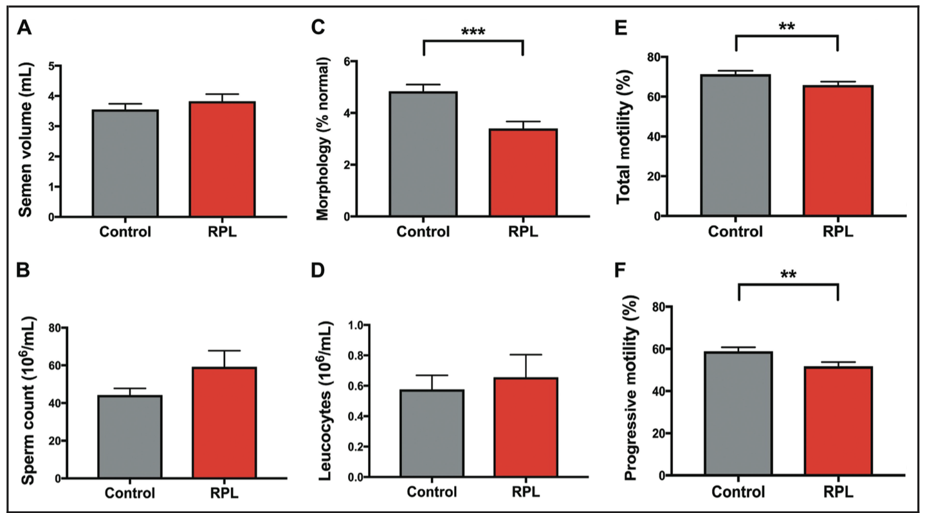
Sperm Characteristics
Figure 1. Sperm characteristics of male partners of women with recurrent pregnancy loss.
Bar graphs compare semen volume (A), sperm count (B), normal sperm morphology (C), leukocyte count (D), total sperm motility (E), and
progressive sperm motility (F) in recurrent pregnancy loss (RPL) group versus control group. Data are mean ±SE. **P < 0.01; ***P < 0.001.

Slide 10
Results
Sperm molecular characteristics
  Mean + SE ROS (RLU/sec/10⁶ sperm) were 4-fold higher in RPL vs. controls (controls, 2.0 + 0.6; RPL, 9.1 + 4.1; P < 0.01).
  Mean + SE sperm DNA fragmentation (%) was 2-fold higher in RPL vs. controls (controls, 7.3 + 1.0; RPL, 16.4 + 1.5; P < 0.0001).
  ROC analysis: sperm morphology, semen ROS, and sperm DNA fragmentation were discriminative of RPL.
  Sperm DNA fragmentation was the most discriminative index between of RPL (area under the curve 81%; P < 0.0001).

Slide 11
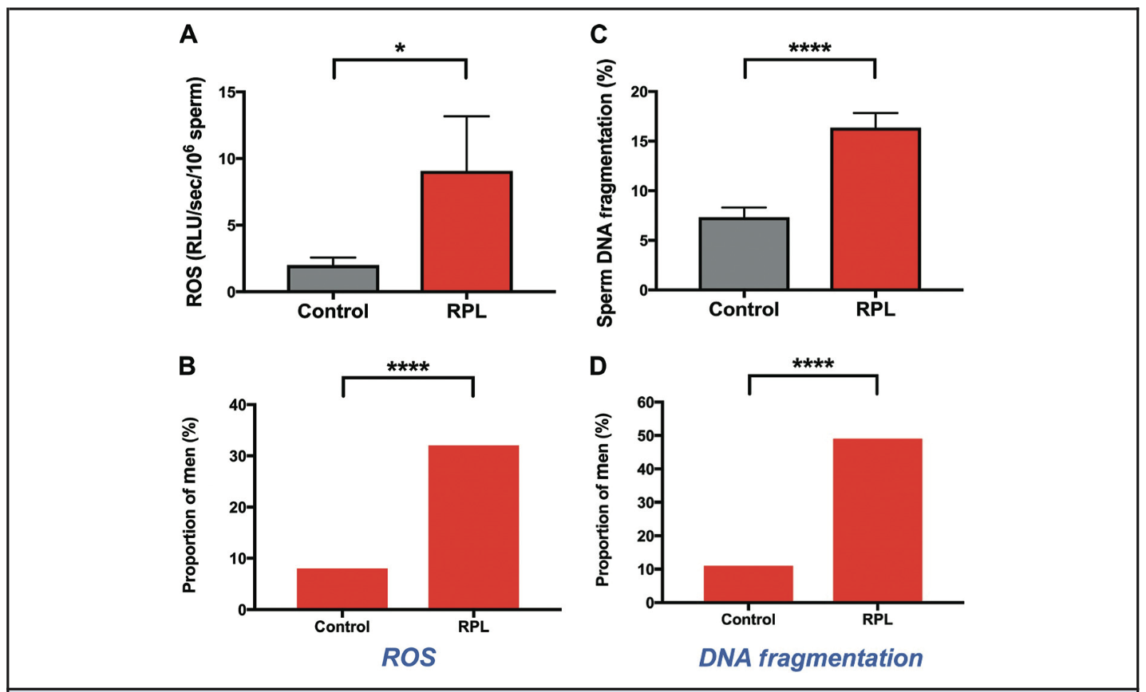
Sperm Molecular Parameters
Figure 2. Sperm DNA damage and oxidative stress in male partners of women with recurrent pregnancy loss.
Bar graphs compare semen reactive oxygen species (ROS; A) and sperm DNA fragmentation (B) in recurrent pregnancy loss (RPL) versus controls. Data are mean +SE. Histograms compare the proportion of participants with increased semen ROS (C) and sperm DNA fragmentation (D). *P < 0.01; ****P < 0.0001.

Slide 12
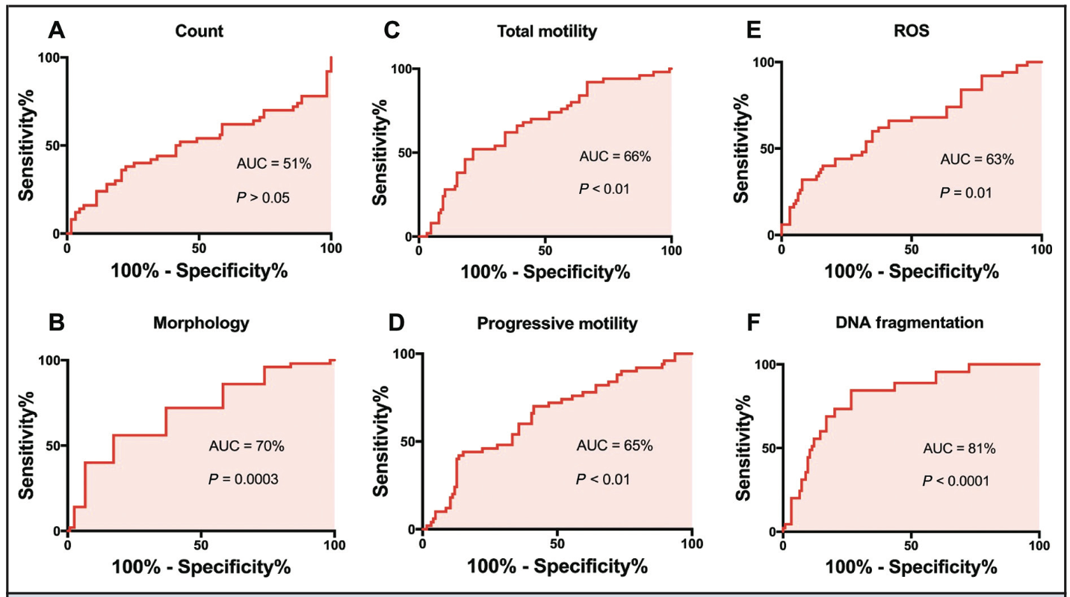
Comparing Controls and RPL
Figure 3. Receiver operation characteristics of reproductive parameters in male partners of women with recurrent pregnancy loss.
ROC analyses for sperm count (A), normal sperm morphology (B), total sperm motility (C), progressive sperm motility (D), semen reactive oxygen species (E), and sperm DNA fragmentation (F). Area under curve (AUC) values are presented for each parameter.

Slide 13
Question 3
What are the potential barriers to routine reproductive testing of male partners affected by RPL?

Slide 14
Discussion
Limitations
  Mean BMI and age were different between groups, but literature suggests these would be unlikely to cause the observed differences in sperm function
  Halosperm method is an index of abnormal chromatic packing rather than a direct assessment of DNA damage
  Unproven fatherhood of controls
Suggested further work
  Large cohort study needed to support conclusions
  Comparison of results from current study with other methods of DNA fragmentation analysis (e.g. SCSA, TUNEL, COMET)
  Investigate the mechanisms how endocrine and sperm dysfunction translate to pregnancy loss

Slide 15
Conclusions
These data suggest that men affected by RPL have abnormalities in sperm and endocrine function vs. unaffected controls.
Clinical implications: Endocrine and molecular sperm profiling may offer a potential novel approach to stratifying future miscarriage risk in couples with RPL

