Slide 1
Performance of the MasSpec Pen for Rapid Diagnosis of Ovarian Cancer
M. Sans, J. Zhang, J.Q. Lin, C.L. Feider, N. Giese, M. Breen, K. Sebastian, J. Liu, A.K. Sood, and
L.S. Eberlin
May 2019
www.clinchem.org/content/65/5/674.full
© Copyright 2019 by the American Association for Clinical Chemistry

Slide 2
Introduction
Need for new technologies for intraoperative ovarian cancer diagnosis
  Tissue identification through gross inspection during surgery is challenging (Nick et al., Nat Rev Clin Oncol 2015;12:239–45).
  Histopathologic diagnosis can be time and labor intensive (Macario et al., J Clin Anesth 2010;22:233– 6).
    Intraoperative – frozen sections: freezing artifacts affecting histology
    Postoperative – permanent sections: ~ 1 week delay time
Mass spectrometry (MS) has shown potential for clinical use and cancer diagnosis
  The MasSpec Pen has been demonstrated for ex vivo and in vivo tissue analysis and diagnosis (Zhang et al., 2017).
  Objective: to further explore the use of the MasSpec Pen for ovarian cancer diagnosis

Slide 3
Questions on Introduction
What are some advantages of the MasSpec Pen for cancer diagnosis and intraoperative use?
How would more accurate tissue identification and diagnosis benefit patients and the healthcare system?

Slide 4
Materials and Methods
Human Tissue samples
  192 ovarian, fallopian tube, and peritoneum samples were obtained as frozen specimens from the Cooperative Human Tissue Network and MD Anderson tissue banks, or collected as fresh specimens at Seton Medical Center.
MasSpec Pen Analysis
  The MasSpec Pen with a 2.7 mm pen tip diameter was used
  Using same procedures and system previously described (Zhang et al., Sci Transl Med 2017;9:eaan3968).
  Q Exactive Orbitrap and LTQ mass spectrometer (Thermo Fisher Scientific).
Statistical Analysis
  Data were binned, normalized, and filtered before being subjected to lasso.
  Cosine similarity was performed on average mass spectra.

Slide 5
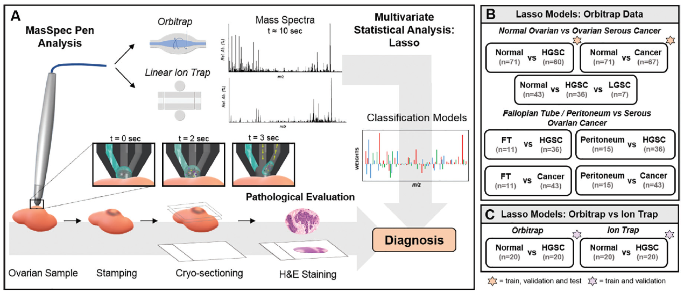
Tissue Sample Analysis with the MasSpec Pen
Figure 1. Tissue sample analysis with the MasSpec Pen using a discrete water droplet (A). For pathological evaluation, tissue samples were stamped post-analysis, frozen, sectioned, and stained. Mass spectra were obtained using (B) an orbitrap and (C) a LIT mass analyzer and used to build molecular models for ovarian cancer classification (orange star = train, test, and validation; purple star = train and validation; no star = train). H&E, hematoxylin and eosin.

Slide 6
Question on Materials & Methods
What are the main differences between ion trap and orbitrap mass analyzers?

Slide 7
Results
MasSpec Pen analysis of ovarian tissue samples using an orbitrap mass analyzer
  Differences in the metabolite and lipid profile between normal, low-grade serous carcinomas (LGSC) and high-grade serous carcinomas (HGSC) samples were observed from MasSpec Pen mass spectra (Fig. 1).
Statistical models were built from MasSpec Pen Data to predict ovarian cancer
  HGSC vs normal and Cancer (HGSC + LGSC) vs normal. The classifier was trained, validated and tested with separate sample sets, obtaining high classification performance (Fig. 2).
  HGSC vs LGSC vs normal – only validation set. Overall accuracy = 97.7%.
  Molecular models included biologically relevant lipid and metabolite species.

Slide 8
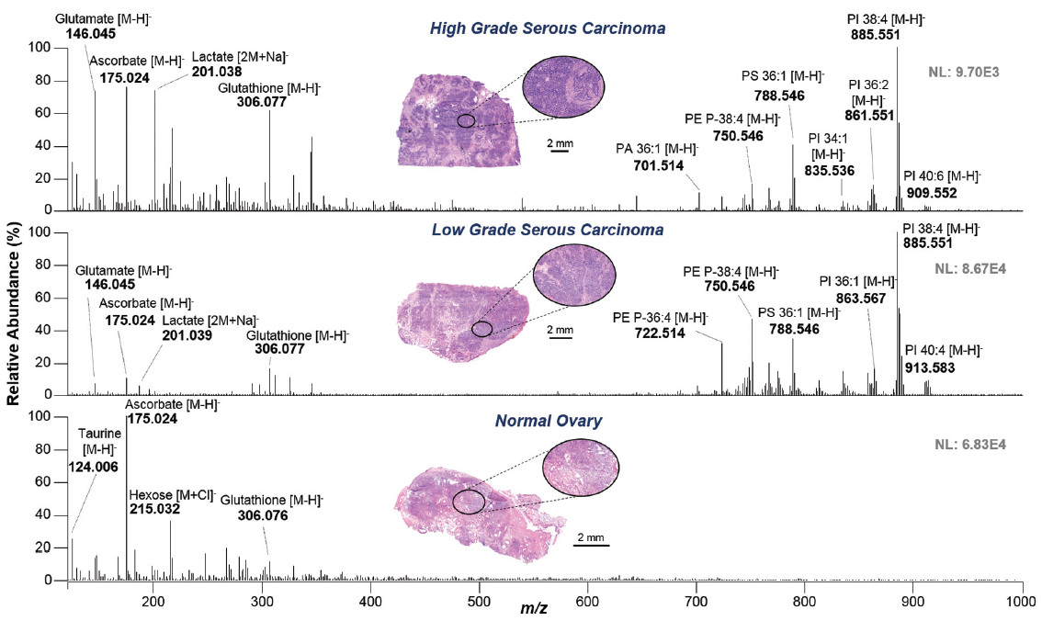
MasSpec Pen Analysis of Ovarian Tissue Samples Using and Orbitrap Mass Analyzer
Figure 2. Representative MasSpec Pen mass spectra of high-grade serous carcinoma (top), low-grade serous carcinoma (middle, background subtracted), and normal ovarian tissue (bottom) obtained with an orbitrap mass analyzer. Optical image of the stained parallel tissue section analyzed is provided. Tentative identifications are shown for selected ions. X:Y represents number of carbon atoms double bonds in the FA chains.

Slide 9
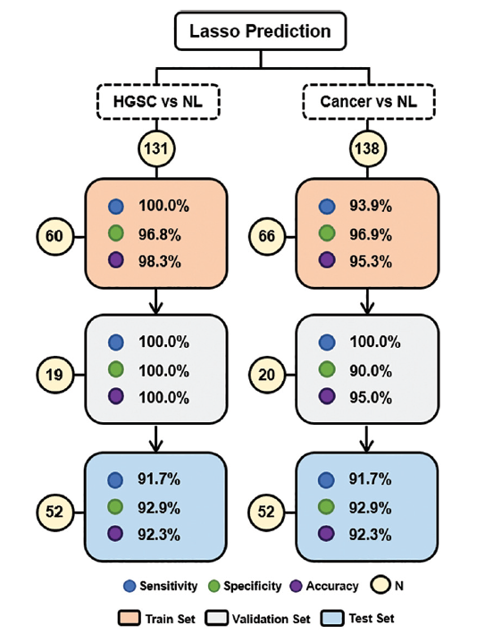
Statistical Prediction of Ovarian Cancer Using Training, Validation and Test Sample Sets
Figure 3. Lasso classification performance for ovarian cancer prediction based on MasSpec Pen data for the training, validation,and test sets. Results are shown in terms of sensitivity, specificity, and overall accuracy. Confusion matrices with per patient prediction are shown in Table 1 in the online Data Supplement. HG, high-grade serous carcinoma, NL, normal, N, sample number.

Slide 10
Results
Distinguishing ovarian cancer from healthy fallopian tube and peritoneum tissue
  Distinct metabolic profiles were obtained for fallopian tube and peritoneum tissue with the MasSpec Pen (Fig. 4a).
  Molecular models were created to differentiate healthy and cancerous tissue types (Fig. 4b).
Validation of the MasSpec Pen using an ion trap mass analyzer
  Highly comparable metabolic profiles were observed for the same tissue sample using both systems (Fig. 5a).
  High classification performance to distinguish normal and HGSC tissue was obtained using molecular models built from ion trap data (Fig. 5b).

Slide 11
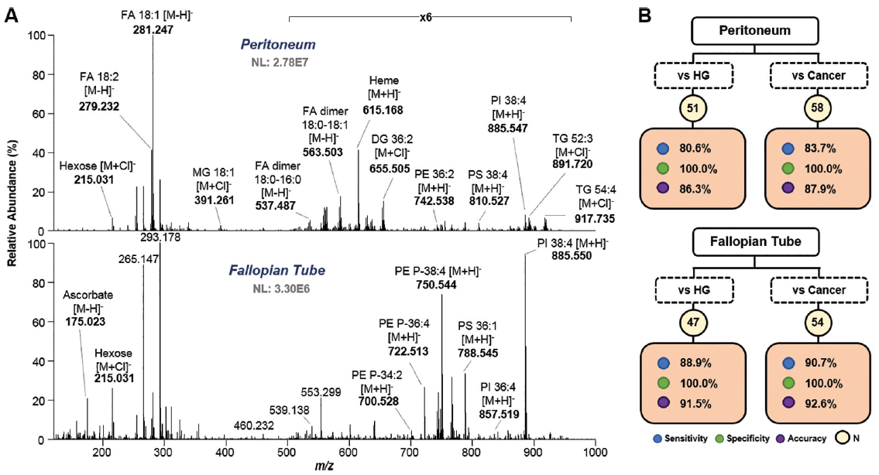
Distinguishing Ovarian Cancer from Healthy Fallopian tube (FT) and Peritoneum Tissue
Figure 4. Differentiating ovarian cancer tissue from healthy peritoneum and FT tissue samples. Representative mass spectra profile obtained from MasSpec Pen analysis of peritoneum (top) and FT (bottom) tissue (A). Tentative identifications are shown for selective ions. Lasso results for peritoneum (top) and FT (bottom) vs HG and cancer tissue differentiation (B).

Slide 12
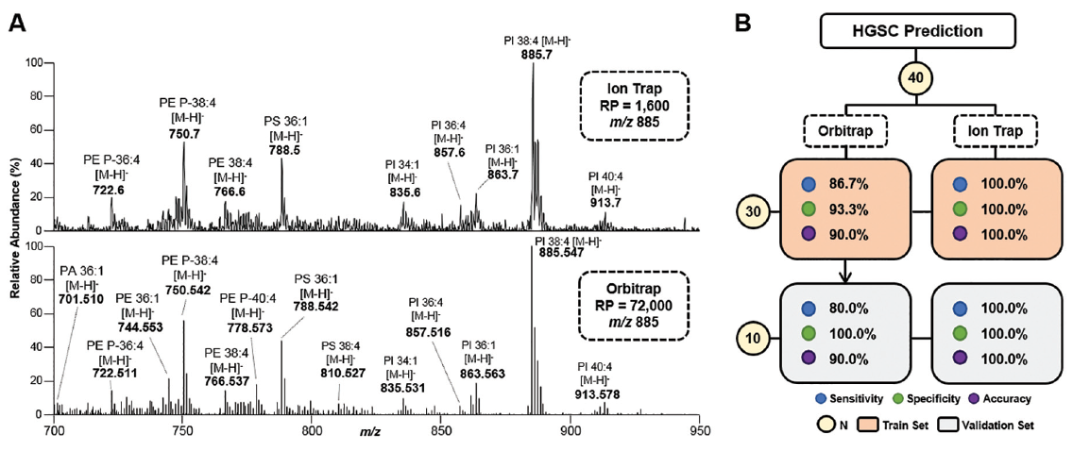
Validation of the MasSpec Pen using and Ion Trap Mass Analyzer
Figure 5. Representative mass spectra profile obtained from the same HGSC sample by ion trap (top, profile mode) and orbitrap (bottom, centroid mode) analysis (A). Tentative identifications are shown for selected ions. Lasso results for HGSC prediction comparing performance between the models built from orbitrap and ion trap data acquired from the same sample set (n = 40) (B). RP, mass resolving power; N, sample number.

Slide 13
Questions on Results
What is the difference between a training, a validation and a test set?
Why is it important to perform these analyses?

