Slide 1
Estimates of Within-Subject Biological Variation Derived from Pathology Databases: An Approach to Allow Assessment of the Effects of Age, Sex, Time between Sample Collections and Analyte Concentration on Reference Change Values
G.R.D. Jones
April 2019
www.clinchem.org/content/65/4/579.full
© Copyright 2019 by the American Association for Clinical Chemistry

Slide 2
Introduction 1: Within-subject Biological Variation
Within-individual biological variation is:
  The random variation of analyte concentration in a person over time
  It (usually) excludes changes due to controllable factors, such as time of day, effect of meals, menstrual cycle etc
  It is expressed as the individual coefficient of variation (CV_{I})
  Is used to provide analytical performance specifications
  Is used to calculate a Reference Change Value (RCV)
  (also known as a Critical Difference)
  RCV includes the total variation in a result (CV_{TOT})
  CV_{TOT} includes CV_{I}, analytical variation (CV_{A}) and pre-analytical variation

Slide 3
Introduction 2: Within-subject Biological Variation
Within-individual biological variation is estimated by:
  Formal studies using healthy “reference individuals”
  Each subject is tested on multiple occasions
  “Few subjects, multiple samples”
  Pre-analytical variation is minimized by standard collection protocols
  Analytical variation is minimized by duplicate analysis in a small number of analytical runs.

Slide 4
Introduction
Discussion Questions.
  Where are CVi data currently found?
  How are CVi data used for analytical quality specifications?
  What is the usual formula for estimating the RCV?

Slide 5
Indirect techniques / data mining
Formal CVi studies are analogous to formal reference interval studies (healthy reference individuals under controlled conditions).
Formal reference interval studies are also called direct studies
Indirect reference interval studies use data from routine pathology databases.
This paper uses data from a routine pathology database to generate CVi data.
This can be considered an indirect method
“Many subjects (thousands), few samples (two)”

Slide 6
Indirect techniques / data mining
Compared with Direct Studies, Indirect Studies are:
Much cheaper (no new subjects, collections or measurements)
Much faster (a few hours rather than a few months)
And they include the analytical and pre-analytical variation seen in routine practice
Can assess different populations (old, young etc)
But:
Do the data reflect the variation seen in healthy people?

Slide 7
Methods
Data extraction.
  Pairs of results from the sample patient
  Pairs produce the Result Ratio (2nd Result / 1st Result)
  29 common chemistry and hematology tests
  Relevant patient demographics: age, sex, location, time between samples
Statistics.
  Aim to determine the variation in the Result Ratio
  This paper used the Bhattacharya technique
  A graphical technique to find a Gaussian distribution in the midst of other data
  No need to remove outliers
  Determines total result variation (CV_{TOT})

Slide 8
Results
Good Gaussian data found for 26 tests
(skewed for CRP, ferritin, trigs not further considered)
CVi estimates taken by removing CVa effects from measured CV_{TOT}
Generally a good correlation was seen with CVI estimates from the Ricos database* (see next slide)
Generally the effects of Age, Sex and Time between sample collection were small (see slide after next)
*www.westgard.com/biodatabase1

Slide 9
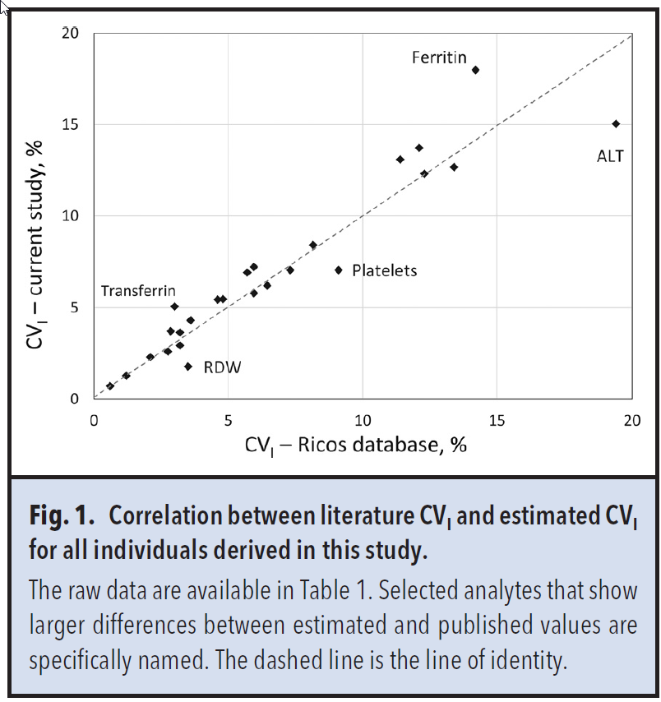

Slide 10
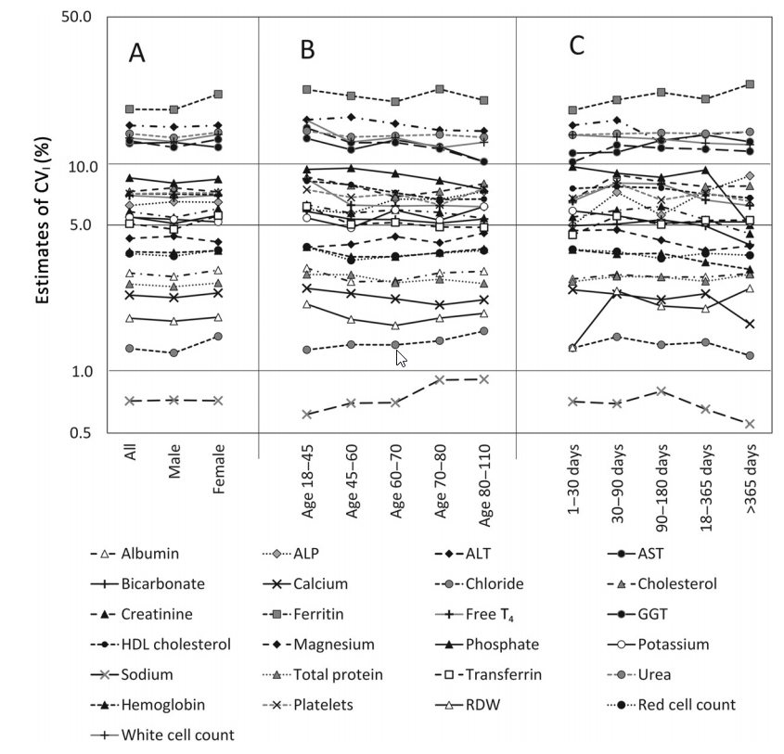
Sex
Age
Time between
samples

Slide 11
Effect of starting concentration
When the first result of a pair from a patient was low compared with the overall median, the next result was likely to be higher.
When the first result of a pair from a patient was high compared with the overall median, the next result was likely to be lower.
This effect was seen for all analytes (see next slide)

Slide 12
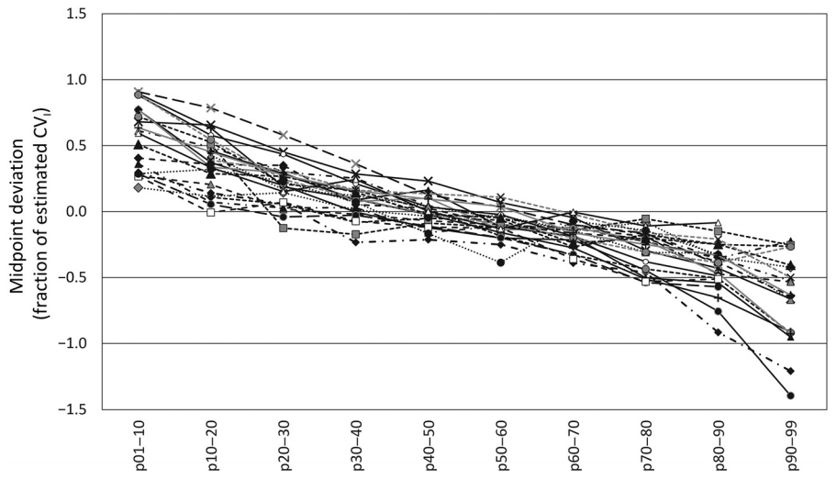
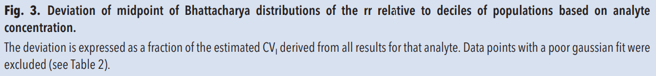
Low concentration of 1st sample, next result likely to be higher
Midpoint Deviation
(fraction of estimated CVi)
High concentration of 1st sample, next result likely to be lower
Starting concentrations – percentile groups
Analyte markers in graph same as previous figure

Slide 13
Discussion 1
The estimates of CVi were obtained without any additional blood collections or measurements.
A reasonable correlation with existing data was obtained.
The estimates reflect the pre-analytical and analytical variation used in routine practice.
CV_{TOT} can be used directly for Reference Change Value calculations.

Slide 14
Discussion 2
Due to the large numbers available, other factors can be addressed.
In this study the effect of sex, age and time between collections was generally small.
Some changes were seen:
  Sodium CVi increased (slightly) with age
  GGT CVi decreased (slightly) with age
  Phosphate variability decreased with time between samples
Further studies can further address these findings

Slide 15
Discussion 3
The asymmetry seen with starting concentration has important implications.
  The next result after a high result sample is less likely to rise further than to fall.
  An increase from a high result is more significant than a fall of the same amount.
RCV calculations should be developed to include this effect.

Slide 16
Limitations
The process needs large numbers of results.
Data measured to more significant figures is preferred.
Strategies can be used to limit the effect of unwell subjects:
  Use General Practice samples (as in this study)
  Use only 2 samples from each person
  Use two samples separated by greater time (the patient is less likely to be considered unwell by the treating doctor)
Strategies need to be developed to address skewed distributions (seen with larger CVs).
Better statistical techniques can be adopted.
Note no confidence limits around the CVi estimates are produced.

Slide 17
Conclusions
Pathology databases contain important information.
Indirect techniques can extract this information.
The only tools are personal computer, a spreadsheet, some data and some time.
Reference interval and CVi data can be developed, investigated and checked.
Thought must be given to the statistical techniques and confounding factors.

Slide 18
Discussion Questions
How might you use stored pathology data to improve your laboratory?

