Slide 1
ProBNP That is Not Glycosylated at Threonine 71 is Decreased With Obesity in Patients with Heart Failure
L.K. Lewis, S.D. Raudsepp, T.C. Prickett, T.G. Yandle, R. Doughty, C.M. Frampton, C.J. Pemberton, A.M. Richards
September 2019
www.clinchem.org/content/65/9/1115.full
© Copyright 2019 by the American Association for Clinical Chemistry

Slide 2
Introduction
  Heart failure (HF) is the leading cause of death worldwide
  N-terminal pro-B-type natriuretic peptide (NT-proBNP) and B-type natriuretic peptide (BNP) concentrations are used routinely for HF diagnosis and risk stratification
  NT-proBNP and BNP result from the cleavage of proBNP108 between amino acids 76 and 77
  ProBNP has 6 central glycosylation sites and 1 site at Threonine 71 (T71)
  Obese individuals have lower NT-proBNP and BNP levels than non-obese
  Mechanism behind lowered NT-proBNP and BNP unidentified

Slide 3
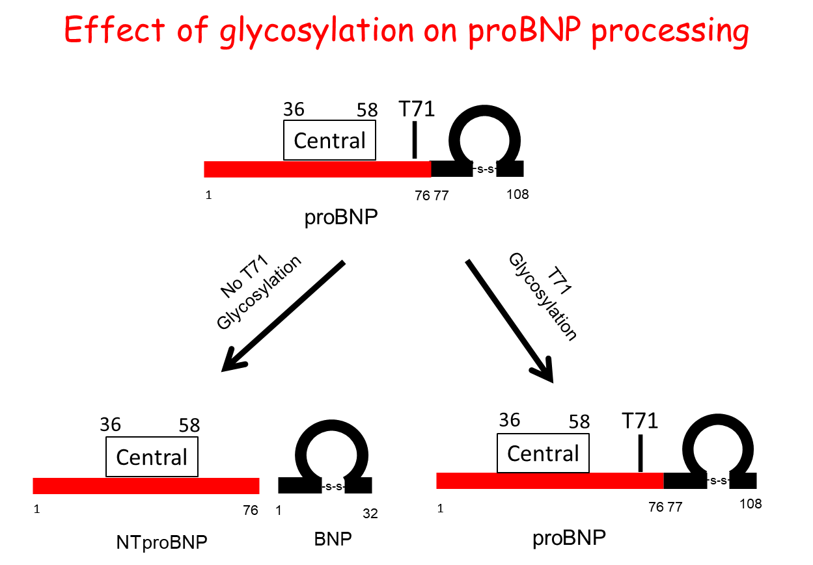
ProBNP glycosylated at T71 is not enzymatically cleaved to produce BNP and NT-proBNP.

Slide 4
Question 1
What is the difference between glycosylation and glycation?

Slide 5
Materials and Methods:
We developed 3 new assays which differentiated glycosylated from non-glycosylated forms of proBNP in plasma. We used these assays to measure peptide levels in the plasma of 238 patients diagnosed with heart failure. Results were compared with those obtained from the Roche Cobas proBNP II NT-proBNP assay.
Our ProBNP assays - Antibody recognition sites
Assay | Epitope 1 | Epitope 2 |  | Symbol
ProBNP (total: glycosylated + nonglycosylated) | BNP11-22 | NTBNP 13-20
NG-C (ProBNP Not Glycosylated Centrally) | BNP11-22 | NTBNP 31-39
NG-T71 (ProBNP not Glycosylated at T71) | BNP11-22 | NTBNP 67-76
T71
1
Central
76 77
-s-s-
108
proBNP
Schematic of proBNP peptide showing both the centrally glycosylated and T71 glycosylated sites as white boxes. Antibodies are unable to bind to glycosylated regions.

Slide 6
Materials and Methods
Size exclusion HPLC profiles analysis using the proBNP (●), NG-T71 (▼) and NG-C (■) assays. a) non-glycosylated proBNP b) glycosylated proBNP and c) a plasma sample from an individual with heart failure in which NG-C was not detected.

Slide 7
Question 2
  What are the advantages and disadvantages of using immunoassays and mass spectrometry in the measurement of circulating peptides

Slide 8
Results: Participant characteristics and plasma peptide concentrations
(median and IQR)
 | Controls Median (IQR) | Heart Failure Median (IQR)
 | (N=106) | All (N=238) | BMI<30 (N=135) | BMI>30 (N=91)
Age (years) | 49 (37-59) | 72.3 (64-80) | 75 (68-82) | 67 (59-74) **
Weight (kg) | 78 (65-87) | 79 (66-93) | 69 (60-77) | 96 (87-110) **
Height (m) | 1.72 (1.65-1.79) | 1.69(1.6-1.76) | 1.69 (1.6-1.8) | 1.68 (1.6-1.75)
BMI (kg/m²) | 25.7 (23.4-28) | 27.4 (23.7-32.0) | 24.2 (21.6-26.3) | 33.3 (31-38) **
Echo-LVEF (%) |  | 43.8(30.9-59.5) | 39 (27-59) | 49 (35-60)
eGFR | 82 (74-91) | 53.0 (42-63.5) | 51 (44-62) | 59 (41-66)
Glucose, mg/dL | 94 (86-101) | 106 (92-135) | 104 (86-126) | 113 (95-142) **
Cholesterol, mg/dL | 201 (178-228) | 170 (139-205) | 174 (143-217) | 166 (135-190)
HFREF (%) | - | 56 | 81 | 35
NYHA I (%) | - | 16 | 16 | 16
NYHA II (%) | - | 42 | 44 | 36
NYHA III (%) | - | 31 | 27 | 35
NYHA IV (%) | - | 11 | 12 | 12
NT-proBNP pg/ml | 39.8 (17-70) | 1791 (880-3459) | 2290 (1506-4111) | 1026 (541-2639) **
ProBNP pg/ml | 36 (36-232) | 300 (43-662) | 309 (47-638) | 264 (31-843)
NG-T71 pg/ml | 36 (18-175) | 113 (18-254) | 163 (18-291) | 36 (18-193) **
NG-C pg/ml | 21 (21-21) | 21 (21-21) | 21 (21-21) | 21 (21-21)
Probnp/NT-proBNP | 1.6 (0.6-5.7) | 0.07 (0.03-0.26) | 0.07 (0.02-18) | 0.15 (0.04-.72) **
Probnp/NG-T71 | 1 (1-4.2) | 1.5 (1-8) | 1.3 (.77-4.4) | 2.2 (1-14.7) *
NTBNP/NG-T71 | 0.8 (0.5-1.8) | 26.3 (10-75) | 27.3 (11-75) | 21.2 (7-70)
HFREF, Heart Failure with Reduced Ejection Fraction; NYHA, New York Heart Association.
* P<0.05 and ** P<0.001 between BMI<30 and BMI>30

Slide 9
Results
When all HF patients were included in the analysis:
BMI was negatively associated with NT-proBNP and NG-T71
but not with proBNP
BMI was positively associated with proBNP/NT-proBNP, and negatively associated with NTproBNP/NG-T71.
Scatter plots showing associations between BMI and various NP combinations in the HF group. Graphs also show Spearmans’ correlation coefficient (r) and significance.

Slide 10
Results
Median proBNP, NGT71 and NT-proBNP were all elevated with HF. NG-C tended to be non-detectable in all groups.
HF patients with BMI <30 had significantly higher proBNP not glycosylated at T71 (NG-T71) and NT-proBNP compared with those whose BMI was >30 (p=0.003 and p=0.001 respectively).
ProBNP levels in HF patients were not different between BMI groups.
Peptide concentrations (median (IQR)) obtained from control individuals and patients with heart failure (HF). P<0.05 was considered significant. †† p<0.01 between control and HF, ** p<0.01 between BMI<30 and BMI>30

Slide 11
Question 3
Why would obese individuals have lower circulating NT-proBNP and BNP levels than non-obese individuals?

Slide 12
Summary of results
In our patients with heart failure:
Circulating levels of proBNP were not altered by BMI
Patients with BMI > 30 showed decreased NG-T71 and increased proBNP:NG-T71. These patients would be expected to have decreased levels of proBNP processing.
Patients with BMI > 30 showed decreased NTproBNP and increased proBNP:NT-proBNP, in agreement with the expected decrease in proBNP processing
HF Patients with BMI > 30 therefore had a lower rate of proBNP processing than patients with BMI < 30.

Slide 13
Conclusion
Our results indicate that HF patients with BMI >30 had lower rates of proBNP processing than HF patients with BMI < 30.
These results provide at least a partial explanation for the reduction in NT-proBNP levels in obese individuals.
Use of these assays will further develop understanding of the relationships between BNP production, BMI and heart failure pathogenesis

Slide 14
Editorial comments
Comment: Results were compared with a commercial NT-proBNP assay, which is known to be affected by glycosylation. Are the conclusions therefore valid?
Reply: The proBNP:NG-T71 ratio is increased in obese patients with HF so both NTproBNP and BNP levels would be expected to decrease in this patient group. Our observed NT-proBNP levels reflected this.
Comment: Assessing ratios of the proBNP forms with BNP may reflect differing processing rates in different subgroups of patients with heart failure.
Reply: We are in the process of analysing BNP using both a general assay (measures proBNP, BNP and BNP metabolites) and a specific BNP1-32 assay Relationships between these assays and our proBNP assays will be assessed and compared with those obtained using NTproBNP

