Slide 1
Generation of Highly Biomimetic Quality Control Materials for Noninvasive Prenatal Testing Based on Enzymatic Digestion of Matched Mother–Child Cell Lines
R. Zhang, J. Ding, P. Gao, Z. Li, P. Tan, and J. Li
June 2019
www.clinchem.org/content/65/6/761.full
© Copyright 2019 by the American Association for Clinical Chemistry

Slide 2
Introduction
  Noninvasive prenatal testing (NIPT) has become the standard method of prenatal screening for trisomies 21, 18, and 13.
  Standardized quality control materials available in large quantities are needed to monitor proper validation of the testing method, calibration during testing, and the external quality assessment (EQA).
  Here we have developed a set of dual enzyme-digested NIPT quality control materials (DENQCMs) which comprise simulated human plasma and a DNA mixture based on the matched mother–child cell line-derived nuclei digestion with DNA fragmentation factor (DFF) and micrococcal nuclease (MNase).
  See Editorial by Sistermans EA. The Importance of Reliable Quality Control Materials for Noninvasive Prenatal Testing. Clin Chem 2019.

Slide 3
Question
  What are the major issues that should be considered in the design of maternal and fetal cell-free DNA (cfDNA） quality control materials?

Slide 4
Materials & Methods
  Cell lines of matched mother-child pairs (not available for trisomy 13 and 18) from the aneuploid or euploid child and his mother were purchased from the Coriell Institute for Medical Research.
  The cfDNA digested by DFF (D-cfDNA) was used to create maternal cfDNA controls and cfDNA digested by MNase (M-cfDNA) was used for fetal controls.
  The matched D-cfDNA and fetal M-cfDNA were mixed with simulated human plasma to generate DENQCMs with fetal fractions (FFs) of 2.5%, 5%, 10%, and 20%, respectively.

Slide 5
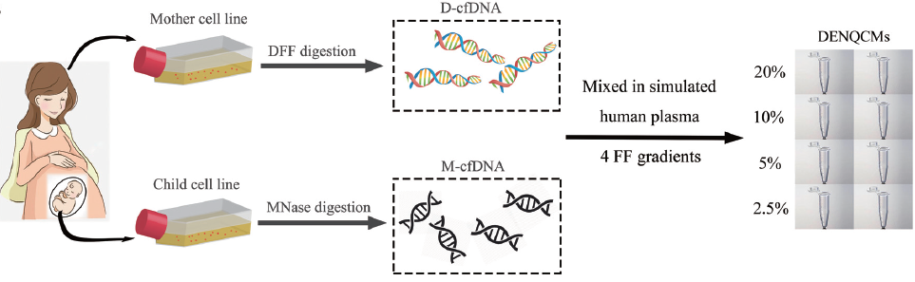
Materials & Methods
Figure 1. A schematic illustration of preparation of DENQCMs in vitro

Slide 6
Materials & Methods
  The DENQCMs were compared with plasma cfDNA and sheared cfDNA (S-cfDNA) to evaluate their biomimetics and reliability.
  DENQCMs were analyzed using random massively parallel sequencing (MPS), targeted MPS, and imaging single DNA molecule methods, and the estimated fetal fractions (FFs) were compared with expected FFs.

Slide 7
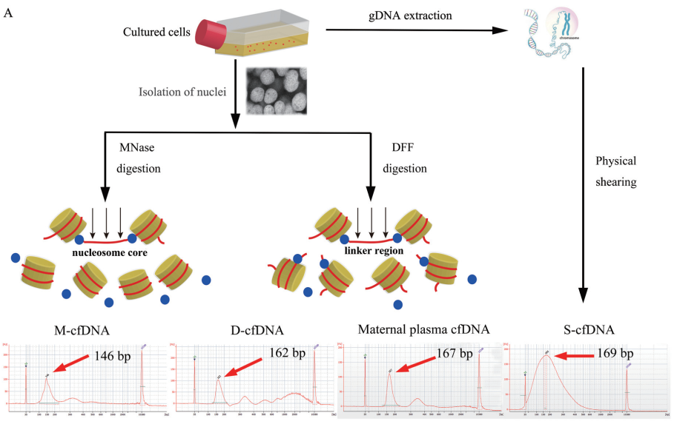
Results
Evaluating the biomimetics and reliability of DENQCMs with plasma cfDNA and S-cfDNA:
D-cfDNA had a 162-bp-sized peak and M-cfDNA exhibited peak sizes around 146 bp, more closely resembling the nucleosome distributions and peak sizes of 166 bp observed for maternal and 143 bp for fetal as compared with S-cfDNA (100 to 200 bp).
The average GC content of D-cfDNA showed comparable GC contents (39.5%) with biological cfDNA, whereas M-cfDNA (44.5%) was higher than maternal plasma cfDNA (40.5%).
Figure 2. A schematic illustration of generation of cfDNA in vitro

Slide 8
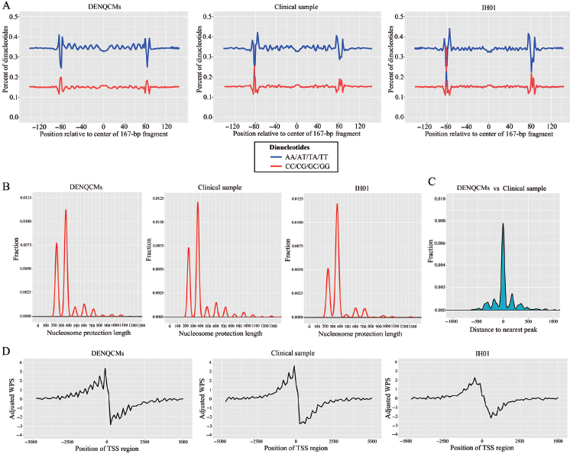
Results
Evaluation the biomimetics and reliability of DENQCMs with plasma cfDNA and S-cfDNA:
DENQCM cfDNA are similar to cfDNA in maternal plasma in sequencing data statistics (read counts, distribution of unique reads ratio).
The biological characteristics (nucleosome protection length, dinucleotide composition, and nucleosome occupancy) were concordant between DENQCMs and the clinical sample, and the nucleosome protection peaks from DENQCMs aligned well with those from the clinical sample and the healthy individual IH01 data set.
Figure 3. Genome-wide cfDNA fragmentation patterns and nucleosome positioning model of DENQCMs and a clinical sample

Slide 9
Results
Table 1.The intended results and validation results of NIPT panel by 4 routine NIPT assays
Sample No. | Intended Results |  | Random MPS by Annoroadª |  | Random MPS by BGI-shenzhenª |  | Targeted MPS by NaHaiª |  | Imaging single DNA molecule methods by Vanadisª
 | Trisomy | FF | Trisomy | Z value | Trisomy | Z value | Trisomy | Z value | Trisomy | Z value
DP1 | Trisomy 21 | 20% | Trisomy 21 | 26.77 | Trisomy 21 | 22.88 | Trisomy 21 | 16.93 | Trisomy 21 | 15.71
DP2 | Trisomy 21 | 10.00% | Trisomy 21 | 15.09 | Trisomy 21 | 12.57 | Trisomy 21 | 10.56 | Trisomy 21 | 7.48
DP3 | Trisomy 21 | 5.00% | Trisomy 21 | 5.52 | Trisomy 21 | 5.27 | Trisomy 21 | 5.54 | Trisomy 21 | 4.01
DP4 | Trisomy 21 | 2.50% | Euploid | -0.73 | Euploid | 0.05 | Trisomy 21 | 4.50 | Euploid | 1.79
DP5 | Trisomy 18 | 20% | Trisomy 18 | 29.33 | Trisomy 18 | 35.24 | Trisomy 18 | 23.03 | Trisomy 18 | 14.41
DP6 | Trisomy 18 | 10.00% | Trisomy 18 | 14.90 | Trisomy 18 | 15.88 | Trisomy 18 | 11.59 | Trisomy 18 | 7.72
DP7 | Trisomy 18 | 5.00% | Trisomy 18 | 7.46 | Trisomy 18 | 7.25 | Trisomy 18 | 4.24 | Trisomy 18 | 5.24
DP8 | Trisomy 18 | 2.50% | Trisomy 18 ^{b} | 3.83 | Trisomy 18 ^{b} | 2.89 | Euploid | 0.49 | Trisomy 18 ^{b} | 2.89
DP9 | Trisomy 13 | 20% | Trisomy 13 | 23.72 | Trisomy 13 | 31.75 | Trisomy 13 | 20.72 | Trisomy 13 | 17.03
DP10 | Trisomy 13 | 10.00% | Trisomy 13 | 13.25 | Trisomy 13 | 14.49 | Trisomy 13 | 11.49 | Trisomy 13 | 8.7
DP11 | Trisomy 13 | 5.00% | Trisomy 13 | 5.38 | Trisomy 13 | 8.11 | Trisomy 13 | 6.46 | Trisomy 13 | 6.58
DP12 | Trisomy 13 | 2.50% | Trisomy 13 ^{b} | 3.71 | Trisomy 13 ^{b} | 2.73 | Trisomy 13 | 4.44 | Trisomy 13 | 3.96
DN1^{c} | Euploid | 10% | Euploid | < Thresholds | Euploid | < Thresholds | Euploid | < Thresholds | Euploid | < Thresholds
DN2 ^{c} | Euploid | 10% | Euploid | < Thresholds | Euploid | < Thresholds | Euploid | < Thresholds | Euploid | < Thresholds
a: Commercial provider. b:Gray zone.

Slide 10
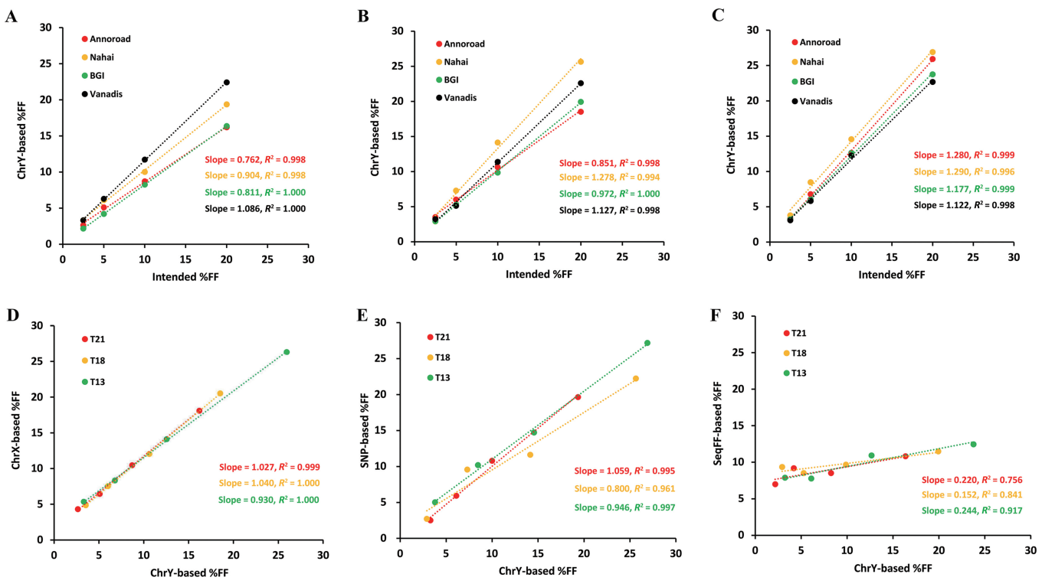
Results
Validation of NIPT panel and linear detection for FF across different methods:
The genetic status of each DENQCM was correctly detected by 4 routine NIPT assays for the samples with FFs ≥ 5%. No false-positive results were reported by either of the laboratories.
The relationship of expected and Y chromosome-based FF from the 4 assays yielded a Pearson correlation coefficient > 0.990. Fetal fraction methods based on Y chromosome, X chromosome, and SNP analysis provided good results, whereas SeqFF performed less well.
Figure 4. Calculation of FF in DENQCMs

Slide 11
Questions
What is the possible difference of the dual enzyme-digested NIPT quality control materials compared with the plasma cfDNA of pregnant women?

Slide 12
Conclusions
  DENQCMs should be desirable as quality control materials for NIPT as the generation mechanisms and biological properties of nucleosomal DNA are biomimetic to those of real plasma cfDNA.
  DENQCMs was found universally applicable for random MPS, targeted MPS, and imaging single DNA molecule.
  DENQCMs could be formulated with flexible FF by adjusting the proportion of the cell lines for quality control of NIPT workflow in laboratories.

Slide 13
Final Comment in Editorial
The method described by Zhang et al. in this issue of Clinical Chemistry will enable the production of the controls; therefore, it is a very important and relevant step in the future development of NIPT and NIPD. It can be envisaged that also for liquid biopsies, or detection of cell-free tumor DNA, control samples can be provided.
Sistermans EA. The Importance of Reliable Quality Control Materials for Noninvasive Prenatal Testing. Clin Chem 2019.

