Slide 1
In Silico Analysis of Gardnerella Genomospecies Detected in the Setting of Bacterial Vaginosis
R.F. Potter, C-A. D. Burnham, G. Dantas
November 2019
Also see accompanying editorial by E. Munson and K.C. Carroll and comments on slide 13.
www.clinchem.org/content/65/11/1375.full
© Copyright 2019 by the American Association for Clinical Chemistry

Slide 2
Introduction- Gardnerella vaginalis is one of the causative agents of bacterial vaginosis
Initially described as Haemophilus vaginalis (1964) then Corynebacterium vaginalis (1975) before becoming its own genus (1979)
G. vaginalis can also be found in the vaginal environment of women without bacterial vaginosis
Known virulence factors for BV include sialidases and vaginolysin (ply gene) toxin
Recently delineated into Gardnerella vaginalis, Gardnerella piottii, Gardnerella leopoldii, and Gardnerella swidsinskii

Slide 3
Question 1
What clinical characteristics and laboratory tests are used to determine if a patient has bacterial vaginosis?

Slide 4
Materials and Methods
Downloaded103 Gardnerella vaginalis genomes from NCBI in October 2018 to perform comparative genomic analysis
1. Average Nucleotide Identity to bin genomes into genomospecies
2. Core-genome phylogeny to determine conserved pattern of evolutionary descent
3. Principal component analysis to examine differences in gene accessory content
4. Pan-genome association test to identify accessory genes specifically enriched within the larger genomospecies
Downloaded 20 metatranscriptomes of women with bacterial vaginosis
(ZL Deng et al, mSphere (2018))
1. Taxonomic assignment to identify presence of novel genomospecies during bacterial vaginosis
2. Identification of Gardnerella genes that are expressed at a high level during bacterial vaginosis.

Slide 5
Question 2
What are treatment options for metroniadazole recalcitrant bacterial vaginosis?

Slide 6
Conservative consensus approach identifies 9 Gardnerella genomospecies (GS01-GS09)
 |  |  | Method
Number | Species/Strain | Assembly | Jspecies-ANIb | Jspecies-Tetra | Kostas-ANI | Kostas-AAI | Consensus
01 | G. vaginalis ATCC 14018(T) | GCA_000178355.1 | 01 | 01=02 | 01 | 01=02 | GS01(01=02)
02 | JCP8108 | GCA_000414525.1 | 02 |  | 02
03 | JCP8017A | GCA_000414605.1 | 03 | 03=04 | 03 | 03=04=11 | GS02(03=04)
04 | G. piotii UGENT 18.01(T) | GCA_003397585.1 | 04 |  | 04
05 | G. leopoldii UGENT 06.41(T) | GCA_003293675.1 | 05 | 05=06 | 05=06 | 05=06 | GS03(05=06)
06 | G. swidsinkii 9838-1(T) | GCA_003397705.1 | 06
07 | JCP8481A | GCA_000414465.1 | 07 | 07 | 07 | 07 | GS04(07)
08 | UMB1686 | GCA_002884775.1 | 08 | 08=09=10 | 08 | 08=09=10 | GS05(08=09=10)
09 | 6119V5 | GCA_000263655.1 | 09 |  | 09=10
10 | 1500E | GCA_000263595.1 | 10
11 | GED7760B | GCA_001546455.1 | 11 | 11 | 11 |  | GS06(11)
12 | CMW7778B | GCA_001563665.1 | 12 | 12 | 12 | 12 | GS07(12)
13 | KA00225 | GCA_002896555.1 | 13 | 13 | 13 | 13 | GS08(13)
14 | NR010 | GCA_003408845.1 | 14 | 14 | 14 | 14 | GS09(14)
 |  |  | 14 | 9 | 12 | 8 | 9 | Number of Species
Notes:
Table depicting the results of 4 different in silico species classification programs (2 average nucleotide identify, 1 tetranucleotide frequency, 1 average amino acid identity) on the same 14 genomes. Results indicate tool dependent classification but some notable overlaps.
A conservative consensus approach was used for downstream analysis where if 2 or more tools agreed on indicating that genomes belong to the same genomospecies, that is what we used.

Slide 7
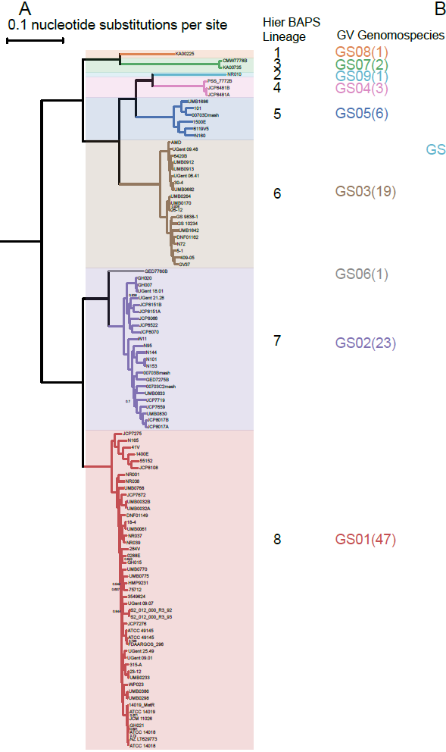
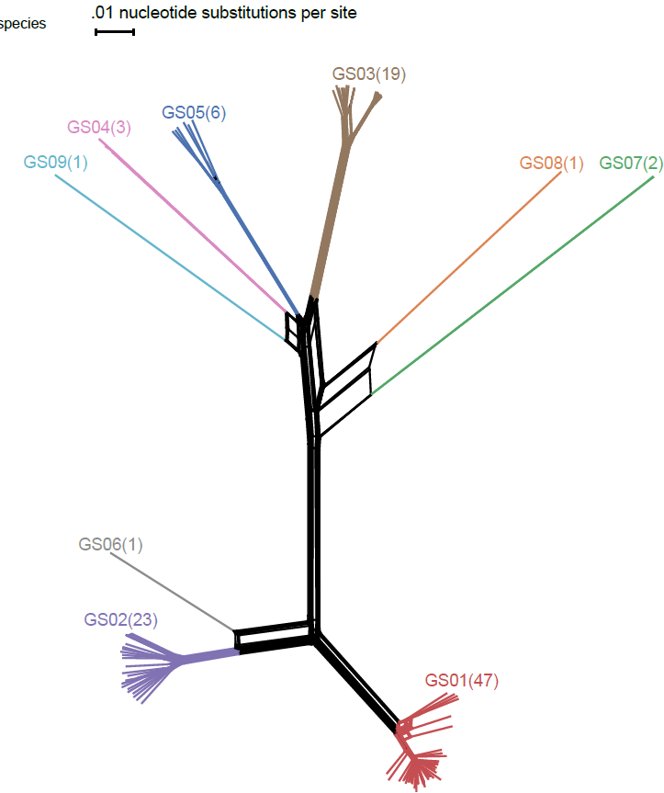
9 distinct Gardnerella groups via core-genome similarity
Notes:
Core genome phylogenetic tree (left) and nearest neighbor network (right) on the ~200 core genes shared by all 103 Gardnerella genomes. Genomospecies classifications are overlaid adjacent to the isolates on the trees.

Slide 8
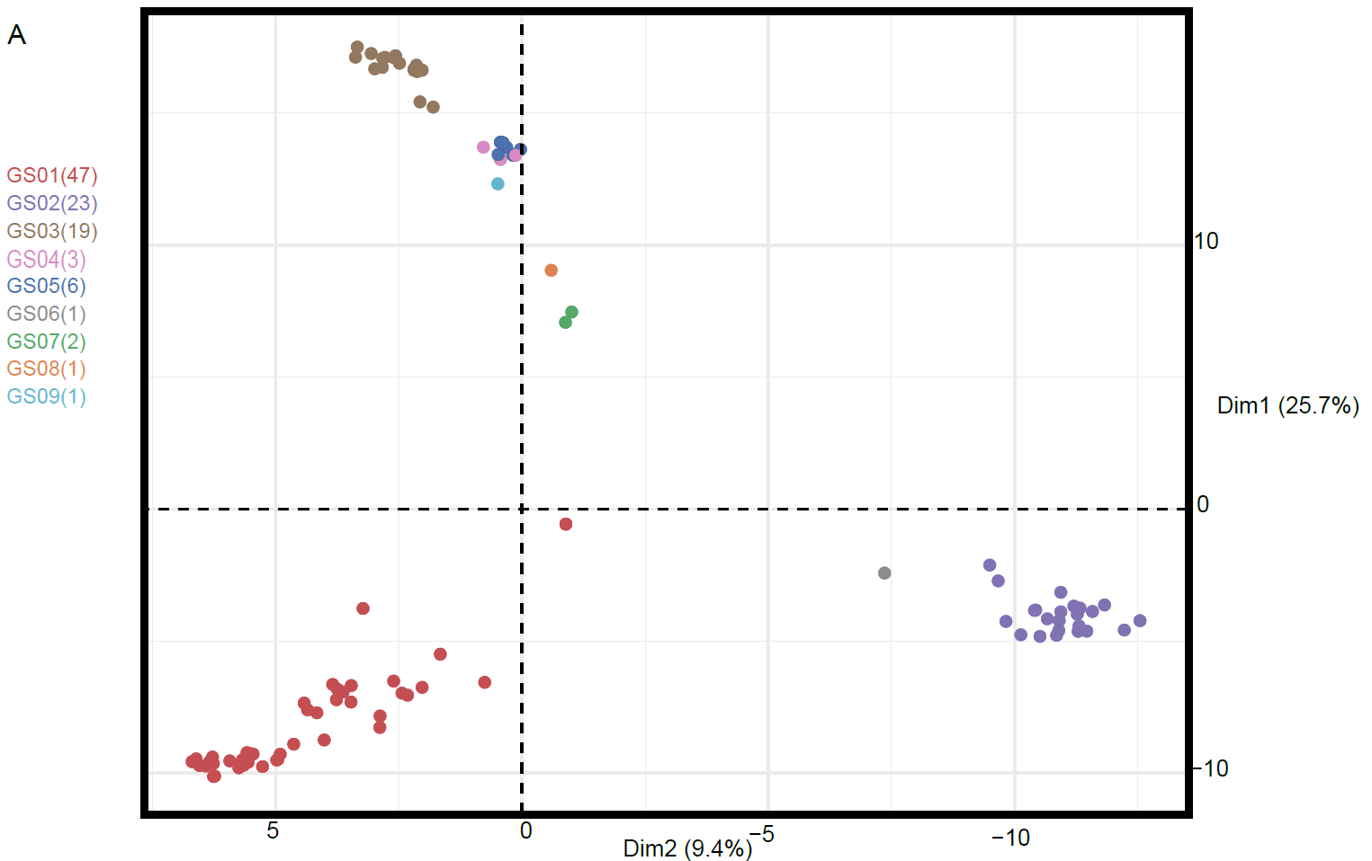
Accessory genome repertoire is linked to Gardnerella genomospecies identify
Notes:
Principal component analysis on the 103 genomes based off of the presence/absence matrix of all accessory genes within the pan-genome. Each point represents one genome and the points are colored based off of their genomospecies identity.

Slide 9
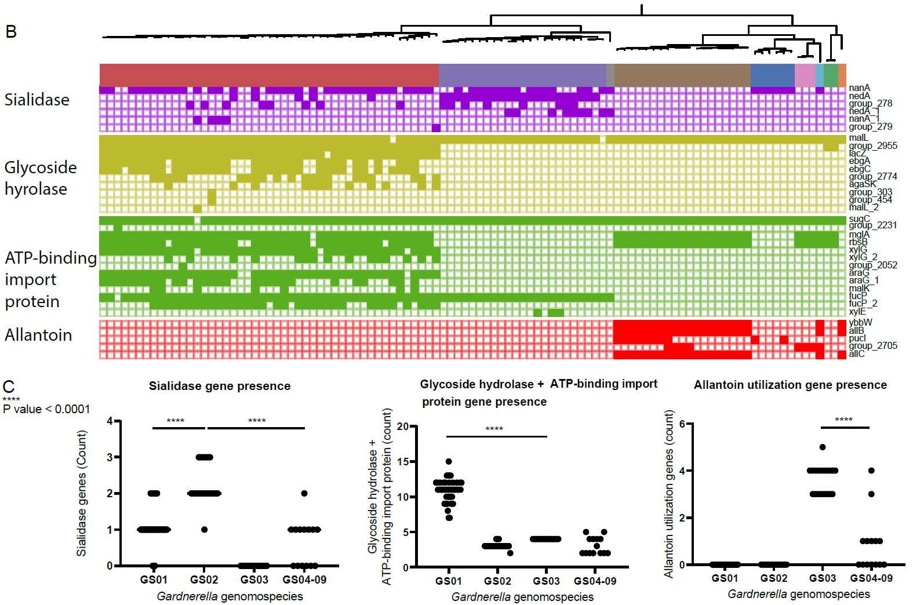
Differences in accessory gene content between the genomospecies include nutrient acquisition genes
Notes:
Core-genome phylogenetic tree (not to scale) adjacent to a presence/absence matrix for genes with putative roles in nutrient acquston. At the bottom of the figure is count data for the portrayed genes.

Slide 10
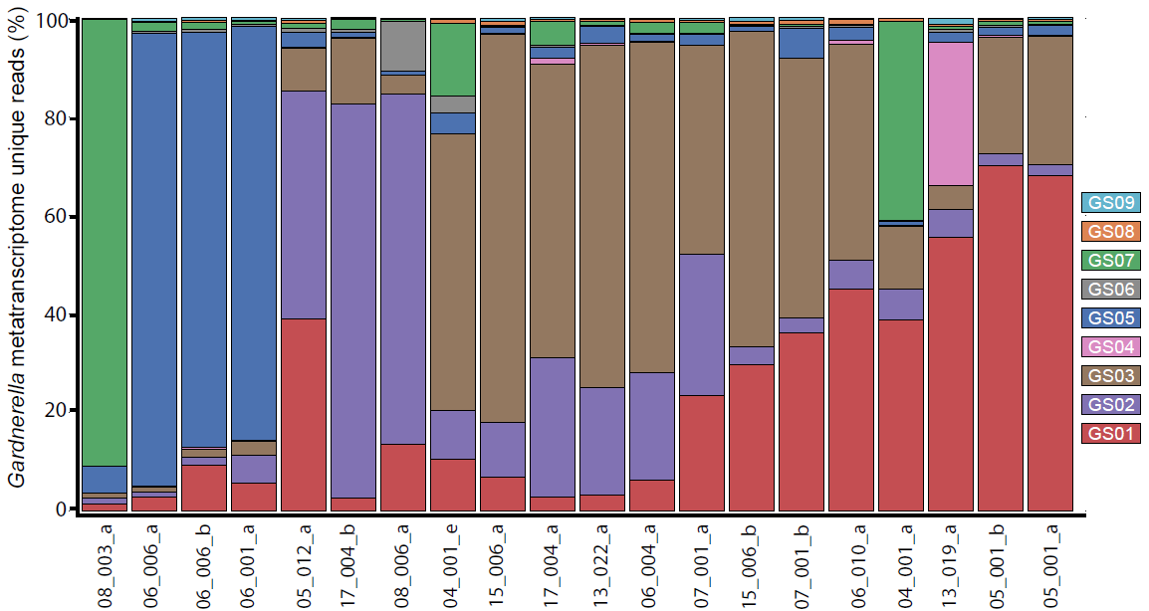
Metatranscriptome sequencing of women with bacterial vaginosis identify unique reads for all 9 genomospecies
Notes:
Stacked barplot depicting the proportion of Gardnerella specific metratranscriptome reads that could uniquely be mapped to one of the genomospecies. Patient ID from the original study are at the bottom.

Slide 11
Question 3
What comorbidities can occur during bacterial vaginosis?

Slide 12
Conclusion - Gardnerella may be 9 different genomospecies with differences in gene content
Tool dependent classification of Gardnerella genomes into 8-14 different genomospecies
Gardnerella genomospecies fall into 9 distinct groups via core-genome phylogeny
Accessory genes are similar within genomospecies but different between the 3 largest genomospecies (GS01, GS02, and GS03) and include genes involved in nutrient acquistion
Unique reads for all 9 genomospecies can be identified in metatranscriptomes of women with bacterial vaginosis

Slide 13
Accompanying Editorial by Munson and Carroll
Comment: Variability in disease presentations previously attributed to host factors may now be associated with or linked to specific microbes
Response: We agree with the authors that more in depth epidemiological analysis combined with these improved species delineations may be useful for further dissecting disease etiology, especially in manifestations that are believed to be polymicrobial. Analysis of host factors via whole-genome sequencing or host response (i.e., inflammatory cytokine analysis) may provide additionally useful pathological context.
Comment: Such amendments [on taxonomic changes of human pathogens] can have a direct impact on how the clinical microbiology laboratory supports the clinical treatment of patients.
Response: We agree with the authors that our goal as clinically minded scientists is to use genomic analysis in a way that would positively benefit the role of the clinical laboratory in patient care decisions. We would further like to add that studies examining the effect of genus, species, or strian level calls (ie. Klebsiella spp, Klebsiella pneumoniae, Klebsiella pneumoniae ST258) in clinical decision making maybe useful in that regard.

