Slide 1
Integrated Extreme Real-Time PCR and High-Speed Melting Analysis in 52 to 87 Seconds
J.T. Myrick, R.J. Pryor, R.A. Palais, S.J. Ison,
L. Sanford, Z.L. Dwight, J.J. Huuskonen,
S.O. Sundberg, and C.T. Wittwer
February 2019
www.clinchem.org/content/65/2/263.full
© Copyright 2018 by the American Association for Clinical Chemistry

Slide 2
Introduction
Polymerase Chain Reaction (PCR)
  1985: Historically slow (hours)
  1991: Rapid-cycle PCR (10 minutes)
  2015: Extreme PCR (30 s)
Melting Analysis
  1997: Introduced as a gel replacement
  2003: High-resolution melting
  2017: High-speed melting (4 s)

Slide 3
Question from the Introduction
Can extreme PCR be combined with high-speed melting (HSM) for integrated real-time amplification and analysis in < 1 min?

Slide 4
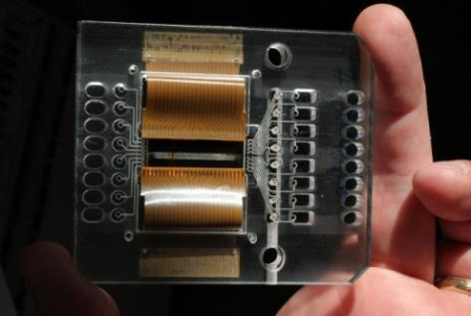
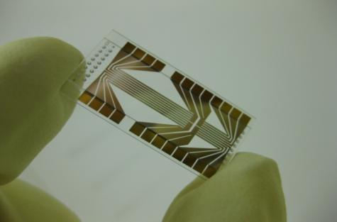
Materials and Methods
Microfluidic Prototype
  Two-temperature PCR
  30 Hz fluorescence
  100 Hz temperature
Chemistry
  Increased primer and polymerase
  Real-time PCR with dye
  HBV, C difficile, genomic single nucleotide variants (SNVs)

Slide 5
Questions on Material and Methods
  Why are primer and polymerase concentrations increased in extreme PCR?
  Why use microfluidics?

Slide 6
Results
Time metrics
  1.05 s cycles during PCR
  40 cycles in 42 s
  High speed melting in 4 s
Six different real-time targets
  HBV and C difficile detected by HSM
  Four SNV targets genotyped by HSM
  Increased polymerase and primers required

Slide 7
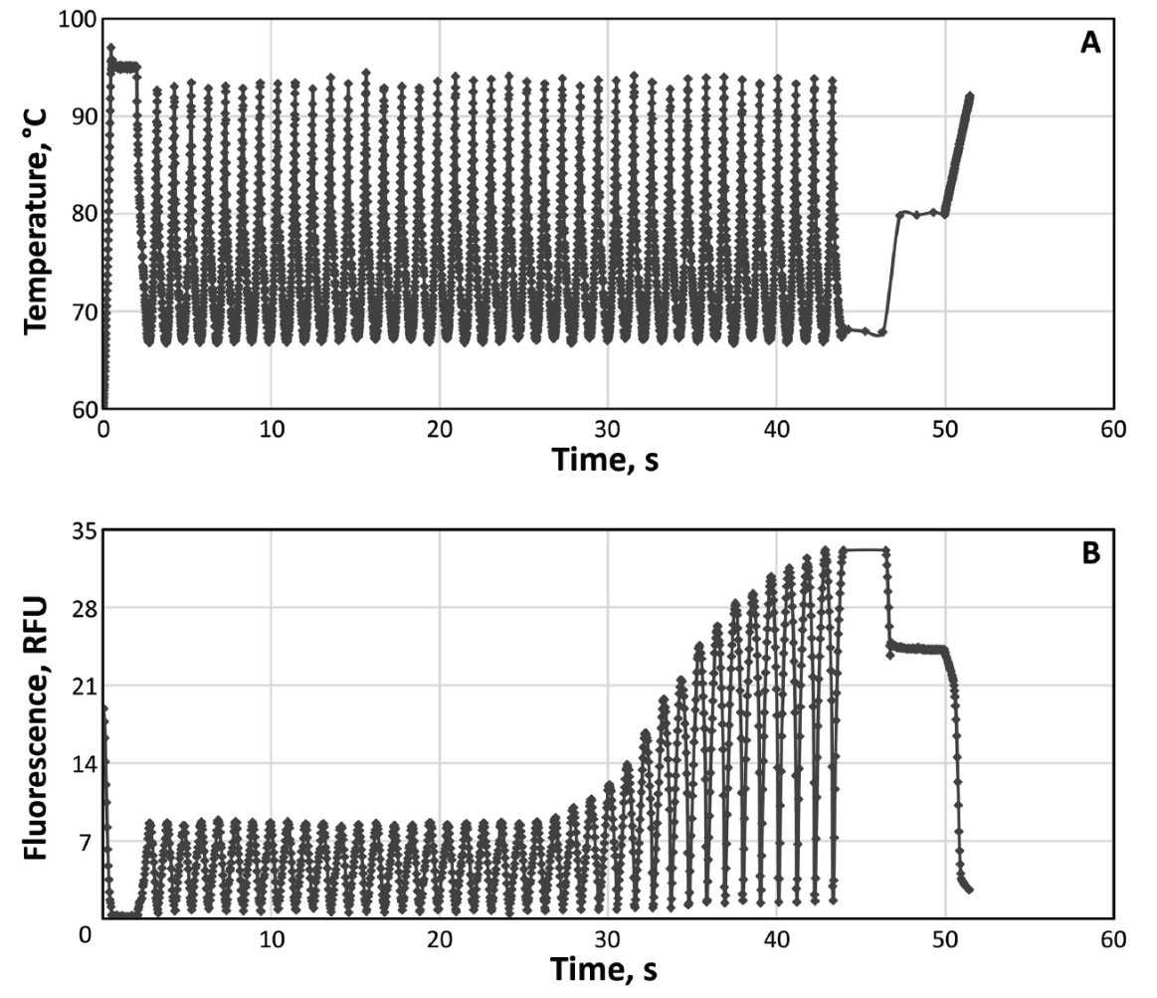
Continuous monitoring of PCR and melting in < 1 min
Figure 1. (A) Temperature vs time (100 Hz). (B) Fluorescence vs time (30 Hz).

Slide 8
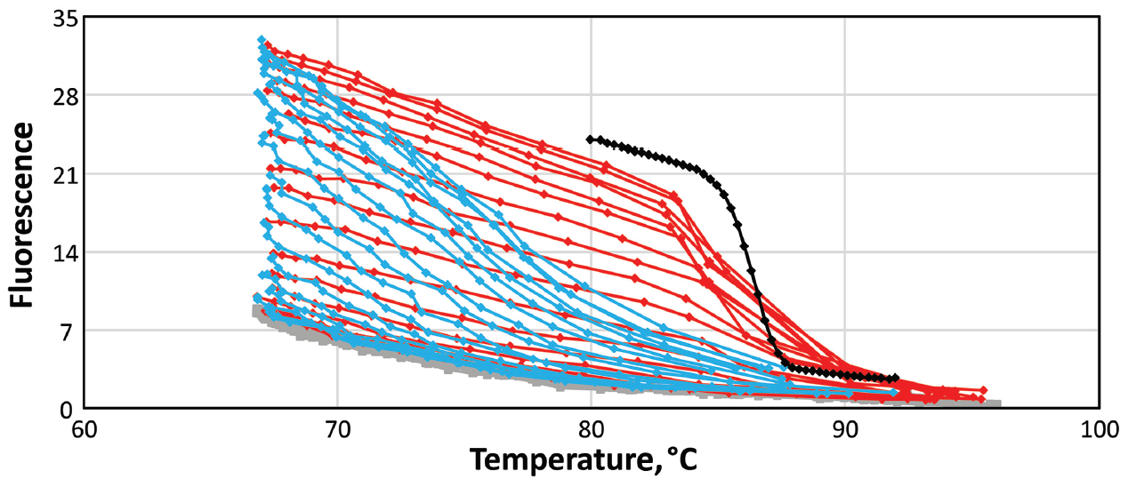
Continuous monitoring of PCR and melting in < 1 min (fluorescence vs temperature)
Figure 2. Melting curves during cycling are red, annealing curves during cooling are blue, and the black curve is from end point melting at high resolution

Slide 9
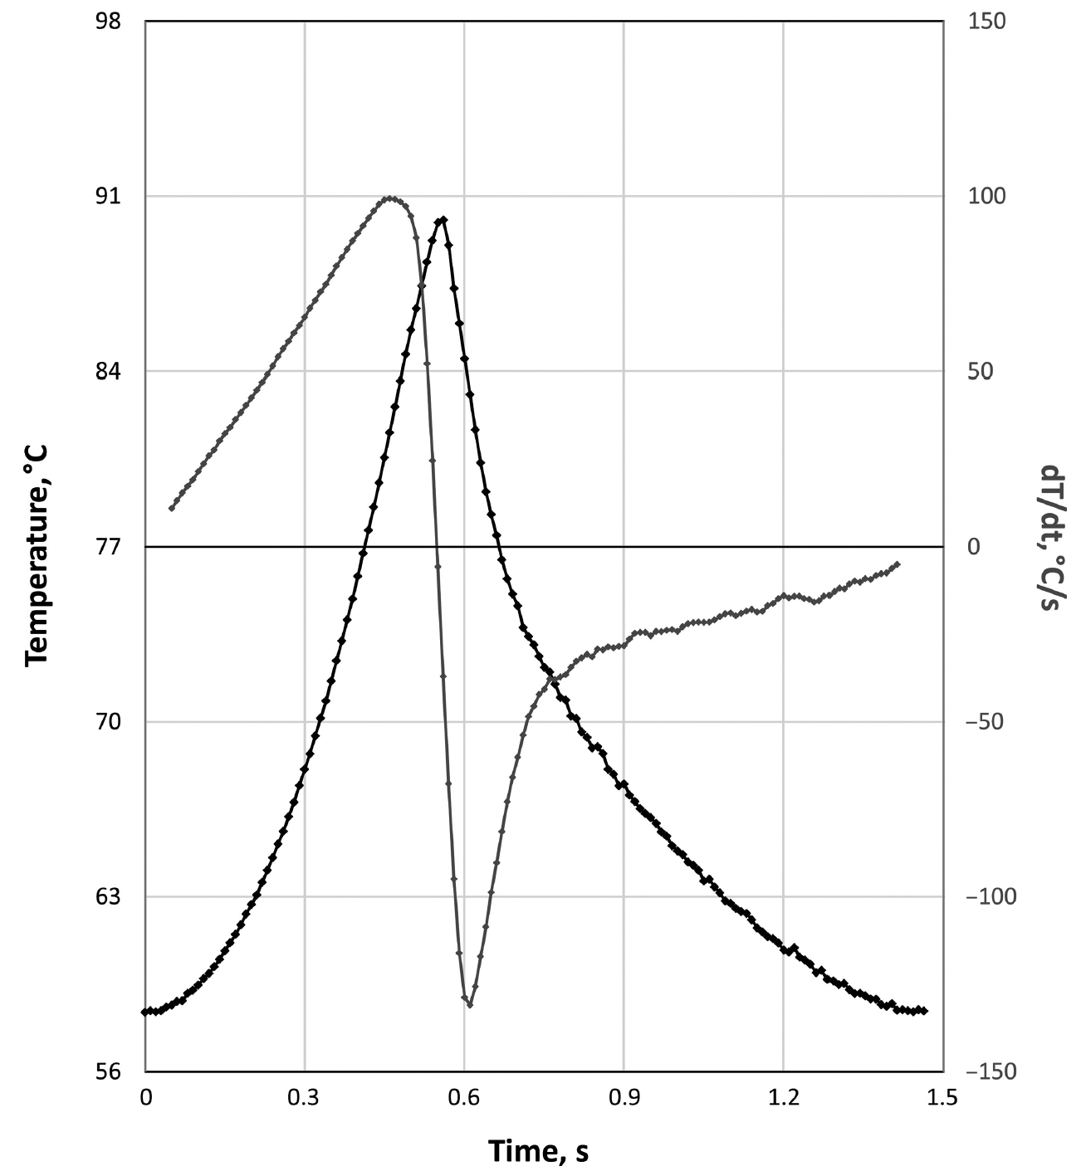
Temperature vs time and its first derivative during extreme cycling
Figure 3. Programmed transition rates were +/- 200°C/s. One of 8 channels is shown.

Slide 10
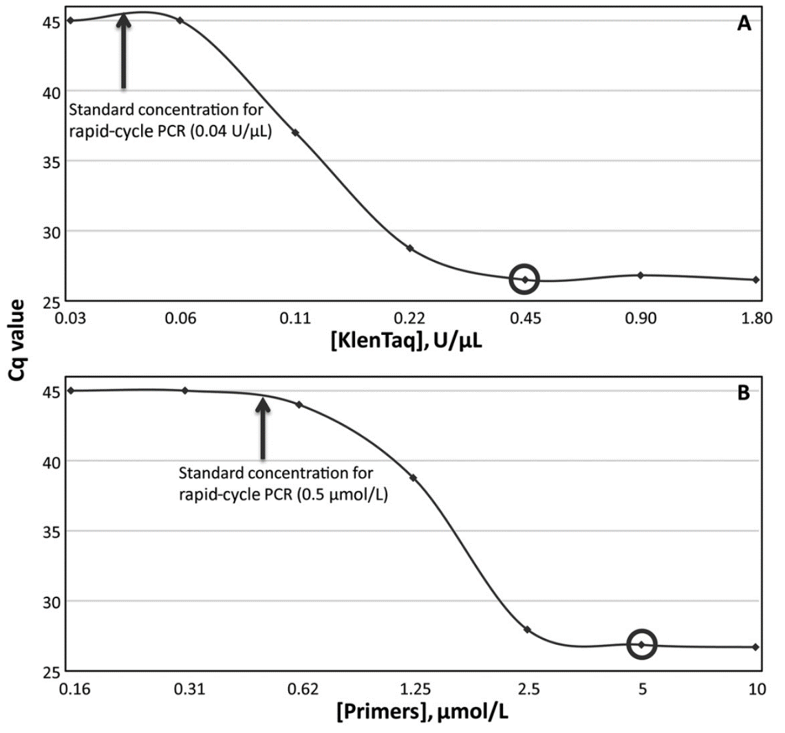
Requirement for increased polymerase and primer concentrations
Figure 4. High concentrations are necessary for efficient amplification (low Cq). Concentrations used in this study are indicated by circles.

Slide 11
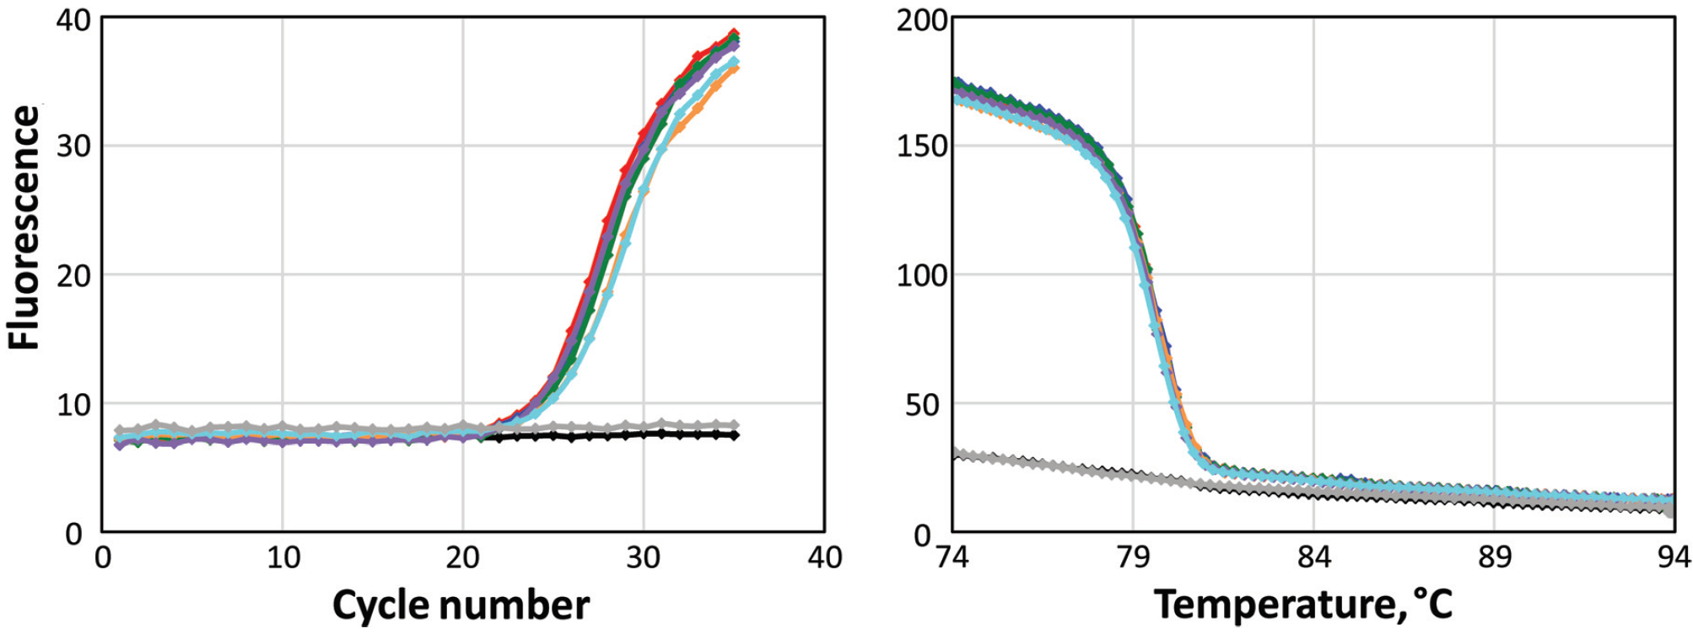
Real-Time PCR (left) and HSM (right) of C difficile
Figure 5. Total time for amplification and melting was 71 s.

Slide 12
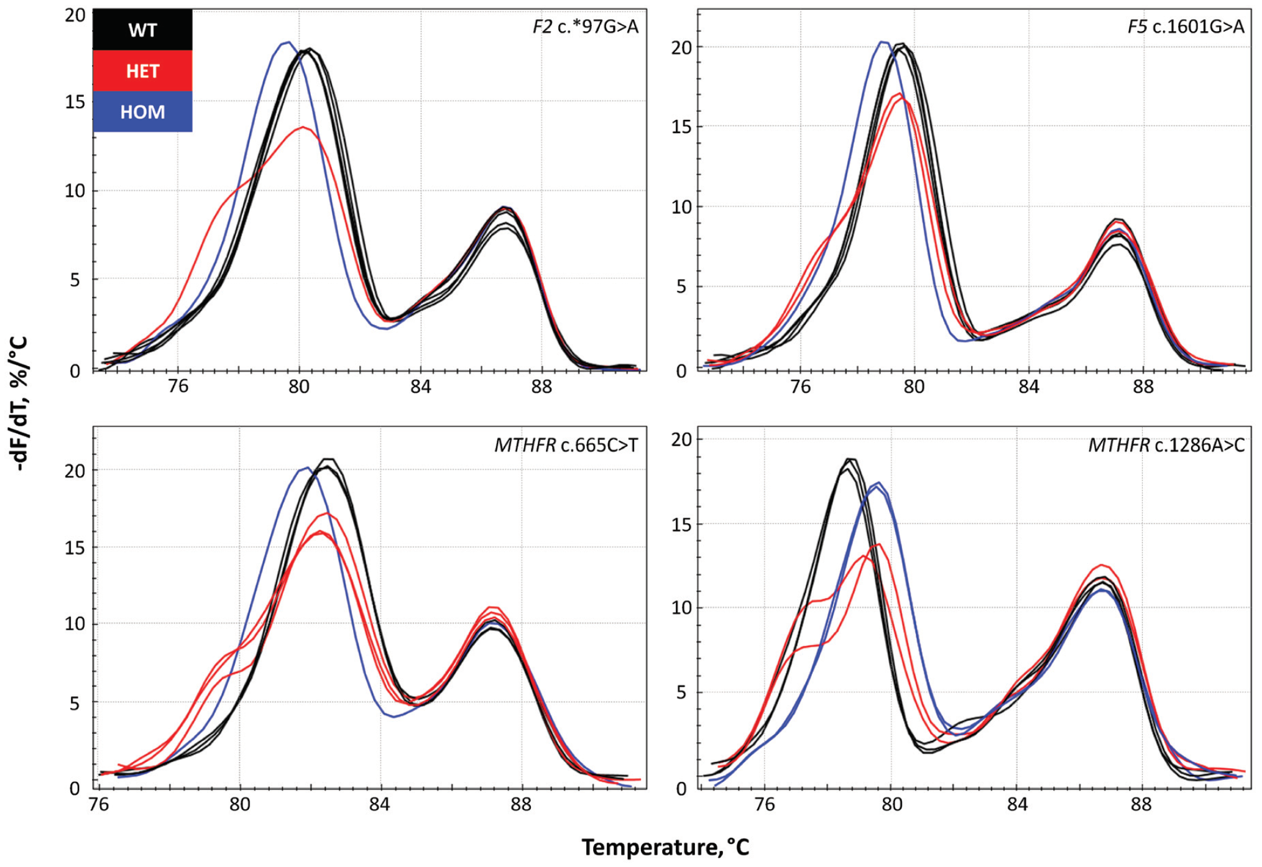
Genotyping of F2, F5 and MTHFR loci by extreme PCR and HSM
Figure 6. In each panel, the peaks used for genotyping are on the left, while the right peak is an internal control used for temperature alignment.

Slide 13
Questions on Results
If you have accurate temperature control, why is faster PCR better than slower PCR?
Why is faster melting better than slower melting?

Slide 14
Editorial on Extreme PCR and High Speed Melting
(G. Mike Makrigiorgos, Clin Chem 2019;65:217-9)
The need for fast molecular diagnostics
  Enables point-of-care value
  ‘While You Wait” diagnosis and monitoring
Counterintuitive developments
  Extreme PCR with high polymerase and primer concentrations
  Better genotyping with faster melting
  Disruptive innovation overturns expectations

