Slide 1

Clinical Correlations of Programmed Cell Death-Ligand 1 Status in Liquid and Standard Biopsies in Breast Cancer
W. Jacot, M. Mazel, C. Mollevi, S. Pouderoux, V. D'Hondt, L. Cayrefourcq, C. Bourgier, F. Boissiere-Michot, F. Berrabah, E. Lopez-Crapez, F.-C. Bidard, M. Viala, T. Maudelonde, S. Guiu, and C. Alix-Panabières
August 2020
https://doi.org/10.1093/clinchem/hvaa121
© Copyright 2020 by the American Association for Clinical Chemistry

Slide 2
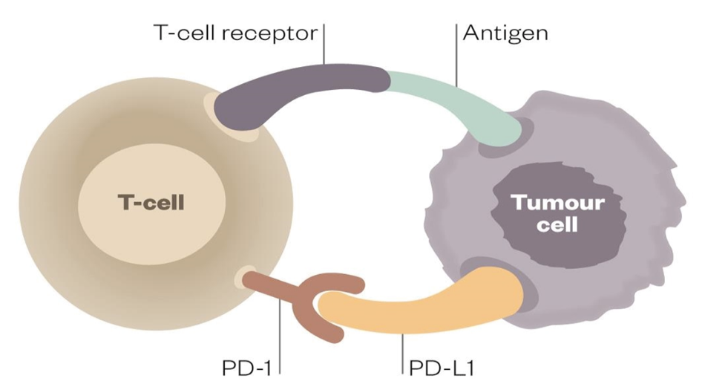
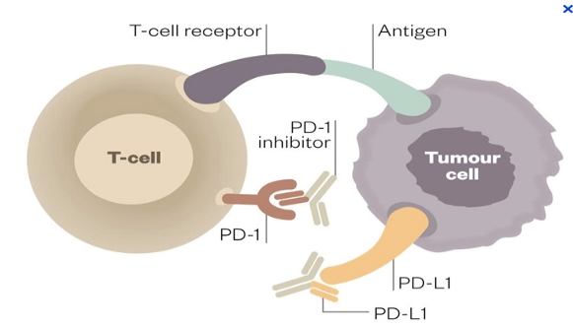
Introduction
PD-1/PD-L1 Pathway
  Upregulated in many tumors: Negative feedback loop regulating the immune cellular response
  Inhibition possible by using anti-PD-1 or anti-PD-L1 antibodies
  Induction of dramatic responses & therapeutic effects in many tumors
Primary Tumor
  Clinical prognostic value of tumor and/or stromal PD-L1 expression : controversial
  PD-L1 expression: biomarker of PD-L1 MoAbs efficacy
Activation of the immune cells by blocking this pathway PD-1/PD-L1 using immunotherapy
Deactivation of the immune system via the interaction PD-1 on T cells & PD-L1 on tumor cells

Slide 3
Introduction – Many issues
PD-L1 evaluation in cancer cells
  Cellular compartment to be tested ?
  Thresholds selected ?
  Anti-PD-L1 antibody used?
Heterogeneity for PD-L1 expression among tumor cells in:
  Primary tumor
  Lymph nodes metastases
  Distant metastases
  Liquid Biopsy

Slide 4


Introduction – Liquid Biopsy
Liquid Biopsy in a simple non-invasive blood sample
  Circulating Tumor Cells (CTCs)
  Can be characterized for PD-L1 expression at the single cell level.
  Because CTCs isolated from the peripheral blood are a pool of cells derived from the primary tumor and/or of different metastatic sites, this approach could provide a comprehensive real-time picture of the whole tumor burden in a given patient.
2013

Slide 5
Introduction – QUESTION 1
What is urgently needed ?
A better understanding of PD-L1 expression during cancer evolution for an accurate monitoring of its status in the metastatic setting ?

Slide 6
Objectives
To determine :
the correlation between the expression of PD-L1 in the primary tumor tissue (as usually used in clinical practice) and CTC-PD-L1 ⁽⁺⁾ in the same patients
the prognostic value of CTC-PD-L1⁽⁺⁾

Slide 7
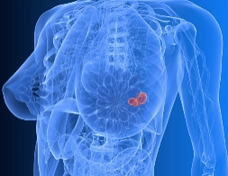

Materials and Methods
Patients
72 Patients with histologically-proven MBC (all lines and subtypes were eligible) enrolled in the monocentric prospective ‘AnaLysis of CIrculatiNg tumor mArkers in blood’ (ALCINA) study (NCT02866149) and treated with conventional therapies (no anti-PD-L1 MoAbs treatments in this cohort).
CTC detection and PD-L1 expression
  Blood was drawn from the arm vein of each patient in CellSave tubes (10 mL). Blood samples (7.5 mL) were used for CTC detection on the FDA-cleared CellSearch system.
Detection of CTC-PD-L1⁽⁺⁾ was performed using the IVD CellSearch CTC Kit with the anti-human B7H1/PDL1^{A488} monoclonal antibody.
  PD-L1 expression in tumor tissue
  Whole primary tumor sections and, if available, recurrent tumor, nodal or distant metastatic tissue samples, were used to assess PD-L1 expression by immunohistochemistry. The percentage of marked tumor cells and staining intensity was reported for each sample, scored using a 0–3 scale [none (0), weak (1+), moderate (2+), and strong staining (3+)]. PD-L1 threshold positivity was set at 1% (1+).

Slide 8
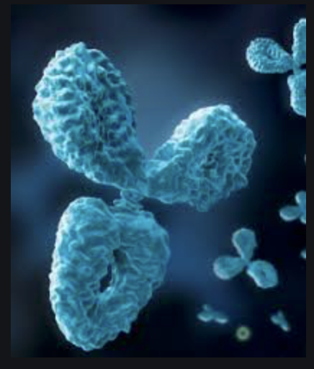
Materials and Methods - QUESTION
Anti-PD-L1 antibody (Ab) used
What can be the key question concerning the selected Ab and the detection of CTCs during the follow-up of the patients receiving anti-PD-L1 immunotherapy ?

Slide 9
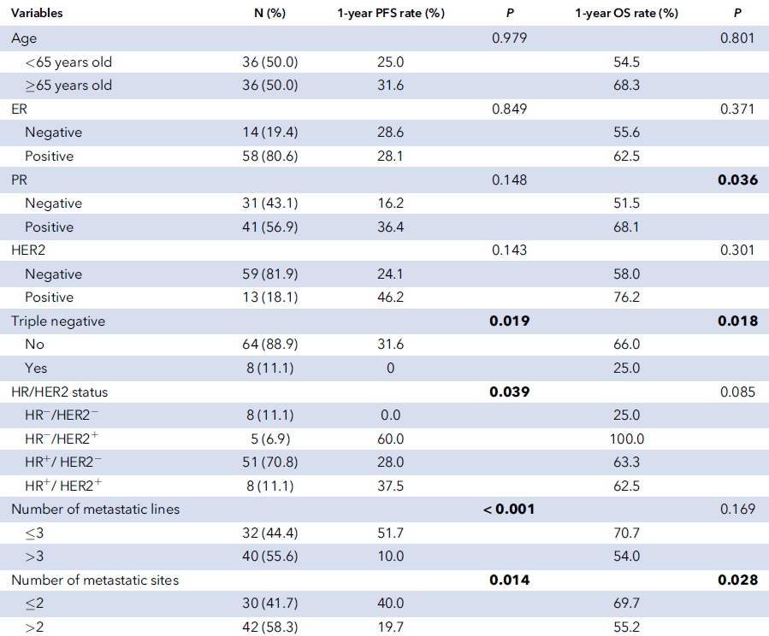
Results
72 advanced breast cancers
All molecular subtypes
All therapeutic lines
Prognostic variables
Univariate analysis

Slide 10
Results - QUESTION
What are the classical prognostic variables in metastatic breast cancer patients?
Does this population appear, in your opinion, representative of a metastatic breast cancer population (in term of prognostic factor or
possible extrapolation of the results to the clinical setting)?

Slide 11
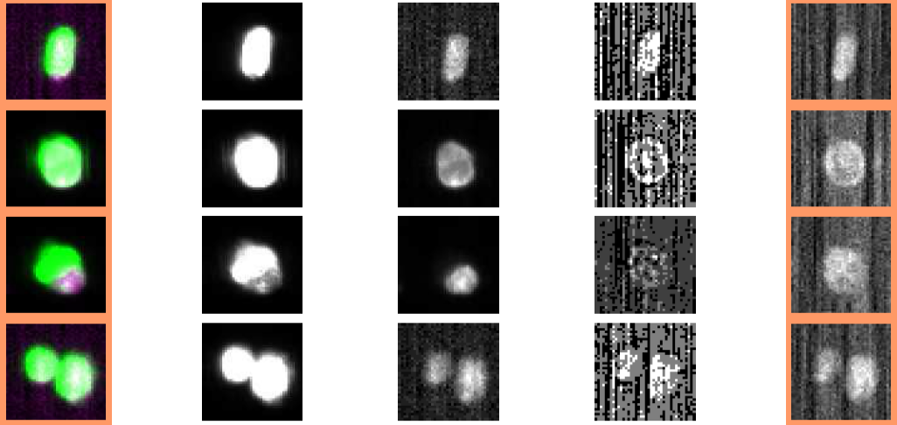
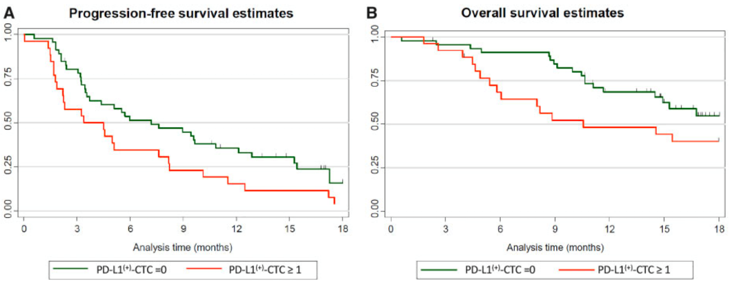
Results
CTC = EpCAM⁽⁺⁾CK⁽⁺⁾Dapi⁽⁺⁾CD45⁽⁻⁾PD-L1^{(+/-)}
Merge
PanCK^{PE}
Dapi
CD45^{APC}
PD-L1^{FITC}
Detection of CTC-PD-L1⁽⁺⁾
  CTCs detected in 57 patients (79.2%)
  CTC-PD-L1⁽⁺⁾ observed in 26 patients (36.1%).
Patients survival according to the detection or absence of CTC-PD-L1⁽⁺⁾

Slide 12
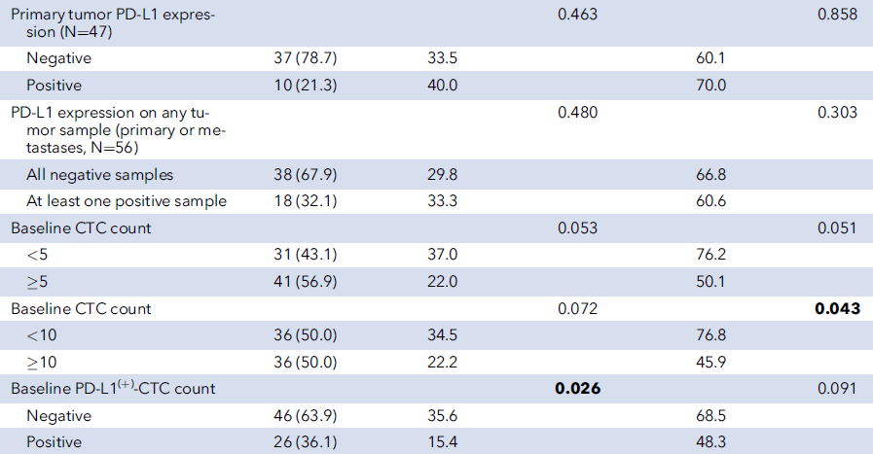
Results
Tissue PD-L1, CTCs and CTC-PD-L1⁽⁺⁾ prognostic value

Slide 13
Results – QUESTION
PD-L1 prognostic value
What can be concluded regarding these results?

Slide 14
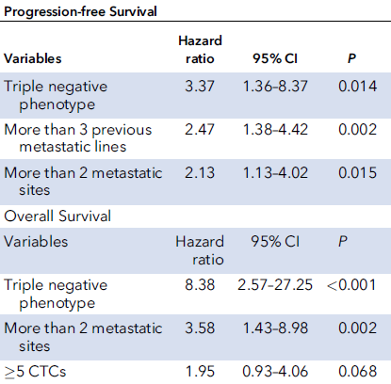
Results
Multivariate analysis

Slide 15
Results – QUESTION
Multivariate analysis
What is the interest of a multivariate model?
What is a possible conclusion regarding the prognostic value of tissue IHC expression, CTCs and CTC-PD-L1⁽⁺⁾ in this specific setting?
How can the differences between univariate and multivariate analysis be explained?

Slide 16
Conclusions
No statistically significant correlation was found between PD-L1 tumor tissue expression and the presence of CTC-PD-L1⁽⁺⁾
MBC harboring CTC-PD-L1⁽⁺⁾ are a negative prognostic biomarker in MBC, because patients with MBC harboring CTC-PD-L1⁽⁺⁾ have a shorter PFS; however, not significant in multivariate analysis (lack of power due to sample size?)
→ A validation of these results in an independent population treated without anti PD-L1 therapies remains necessary to precisely define its prognostic value.
MBC : Metastatic breast cancer

Slide 17
Conclusions – QUESTION
Prognostic and predictive factors
What is the difference between these 2 concepts?
After a validation of these results, what would be the logical next step?

