Slide 1
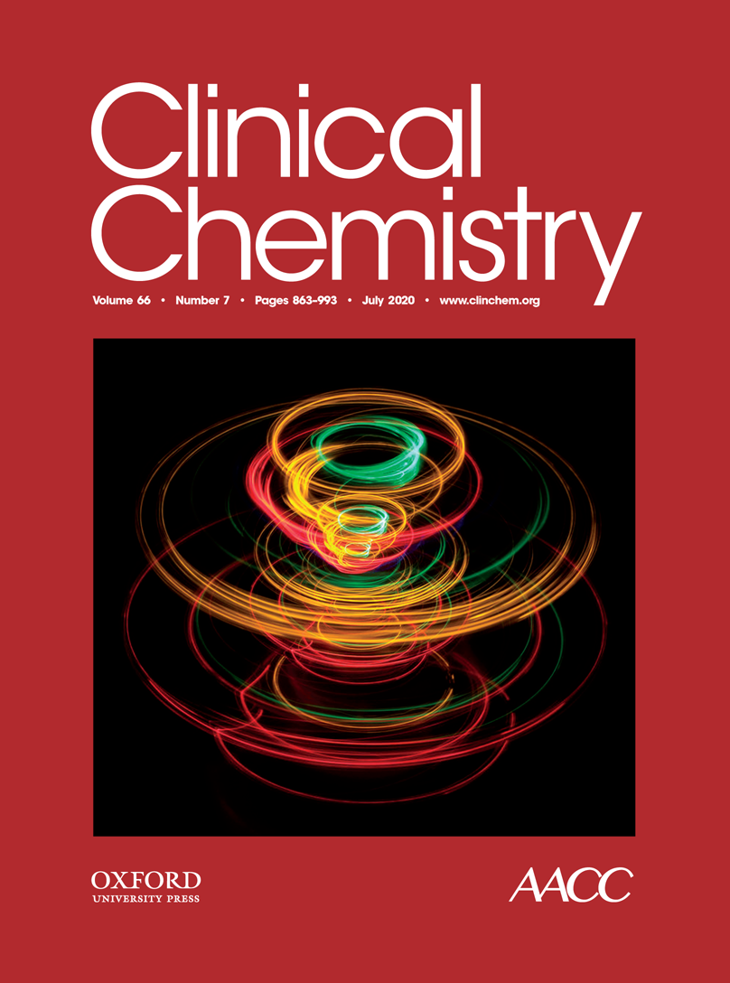
Enhanced Performance of DNA Methylation Markers by Simultaneous Measurement of Sense and Antisense DNA Strands after Cytosine Conversion
S.Ø. Jensen, N. Øgaard, H.J. Nielsen, J.B. Bramsen, C.L. Andersen
July 2020
https://doi.org/10.1093/clinchem/hvaa100
© Copyright 2020 by the American Association for Clinical Chemistry

Slide 2
Introduction
Background
  Circulating tumor DNA (ctDNA) in the blood provides a minimally invasive approach for detection of cancer
  Cancer-specific DNA methylation markers can be used for detection of ctDNA
  DNA methylation-based methods for detection of ctDNA are often based on cytosine conversion by either enzymatic or bisulfite treatment.
  After cytosine conversion, the two DNA strands are no longer complementary
  Thus, targeting only one strand, which is the most commonly used strategy, utilizes only half of the DNA available for cancer detection

Slide 3
Introduction
Aim
  To investigate whether targeting both DNA strands after cytosine conversion increases the detection of DNA methylation markers
  Investigate whether the sensitivity of TriMeth, a colorectal cancer (CRC)-specific ctDNA detection test targeting the sense strand of three DNA methylation markers, can be increased by targeting both strands

Slide 4
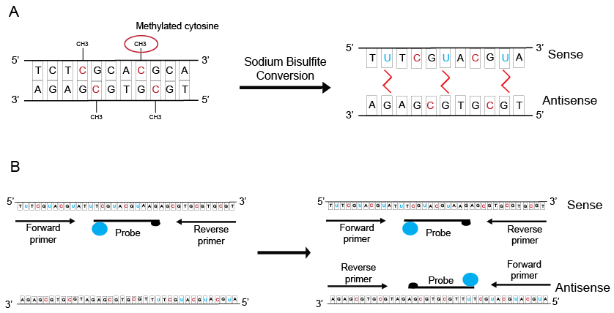
Study strategy
Figure 1 A, During sodium bisulfite conversion of DNA, unmethylated cytosines are deaminated to uracils resulting in non-complementary sense and antisense DNA strands. Therefore, methylation-specific ddPCR assays targeting only the bisulfite-converted sense DNA strand will not amplify the antisense strand. B, The study strategy was to develop methylation specific ddPCR assays targeting the bisulfite-converted antisense DNA strand of the 3 DNA methylation markers C9orf50, KCNQ5, and CLIP4 and to use these in duplex reactions combined with previously published assays targeting the sense strand of these markers.

Slide 5
Question 1
Why are highly sensitive markers needed for detection of ctDNA, particularly in early detection studies?

Slide 6
Material and Methods
Tissue and plasma were collected from patients diagnosed with CRC and from healthy controls
Droplet Digital PCR (ddPCR) assays exclusively specific for methylated DNA were designed targeting the antisense DNA strands of three previously published DNA methylation markers (ref #13, Jensen et al. Clin Epigenet 2019)
Bisulfite treatment of the DNA was used for conversion of unmethylated cytosines.
ddPCR was used to measure the number of methylated DNA copies.
Results were compared between samples analyzed in parallel with single-strand and dual-strand assays
The sensitivity of the TriMeth test was compared between plasma samples analyzed in parallel with the single and dual strand assays.

Slide 7
Question 2
Why is cytosine conversion needed for the detection of DNA methylation and what effect does it have on DNA?

Slide 8
Results / summary
Assay performance in CRC tumor tissue and blood
The 3 top antisense assays were duplexed with their respective sense assay and applied on DNA from CRC tumors (stage I and II, n = 36) and peripheral leucocytes (PBL, n=22). The single-strand assays were also applied on these samples
The number of methylated DNA copies detected in tumor samples by dual-strand assays were approximately 2-fold higher compared with the single-strand assay for all three markers
The dual-strand assays for KCNQ5 and CLIP4 showed almost no signal in the PBL samples, whereas, the C9orf50 antisense assay caused increased false-positive PBLs, thus consequently was eliminated

Slide 9
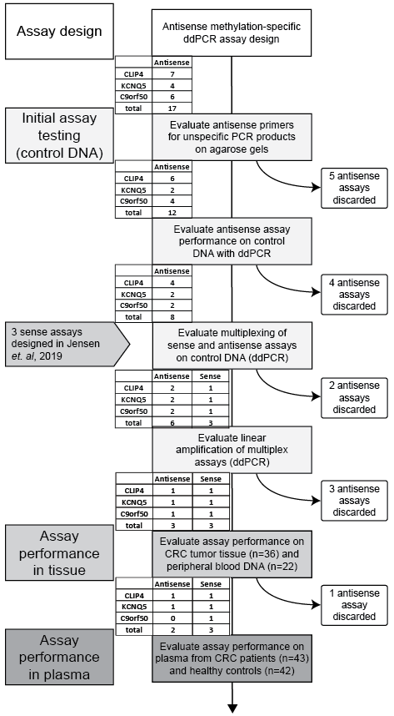
Study workflow
Figure 2 Seventeen antisense methylation-specific ddPCR assays were designed for the C9orf50, KCNQ5, and CLIP4 DNA methylation markers. Assays were excluded if they produced unspecific PCR products, as visualized by agarose gel electrophoresis. Assays with poor separation of positive and negative droplets by ddPCR using methylated control DNA as a template were eliminated. Assays were tested in duplex with their corresponding sense assays and excluded if they did not amplify methylated control DNA or failed to separate positive and negative droplets in ddPCR experiments. Dual-strand assay performance was evaluated on colorectal tumor tissues (n=36) and peripheral blood leukocyte DNA (n=22). The C9orf50 dual-strand assay showed positive signals in some PBLs and thus was excluded from further analyses. The KCNQ5 and CLIP4 dual strand assays were evaluated in plasma from CRC patients (n=43) and healthy controls (n=42) and compared with the performance of the sense single-strand assays in the same plasma samples.

Slide 10
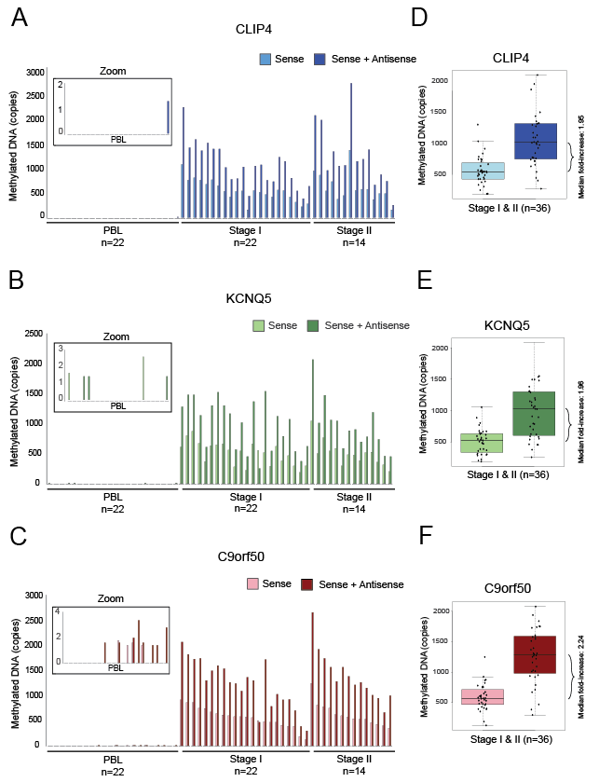
Assay performance in CRC tumor tissue and blood
Figure 3 Methylated DNA copies detected by sense and antisense dual-strand assays and sense single-strand assays in PBL and colorectal tumor tissues (stages I and II) are shown for CLIP4 (A), KCNQ5 (B), and C9orf50 (C). Box plots show the signal increase in colorectal tumor tissue for CLIP4 (D), KCNQ5 (E), and C9orf50 (F).

Slide 11
Results / summary
Assay performance in plasma
Dual-strand and sense single-strand assays were applied to plasma from stage I-IV CRC patients (n = 43) and healthy controls (n = 42) (4 mL plasma for each reaction)
All dual-strand assays were blank in the healthy controls, indicating that the high specificity of the sense single-strand assays was not affected by adding the antisense assays.
Dual-strand assays detected more methylated copies compared to the single strand assays in most of the CRC plasma samples, supporting the hypothesis of this study
Addition of the antisense assays to the sense assays applied in the TriMeth test increased test sensitivity from 74% to 86%.
The specificity remained 100% when dual strand assays were used (All healthy controls were negative)

Slide 12
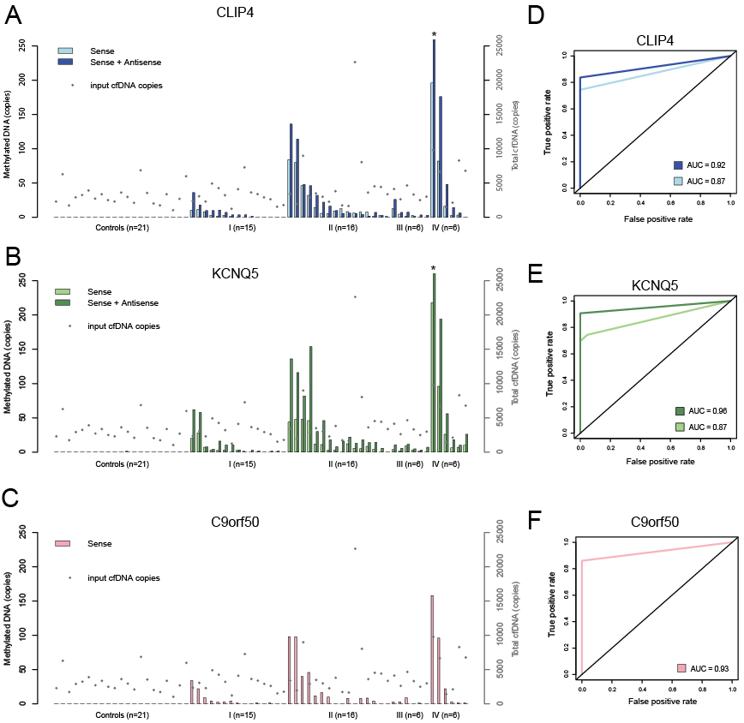
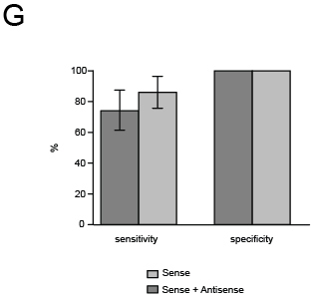
Assay performance in plasma
Figure 4 Methylated DNA copies detected by single- and dual-strand assays in plasma from patients with stage I and II CRC (n=43) and age-matched controls (n=21) are shown for CLIP4 (A), KCNQ5 (B), and C9orf50 (C). Equal amounts of cfDNA input were used for single- and dual-strand assay reactions. The cfDNA quantities are illustrated as gray dots. Asterisks indicate that >250 ctDNA copies were detected (452 methylated copies of DNA for KCNQ5, 360 methylated copies of DNA for CLIP4). ROC curves and AUCs based on ctDNA copies detected in plasma are shown for single- and dual-strand assays for CLIP4 (D), KCNQ5 (E), and C9orf50 (F). G, The sensitivity and specificity of the TriMeth test are shown for the combination of the 3 markers, based on either single or dual-strand assays (samples were called positive or negative based on the 2-of-3 algorithm).

Slide 13
Question 3
  Why does adding ddPCR assays targeting both DNA strands increase the detection of methylated DNA by two-fold?
  Are there any drawbacks of adding assays targeting both strands?
  In a few samples, the number of methylated DNA copies was highest with single-strand assay compared to dual-strand. What are the likely explanations for this?

Slide 14
Discussion
In this study, we showed that simultaneously measuring both the sense and the antisense DNA strands after cytosine conversion increased the number of methylated DNA copies detected when applied to both CRC tissue and plasma
Importantly, the specificity remained 100% after addition of antisense assays.
This approach may be particularly useful in other studies working with cytosine conversion and PCR-based strategies for sensitive detection of methylated DNA

