Slide 1

Sex-Specific 99th Percentile Upper Reference Limits for High Sensitivity Cardiac Troponin Assays Derived Using a Universal Sample Bank
F.S. Apple, A.H.B. Wu, Y. Sandoval, A. Sexter, S.A. Love, G. Myers, K. Schultz, S-H. Duh, R.H. Christenson
March 2020
https://doi.org/10.1093/clinchem/hvz029
© Copyright 2020 by the American Association for Clinical Chemistry

Slide 2
Introduction
  Cardiac troponin (cTn) I and T are the preferred biomarkers for detection of myocardial injury and support the diagnosis of acute myocardial infarction (MI)
  The IFCC Committee on the Clinical Application of Cardiac Bio-Markers (C-CB), AACC Academy and Fourth Universal Definition of Myocardial Infarction (2018) have recommended that the 99th percentile upper reference limit (URL) defines cTn normality.
  99th percentile URLs are influenced by age, sex, and presence of comorbidities, with a lack of harmonization for uniform criteria in defining patient enrollment characteristics and analysis methodologies.
  Further, global confusion has been evident on how to implement 99th percentile URLs
  IFCC C-CB and AACC Academy guidance has defined reference populations, including the need for clinical and surrogate biomarker screening for better identification of apparently normal individuals, specifying what statistical methods should be used to calculate 99th percentile URLs.

Slide 3
Study Goals
  Our study determined and compared the sex-specific 99th percentile URLs for 9 high-sensitivity (hs)-cTnI and 3 hs-cTnT assays using a ‘Universal Sample Bank’ (USB) of apparently healthy individuals as defined by a health questionnaire, medication use, and surrogate biomarkers including NT-proBNP, HbA1C, and eGFR

Slide 4
Subjects
    Specimens from apparently healthy subjects were obtained from the AACC Universal Sample Bank (USB)
    Participants included 426 men and 417 women who were screened using a health questionnaire, medication use, and surrogate biomarkers
    Participants were without any prior history of hypertension, renal failure, diabetes, congestive heart failure, heart disease, cancer, deep vein thrombosis/pulmonary embolism, warfarin use, or treatment with cardiovascular medications for known disease, and were symptom free.

Slide 5
Methods
  High-Sensitivity Cardiac Troponin I Assays Studied
    Abbott Architect i2000
    Beckman Coulter Access 2
    ET Healthcare Pylon
    Mitsubishi PATHFAST
    Ortho-Clinical Diagnostics VITROS 3600
    Siemens Healthineers Attelica
    Siemens Healthineers ADVIA Centaur XP
    Siemens Healthineers Dimension Vista 1500
    Singulex Clarity
  High-sensitivity cardiac troponin T assays studied
    Roche Diagnostics cobas e601 (using Gen 5 reagents,)
    Roche Diagnostics e602 (using hs-reagents)
    ET Healthcare Pylon

Slide 6
Methods
  Surrogate biomarkers used for health exclusion criteria
    Hemoglobin A1c (>URL 6.5%)
    NT-proBNP (>URL 125 ng/L)
    eGFR (<60 mL/min)
    Statin/other cardiovascular drug use
  Statistical methods for 99th percentile determinations
    Nonparametric (NP),
    Harrell--Davis bootstrap (HDB)
    Robust (R)
  All analyses were done for the overall group and for each sex. Subgroup analysis was performed on those meeting our stricter definition of “normal/healthy” subjects following surrogate marker exclusions

Slide 7
Question
How do laboratory medicine clinical scientists, pathologists, administrative directors or clinical trialists decide what 99th percentile URLs to use and whether sex-specific or overall URLs should be used in clinical practice or studies?

Slide 8
Results
  Subjects were ages 19 to 91 years, Caucasian 58%, African American 27%, Pacific Islander/Asian 11%, other 4%, Hispanic 8%, and non-Hispanic 92%.
  The overall and sex-specific 99th percentiles for all assays, before and after exclusions (n = 694), were influenced by the statistical method used, with substantial differences noted between and within both hs-cTnI and hs-cTnT assays.
  Men had higher 99th percentiles (ng/L) than women.
  The Roche cTnT and Beckman and Abbott cTnI assays (after exclusions) did not measure cTn values at ≥ the limit of detection (LoD) in ≥50% women.
  Some assays demonstrated near Gaussian distributions, while others did not because those assays’ lower analytical sensitivity to detect women at low concentrations were below the LoD.
  99th Percentiles post exclusions when stratified by age tertiles for each assay did not demonstrate a consistent trend towards higher concentrations with increasing age

Slide 9
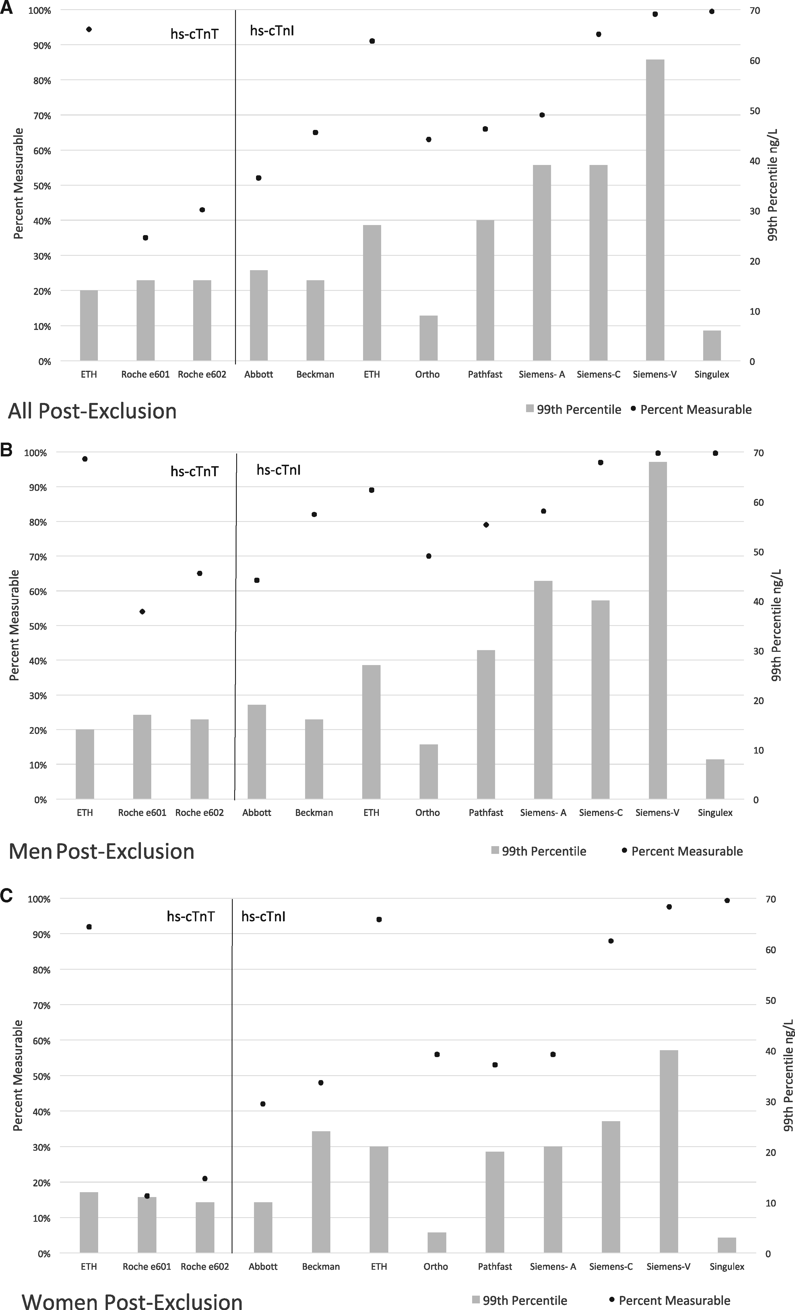
hs-cTn Assays: 99th Percentiles & Measurable Values
Fig 1. Schematic representation of hs-cTnI and hs-cTnT assays percentages of measurable concentrations (≥ LoD) [●] and non-parametric 99th percentile URLs [bars]

Slide 10
hs-cTnI and hs-cTnT Assays Non-parametric 99th Percentile URLs
Figure 2. Schematic representation of hs-cTnI and hs-cTnT assays non-parametric 99th percentile URLs grouped by assay post exclusion.

Slide 11
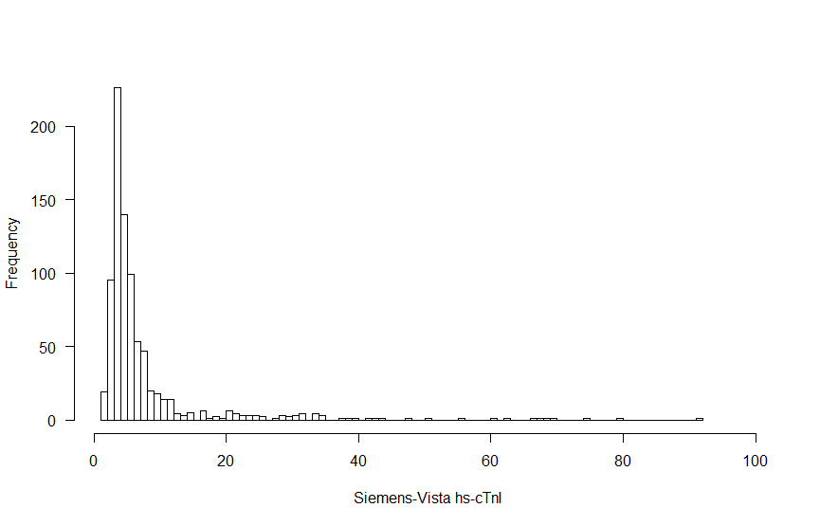
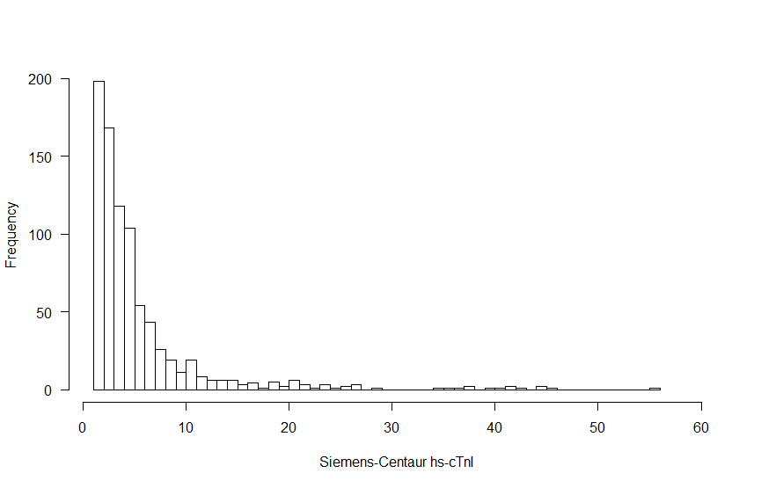
Histograms of hs-cTnI Assays
Figure 3. Histograms for 2 different hs-cTnI assays by the same manufacturer demonstrating different distributions primarily predicated on an assay’s ability to detect low concentrations in women that are above the assays’ LoD.

Slide 12
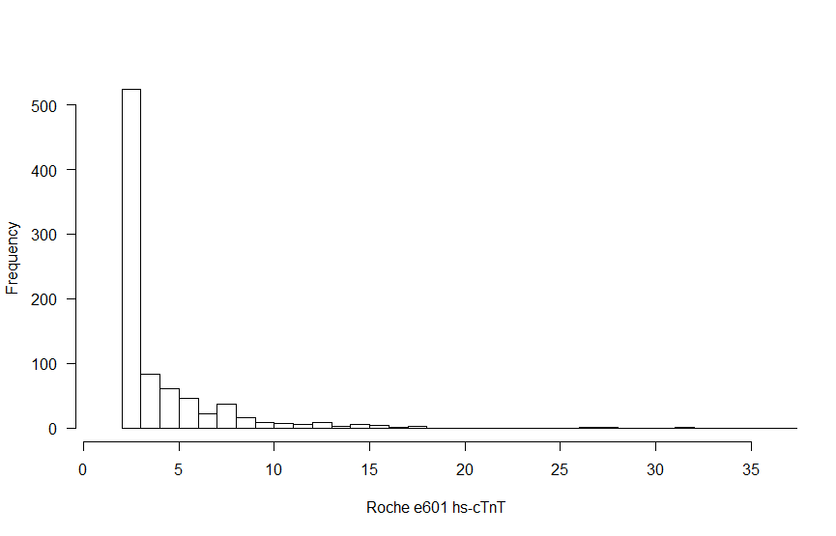
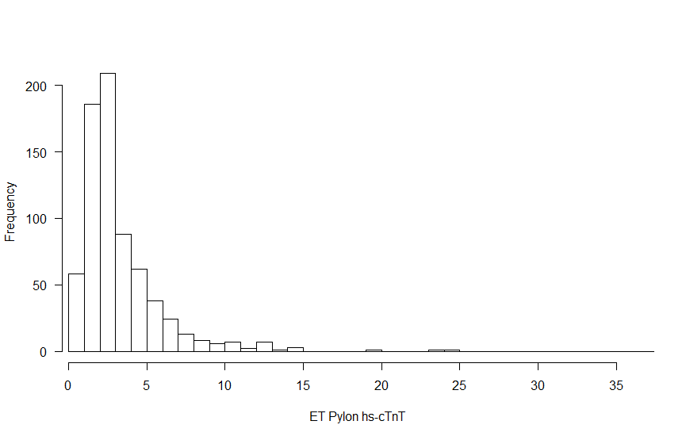
Histograms of hs-cTnT Assays
Figure 4. Histograms for 2 different hs-cTnT assays demonstrating different distributions primarily predicated on an assay’s ability to detect low concentrations in women that are above the LoD.

Slide 13
Question
What are the fundamental reasons why cTnI and hs-cTnT assays measure substantially different concentration in patients which underline the lack of standardization and harmonization?

Slide 14
Discussion
  Our novel study has important clinical practice implications in that sex-specific 99th percentile URLs vary according to the
    hs-assay used to measure cTn
    statistical method used to calculate the 99th percentile.
  We do not recommend the use of the robust statistical methodology in determination of 99th percentile calculations
  Not all assays marketed as high sensitivity meet guideline criteria to provide measurable concentrations ≥ LoD in >50% for women
  Surrogate exclusion criteria used to define normality in apparently healthy subjects tend to lower 99th percentile URLs, providing a better representation of a normal population.
  How a clinical or research laboratory chooses to define ‘normality’ will influence both diagnostic and risk assessment decisions

Slide 15
Editorial Critiques of Manuscript by Gore & de Lemos, with Responses
  “..99th percentile URLs for cTn assays ..there is no consensus regarding …appropriate inclusion and exclusion criteria to define the normal reference population, nor.. regarding statistical methodology”
    Response: The paper complements the IFCC C-CB and AACC Academy published expert opinions on how to define normality using hs-cTn assays
  “raising questions as to whether even a carefully determined 99th percentile URL can be considered reliable.. for MI diagnosis”
    Responses: The Fourth Universal Definition of MI (2018), the IFCC C-CB and AACC Academy expert guidelines define cardiac troponin 99th percentiles as the definitive, laboratory medicine medical decision cutoff for abnormality and one of the foundations of a clinical use of any analyte in clinical practice of medicine
    The editorial authors misfocus their views on early rule out using baseline samples and risk assessment, that were not part of the goals of the current study; taking editorial liberty away form the study’s goals
    The editorial misses an opportunity to address the power of sex-specific URLs that benefits females for appropriate diagnoses

