Slide 1
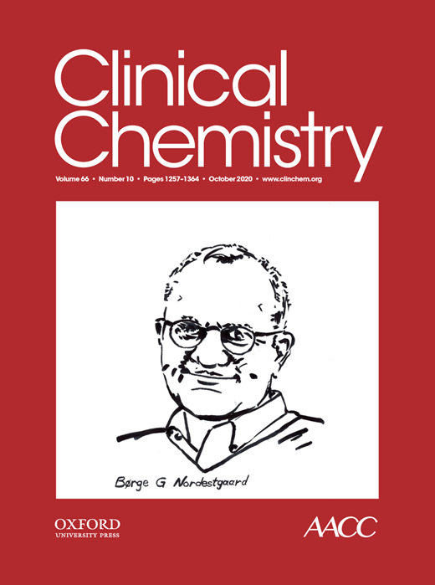
Time-Dependent Apparent Increase in dd-cfDNA Percentage in Clinically Stable Patients Between One and Five Years Following Kidney Transplantation
E. Schütz, T. Asendorf, J. Beck, V. Schauerte, N. Mettenmeyer, M. Shipkova, E. Wieland, M. Kabakchiev, P.D. Walson, V. Schwenger, M. Oellerich
October 2020
https://doi.org/10.1093/clinchem/hvaa175
© Copyright 2020 by the American Association for Clinical Chemistry

Slide 2
Why donor-derived cell free DNA?
  Donor-derived cell free DNA (dd-cfDNA) is a minimally invasive marker that:
  detects and excludes rejection and graft cell injury at an early actionable stage.
  helps avoid unnecessary biopsies
  indicates response to rejection treatment
  detects under-immunosuppression
  shifts emphasis from reaction to prevention
  Question: Are data on clinical validity of dd-cfDNA from more than about 50 published studies sufficient to justify clinical application?

Slide 3
The Nature of the Problem
dd-cfDNA is mostly expressed as percent
  Main source of total cf-DNA are leucocytes in blood
  dd-cfDNA fraction is in low percentage range
  Possible changes in leucocytes will have huge impact
No reasons to believe that immunosuppressive drugs have no influence
  Direct influence on nuclear factor of activated T cells ->lymphocytes
  Calcineurin inhibitors are negatively influencing cell stability
  ->leucocytes
  Changes in leucocyte composition likely
Other reasons for variability of total cfDNA
  Exercise and infection have a well known effect

Slide 4
The Hypothesis
dd-cfDNA percent has confounding variables
  Changes in host cfDNA will change dd-cfDNA percentage without pointing to the transplant
  dd-cfDNA % can change at the same true concentration
  Can lead to misleading results of percentage
The tapering of immunosuppressive drugs after transplantation
  Done to ameliorate the side effects of immunosuppressive drugs
  Should lead to a decreased host cfDNA, which represents the denominator of percentage calculations
  Should be observable in stable organ recipients

Slide 5
The Study Design
303 patients from 12 to 60 months after kidney transplantation (Ktx)
  Predefined sampling time points
  929 samples eligible and evaluated over time
  percentage and concentration compared head to head
  other laboratory values from routine monitoring
  univariate statistics and interclass (time) correlation
Questions to be answered
  Is the total cf-DNA stable?
  Are upper limits of dd-cfDNA in such a reference population stable?
Months after KTx | 12 | 15 | 18 | 21 | 24 | 30 | 36 | 48 | 60
Number of samples | 135 | 83 | 97 | 72 | 117 | 104 | 114 | 116 | 102

Slide 6
The Analytical Methods
Cell-free DNA
  Total (copies/ml plasma – cp/ml) – digital droplet PCR
    controlling DNA extraction with internal standard and individual fractionation of cf-DNA using a separate analysis to estimate it.
  dd-cfDNA
    Percentage (fractional abundance) - digital droplet PCR (SNP)
    Concentration (cp/ml) – calculated as percentage x total
Other parameters (from clinical laboratory)
  Creatinine/eGFR – enzymatic
  White blood cell count – automated counters
  Immunosuppressive drugs – LC-MS/MS
Question: What are the requirements for an accurate absolute quantification of dd-cfDNA?

Slide 7
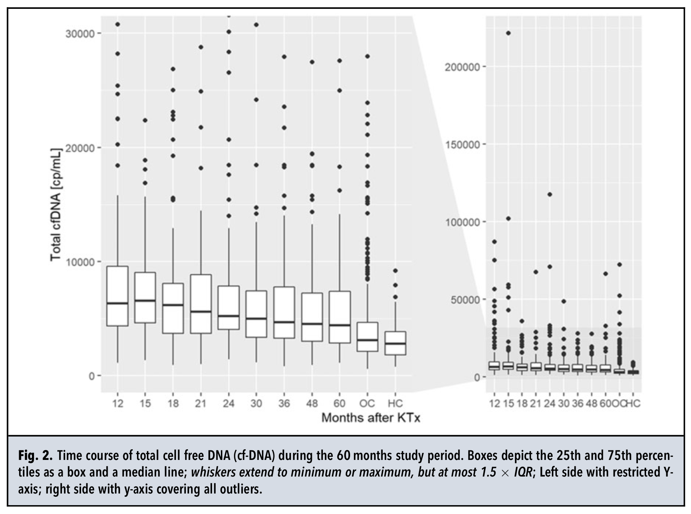
Time course of total cfDNA concentration
Figure 1. Steady decrease of total (host) cf-DNA concentration (highly significant). Sustained significant difference to healthy individuals and patients with OMC not receiving ISD

Slide 8
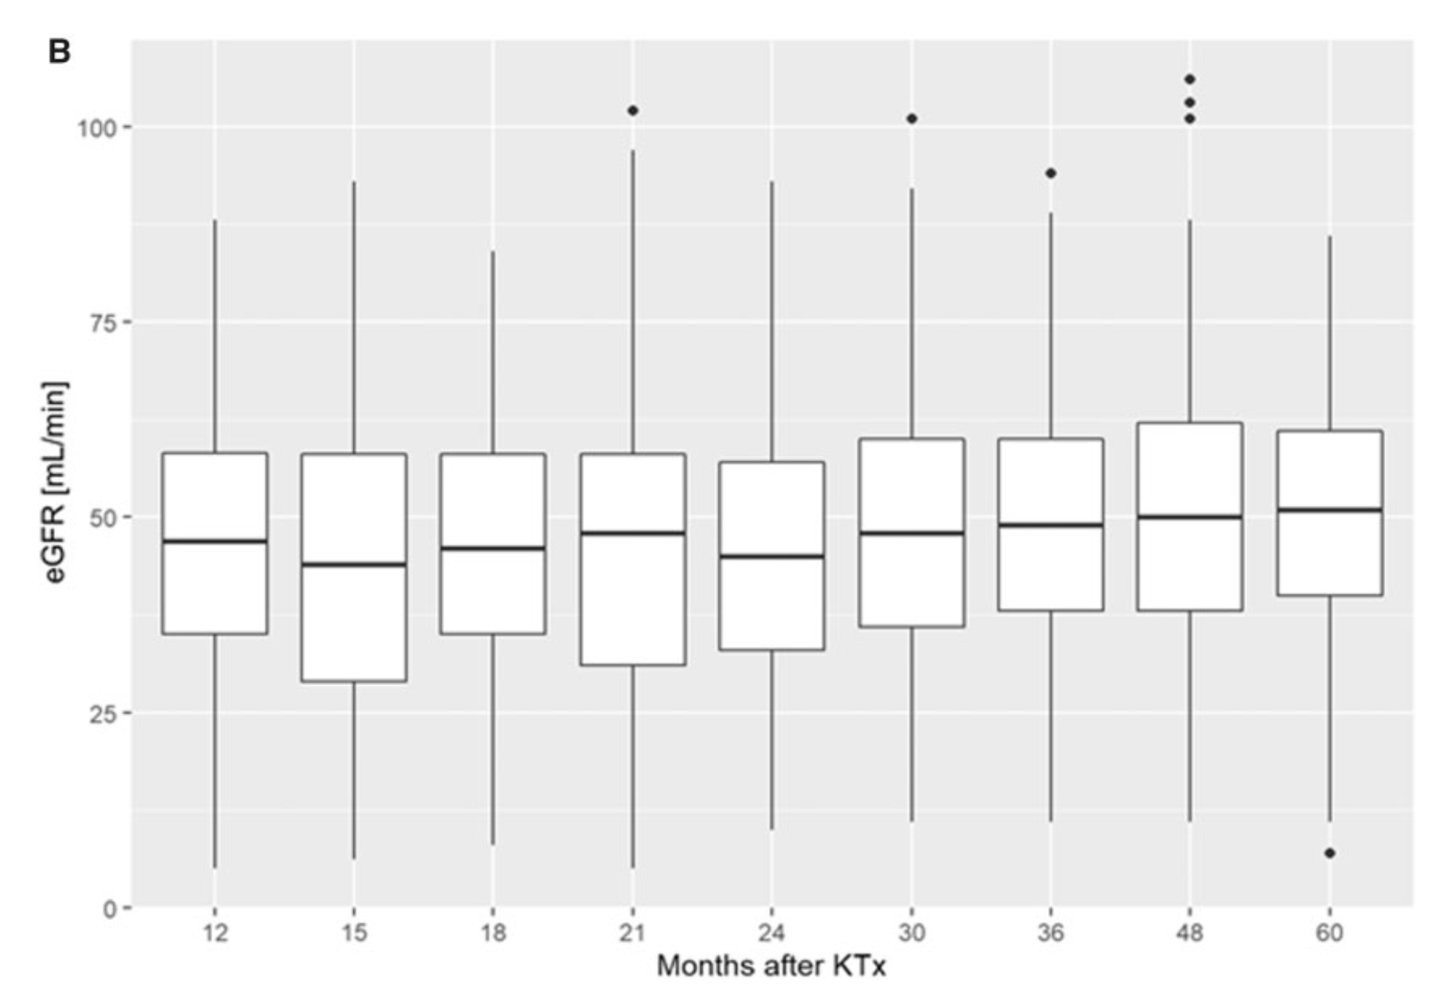
Time course of eGFR
Figure 2. No indication of functional kidney changes in the reference cohort

Slide 9
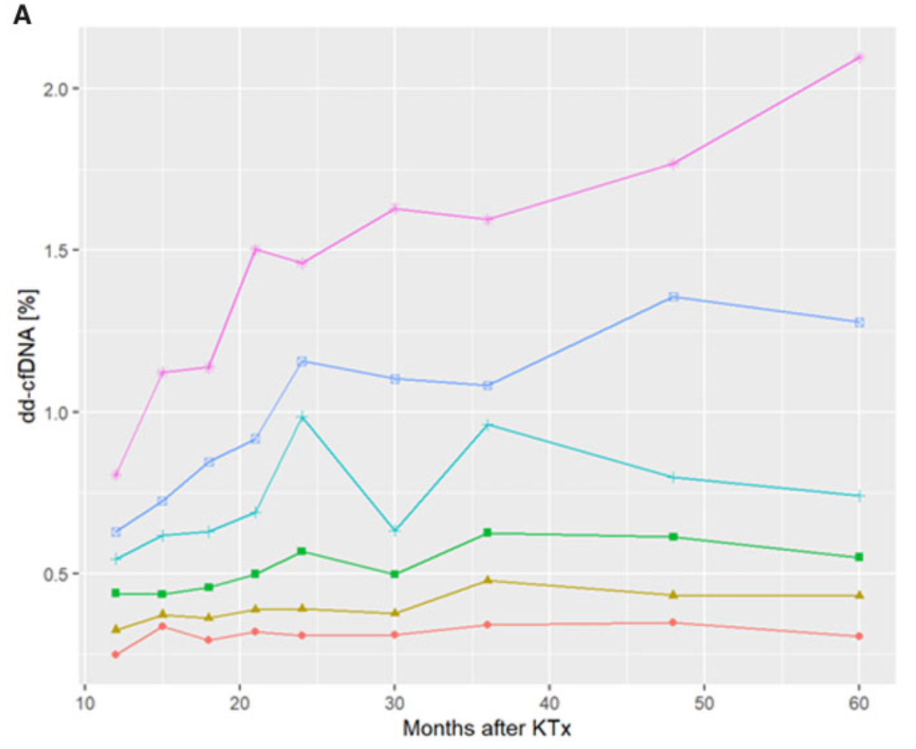
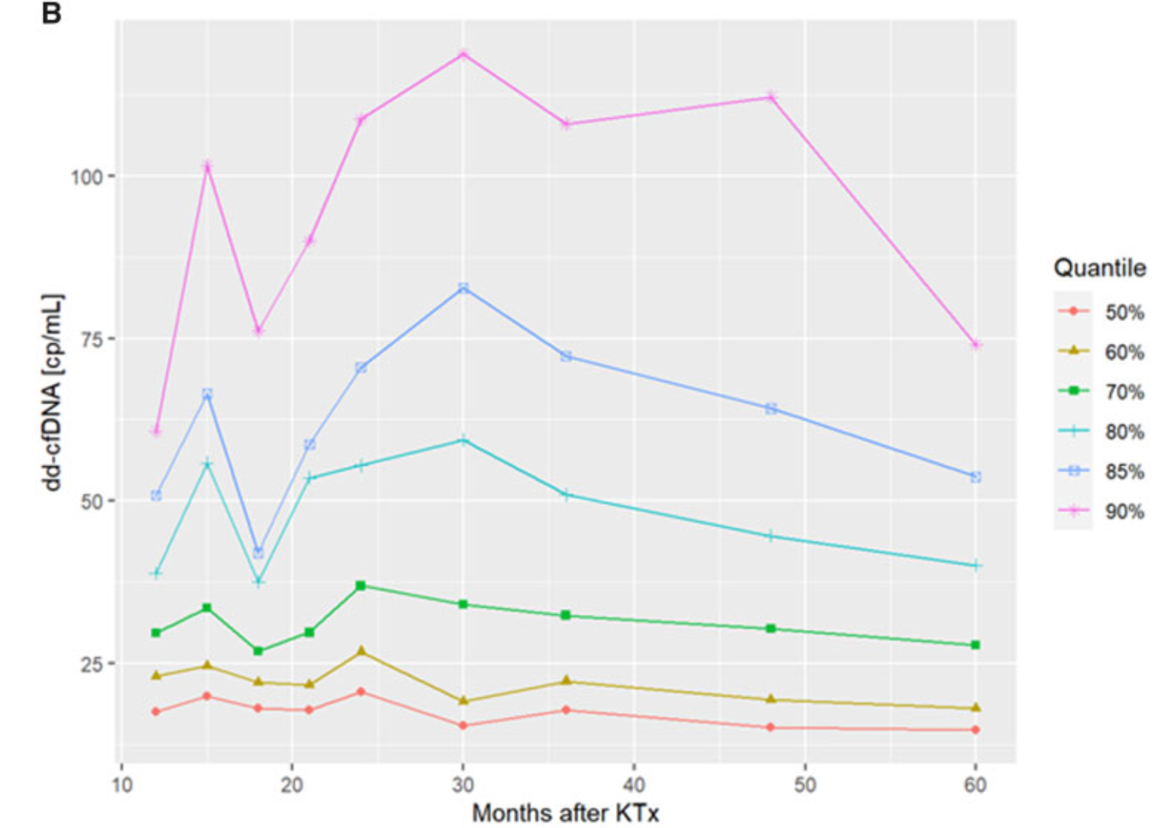
Upper range of dd-cfDNA
Figure 3. dd-cfDNA time course of quantiles

Slide 10
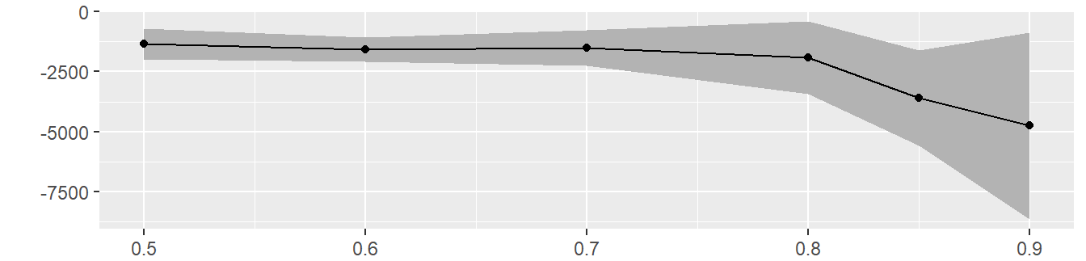
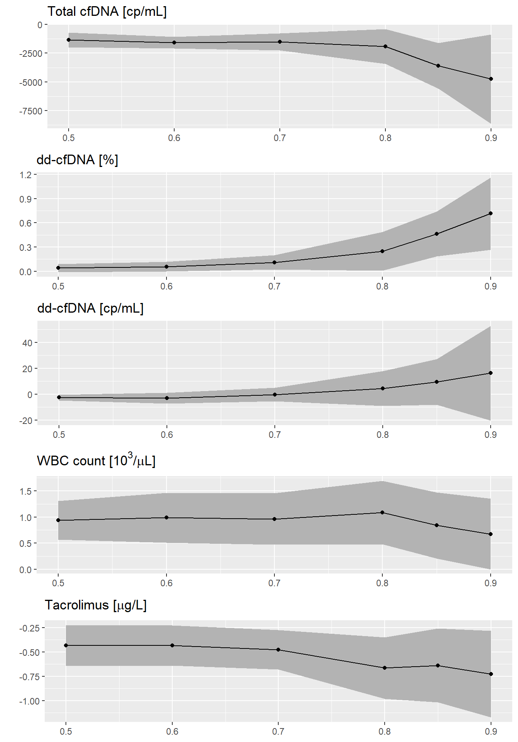
Slopes vs time [log(months)]
Total cf-DNA
(cp/ml)
dd-cfDNA
(%)
dd-cfDNA
(cp/ml)
Figure 4. Any deviation from the 0-line (red) of the confidence boundaries (grey area) indicates a significant time-dependent shift of values

Slide 11
Slopes vs time
Figure 5. Any deviation from the 0-line (red) of the confidence boundaries (grey area) indicates a significant time-dependent shift of values

Slide 12
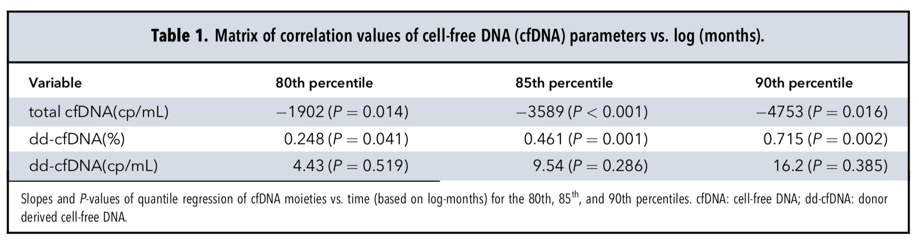
Summary of cf-DNA time trends
Table 1. Upper percentiles of total(host) cfDNA had a significant downward trend over time, resulting is the opposite trend for the percentage of donor derived cfDNA, since the real concentration of dd-cfDNA remained unchanged!
Question: What are the main problems with fractional dd-cfDNA determination?

Slide 13
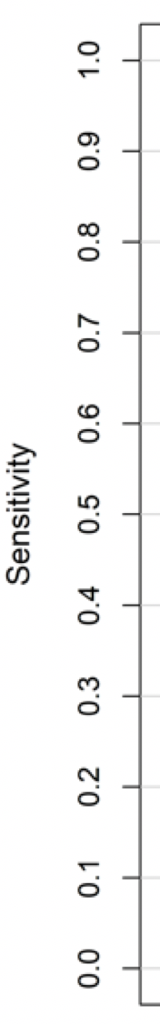
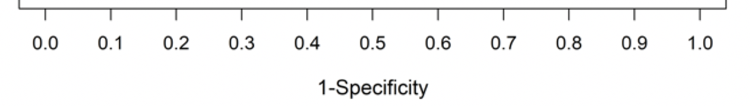
Significance for Rejection diagnosis
dd-cfDNA (cp/mL)
AUC: 0.83
p=0.02
dd-cfDNA (%)
AUC: 0.73
Figure 6. Practical consequences in clinical samples
From Oellerich et al. Am J Transplant 2019

Slide 14
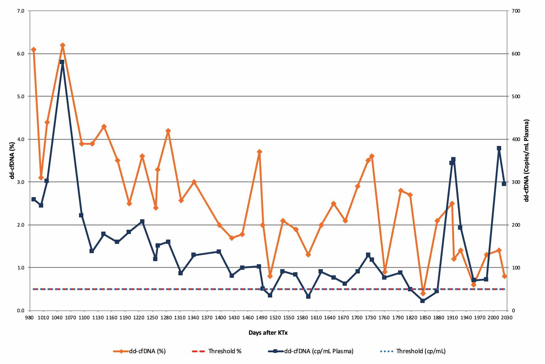
Clinical case Example
Increased variability of dd-cfDNA fraction (orange) due to changes in total cfDNA compared to absolute quantification (blue).
Crea* 78 78 88 83 72 74 74 75 79 74 76 70 92 92 129 93 98 100 97 87 121 98 102 99 80 103 80 93 129 88 97 138 96 150 136 102 178 146 76 138 190
ABMR
16 y, male, secondary oxalate nephropathy
Total cfDNA (cp/mL): *8,419
** 3,153
**
*
*Reference range: 40-68 µmol/L; DSA positive
Figure 7. dd-cfDNA in a KTx patient with acute AMBR and tubulointerstitial oxalate

Slide 15
Discussion
An accompanying editorial discusses the strengths and weaknesses of fractional and absolute determination of dd-cfDNAª
Concludes that diagnostic models may integrate both the fractional and absolute amount of dd-cfDNA
In clinical practice the combination of fractional and absolute determination has proven to be useful
ª Vlaminck I. The proportion of donor-specific cell-free DNA in blood as a marker of transplant rejection: not an absolute. Clin Chem 2020;66:1257-8.

Slide 16
Take home Conclusion
  Time-dependent decrease of recipient cfDNA during long-term surveillance in stable KTx patients
  associated with an apparent increase of dd-cfDNA fraction over time.
  risk of false positive results for dd-cfDNA fraction
  no influence on absolute dd-cfDNA quantification, which is the preferred method

