Slide 1

Using Machine Learning to Identify True Somatic Variants from Next-Generation Sequencing
C. Wu, X. Zhao, M. Welsh, K. Costello, K. Cao, A.A. Tayoun, M. Li, and M. Sarmady
January 2020
https://doi.org/10.1373/clinchem.2019.308213
© Copyright 2020 by the American Association for Clinical Chemistry

Slide 2
Introduction
Cancer genome characteristics
  Somatic variants
  Germline variants
  Tumor heterogeneity leads to low variant allele fraction of somatic variants
  100% variant detection sensitivity is our target in clinical testing
Next generation sequencing challenges
  Tumor/normal paired sequencing is not always an option clinically
  Lack of normal tissue data, makes differentiating somatic variant from germline complicated
  Variant callers are not perfect and produce false positive and false negative variants
  Different sample processing steps in sequencing workflow can add noise and false positive variants to the results
Notes:
4-6 points

Slide 3
Introduction cont.
Ensemble variant calling
  Lack of concordance among different somatic variant callers
  Union of variant calls from multiple variant callers used to increase sensitivity
  Ensemble approach leads to abundance of false positive variants
Variant review in clinical labs
  It is essential to ensure only real variants are reported clinically
  Due to low variant allele fraction and number of variants in a panel, orthogonal confirmation is not feasible
  Manual review is currently standard practice in clinical labs to identify real somatic variants from artifacts
  Manual review is tedious, error prone, subjective
  We present a machine learning (ML) model to automate this process
Notes:
4-6 points

Slide 4
Question
What are the sources of false positives in somatic variant calling?
How would having variants from normal tissue help with reducing FP somatic variants?
Notes:
4-6 points

Slide 5
Materials and methods
Variant Data set
  Compiled from pediatric cancer patients
  Ran through CHOP NGS solid-tumor and hematological profiling assays (238 and 118 genes respectively)
  11,278 single nucleotide variants (SNV) manually reviewed by clinical variant scientists were used for the model
Variant Callers
  Mutect, Scalpel, Freebayes, VarScan2
  Final vcf was generated by taking union of the calls

Slide 6
Materials and methods cont.
Features considered by manual review
  High allele ratio (VAF) in patient sample and at least 2 control sample
  Low mapping quality
  High strand bias both in patient and control samples
  Located in difficult to sequence genomic regions such as pseudogenes, poly A
All 11,278 variants were assigned true positive or artifact labels
Similar features were considered by the ML classifier

Slide 7
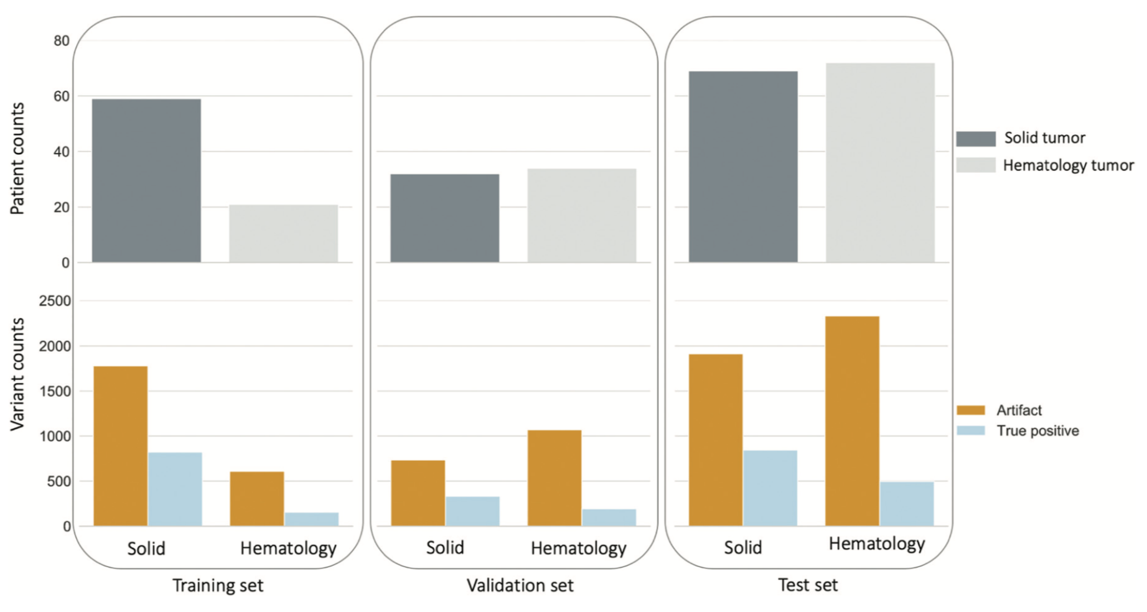
Variants used in the study
Figure 1. The training set comprised 61 solid and 23 hematology tumor samples, including 976 TPs (821 solid, 155 hematology) and 2386 artifacts (1779 solid, 607 hematology). The validation set comprised 32 solid and 34 hematology samples, including 526 TPs (333 solid, 193 hematology) and 1803 artifacts (734 solid, 1069 hematology). The test set comprised 69 solid and 72 hematology samples, including 1341 TPs (845 solid, 496 hematology) and 4246 artifacts (1913 solid, 2333 hematology).

Slide 8
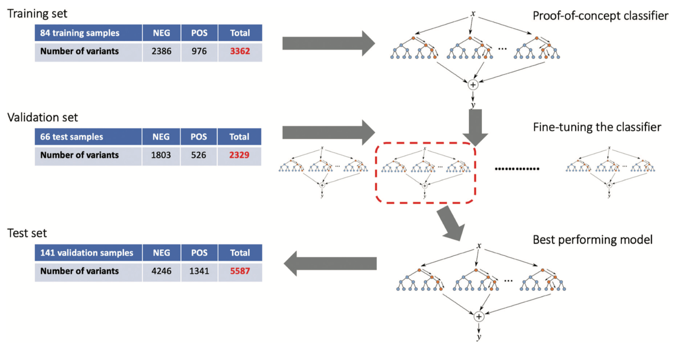
Workflow of computational classifier development
Figure 3. A baseline model was trained with the training set. Different sets of parameters were evaluated to identify the best performing model with an independent validation set, before benchmarked with the test set. Random forest was implemented

Slide 9
Materials and methods cont.
Random forest classifier assigns a confidence score to the call
  Score ranges between 0 (100% confident TP) and 1 (100% confident FP)
  We derived thresholds to have 3 classes
    True variant: no manual review needed
    Uncertain: require manual review
    Artifact (false positive) no manual review needed
Notes:
4-6 points

Slide 10
Question
Why is it necessary to divide up the data to training, test and validation sets?
Notes:
4-6 points

Slide 11
Results
The following variant features were selected by the machine learning model
  Alternate allele coverage
  Strand bias
  Variant allele fraction (VAF)
  Dissimilarity to normal controls
  Batch effect
Notes:
4-6 points

Slide 12
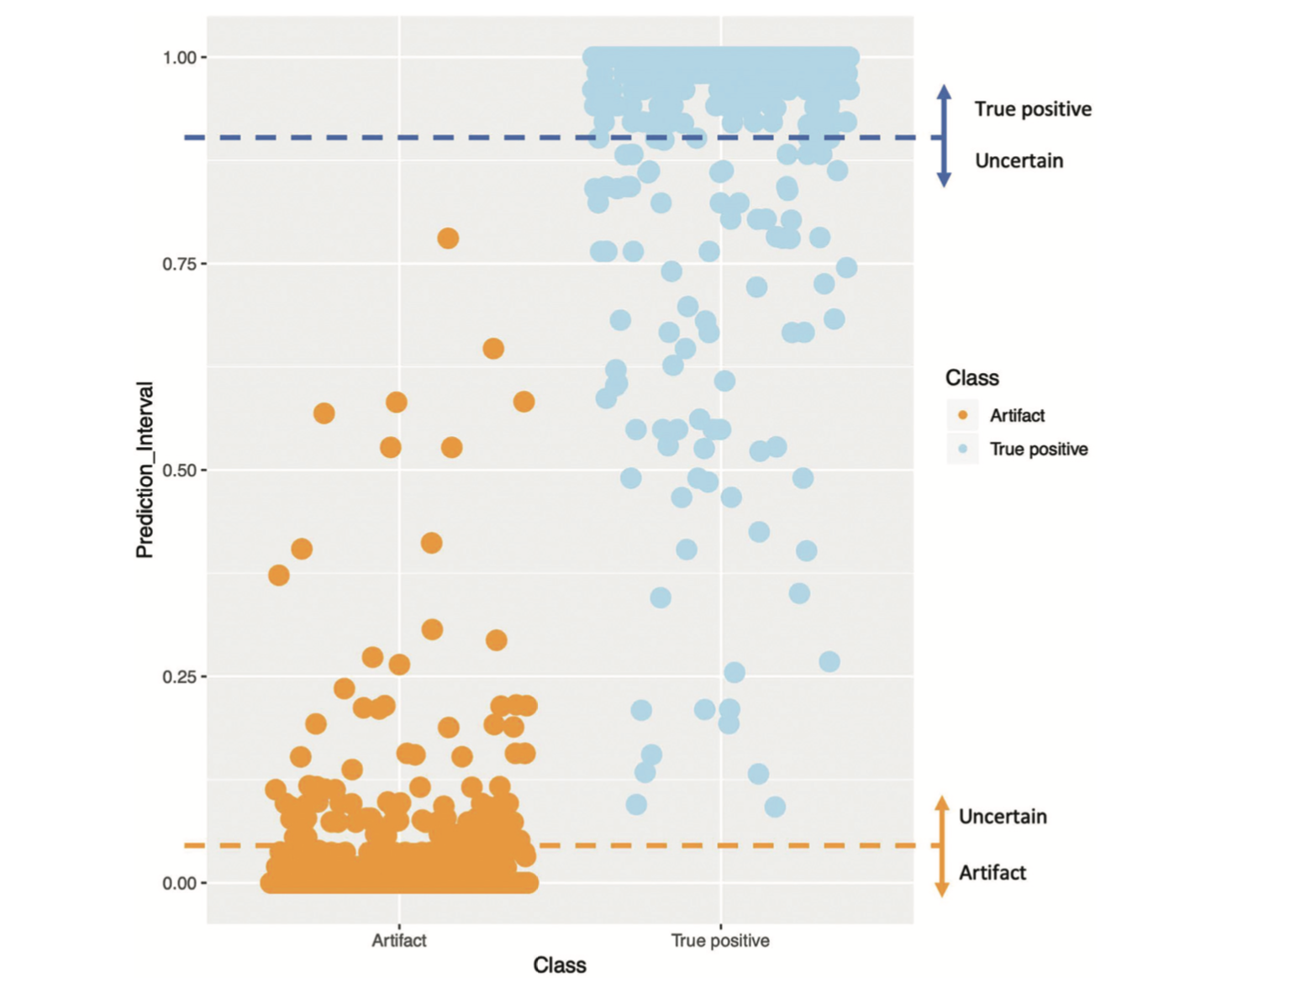
Plot of prediction intervals of variants in the test set including the thresholds defining the class of“uncertain.”
Figure 4. In total, 192 variants of prediction intervals between 0.05 and 0.9 were assigned the label of “uncertain.”

Slide 13
Results
Test set results
Overall sensitivity: 97%
Overall specificity: 100%
Total SNV | True SNVs | Artifacts | Uncertain | Exempt manual review
5587 | 1252 | 4143 | 192 | 5395
Concordance with manual review | 93% | 97%

Slide 14
Question
Why do we need a 3 class classifier (real, uncertain, false) instead of 2 class (real, false) in a clinical lab?
Notes:
4-6 points

Slide 15
Discussion
The developed machine learning model was designed to be equivalent to the best manual review
All our data were derived from non-FFPE samples
Our data showed 96.6% of variants get definitively labeled and exempted from manual review
Clinical implementation of this model led to 63% reduction of hands on time per case
This result enabled our lab to reduce turn-around time and increased capacity with the same number of genome scientists

