Slide 1

High-Accuracy Determination of Microsatellite Instability Compatible with Liquid Biopsies
A.B. Silveira, F-C. Bidard, A. Kasperek, S. Melaabi, M-L. Tanguy, M. Rodrigues, G. Bataillon, L. Cabel, B. Buecher, J-Y. Pierga, C. Proudhon, M-H. Stern
April 2020
https://doi.org/10.1093/clinchem/hvaa013
© Copyright 2020 by the American Association for Clinical Chemistry

Slide 2
Introduction
Background
  DNA mismatch repair (MMR) deficiency induces a hypermutability in short repetitive elements leading to microsatellite instable phenotype (MSI)
  Microsatellite instability has recently emerged as a predictive pan-tumor biomarker of immunotherapy efficacy
  The FDA approval of Pembrolizumab treatment for tumors with MSI status or MMR deficiency has stimulated the development of diagnostic tools for large-scale screening of patients including non-invasive detection from circulating tumor DNA
  Next-generation sequencing allows MSI detection in various cancer types, including those with low MSI incidence, but is time-consuming and requires a powerful bioinformatics support.

Slide 3
Introduction
  Aims
  To develop a drop-off droplet-digital PCR (ddPCR) approach for highly sensitive detection of MSI from tissue and body fluid to be used as an affordable and rapid diagnostic tool for large screening of patients who could benefit from immunotherapy agents
  To develop a universal circulating tumor DNA (ctDNA) assay for MSI patient follow-up

Slide 4
Question 1
What is the clinical importance of microsatellite instability detection ?

Slide 5
Material and methods
  Tissue (n= 185) and plasma (n= 72) were collected from patients with colorectal cancer (CRC) or other cancers, with known MSI status at different points of treatment (before/during therapy)
  Drop-off ddPCR assays were developed for a panel of 3 microsatellite markers with long (BAT-26: 27 bp) and short sequences (ACVR2A : 8 bp and DEFB105 A/B: 9 bp)
  HCT-116 and HCT-15 CRC cell lines were used as MSI controls to validate ddPCR assays
  Performance of the ddPCR assays was estimated using reconstitution experiments of various ranges of mutant allelic frequency (MAF)
  Receiver operating curve analyses were performed to determine MAF thresholds for microsatellite instability

Slide 6
Question 2
What are the advantages of using ddPCR over next-generation sequencing for MSI detection?

Slide 7
Results/Summary
  ddPCR assays successfully detected MSI in BAT-26, ACVR2A and DEFB105 A/B with long or short mononucleotide repeats
  High analytical sensitivity was achieved for the 3 ddPCR assays (<0.1% MAF)
  MAF thresholds for microsatellite instability were estimated (6% for BAT-26 and 1.2% for both ACVR2A and DEFB105A/B)
  A sample was considered MSI when ≥2 markers out of 3 were reported unstable by ddPCR
  126 CRC and 59 non-CRC formalin fixed paraffin embedded samples with known mismatch repair and microsatellite instable/microsatellite stable status were blindly analyzed using the 3 marker-ddPCR test

Slide 8
Results-summary
  High concordance was observed between MSI status determination by the 3-marker ddPCR test and the reference pentaplex test (100% for colorectal tumors and 93% for other tumor types)
  The dynamic of circulating tumor DNA from MSI CRC/endometrial blood samples showed good correlations with clinical response
  The 3 ddPCR assays showed 100% clinical specificity when tested on MSS ctDNA samples with advanced tumors and from healthy donors
  MAFs from MSI-ddPCR assays were highly correlated (r ≥ 0.99) with ddPCR MAFs from other ctDNA markers (BRAF V600E and PIK3CA H1047R)

Slide 9
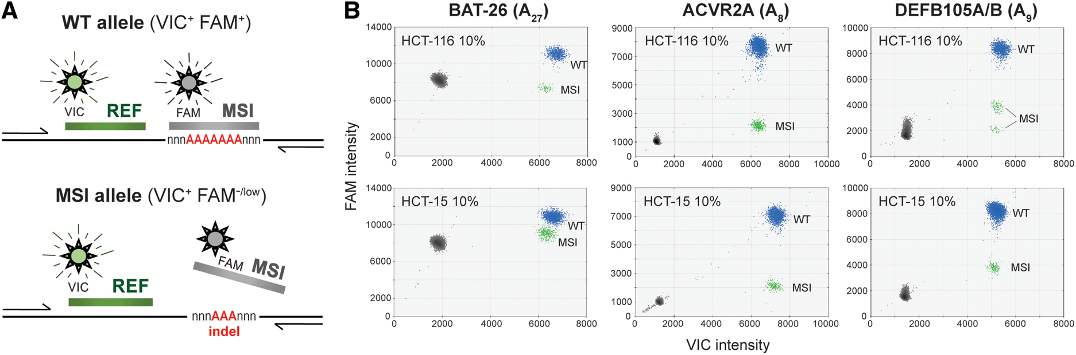
Drop-off ddPCR assays : principle and performance on cell lines
Figure 1. Microsatellite instability (MSI)-ddPCR drop-off assays. a) Schematic representation of the principle of the method. The MSI probe recognizes only the wild-type allele, whereas the REF probe recognizes wild-type and mutant alleles. MSI phenotype will be characterized by droplets positive for the REF but not by the MSI probes. b) 2D scatter plots of BAT-26, ACVR2A, and DEFB105A/B assays using 10% dilutions of HCT-116 or HCT-15 MSI CRC cell lines in WT DNA. Droplets containing wild type (WT), MSI alleles and no DNA template are indicated as blue, green, and gray clusters, respectively.

Slide 10
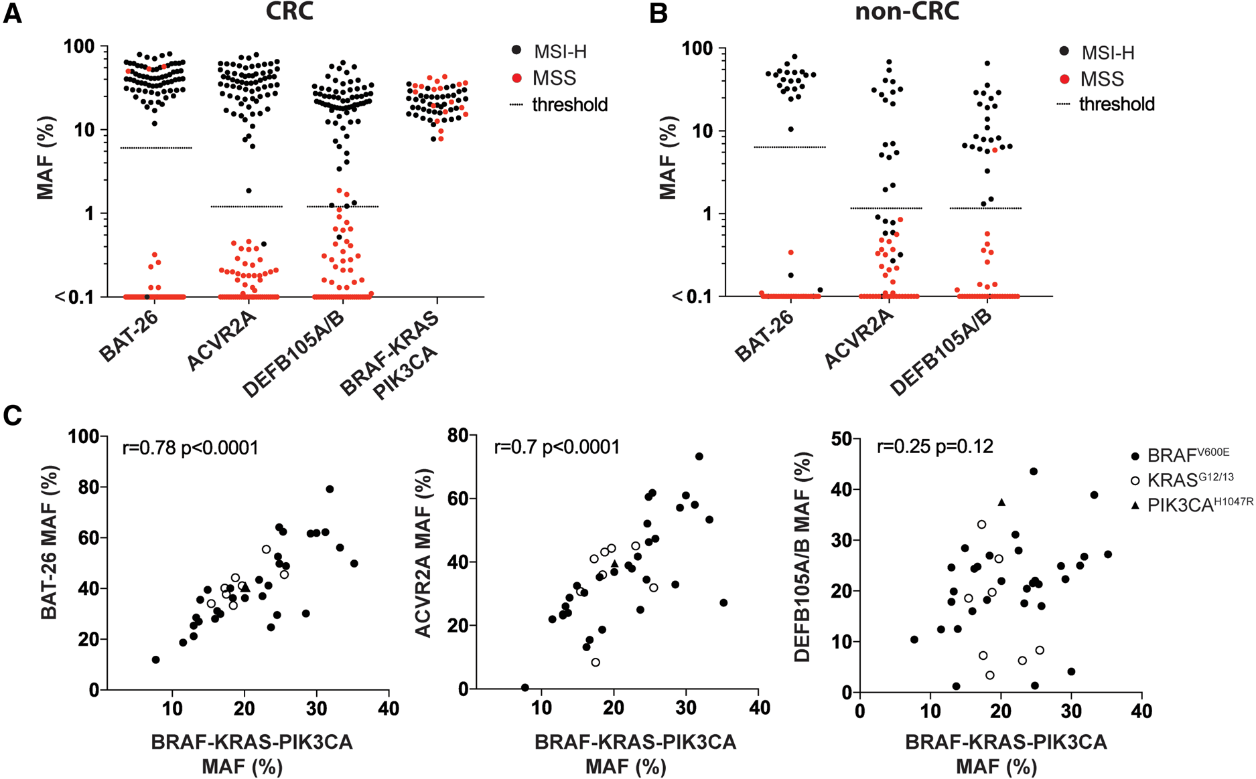
MSI detection in CRC and non-CRC tumors (ddPCR VS pentaplex test)
Figure 2. Microsatellite instability (MSI) status characterization in tumor specimens by MSI-ddPCR. Distribution of MSI allelic frequencies measured by BAT-26, ACVR2A, and DEFB105A/B assays in colorectal carcinoma (CRC) a) or non-CRC tumors b). Black and red dots represent samples classified as MSI or MSS by the pentaplex test, respectively. Optimized thresholds were calculated using receiver operating characteristics analysis. c) Correlation between mutant allele frequencies (MAFs) measured by MSI-ddPCR and BRAF V600E, KRAS G12/13, or PIK3CA H1047R ddPCR assays.

Slide 11
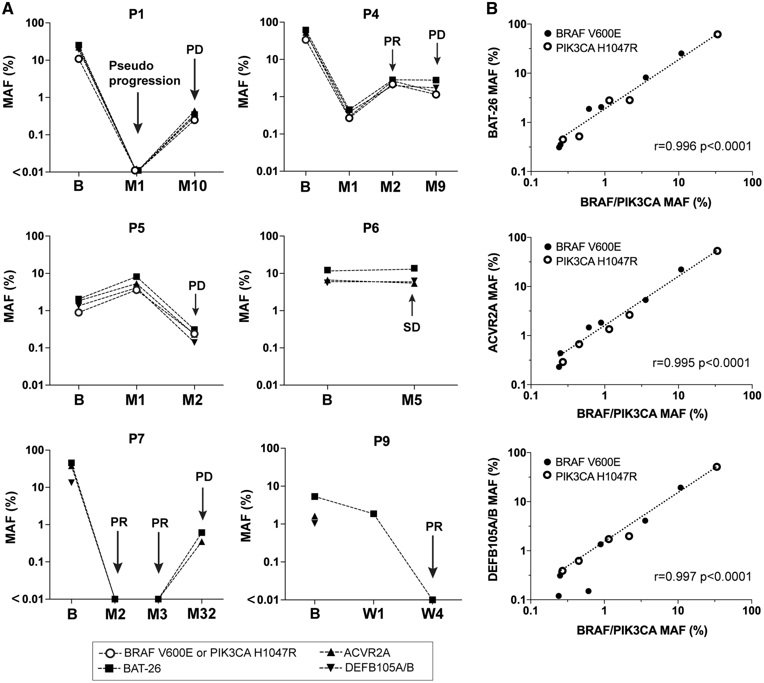
ctDNA dynamics and clinical response
Figure 3. Microsatellite instability (MSI) detection in blood samples of advanced cancer patients by MSI-ddPCR. a) ctDNA dynamics in blood samples at baseline (b) and during treatment (M, month; W, week). Arrows indicate associated responses based on computed tomography scans (PR, partial response; SD, stable disease; PD, progressive disease). b) Correlation between ctDNA fractions estimated by MSI-ddPCR assays and ddPCR assays specifically targeting BRAF V600E or PIK3CA H1047R mutations for patients (P) 1, 2, 4, 5, and 8.

Slide 12
Question 3
What is the rationale behind the criterion used to consider
a sample as microsatellite instable ?

Slide 13
Discussion
  We developed a highly sensitive MSI-ddPCR approach for non-invasive detection of MSI and quantification of ctDNA
  MSI-ddPCR is suitable for high-throughput screening of patients including those with low MSI prevalence and could be used for the monitoring of response to treatment, and to improve access to personalized treatments
  A cancer-specific MSI-ddPCR approach needs to be developed for screening of patients with other cancer types

