Slide 1
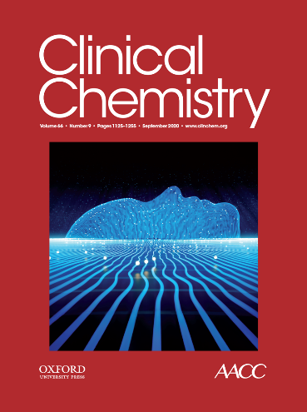
Evaluation of the Risk of Laboratory Microbial Contamination During Routine Testing in Automated Clinical Chemistry and Microbiology Laboratories
C.W. Farnsworth, M.A. Wallace, A. Liu, A.M. Gronowski, C.-A. Burnham, and M.L. Yarbrough
September 2020
https://doi.org/10.1093/clinchem/hvaa128
© Copyright 2020 by the American Association for Clinical Chemistry

Slide 2
Introduction
Testing of infectious specimens is routine in clinical laboratories
  ~1 million people in the US infected with HIV
  ~3 million people in the US diagnosed with HCV
Increased concern and awareness of testing high risk specimens due to Ebola and COVID-19
  Many viruses are viable several days in dried blood spots
  Estimated 4% of health care worker exposures are among laboratorians
  Previous studies demonstrated contamination of total laboratory automation (TLA) with bloodborne viruses (HCV and HBV)

Slide 3
Unresolved Questions:
Do newer engineering controls decrease risk of exposure (i.e. fully enclosed track systems on TLA)?
What are the potential risk points on contemporary chemistry and microbiology TLA?
Outside of automation, what are other risk points for exposure in the lab environment?

Slide 4
Study Objective
Assess points of risk for laboratory contamination on contemporary TLA and in the laboratory environment
  Sample acquisition/ processing
  Clinical chemistry TLA and analyzers
  Microbiology TLA

Slide 5
Methods
Applied fluorescent marker to outside of specimen tube to assess gross contamination
  Monitored by ultraviolet light
Added MS2, a non-pathogenic virus (10⁷ pfu/mL) to a variety of matrices
  Blood, urine, and ESwab
  Monitored for MS2 contamination by swabbing designated areas and performing MS2 PCR on swabs
Perform hand hygiene and personal protective equipment (PPE) survey of staff in chemistry and microbiology laboratories

Slide 6
Figure 1. Experimental Design

Slide 7
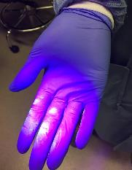
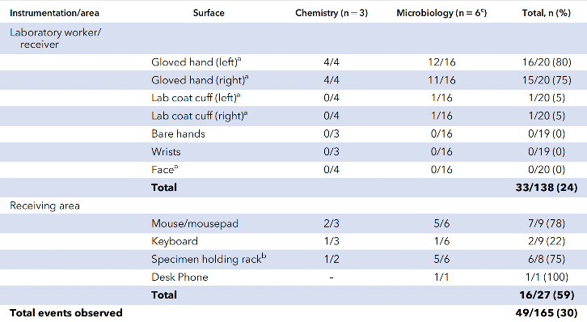
Fluorescence transfer to laboratory workers and environment
Gloved hand
Specimen rack
Table 1. Transfer of “fluorescence”, a surrogate for gross contamination, observed in the processing areas of the laboratory

Slide 8
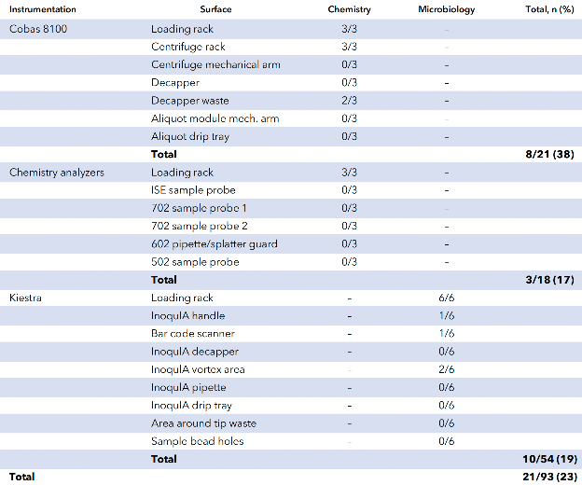
Fluorescence transfer to automated laboratory instrumentation
Table 2. Transfer of “fluorescence”, observed on indicated TLA in microbiology and chemistry laboratories
Barcode scanner

Slide 9
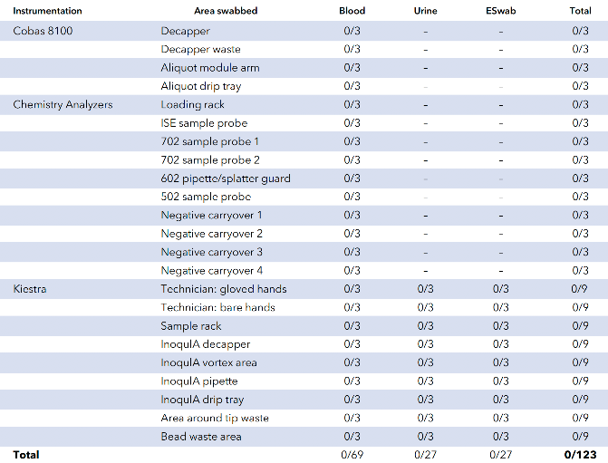
MS2 contamination of laboratory automation and staff
Table 3. Analysis of contamination of laboratory workers and TLA with MS2

Slide 10
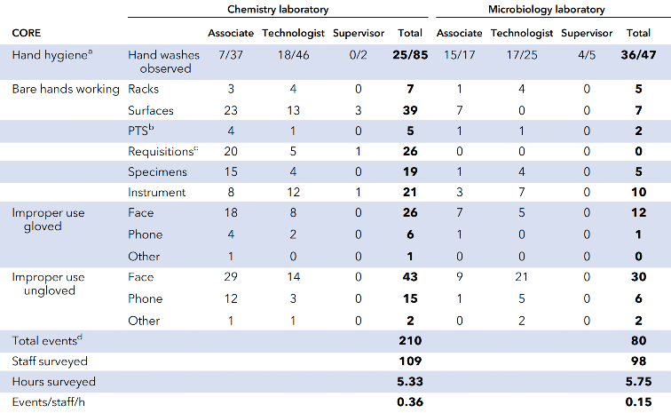
Number of observed improper hand hygiene and PPE misuse by laboratory workers
Table 3. Examination of contamination of lab workers and TLA with MS2

Slide 11
Question:
Given the results of this risk analysis, where should laboratorians focus their efforts when attempting to mitigate laboratory acquired infections?

Slide 12
Discussion
Routine analysis of highly infectious specimens with contemporary TLA presents limited risk of contamination
“Gross contamination” transferred frequently to laboratory staff and the environment
  Computers and specimen racks were particularly high risk and should be regularly decontaminated
PPE may be frequently misused by laboratory workers, increasing the likelihood of laboratory acquired infection
  Represents an opportunity for staff education and training about the utility of PPE

Slide 13
For more, see accompanying editorial in the same issue by JR Genzen:
Wiping the Slate Clean—Assessing Clinical Laboratory Contamination Risk
Clin Chem 2020;66:1128-30.
Notes:
Highlights needs for individual risk assessment

