Slide 1
Inadequate Reporting of Analytical Characteristics of Biomarkers Used in Clinical Research:
A Threat to Interpretation and Replication of Study Findings
Q. Sun, K.J. Welsh, D.E. Bruns, D.B. Sacks, and Z. Zhao
December 2019
www.clinchem.org/content/65/12/1554.full
© Copyright 2019 by the American Association for Clinical Chemistry

Slide 2
Introduction
Background
  Reporting of analytical characterization of biomarker tests:
  Allows readers to assess the internal validity and generalizability of clinical studies
  May be absent, which may result in research waste
  Has received minimal attention
Objective
  To assess the reporting of analytical characteristics of biomarkers used in clinical research
  To evaluate the extent of reported data on assay precision

Slide 3
Question 1
What is the current state of regulation of the reporting of analytical characteristics of biomarker tests used in clinical research?

Slide 4
Methods (I)
Search Strategy
  Five journals: Annals of Internal Medicine (Annals), The Journal of the American Medical Association (JAMA). The Lancet, The New England Journal of Medicine (NEJM), and PLOS Medicine (PLOS Med), 2006-2016
  The archives of each journal were searched for the term “biomarker”.
  Identified studies in which biomarkers were used
    For inclusion/exclusion of patients in the study,
    For classification of patients (diagnosis, response to Rx, etc.) or
    As a study outcome.

Slide 5
Methods (II)
Study selection
604 Original research articles identified in journal archives
  66 Annals
  146 JAMA
  135 Lancet
  163 NEJM
  94 PLOS Med
60 Excluded articles
  43 Modeling or survey studies not involving biomarker measurement
  14 Use of immunohistochemical or imaging markers
  2 Retracted article
  1 Fewer than10 patients in cohort
1348 Biomarkers in 544 full articles
49 Excluded biomarkers
  46 Review article
  2 Biomarker levels not measured in study
  1 Biomarker result not used for patient classification or outcome
1299 Biomarkers included in review
Figure 1.
Flow of review process for biomarker selection.

Slide 6
Methods (III)
Data Extraction
  11 analytical characteristics were evaluated for each biomarker test:
  Accuracy
  Analytical sensitivity
  Calibration/Calibration verification
  Cutoff
  Interferences/Specificity
Precision
    Within-run
    Total
    Unspecified
Quality control
Reportable range
Reference interval

Slide 7
Question 2
Why is reporting of analytical characteristics important for FDA-approved tests if a comprehensive method evaluation was required as part of the approval process?

Slide 8
Results (I)
For 67% of 1299 biomarkers, no analytical characteristics were reported.
The mean number of analytical characteristics reported was less than one (mean 0.72; 95% CI: 0.65 to 0.79; median 0).
The name of the assay manufacturer could not be determined for 53% of the methods.
The extent of the assessments of assay imprecision, when reported, did not meet expectations for clinical use of assays for biomarkers.

Slide 9
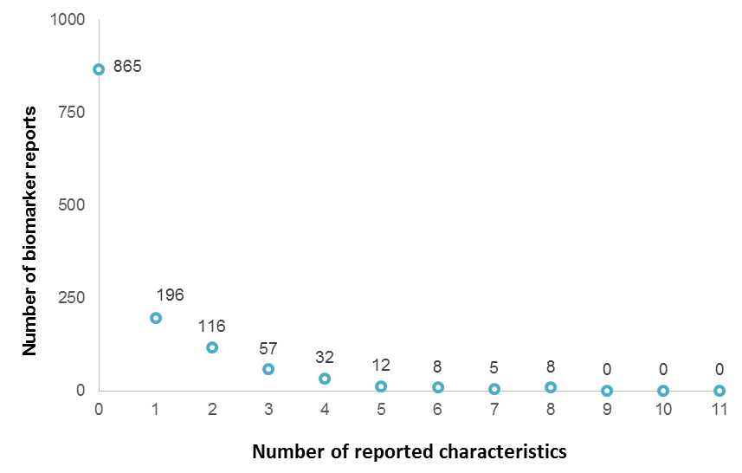
Results (II) OVERALL REPORTING OF ANALYTICAL CHARACTERISTICS OF BIOMARKER TESTS, PART 1
Figure 2.
Distribution of the number of analytic performance characteristics reported for 1299 measurement systems. For each biomarker that was included, the number of analytical characteristics reported was tabulated. For example, no characteristic was provided for 865 biomarker measurements.

Slide 10
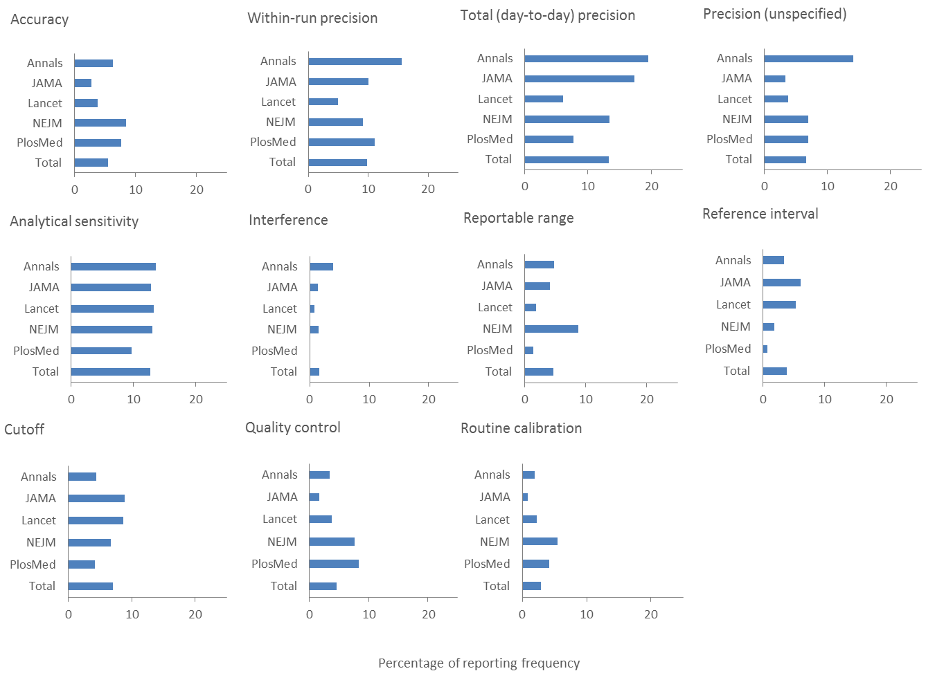
Results (III) OVERALL REPORTING OF ANALYTICAL CHARACTERISTICS OF BIOMARKER TESTS, PART 2
Figure 3.
Reporting rate (%) of analytic performance characteristics in 5 journals.

Slide 11
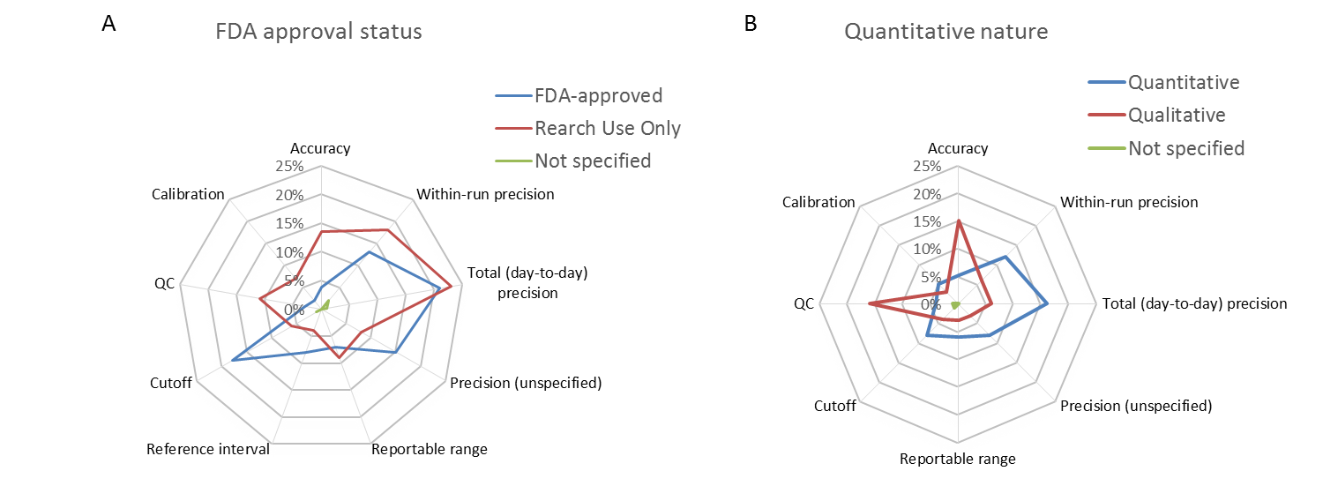
Results (IV) REPORTING OF METHOD CHARACTERISTICS ACCORDING TO FDA REVIEW STATUS AND QUANTITATIVE/QUALITATIVE
NATURE OF METHODS
Figure 4.
Analytical characterization reporting based on (A) FDA-approval status and (B) quantitative nature of methods. Numerical scale: 0% to 25%. QC: Quality control.

Slide 12
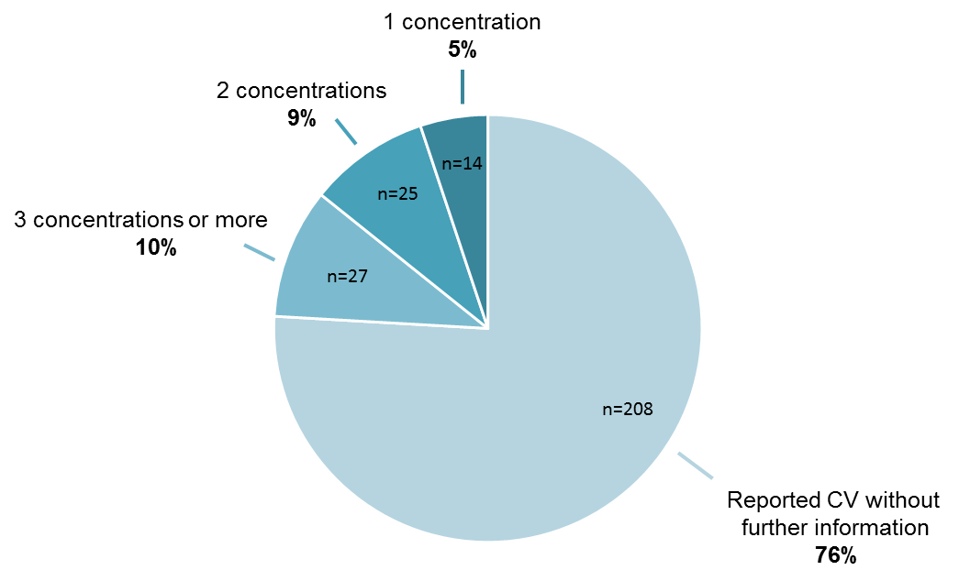
Results (V) ASSESSMENT OF THE EXTENT OF REPORTED
CHARACTERIZATIONS OF ANALYTICAL IMPRECISION
Figure 5.
Number of concentrations of analyte tested to determine imprecision of analytical method. Among the 274 papers that provided imprecision results.

Slide 13
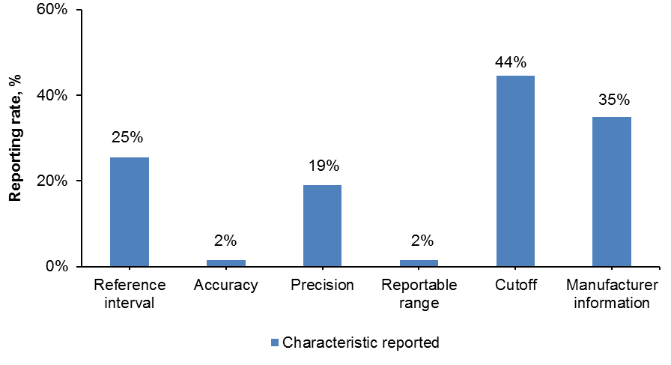
Results (VI) SPECIFIC BIOMARKERS: CARDIAC TROPONIN
Figure 6.
Reporting frequency in 63 cardiac troponin measurements.

Slide 14
Question 3
In reports of clinical trials of drugs, what analytical characteristics do you think should be reported for FDA-cleared measurement procedures for cardiac troponin? Glucose? How do they differ?
And what about Research-Use-Only tests?

Slide 15
Question 4 - Analytical performance of tests affects findings of clinical research: Examples
The Discussion describes examples, such as
  Inaccuracy of glucose measurements impairs ability to control plasma glucose
  Higher limit of quantification of a test may alter the composition of the study population and thus the apparent effectiveness of a studied treatment.
Can you suggest ways in which
  Inaccuracy (analytical bias and/or imprecision) affects findings of a clinical study of effectiveness of a drug?
  High limit of quantification of a glucose measurement procedure impairs ability to control plasma glucose?

Slide 16
Replication and Application Crisis in Clinical Research
Editorial: P.M. Bossuyt, Clin Chem 2019;65:1479-80)
The lack of information about analytical performance of tests in published clinical studies reveals a lack of awareness of the importance of methods.
Actions for clinical chemists: Ask for sufficient detail on methods when acting as a reviewer, comment on methods sections with incomplete reporting in study protocols and reports.
The Editorial ends with the words, “How one measures matters.”

