Slide 1
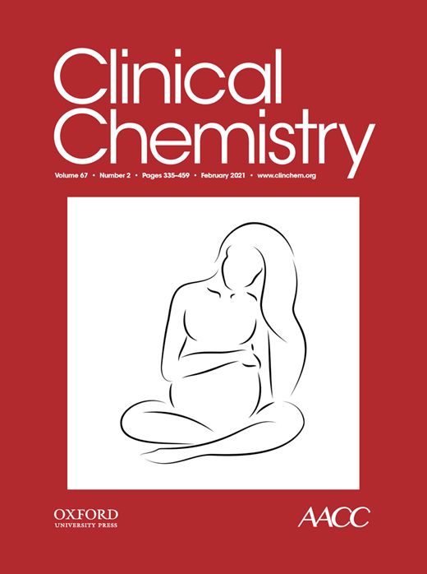
Commercial Serology Assays Predict Neutralization Activity against SARS-CoV-2
R.T. Suhandynata, M.A. Hoffman, D. Huang, J.T. Tran, M.J. Kelner, S.L. Reed, R.W. McLawhon, J.E. Voss, D. Nemazee, R.L. Fitzgerald
February 2021
https://doi.org/10.1093/clinchem/hvaa262
© Copyright 2021 by the American Association for Clinical Chemistry

Slide 2
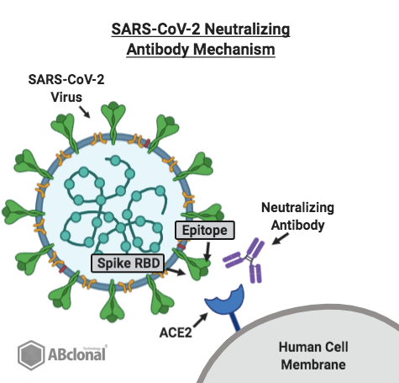
Neutralizing Antibodies (Nabs)
Prevent Viral Infection
Nabs prevent viruses from entering host cells.
  Part of the humoral immune response.
  Help protect against re-infection.
Other sources of SARS-CoV-2 Nabs.
  Convalescent plasma
  Therapeutic monoclonal antibodies.
  Vaccines
Blocks Viral
Entry into Cell
https://blog.abclonal.com/blog/featured-product-weekly-sars-cov-2-neutralizing-antibody

Slide 3
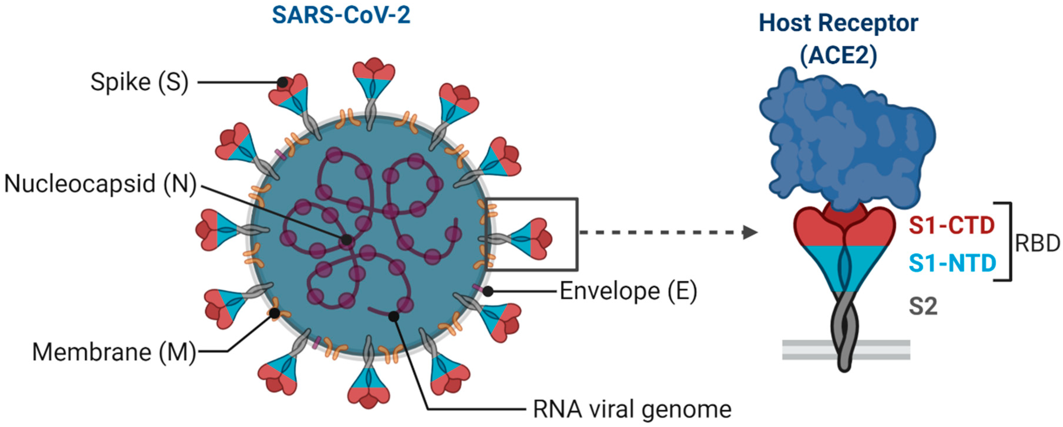
Anatomy of SARS-CoV-2
Jain, S. et al. Vaccines 2020
SARS-CoV-2 mRNA vaccines target the Spike (S) protein.
Individuals receiving mRNA vaccines will only have antibodies against the S protein.
Q?: A healthcare provider orders a SARS-CoV-2 antibody test to determine
if a vaccinated patient is developing antibodies. What aspects of the assay
should be considered?

Slide 4
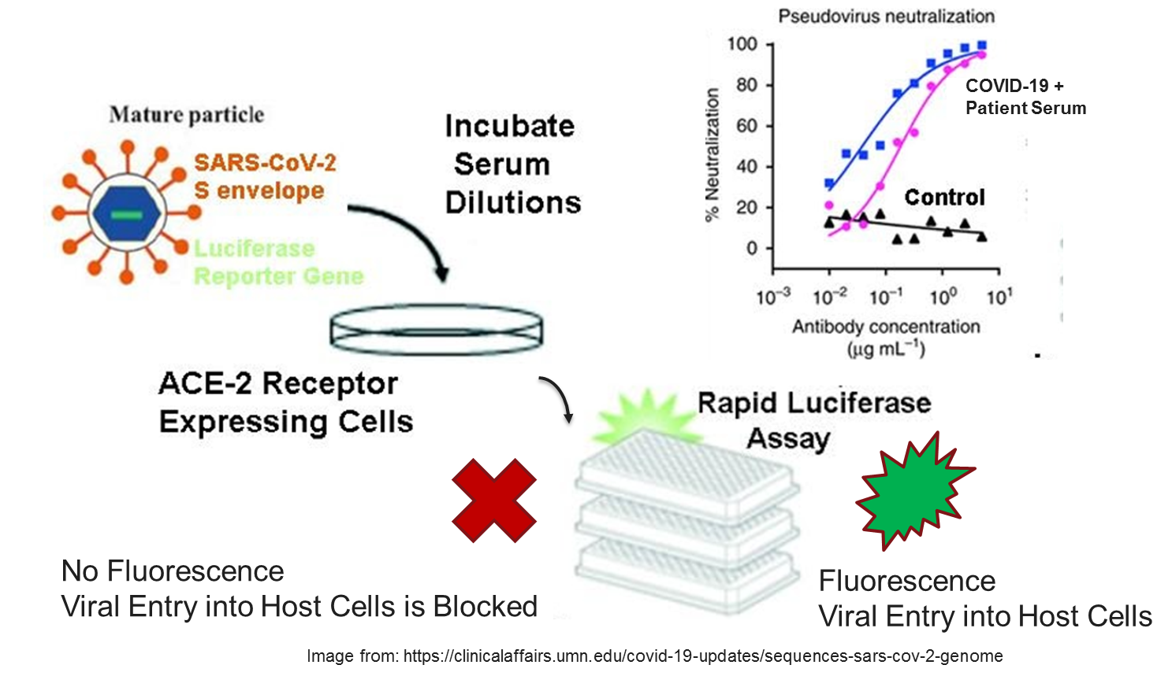
Pseudovirus (PSV) Neutralizing Antibody Assays
Measures how effectively patient serum blocks viral entry
Low-throughput and unsuitable for high-volume testing
PSV displaying SARS-CoV-2 Spike protein

Slide 5
Aim of the Study
Do commercial SARS-CoV-2 serology assays predict the presence of neutralizing antibodies?
Commercial Serology Assays:
Detect antibodies against Nucleocapsid, Spike, or a mixture.
Unknown if the antibodies are protective against SARS-CoV-2.
SARS-CoV-2 neutralization assays:
How do commercial serology assays compare?
Do commercial serology assays predict neutralizing antibodies?

Slide 6
Study design
351 plasma/serum specimens:
  164 specimens from 164 individuals with SARS-CoV-2 seropositive tests
    Screened from 9,530 SARS-CoV-2 serology tests (Diazyme Assay).
    9,366 seronegative tests had no further testing performed.
  87 specimens from SARS-CoV-2 PCR positive patients
    Obtained from 31 patients confirmed for SARS-CoV-2 by PCR.
  100 presumed SARS-CoV-2 negative specimens
    79 specimens collected in 2018.
    11 patients with other respiratory pathogens (Non-COVID corona virus etc.).
    10 healthy individuals collected in 2020.
All specimens were tested on the following serology assays
  Roche Total Ig, Abbott IgG, and a PSV neutralizing antibody assay

Slide 7
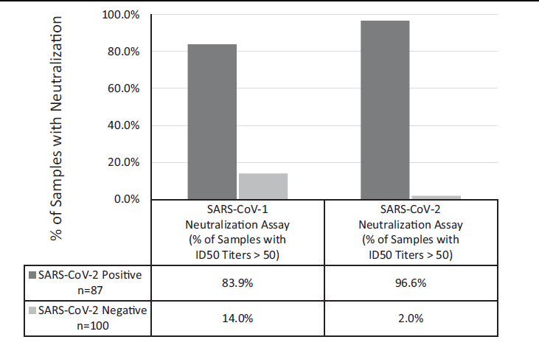

Clinical Validation of PSV Nabs Assay
Q?: What are the implications of the observed
cross-protection against SARS-CoV-1?
Figure 2. COVID-19 patients produce neutralization activity against SARS-CoV-2 and SARS-CoV-1. Percentage of specimens (N=87) from SARS-CoV-2 PCR confirmed patients (N=31, dark grey) and a SARS CoV-2 negative patient cohort (N=100 specimens from 100 individuals, light grey) that had ID50 titers >50 against SARS-CoV-2 or SARS-CoV-1.

Slide 8
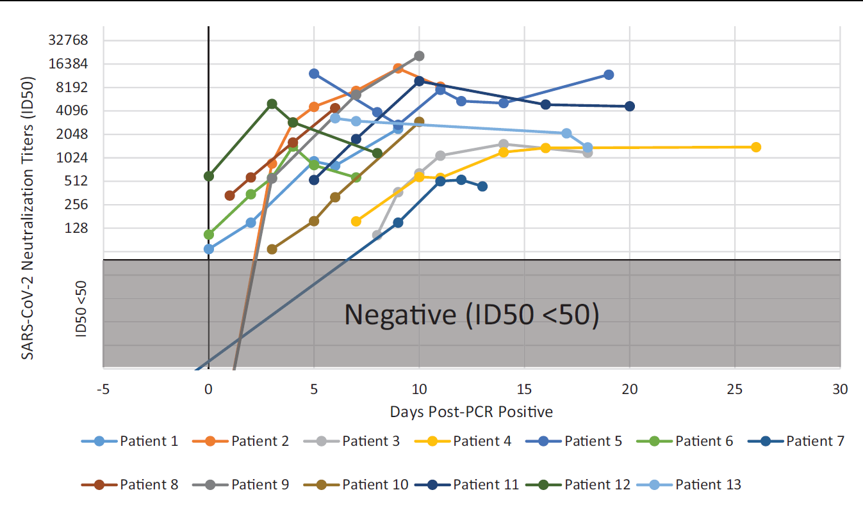
Acutely Sick COVID-19 Patients Develop Robust Nabs
Fig. 3. Longitudinal monitoring of SARS-CoV-2 neutralization titers in COVID-19 patients. The ID50 titers of 13 SARS-CoV-2 PCR confirmed patients are plotted on a semi-log scale (Y-axis) with the number of days following a positive PCR result indicated for each sample (X-axis). ID50 values of <50 are considered negative for neutralization activity and represented by the greyed-out area.
Patient 13 expired even with high levels of Nabs.
What are some possible explanations?

Slide 9
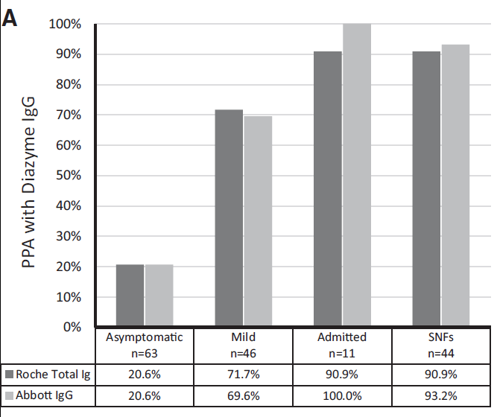
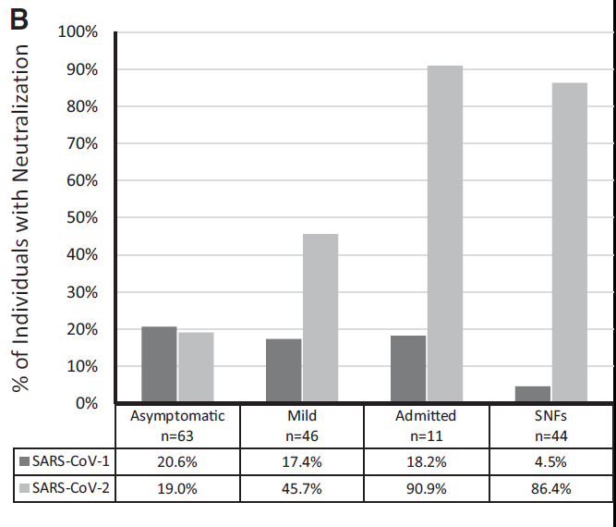
Evaluation of 9,530 Serology Tests
Fig. 4A and 4B. Interplatform agreement between serology and neutralization activity. A) The PPA between the Diazyme IgG and Roche assay and the Diazyme IgG and Abbott assays are shown for 4 different populations of individuals. B) The percentage of individuals with neutralization activity against SARS-CoV-2 or SARS-CoV-1 are shown for 4 different populations of individuals.
Q?: Why are the PPAs with the Diazyme IgG assay and the PSV assays so poor in the asymptomatic population?
Q?: How does prevalence of a disease affect the predictive values of a clinical assay?

Slide 10
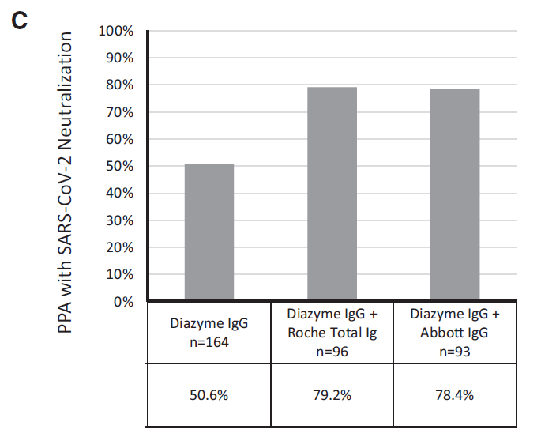

A Screen and Confirm Approach Better Predicts Nabs
For a 1% prevalence of COVID-19 the PPV is 50% using a single assay¹.
The nearly 30% increase in PPA with the PSV neutralization assay indicates a screen and confirm approach is necessary to prevent reporting false positive serology results.
The CDC recommends an orthogonal testing algorithm for testing low prevalence populations².
¹Suhandynata et al, J Appl Lab Med. 2020 5(5):908-920.
²CDC Interim Guidelines for COVID-19 Ab Testing.
Fig. 4C. The overall PPA between the Diazyme IgG assay alone and in combination with the Roche or Abbott serology platforms with SARS-CoV-2 neutralization activity are indicated for 164 seropositive individuals identified on the Diazyme IgG platform.

Slide 11
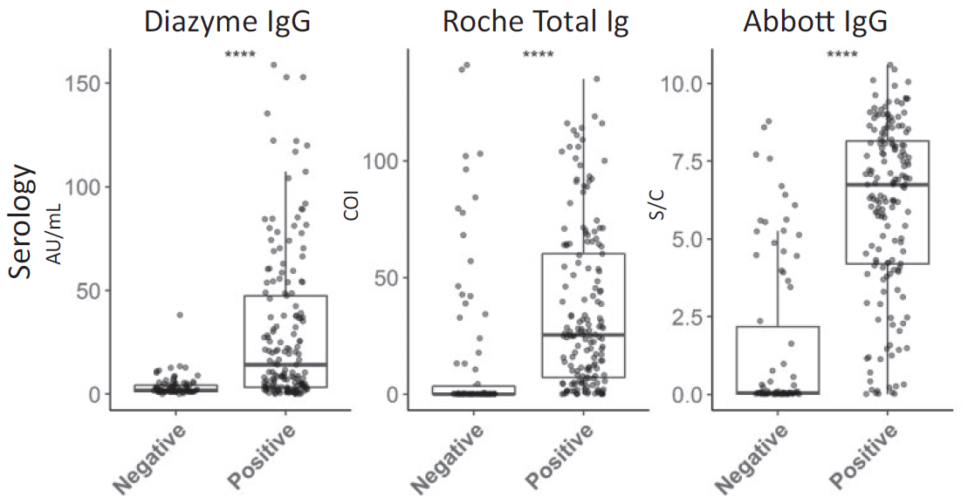
Higher cutoffs on Commercial Serology Assays Lead to Better Prediction of Nabs
Raising the assay cutoffs to the median values observed for each assay improves the prediction for Nabs.
Neutralization
Fig. 5. Distribution of commercial serology platform results in specimens negative and positive for SARS-CoV-2 neutralization activity that initially screened positive by the Diazyme IgG assay. Median AU/mL, COI, and S/C values (Y-axis) on the Diazyme IgG, Roche total Ig, and Abbott IgG platforms, respectively, are shown in boxplots (whiskers are up to but no greater than 1.5 times the IQR) for specimens without (negative) or with (positive) ID50 neutralization titers against SARS-CoV-2 (X-axis). **** indicates significant difference between positive and negative group at a p value of <0.00001 by Mann-Whitney.

Slide 12
Questions for discussion:
Should commercial SARS-CoV-2 serology assays be used to indicate immunity?
How should serology tests be utilized with the advent of prophylactic SARS-CoV-2 vaccines?

Slide 13
Discussion
Should commercial SARS-CoV-2 serology assays be used to indicate immunity?
On a population basis understanding that positive serology using a screen and confirm approach has 80% PPA with Nabs is important.
Serology tests should not be used to determine Nabs on individuals
More work needed to understand relationship of Nabs and long term immunity

Slide 14
Discussion
How should serology tests be utilized with the advent of prophylactic SARS-CoV-2 vaccines?
Currently there are no recommendations for confirming vaccination with antibody testing (generally not needed)
If indicated, use an S antibody assay to verify seroconversion following vaccination.
Commercial serology tests shouldn’t be used to evaluated the immunity of a vaccinated individual.

