Slide 1

Evaluation of Radioactivity in Patient Specimens Received in the Core Laboratory at a National Cancer Institute (NCI) Designated Cancer Center
C.G. Suciu, M. Amurao, D. Luechtefeld, A. Marko, L. Ashby, A.M. Gronowski
October 2021
https://doi.org/10.1093/clinchem/hvab135
© Copyright 2021 by the American Association for Clinical Chemistry

Slide 2
Introduction
Nuclear medicine & radiation oncology use radiopharmaceuticals for diagnostic & therapeutic purposes
~20 million nuclear medicine procedures/year in the US
Specimens from patients who received radiopharmaceuticals are often sent to clinical laboratories without radioactive labels
Residual radiation in specimens has long been assumed to be minimal, but relevant literature is sparse & outdated
This study examined the types & amounts of radiopharmaceuticals in patient specimens sent to the core laboratory & investigated the risk of radiation exposure in the laboratory
Q1: What are the most frequently used radioisotopes and radiopharmaceuticals at your hospital?

Slide 3
Radiopharmaceuticals Contain Radionuclides that Emit Particles and/or Rays
 | Particles (α and β) | Rays (γ and X-rays)
Ionizing effects | Localized tissue damage | Tissue damage inversely proportional to distance² from radiation source
Shielding | Blocked by thin materials | Highly penetrant, blocked by thick metal
Medical Uses | Antineoplastic agents | Diagnostic imaging
Exposure risk | Ingestion or skin surface contamination | Passive external exposure, ingestion, skin surface contamination

Slide 4
Radiation Safety: Terms & Definitions
Activity
Amount of ionizing radiation released by radioactive source
Exposure
Amount of radiation in the air
Absorbed dose
Measured in curies (Ci) or becquerels (Bq)
Effective Dose
Radiation risk estimate for a population of similarly-exposed individuals
Exposure = [(Activity_{source} * Γ constant * Time_{Exposure}) / Distance_{Target}²] * e^{(-μz)}
Measured in roentgens (R) or coulombs/kilogram (C/Kg)
Considered equivalent to the exposure in our study
Measured in rads or grays (Gy)
Dose_{Effective} = Dose_{Absorbed} * W_{R} * W
Measured in sievert (Sv) & roentgen equivalent man (rem)

Slide 5
Materials & Methods:
EHR Data
Large hospital & National Cancer Institute (NCI)-designated cancer center
Retrospective analysis of electronic health record & radiation oncology laboratory information system data from a 20-mo period
Identified laboratory specimens collected within 10 physical half-lives of radiopharmaceutical administration
Only evaluated structured data for radiopharmaceutical administration doses and timestamps
Modified external dose equation to estimate duration at which exposure to external γ radiation from blood specimens > 0.2 mSV

Slide 6
Estimation of External γ Ray Exposure:
Modified External Dose Equation Model Assumptions
Entire dose of radiopharmaceutical retained in circulating blood
Decay rate of radioactive activity equivalent to physical half-life
  Physical half-life represents the reduction in radioactivity over time due solely to radioactive decay
  Effective half-life represents the reduction in radioactivity over time due to radioactive decay and biological factors (biological half-life)
5mL specimen collected from a 5L blood volume
Decay only occurred between radiopharmaceutical administration & specimen collection
Specimen collected in a 0.1 cm polyethylene terephthalate (PET) vacutainer tube
Specimen in collection tubes held 1.0 or 0.1 cm from the hand
Notes:
Effective half-life (U.S. Nuclear Regulatory Commission): https://www.nrc.gov/reading-rm/basic-ref/glossary/effective-half-life.html
“The time required for the activity of a particular radioisotope deposited in a living organism, such as a human or an animal, to be reduced by 50 percent as a result of the combined action of radioactive decay and biological elimination. Effective half-life is related to, but different from, the radiological half-life and the biological half-life.”
Half-life, biological (U.S. Nuclear Regulatory Commission): https://www.nrc.gov/reading-rm/basic-ref/glossary/half-life-biological.html
“The time required for the body to eliminate one half of the material taken in by natural biological means.”
Half-life (radiological) (U.S. Nuclear Regulatory Commission): https://www.nrc.gov/reading-rm/basic-ref/glossary/half-life-radiological.html
“The time required for half the atoms of a particular radioisotope to decay into another isotope. A specific half-life is a characteristic property of each radioisotope. Measured half-lives range from millionths of a second to billions of years, depending on the stability of the nucleus. Radiological half-life is related to, but different from, the biological half-life and the effective half-life.”

Slide 7

Materials and Methods:
Radiation Exposure in the Lab
Weekly Meter Survey
Weekly Surface Wipe Tests
Personnel Exposure
Survey random patient specimens to detect radiation levels >background
19 laboratory surfaces to detect removable contamination
44 weeks
44 weeks
Wearable ring & radiation dosimeters
Worn by 18 personnel
6-mo cumulative exposure
Environmental Exposure
Badge radiation dosimeters strategically placed in the laboratory
10 locations
Q2: How many radioactive specimens are sent to your laboratory & what challenges may be encountered when collecting such data?

Slide 8
Results:
Administered Radiopharmaceuticals
Radiopharmaceuticals containing radionuclides with short half-lives were most common
Diagnostic Radiopharmaceuticals
Radionuclides | Administrations | Physical Half-life
F-18 | 4107 | 1.8 h
Ga-68 | 588 | 1.1 h
I-123 | 33 | 13.2 h
I-131 | 693 | 8.0 d
In-111 | 190 | 2.8 d
Tc-99m | 7790 | 6.0 h
Tl-201 | 43 | 3.0 d
Therapeutic Radiopharmaceuticals
Radionuclides | Administrations | Physical Half-life
I-131 | 215 | 8.0 d
Lu-177 | 243 | 6.6 d
Ra-223 | 94 | 11.4 d
Sm-153 | 3 | 1.9 d
Y-90 | 1 | 2.8 d
Table 1 (modified). Radionuclides associated with radiopharmaceuticals administered at WU/BJH during the 20-month study period.

Slide 9
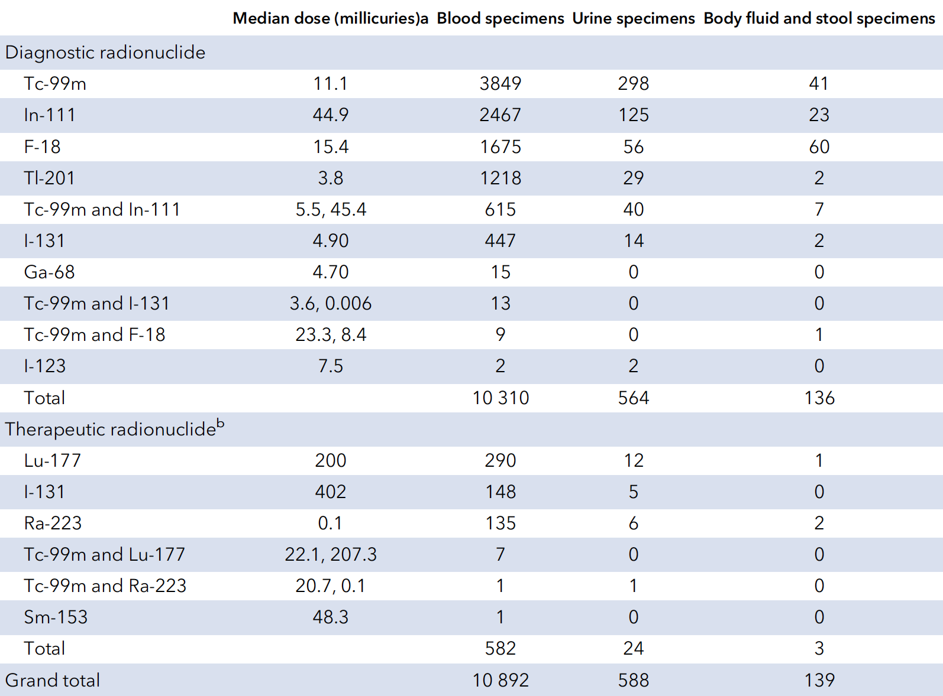
Results:
Potentially Radioactive Specimens Processed by the Lab
Blood specimens from patients receiving low-dose diagnostic radiopharmaceuticals were most common
Urine specimens from patients receiving high-dose therapeutic radiopharmaceuticals were uncommon
Table 2 (modified). Number of specimens collected within 5 physical half-lives of radiopharmaceutical administration (at any BJC Healthcare network facility) for testing in the BJH core laboratory during the 20-month study period.

Slide 10
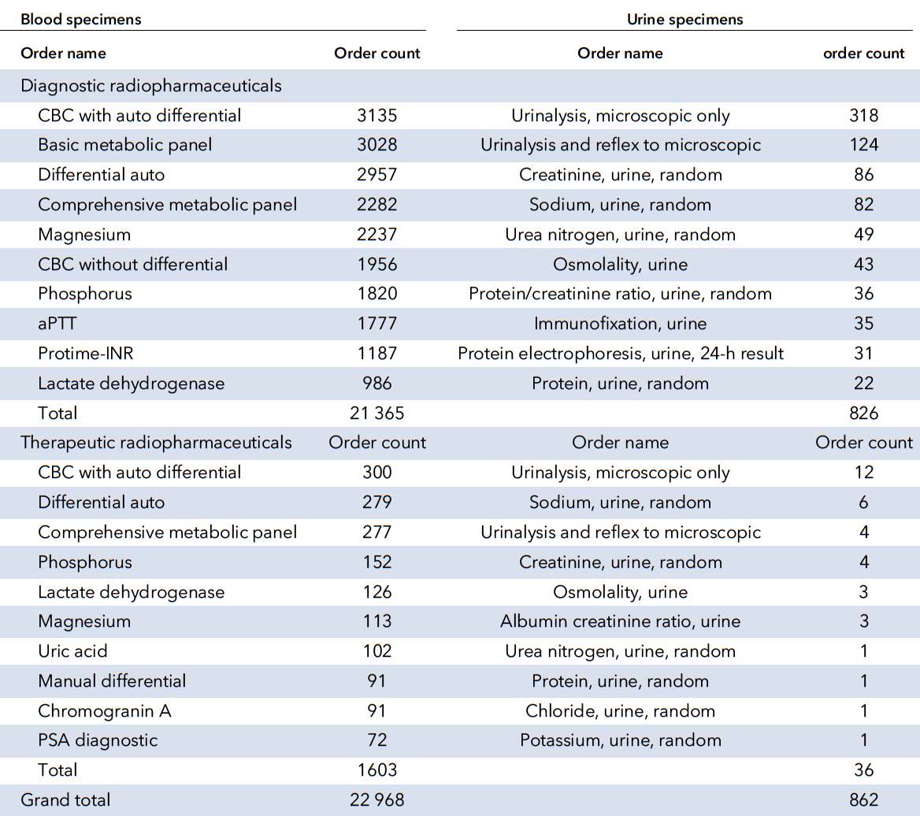
Results:
Commonly Associated Lab Tests
CBC, CMP, electrolyte, and coagulation testing were most common
Q3: What are ways to prevent & assess potential radiation exposure from clinical samples?
Table 3 (modified). Top 10 ordered tests received in the laboratory within 5 half-lives of radioisotope administration during the 20-month study period.

Slide 11
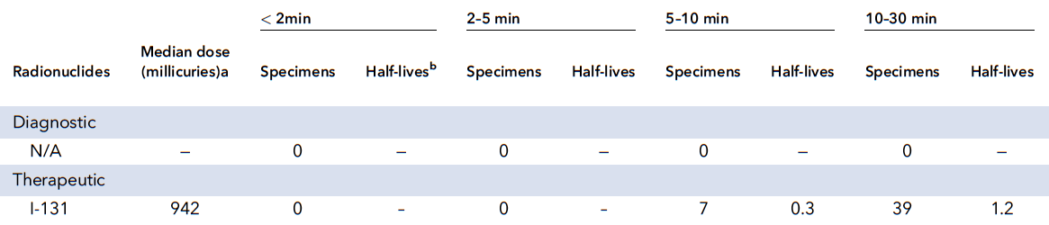
Results:
Potential Exposure from Blood Specimens at 1.0 cm
Specimens from 2 patients who received high-dose radiopharmaceuticals as part of a cancer therapy clinical trial were estimated to deliver a 0.02 mSv effective dose of γ radiation
Table 4 (modified). Number of blood specimens received during the 20-month study period that could deliver a 0.02 mSv effective dose of gamma radiation in <2 min, 2–5 min, 5–10 min, 10–30 min, if held at a distance of 1.0 cm.

Slide 12
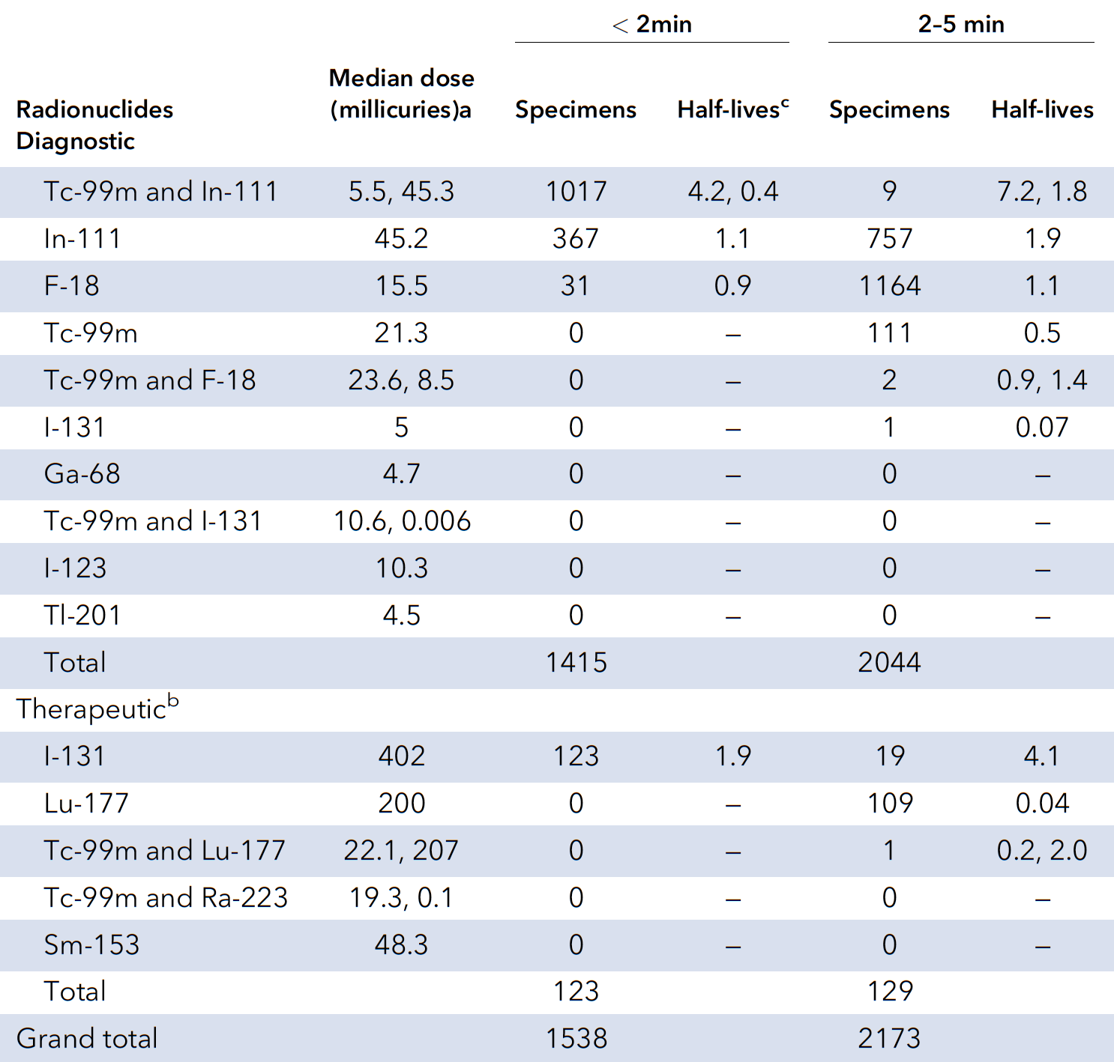
Results:
Potential Exposure from Blood Specimens at 0.1 cm
3,711 specimens cannot be ruled out as being capable of delivering a 0.02 mSV effective dose of γ radiation in <5 min
Table 5 (modified). Number of blood specimens received during the 20-month study period that could deliver a 0.02 mSv effective dose of gamma radiation in <2 min, 2–5min, if held at a distance of 0.1 cm.

Slide 13
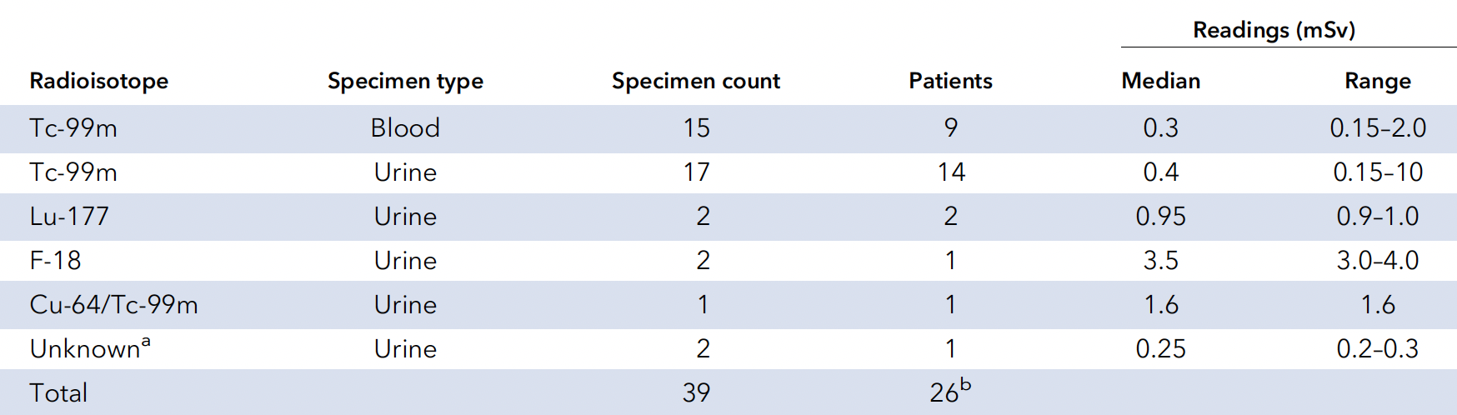
Results:
Surveys of Random Clinical Specimens
*
Specimens with radiation intensity >background were identified in 41% (18/44) of weekly surveys using GM survey meter
  None had radioactive labels
  Maximum reading of 10.0 mR/hr at 1 cm from a urine jug
  Median of 4.0 elapsed physical half-lives between radiopharmaceutical administration and dosimeter reading for the 28 specimens with clinical data
Table 6 (modified). Radioactive specimens identified using manual survey meter during 44-week study period.
Notes:
*

Slide 14
Results:
Radiation Exposure in the Lab
Weekly wipe testing of 19 laboratory surfaces over a 10-month period:
  >850 measurements did not identify any contamination above the institutional cutoff
  These tests can alert the lab to spills associated with radioisotopes with long physical half-lives
Six-month cumulative exposure of 18 personnel & 10 strategically placed locations in the laboratory:
  All readings were < minimum reporting capabilities of the dosimeters for γ rays

Slide 15
Study Limitations
Under-estimation of specimen quantities
  Missed administration data from clinical note free-text & radiation oncology LIS’s at other hospitals
  Reduced specimen quantities due to COVID-19 pandemic
Over-estimation of residual blood specimen radioactivity
  Published effective half-life data not available for all radiopharmaceuticals
  Did not evaluate specimen transport times
Did not evaluate residual radiation from urine, stool, or body fluid specimens

Slide 16
Recommendations for NCI Laboratories
Provide radiation safety training - including how to handle major spills
Receive notice from radiation safety, nuclear medicine, & radiation oncology when patients are administered high-dose radioactivity
Develop protocols for labelling & transport of specimens with significant radioactivity
Develop protocols for tracking receipt, processing, & disposal of specimens from patients who received large doses of radiopharmaceuticals
Use universal precautions at all times
Assess cumulative exposure to personnel & instruments with dosimeters
Assess potential environmental contamination with periodic wipe testing
Collect specimens prior to radiopharmaceutical administration when possible

Slide 17
Conclusions
If radiation safety guidelines are followed, laboratory personnel are unlikely to be exposed to external γ rays that exceed the NRC’s radiation dose limits
When handling radioactive materials:
  Wear gloves and other protective materials
  Maximize distance from the radioactive source
  Minimize exposure time

