Slide 1

Clonotypic Features of Rearranged Immunoglobulin Genes Yield Personalized Biomarkers for Minimal Residual Disease Monitoring in Multiple Myeloma
P. Langerhorst, A.B. Brinkman, M.M. VanDuijn, H.J.C.T. Wessels, P.J.T.A. Groenen, I. Joosten, A.J. van Gool, J. Gloerich, B. Scheijen, J.F.M. Jacobs
June 2021
https://doi.org/10.1093/clinchem/hvab017
© Copyright 2021 by the American Association for Clinical Chemistry

Slide 2
Introduction
Improved treatment strategies for Multiple Myeloma have led to a clinical need for minimal residual disease (MRD)-evaluation
  Successful bone marrow based MRD methods have been developed
  However prone to sample-bias and invasive
  Blood based MRD-evaluation is preferred alternative
MRD by LC-MS/MS based on clonotypic peptides (MS MRD blood test)
  M-protein consists of a constant and variable region
  Peptides specific to the M-protein from the variable region are called clonotypic peptides
  These clonotypic peptides in the blood provide a surrogate for the M-protein concentration
Question: Does MRD-evaluation on bone marrow and blood provide complementary information?
Munshi et al. Blood Adv 2020; 4:5988-5999
Zajec et al. Clin Chem 2020; 66:421-433

Slide 3
Justification of study
To assess applicability of the MS-MRD blood test in multiple myeloma (MM) patients the following requirements should be met:
  A unique V(D)J-gene rearrangement can be identified in all patients
  These unique rearrangements result in clonotypic peptides
  These clonotypic peptides are MS-compatible
  The sequence of the unique rearranged region must remain stable during disease progression

Slide 4
Materials and Methods
Identification of clonal fingerprint and clonotypic peptides from the RNA-seq data of 609 patients diagnosed with MM in the CoMMpass database (see slide 6)
Determine the stability of clonal Ig fingerprint during MM disease progression
  RNA-seq data from both primary and relapsed tumor available
Questions: How is a ‘clonotypic peptide’ defined in this study? Does this definition guarantee the peptide is not secreted by normal plasma cells?

Slide 5
Materials and Methods
Validation of the algorithm to identify clonotypic peptides from RNA-seq data in MM cell lines
  Prediction of clonotypic peptides for three MM cell lines (RPMI8226, MM1.S and U266) based on RNA-Seq data
  Enrich M-proteins from culture medium
  Develop targeted LC-MS/MS assays for the clonotypic peptides
Questions: In this study, RNA-seq data was used. Can you use whole-exome or whole-genome sequencing data as well? What are the benefits of using either?

Slide 6
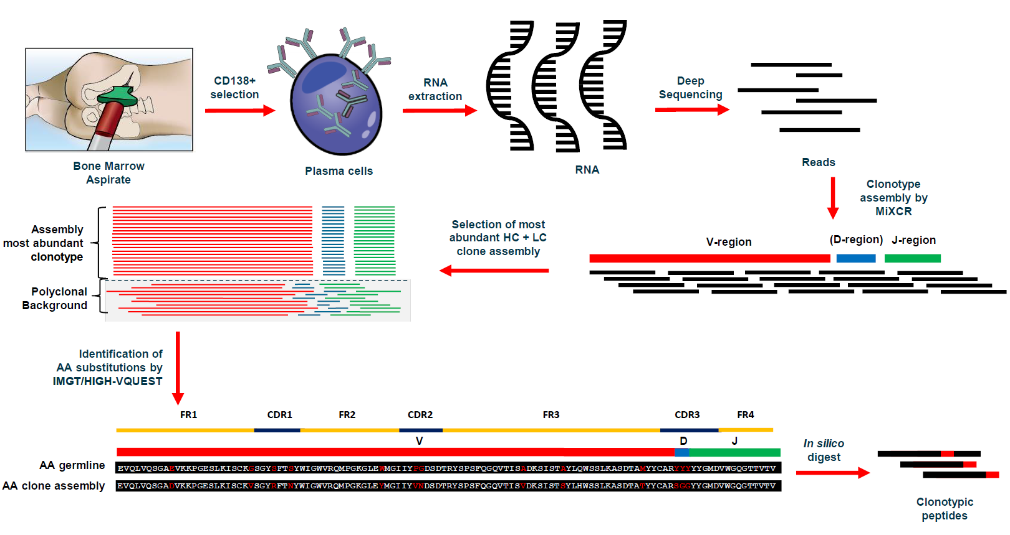
Schematic representation of the clonotypic peptide selection pipeline of the M-protein

Slide 7
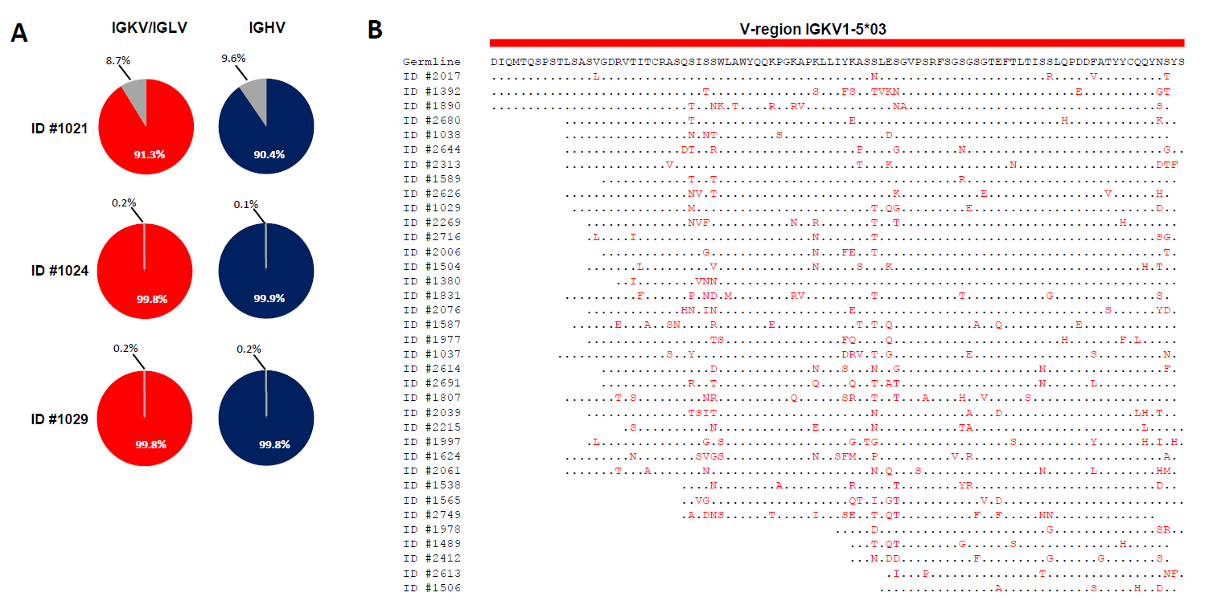
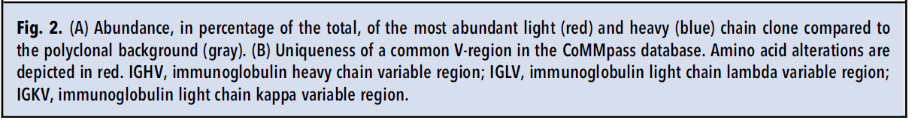
Identified clonal fingerprint in MM patients
based on RNA-seq data
MM clone easily distinguishable from polyclonal background due to difference in copy number
The clonal fingerprint is unique for each patient, even in the most common V-region

Slide 8
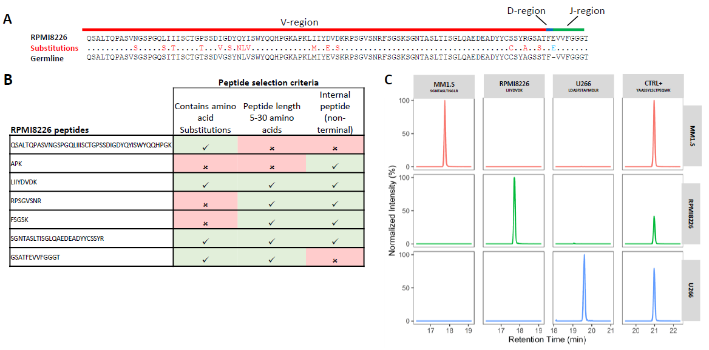
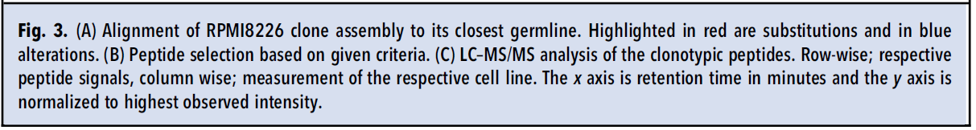
Validation of the algorithm to determine clonotypic peptides from RNA-seq data
Based on RNA-seq data clonotypic peptides could be selected
These clonotypic peptides were measurable in the secreted M-proteins of MM cell lines
Validation of the algorithm to select clonotypic peptides from RNA-seq data

Slide 9
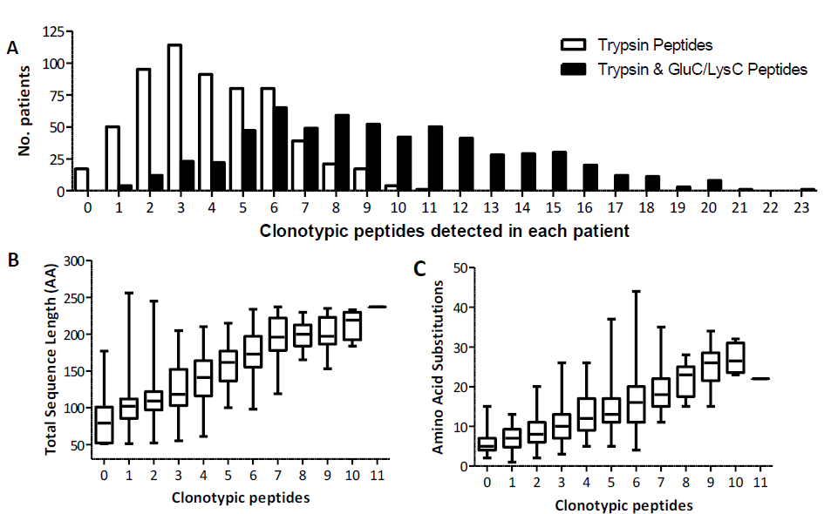
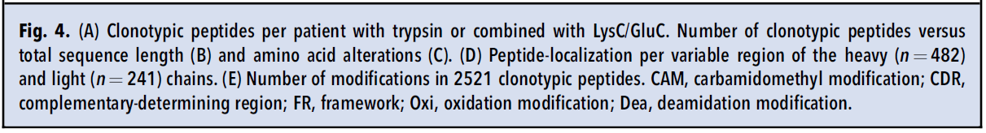
Clonotypic peptides identified and their characteristics
In 97% of the patients, clonotypic peptides were identified with an in silico tryptic digest.
There was a 100% success rate when other proteases were used (GluC and LysC)
The amount of clonotypic peptides identified in each patient was correlated with the V(D)J-gene sequence length and the number of amino acid substitutions

Slide 10
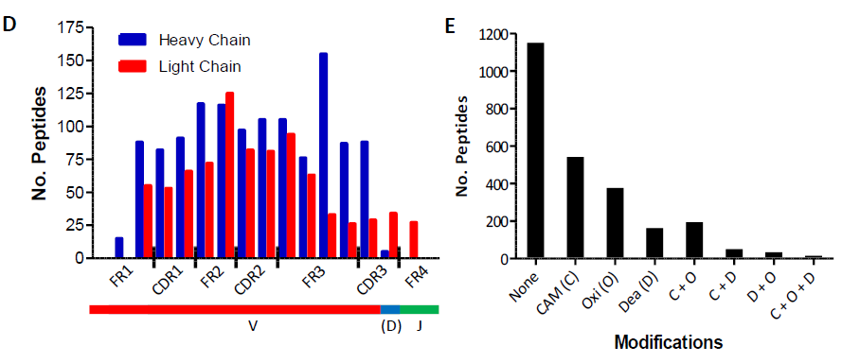
Clonotypic peptides identified and their characteristics
(continued)
Clonotypic peptides could be identified across the entire heavy and light V(D)J-gene
Clonotypic peptides also present in Framework region, not solely in the mutational hotspots (CDR)
Out of the 2521 identified clonotypic peptides 1150 (46%) contained no modification-prone amino acids and 1079 (43%) contained 1 modification-prone amino acid.
Therefore, majority of the clonotypic peptides are MS compatible

Slide 11
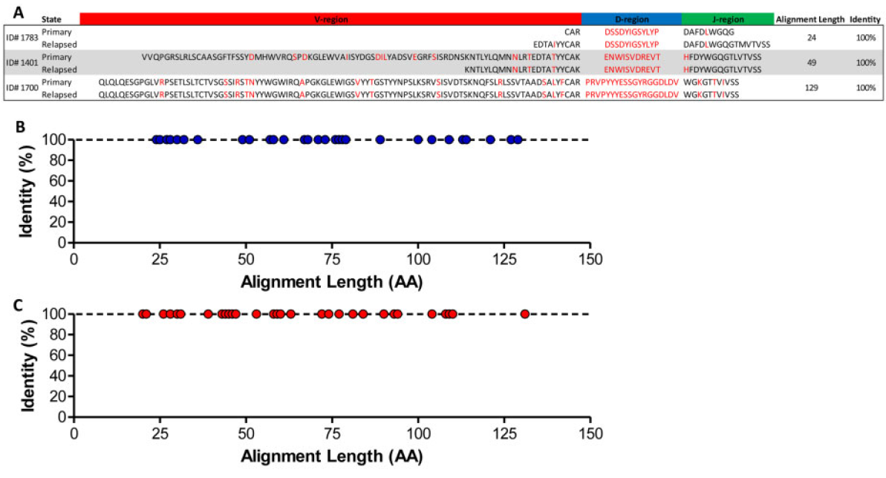
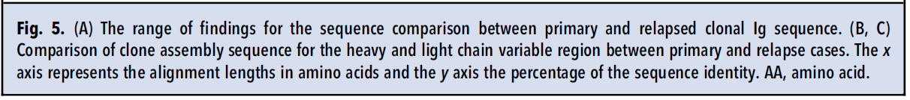
Stability of clonotypic peptides during MM progression
BLAST analysis of primary and relapse clonal fingerprint revealed 100% sequence identity in relapsed samples compared to primary tumors.
100% stability was shown to occur in both the Ig-heavy and light chain.
Question: How can this be explained in the context of MM clonal evolution?

Slide 12
Results/Summary
  A large-scale unbiased analysis of the CoMMpass database, the most comprehensive sequencing database of MM patients, was conducted to investigate applicability of clonotypic peptide MS-assays to monitor MRD in MM patients.
  A unique clonal fingerprint belonging to the MM clone could be identified in all 609 included patients based on RNA-seq data
  In 100% of the MM patients ≥1 M-protein-specific clonotypic peptides could be identified.
  The sequence of the rearranged V(D)J-gene remained stable during disease progression. The M-protein-specific clonotypic peptides are thus cancer-specific and stable targets for disease monitoring.
Question: What further hurdles must be addressed to implement MS-MRD blood-evaluation in MM patients?

