Slide 1

Jagged Ends of Urinary Cell-Free DNA: Characterization and Feasibility Assessment in Bladder Cancer Detection
Z. Zhou, S.H. Cheng, S.C. Ding, M.M.S. Heung, T. Xie, T.H.T. Cheng, W.K.J. Lam, W. Peng, J.Y.C. Teoh, P.K.F. Chiu, C.-F. Ng, P. Jiang, K.C.A. Chan, R.W.K. Chiu, Y.M.D. Lo
April 2021
https://doi.org/10.1093/clinchem/hvaa325
© Copyright 2021 by the American Association for Clinical Chemistry

Slide 2
Introduction
Cell-free DNA shed from various tissues are nonrandomly fragmented.
  Size profile of plasma DNA exhibits a major peak at 166 bp.
  Urinary DNA is much more fragmented, lacking the 166-bp peak.
Plasma DNA molecules often carry single-stranded protruding ends, referred to as jagged ends.
  Plasma DNA jaggedness varied across different sizes.
  Characteristics of plasma DNA jagged ends are related to the tissue of origin.
  DNA nucleases such as DNASE1 and DNASE1L3 have been shown to affect plasma DNA jaggedness in a mouse model.
Lo ﻿et al., Science ﻿2021; 372: eaaw3616
Jiang et al. Genome Res 2020; 30: 1144-53

Slide 3
Questions
Do urinary cell-free DNA molecules bear jagged ends?
If present, can the urinary DNA jagged ends could be used as a biomarker for urologic cancer?

Slide 4
Materials and Methods
39 healthy control subjects and 46 patients with cancer
  39 cancer-free subjects with hematuria (Controls)
  19 patients with low grade non–muscle-invasive bladder cancer (NMIBC LG)
  18 patients with high grade non–muscle-invasive bladder cancer (NMIBC HG)
  9 patients with muscle-invasive bladder cancer (MIBC)
Jagged end analysis by sequencing (Jag-seq)

Slide 5
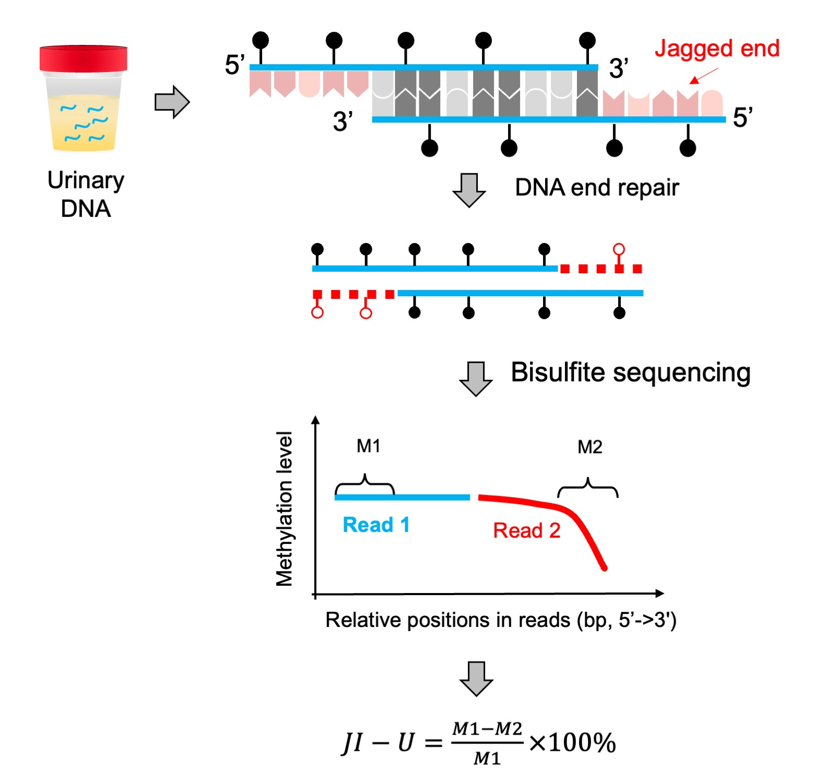
Jag-seq of urinary DNA
Figure 1. Urinary cfDNA were first end-repaired using unmethylated dNTPs and thereafter were subjected to bisulfite paired-end sequencing. The methylation reduction between the DNA 5’ and 3’ ends allowed for deducing the jaggedness in terms of jagged index﻿–unmethylated (JI-U).

Slide 6
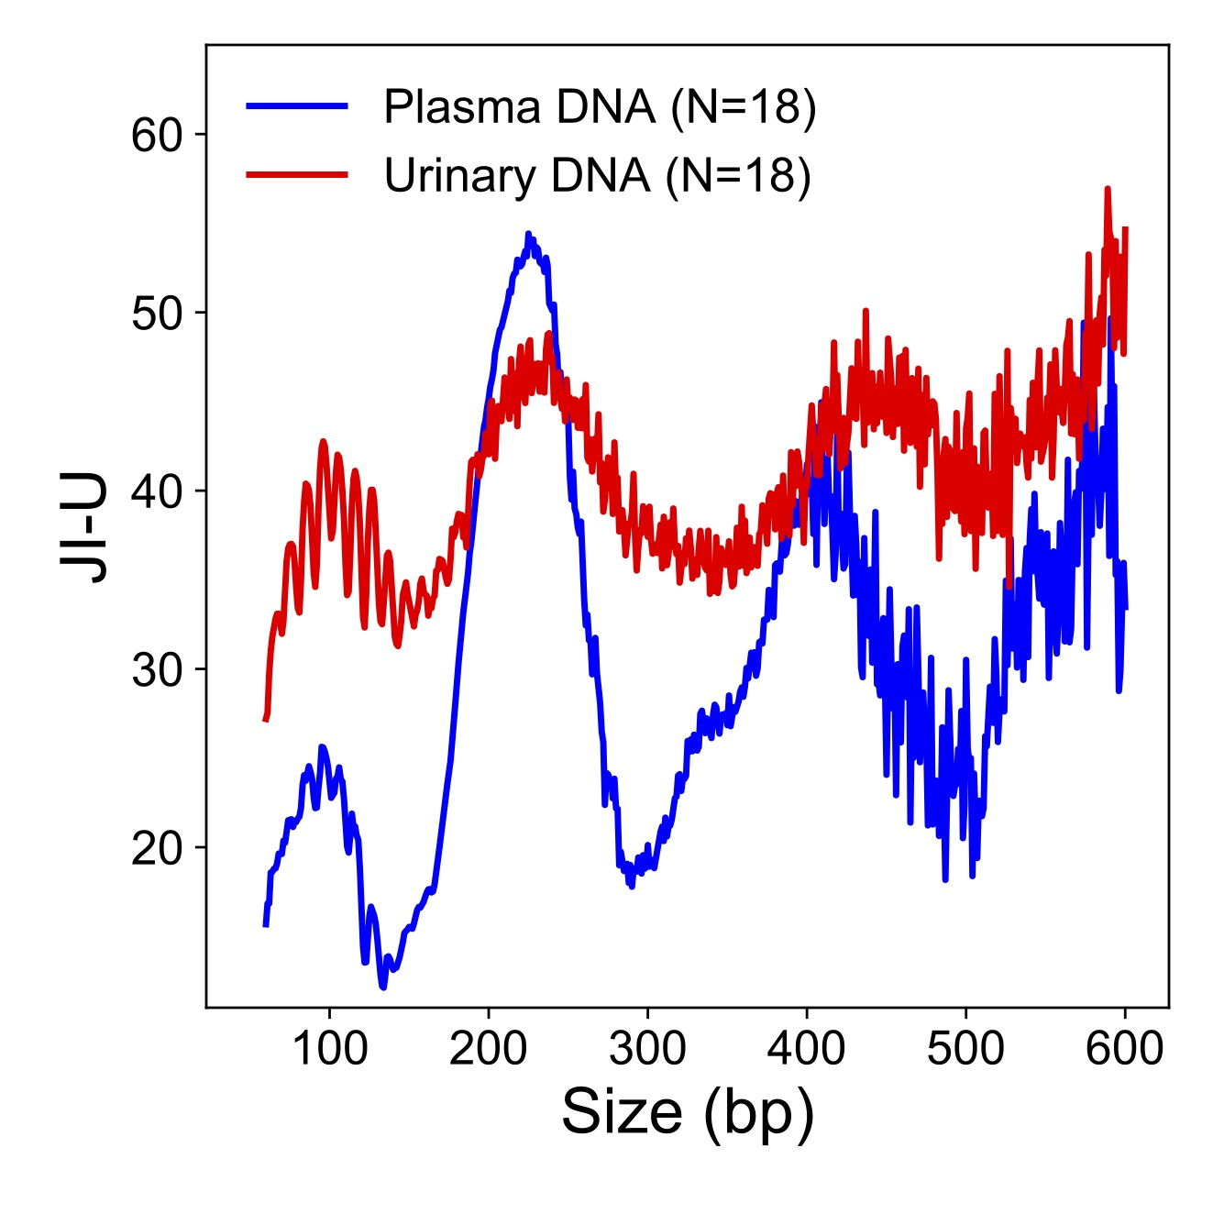
Jaggedness between plasma and urinary DNA
Figure 2. The JI-U values of urinary DNA across each size were nearly all higher than those of plasma DNA. Furthermore, the JI-U profile of urinary DNA displayed weaker oscillating major peaks and a series of stronger oscillating 10-bp minor peaks for small molecules in comparison with plasma DNA.

Slide 7
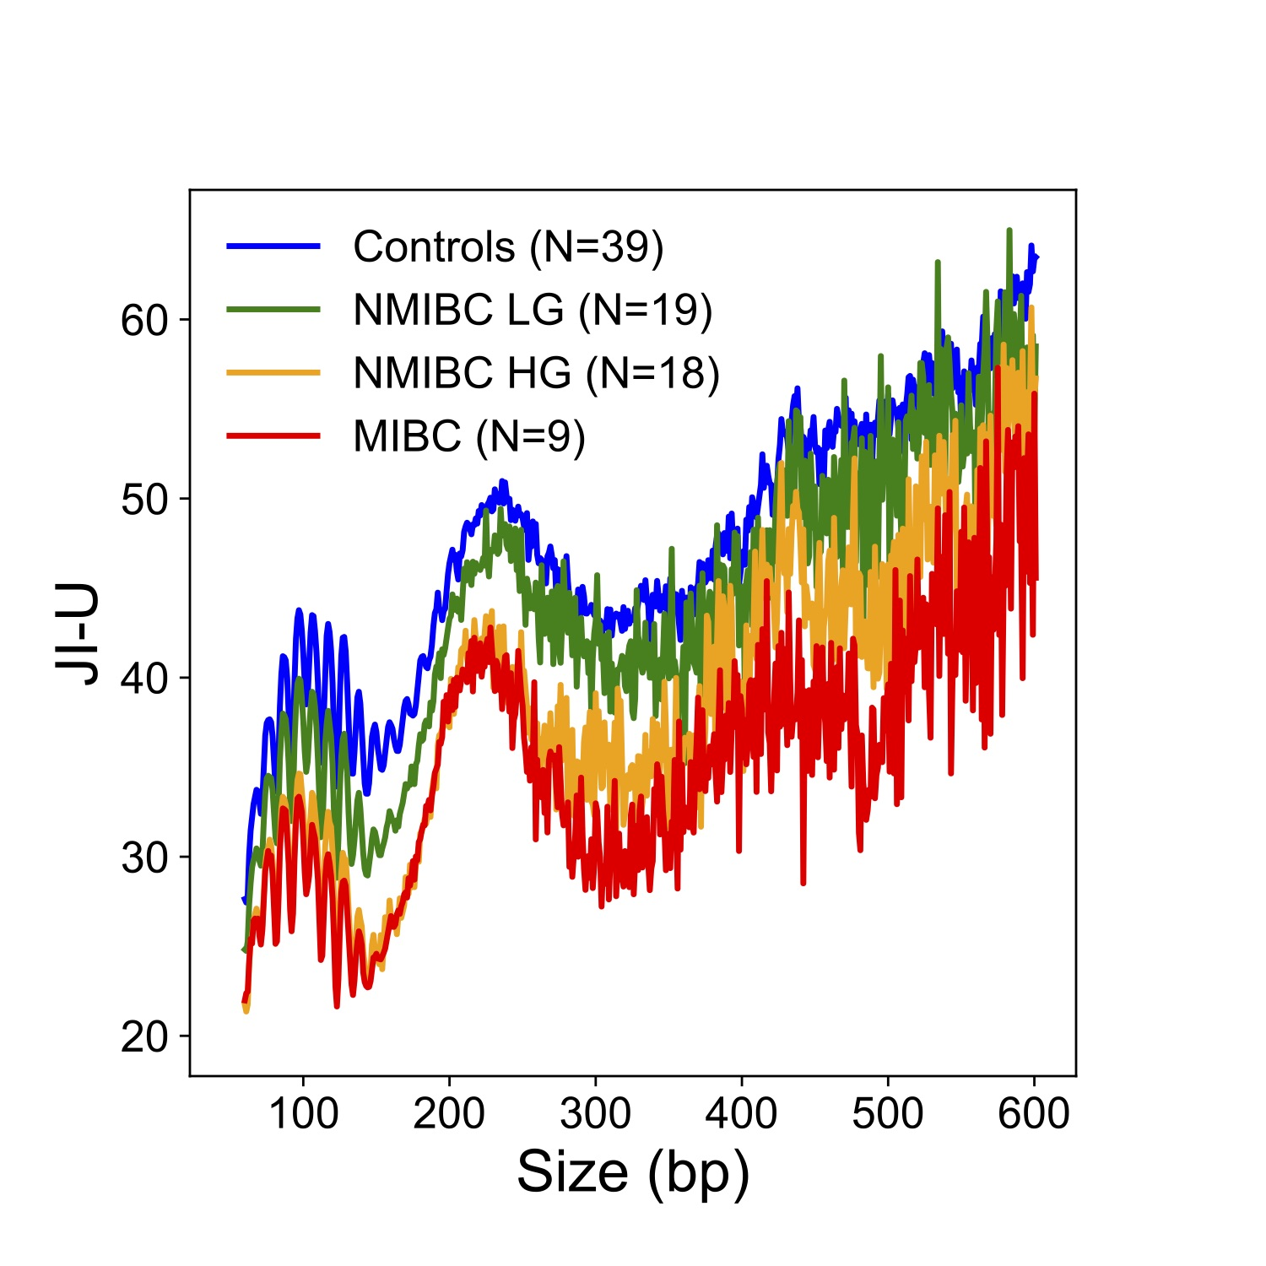
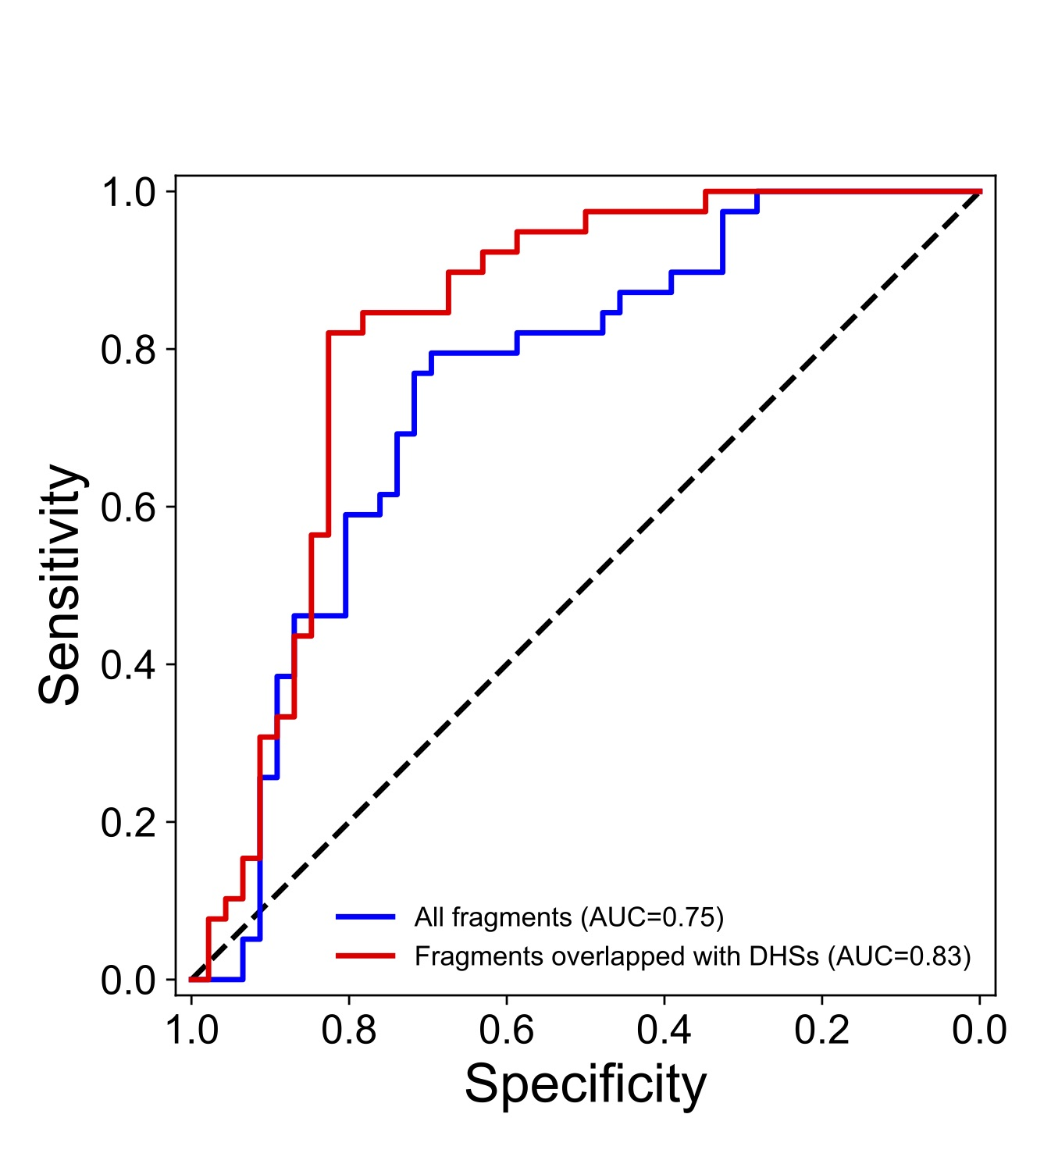
Jaggedness in urinary DNA of patients with bladder cancer
Figure 3. JI-U values varied across different sizes in different types of samples. Intriguingly, the analysis of jaggedness in urinary cfDNA with a size range of 130–160 bp, overlapping DNase I hypersensitivity sites, significantly improved the diagnostic performance (P = 0.02; DeLong test).

Slide 8
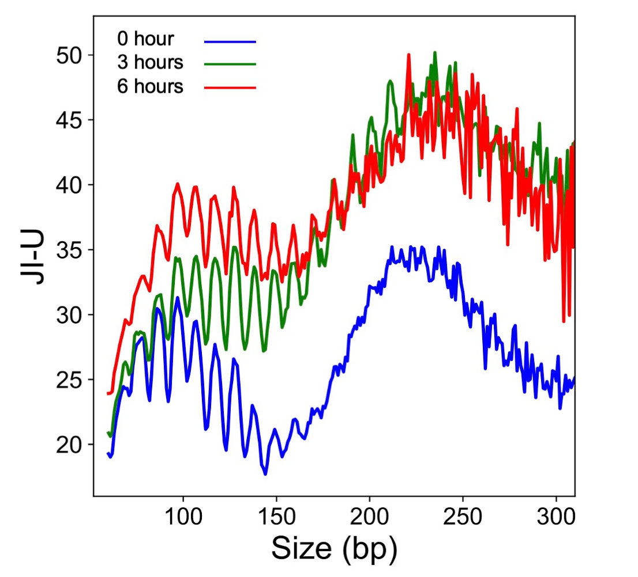
Jaggedness increased during in vitro incubations
Figure 4. JI-U values of urinary DNA samples subjected to in vitro incubations for 3 h and 6 h.

Slide 9
Conclusions
Urinary DNA frequently carried jagged ends
  ﻿Urinary DNA JI-U values were higher than plasma.
  In contrast to plasma DNA, JI-U values showed ﻿strongly oscillating minor peaks (~10-bp periodicities), with a series of weakly oscillating major peaks (~165-bp periodicities).
Bladder tumor-derived urinary DNA had less jaggedness
  ﻿JI-U values were significantly lower in patients with bladder cancer.
  ﻿Selective analysis of fragments from DNase I hypersensitivity sites (DHSs) ﻿enhanced diagnostic performance for bladder cancer detection (AUC: 0.83), suggesting that urinary DNA jagged ends might serve as a potential biomarker for bladder cancer.
Urinary DNA degradation and jagged ends
  JI-U values increased after 3-h in vitro incubation.

Slide 10
Discussions
Why does urinary DNA show increased jaggedness when compared with plasma DNA?

Slide 11
Our group previously demonstrated that the knockout of the Dnase1 gene in mice would result in a reduction of jaggedness in plasma DNA (Jiang et al. Genome Res 2020; 30: 1144-53).
DNASE1 might be one of the enzymes responsible for generating jagged ends.
DNASE1 activity in urine was dramatically higher compared with other bodily fluids.
Thus, we suspected that the differential presence of DNASE1 activity might be one of the factors contributing to such a difference in jaggedness between urinary and plasma DNA.

Slide 12
Why does urinary DNA in patients with bladder cancer show lower jaggedness when compared with healthy subjects?

Slide 13
The bladder tumor-derived DNA molecules were directly released into the urine, whereas other DNA molecules such as kidney-derived DNA and transrenal DNA molecules needed to flow through the urinary tract, before reaching the bladder. Therefore, bladder tumor-derived DNA might undergo less degradation than other DNA molecules originating from the upper urinary system or from the transrenal route.
The hypothesis was consistent with the fact that the jaggedness of urinary DNA further increased after 3-h in vitro incubation at 37 °C.

Slide 14

Bladder cancer represents a major health problem in Western populations.
Several FDA-approved molecular tests, including BTA stat, BTA TRAK, NMP22 and UroVysion tests, do not show sufficient sensitivity and specificity.
The identification of jagged ends in urinary DNA redefines fragmentomics, as a modern and minimally invasive source of cancer markers for patients’ diagnosis and monitoring.
The large-scale clinical evaluation could unveil their biomarker strength.

