Slide 1
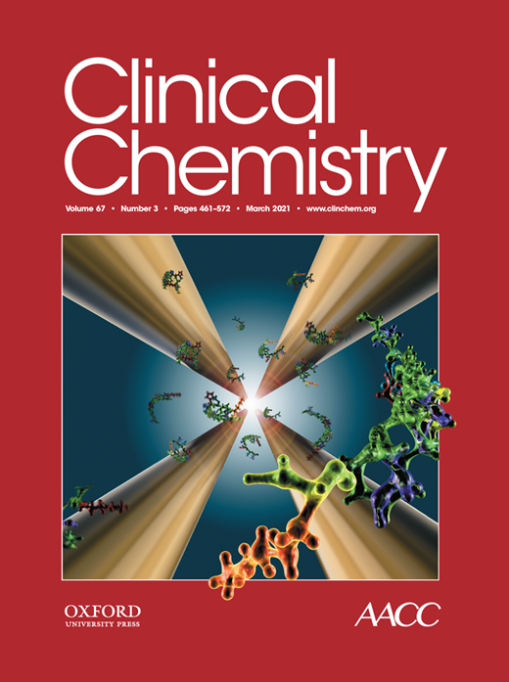
Circular RNA Sequencing of Maternal Platelets: A Novel Tool for the Identification of Pregnancy-Specific Biomarkers
C.B. Oudejans, V. Manders, A. Visser, R. Keijser, N. Min, A. Poutsma, J. Mulders, T. Van den Berkmortel, D. Wigman, B. Blanken, A. Jongejan, E. Pajkrt, M. de Boer, E.A. Sistermans, D. Sie, M.G. Best, T. Wurdinger, G. Afink
March 2021
https://doi.org/10.1093/clinchem/hvaa249
© Copyright 2021 by the American Association for Clinical Chemistry

Slide 2
Introduction
In the first trimester of pregnancy, the maternal platelet is directly involved in a positive feedback mechanism that facilitates invasion of the extravillous trophoblast into the maternal spiral arteries.
Dysfunctional trophoblast invasion with defective deep invasion is primordial in the etioloy of the ‘great obstetrical syndromes’.
Study question: Which platelet molecules, if any, are involved in this process and are these pregnancy-specific?
This proof-of-concept study, using transcriptome analysis of circular RNA (circRNA) following RNA sequencing of maternal platelets, tested whether pregnancy-specific circRNA markers could be identified in the first trimester of normal pregnancies.

Slide 3
Materials and Methods
STUDY POPULATION
The Noninvasive Prenatal Testing by RNA Sequencing (NIPTeR) study is a prospective multicenter study (NL48929.029.1). Participants were women attending the prenatal units of one of 3 hospitals (VU University Medical Center, Academic Medical Center, and OLVG Oost) in the greater Amsterdam region in the Netherlands. Inclusion criteria were an intact intrauterine pregnancy, confirmed by ultrasound within the 2 weeks before the blood sample was drawn, and gestational age between 9 + 0 and 13 + 6 weeks.

Slide 4
Materials and Methods, continued
SAMPLE PROCESSING
EDTA blood (4 x 6 mL) was stored at 4ºC and processed within 6h after collection using a triple-centrifugation step to obtain both plasma and platelet fractions from the same blood sample. After centrifugation for 20 min at 120g and 4ºC, platelet-rich plasma was collected and subjected to a second centrifugation step for 20 min at 360g and 4ºC. The supernatant plasma was carefully removed without disturbing the platelet pellet. The platelet pellet was resuspended in 120mL RNAlaterTM (AM7020; Thermo Fisher Scientific) and, following overnight storage at 4ºC, stored in a -80ºC freezer.
RNA ISOLATION
Total RNA was isolated from platelets using the QIAsymphony SP robot (Qiagen), according to the manufacturer’s instructions, with the exception that an on-column DNase step was included. For platelet RNA isolation, the “miRNA CT 400 V8” protocol was used.

Slide 5
Materials and Methods, continued
COMPLIMENTARY DNA LIBRARY CONSTRUCTION
Libraries of complimentary DNA (cDNA) were generated using the SMARTer Stranded Total RNA-Seq Kit (pico input mammalian, version 1 [cat.no. 635007], TakaraBio), according to the manufacturer’s instructions, except that the reverse primer was replaced with an N6-oligo primer lacking the oligo-dT primer. RNA input was 1 ng. RNA denaturation time for platelet samples was RNA Integrity Number value dependent (Agilent RNA 6000 Pico Kit). Final PCR amplification was done for 16 cycles. Ribosomal and mitochondrial cDNA was removed using ZapR treatment with R-probes. Purification was done with Agencourt AMPure XP beads (A63881; Beckman Coulter). Following bioanalyzer profiling, cDNA libraries were pooled in equimolar amounts (5 nm in 60 mL).

Slide 6
Materials and Methods, continued
RNA SEQUENCING
High-throughput sequencing (paired end) was performed on the HiSeq 4000 (Illumina) (2 x150 bp) using TruSeq chemistry (version 4) with 12 samples (dual index) per lane (12 plex). Index combinations were cho- sen according to the Illumina recommendations. PhiX was spiked at 5%.
CIRCRNA ANALYSIS
For circRNA analysis, unmapped sequences were retrieved from Hisat2-output (.sam files) using awk by selecting reads with sequence alignment map flags 73, 69, and 77 in read 1 and 133, 137, and 141 in read 2.
Differential transcript expression analysis of circRNAs, as predicted by Accurate CircRNA Finder Suite, CircRNA Identifier (version 2), and Known and Novel Isoform Explorer, was done using thromboSeq.R with variation of multiple settings.

Slide 7
Materials and Methods, continued
Question: Which quality controls should be applied to assure that the approach used is solid and valid?

Slide 8
Materials and Methods, continued
Quality controls that could be applied to assure that the approach used is solid and valid
(a) De novo circRNA identification using the novel platelet-specific Plt-circR4 as a positive control (Figures 1 and 2),
(b) Complete segregation of groups (pregnant vs nonpregnant) after heat map–dendrogram clustering (Figure 3),
(c) Identification of pregnancy-specific circRNA markers at a false discovery rate <0.05, and
(d) Confirmation of differentially expressed circRNA markers with a false discovery rate <0.05 by an independent method, i.e., reverse transcription–quantitative PCR.

Slide 12
Results
Of the differentially expressed circRNAs with P values <0.05, 41 circRNAs were upregulated (logFC >2), and 52 circRNAs were downregulated (logFC less than -2) in first-trimester platelet RNA.
Of these, nuclear receptor-interacting protein1 circRNA covering exons 2 and 3 of the 5’-untranslated region was pregnancy specific with upregulation in first-trimester maternal platelets compared to nonpregnant controls (Figure 4).

Slide 14
Conclusion
Circular RNA’s in first-trimester maternal platelets appear to be involved in the process of vascular wall modification by the invasive trophoblast.
CircRNA sequencing of first-trimester maternal platelets permits the identification of novel pregnancy-specific RNA biomarkers.
Future use could include the presymptomatic assessment of maternal and fetal well-being.

Slide 15
Funding and acknowledgments
V. Manders and N. Min were supported by an Alliance grant from the Amsterdam University Medical Centers, Hartwig Medical Foundation, Surf Cooperative, HPC Center of Expertise. Additional support was provided by a generous unrestricted grant from the Hartwig Medical Foundation. This work was partially carried out on the Dutch national e-infrastructure with the support of SURF Cooperative and local computational resources provided by the HPC Center of Expertise.
All patients and medical professionals are greatly thanked for their willingness and efforts. The support by the Core Facility Genomics of the Department of Clinical Genetics, Amsterdam University Medical Centers, and the technical assistance of Omar Michel are kindly acknowledged. Marianne Tam is thanked for editing. This work is dedicated to the loving memory of Ineta Aryani Satyanagara.

