Slide 1
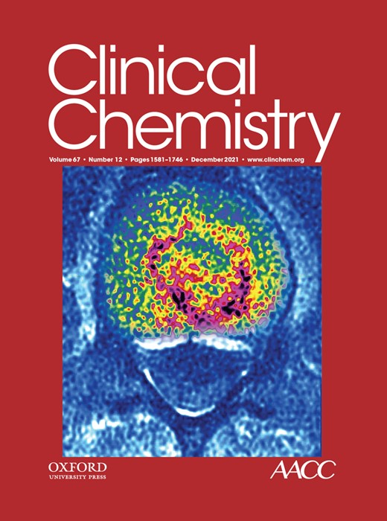
Combining First and Second-Tier Newborn Screening in a Single Assay Using High-Throughput Chip-Based Capillary Electrophoresis Coupled to High-Resolution Mass Spectrometry
C.A. Pickens, S.L. Isenberg, C. Cuthbert, K. Petritis
December 2021
https://doi.org/10.1093/clinchem/hvab171
© Copyright 2021 by the American Association for Clinical Chemistry

Slide 2
Introduction
Newborn screening (NBS) saves lives
  Every newborn is screened for inborn errors of metabolism (IEM)
  Babies with certain IEMs can die within 1-2 weeks if untreated
  Early identification leads to decreased morbidity and mortality
  NBS is one of the most successful public health programs
Dried blood spots (DBS) are the collection device
  After birth, newborns receive a heel prick
  Blood droplets are collected on the DBS card
  DBS cards are sent to public health labs for analysis by mail

Slide 3
Introduction
First-tier NBS is high-throughput
  Rapid analysis of samples is critical (< 2 min per sample)
  DBS extracts are a complex sample matrix with isobars and interferences for many small molecules
  Very little sample clean up prior to first-tier screening
Mass spectrometers are the analytical workhorse
  Triple quadrupole (TQ) instrumentation
  Flow injection analysis (FIA) of DBS extracts
  Tandem mass spectrometry (MS/MS) to increase specificity
  Highly multiplexable assays, easily screen new biomarkers

Slide 4
Introduction
Current challenges in the first-tier MS screening
  FIA-MS/MS analysis using TQ instruments does not separate isobaric interferences (e.g., leucine and hydroxyproline)
    This causes more samples reflexed to second-tier screening
  Researchers previously investigated direct infusion (DI) high resolution MS (HRMS) to separate interferences and isobars¹
    Worked well, except for isomers that yield identical product ions
  Common isomeric problem in NBS is differentiating between leucine, isoleucine, alloisoleucine
Goal of this study was to add rapid separation prior to MS/MS analysis, without increasing the time of analysis (e.g., < 2 min)
1: High resolution mass spectrometry newborn screening applications for quantitative analysis of amino acids and acylcarnitines from dried blood spots. Pickens et al. Anal Chim Acta. 2020.

Slide 5
Materials and methods
Quality control DBS materials used in study
  Contain increased concentrations of biomarkers for over 20 IEM
  Used sample preparation similar to current first-tier workflows
Chip-based microfluidic capillary electrophoresis (CE)
  Provides rapid separation of biomarkers
  Plug and play hardware, attach to MS for sample introduction
  Coupled to high resolution MS (HRMS) for added specificity in our study

Slide 6
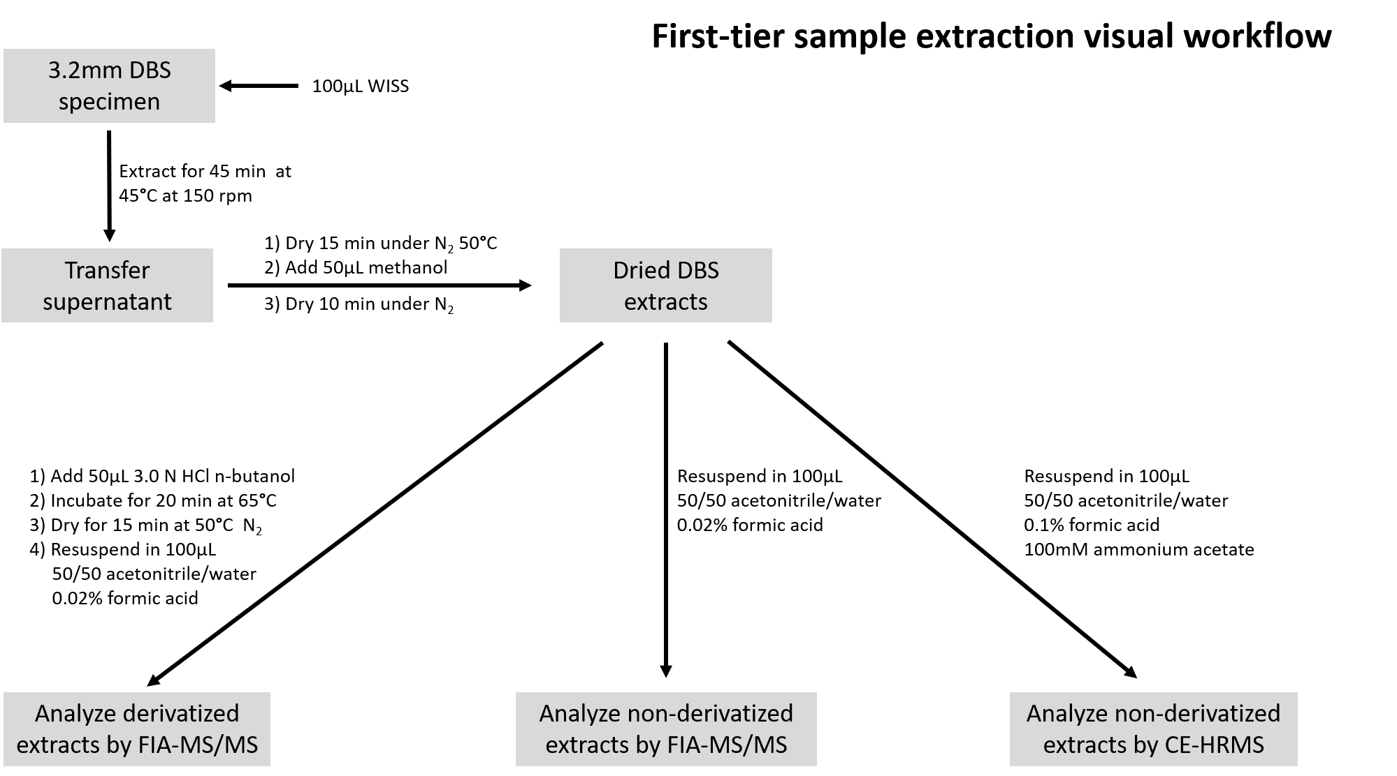
WISS, working internal standard solution

Slide 7
Multiplexed first- and second-tier analysis of newborn screening biomarkers in a single injection.
Using CE > 30 biomarkers were screened in < 2 min
Interferences and isobars were separated allowing for accurate quantification
No added steps or sample preparation to the current workflow
(A) Total ion electropherogram from analysis of the sample. (B) Extracted ion electropherogram for all enriched acylcarnitines in the sample. (C) Extracted ion electropherogram for several amino acid and second-tier biomarkers. (D) Extracted ion electropherogram for the remaining amino acid and second-tier analytes. Analytes in C and D displayed in 2 separate figures for visualization purposes due to the difference in analyte intensities.

Slide 8
Matrix effect comparison - CE-HRMS vs DI-HRMS
Analysis of DBS extracts by FIA- or DI-MS/MS or HRMS results in ion suppression due to matrix effects
Separation by CE prior to HRMS analysis reduced ion suppression associated with matrix effects by over 50% for most biomarkers

Slide 9
Comparison of chip-based CE-HRMS quantification to certified values
Biomarkers | Base QC CE-HRMS Results ª | Base QC Certified Values ^{b} | Low QC CE-HRMS Results ª | Low QC Certified Values ^{b}
Crn | 14.76 ± 0.76 (5.2%) | 22.18 [17.95, 26.41] | 33.62 ± 1.61 (4.8%) | 46.17 [38.24, 54.10]
Arg | 7.08 ± 1.09 (15.4%) | 8.48 [5.03, 11.93] | 78.53 ± 6.08 (7.7%) | 89.84 [69.18, 110.50]
Orn | 164.61 ± 18.02 (10.9%) | 138.71 [98.44, 178.98] | 191.38 ± 19.08 (10.0%) | 179.96 [134.76, 225.17]
C0 | 13.70 ± 1.01 (7.4%) | 16.94 [15.08, 18.80] | 24.47 ± 1.49 (6.1%) | 29.59 [26.43, 32.75]
GUAC | 0.68 ± 0.05 (8.0%) | 0.76 [0.29, 1.23] | 4.73 ± 0.25 (5.2%) | 4.64 [3.59, 5.68]
C2 | 8.17 ± 0.57 (6.9%) | 11.18 [9.90, 12.46] | 18.84 ± 1.01 (5.4%) | 24.12 [21.52, 26.71]
C3 | 0.98 ± 0.07 (7.3%) | 1.23 [1.06, 1.41] | 4.84 ± 0.30 (6.3%) | 5.62 [4.95, 6.28]
Cre | 143.15 ± 9.00 (6.3%) | 183.13 [152.51, 213.74] | 205.39 ± 13.91 (6.8%) | 263.42 [223.82, 303.02]
C4 | 0.08 ± 0.01 (11.9%) | 0.09 [0.07, 0.11] | 0.85 ± 0.04 (4.3%) | 0.97 [0.84, 1.11]
C5 | 0.19 ± 0.08 (39.3%) | 0.16 [0.14, 0.19] | 0.60 ± 0.06 (9.2%) | 0.56 [0.50, 0.62]
C5:1 | 0.11 ± 0.01 (6.0%) | 0.07 [0.01, 0.12] | 0.42 ± 0.02 (5.8%) | 0.35 [0.28, 0.42]
C6 | 0.09 ± 0.01 (5.4%) | 0.10 [0.08, 0.12] | 0.41 ± 0.03 (7.7%) | 0.43 [0.37, 0.49]
C4OH | 0.17 ± 0.01 (8.5%) | 0.15 [0.13, 0.18] | 0.52 ± 0.04 (7.9%) | 0.45 [0.39, 0.50]
C5OH | 0.40 ± 0.03 (6.7%) | 0.64 [0.55, 0.74] | 1.47 ± 0.09 (6.3%) | 1.65 [1.48, 1.82]
C8 | 0.12 ± 0.01 (5.8%) | 0.16 [0.13, 0.18] | 0.49 ± 0.03 (6.0%) | 0.56 [0.49, 0.64]
Ile | 38.45 ± 1.86 (4.8%) | 39.39 [30.34, 48.44] | 109.13 ± 7.47 (6.8%) | 123.24 [100.31, 146.17]
C5DC | 0.08 ± 0.01 (13.8%) | 0.13 [0.09, 0.18] | 0.48 ± 0.03 (6.9%) | 0.57 [0.49, 0.65]
C3DC | 0.03 ± 0.01 (30.7%) | 0.11 [0.09, 0.13] | 0.18 ± 0.02 (10.7%) | 0.42 [0.36, 0.49]
Val | 62.42 ± 3.57 (5.7%) | 77.03 [66.17, 87.89] | 127.77 ± 5.89 (4.6%) | 161.73 [143.38, 180.08]
Leu | 67.97 ± 3.95 (5.8%) | 95.63 [80.01, 111.24] | 188.11 ± 9.30 (4.9%) | 220.42 [195.29, 245.54]
aIle | 9.78 ± 0.54 (5.6%) | 10.72 [8.20, 13.24] | 81.84 ± 3.55 (4.3%) | 86.95 [71.67, 102.23]
C10:0 | 0.07 ± 0.01 (6.5%) | 0.24 [0.18, 0.30] | 0.37 ± 0.03 (7.5%) | 0.66 [0.56, 0.76]
SUAC | † | 0.25 [0.16, 0.34] | 0.84 ± 0.07 (8.5%) | 1.24 [0.92, 1.55]
C12 | 0.08 ± 0.01 (7.8%) | 0.10 [0.08, 0.11] | 0.80 ± 0.04 (5.4%) | 0.84 [0.72, 0.97]
Hcy | 12.5 ± 2.13 (17.0%) | 4.48 [3.30, 5.66] | 28.12 ± 4.90 (17.4%) | 9.73 [7.33, 12.12]
C14 | 0.06 ± 0.01 (9.7%) | 0.06 [0.05, 0.08] | 0.46 ± 0.03 (5.7%) | 0.51 [0.44, 0.59]
Met | 10.43 ± 0.56 (5.4%) | 11.47 [8.74, 14.20] | 47.49 ± 2.36 (5.0%) | 48.60 [42.89, 54.30]
C14:1 | 0.05 ± 0.01 (13.3%) | 0.07 [0.05, 0.08] | 0.26 ± 0.02 (6.0%) | 0.43 [0.35, 0.52]
Phe | 33.65 ± 1.90 (5.7%) | 36.06 [29.93, 42.20] | 159.38 ± 7.15 (4.5%) | 170.46 [151.45, 189.46]
C16 | 0.73 ± 0.05 (7.5%) | 0.75 [0.63, 0.88] | 3.73 ± 0.20 (5.4%) | 3.85 [3.28, 4.41]
C16OH | † | 0.10 [0.08, 0.12] | † | 0.24 [0.20, 0.29]
C18:0 | 0.54 ± 0.04 (8.1%) | 0.53 [0.43, 0.63] | 1.37 ± 0.11 (8.2%) | 1.37 [1.15, 1.58]
Tyr | 30.81 ± 1.91 (6.2%) | 31.16 [25.40, 36.92] | 268.42 ± 11.92 (4.4%) | 276.13 [242.02, 310.25]
C18OH | † | 0.06 [0.04, 0.07] | 0.12 ± 0.03 (23.9%) | 0.14 [0.12, 0.17]
Cit | 13.99 ± 1.11 (8.0%) | 14.99 [10.91, 19.06] | 32.77 ± 2.22 (6.8%) | 36.54 [28.68, 44.39]
Achieved similar concentrations between platforms
Quantification differences often due to separation of isomers, isobars, and interferences on CE-HRMS platform
Quantification differences were also due to the electrophoretic separation of the surrogate used as internal standard under FIA-MS/MS and the biomarker of interest

Slide 10
Comprehensive overview of NBS core conditions and their biomarkers observed by CE (this study and others). Core condition categories represented as parent nodes; specific conditions/disorders represented as child nodes, along with their respective biomarkers. Gray-colored bubbles represent biomarkers that have not yet been analyzed by CE. Biomarkers in black text analyzed using CE for the first time here. Core conditions not included are critical congenital heart disease, hearing loss, severe combined immunodeficiencies, and spinal muscular atrophy.

Slide 11
Advances in this study
This CE method quantified 35 biomarkers for over 20 disorders in < 2 min
Separation of isomers and isobars that often cause inconclusive results or false positives
Screening of conventionally second-tier biomarkers in a first-tier analysis time
Reported new biomarkers analyzed by CE

Slide 12
Limitations of the study
Polarity switching not possible within a CE run, negative ions would be a separate injection
Lysophosphatidylcholines not detected at background electrolyte pH
CE system had overhead (e.g., sample delivery, clearing, background electrolyte refreshed) that added time to total analysis
The rapid separation by CE proved difficult to achieve adequate number of scan on FT instrumentation

Slide 13
Discussion Questions
What are some strengths and limitations of first-tier NBS and the high-throughput requirements?
What are benefits and limitations of using CE in comparison to liquid chromatography?
What impacts would separating biomarkers from isomers and interferences during first-tier screening have on NBS and the public health system?

