Slide 1
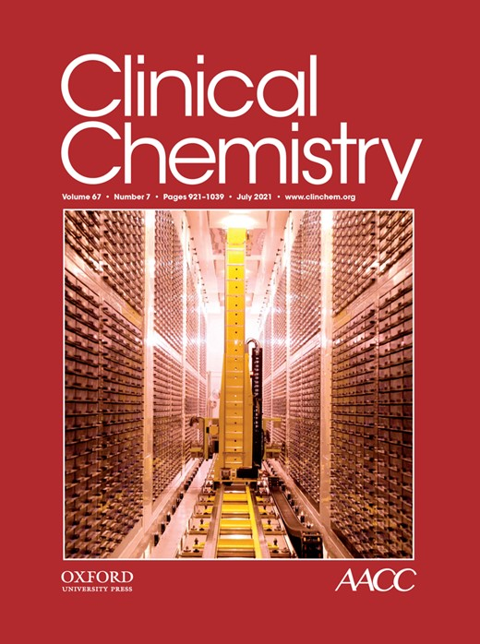
A New Equation Based on the Standard Lipid Panel for Calculating Small Dense Low-Density Lipoprotein-Cholesterol and Its Use as a Risk-Enhancer Test
M. Sampson, A. Wolska, R. Warnick, D. Lucero, A.T. Remaley
July 2021
https://doi.org/10.1093/clinchem/hvab048
© Copyright 2021 by the American Association for Clinical Chemistry

Slide 2
sdLDL and the risk of ASCVD
Increased LDL-C is a key causal factor in the development of ASCVD.
LDL particles vary in their size and density and possibly in their atherogenicity.
There are 2 major LDL size phenotypes: pattern A and B:
Pattern A: large buoyant LDL (lbLDL), diameter 20.6-22 nm,
Pattern B: small dense LDL (sdLDL), diameter 19.0-20.5 nm.
ASCVD risk is more strongly associated with sdLDL.
In 2002, the National Cholesterol Education Program recognized sdLDL-C as an emerging risk factor.

Slide 3
sdLDL-C measure methods
The traditional methods used to measure sdLDL-C are ultracentrifugation and gradient gel electrophoresis.
A fully automated direct method (Denka) for sdLDL-C approved by the FDA shows good agreement with the ultracentrifugation method.
In several large studies the direct sdLDL-C test was found to be a stronger risk marker than LDL-C.
Calculated sdLDL-C
We have developed a new sdLDL-C equation that is just based on the results of the standard lipid panel.
We show how calculated sdLDL-C can potentially be used as a risk-enhancer test to identify higher risk patients and discuss several other possible applications.

Slide 4
Three populations studies were used in this research
 | TC mg/dL | HDL-C mg/dL | TG mg/dL | LDL-C mg/dL | apoB* mg/dL | Age years | % male | % African American
NHANES (n=13,085) |  |  |  |  |  |  | 49% | 19%
median (IQR) | 189 (163-217) | 52 (43-63) | 103 (72-153) | 113 (90-138) | 91 (75-108) | 48 (34-63)
min | 69 | 6 | 14 | 16 | 20 | 18
max | 528 | 226 | 2742 | 369 | 345 | 85
Prism Health Dx (n=20,171) |  |  |  |  |  |  | 45% | N/A
median (IQR) | 185 (158-215) | 52 (43-63) | 110 (77-161) | 107 (83-133) | 94 (79-111) | 55 (43-66)
min | 56 | 10 | 22 | 0.3 | 27 | 4
max | 1161 | 190 | 2569 | 1053 | 388 | 101
MESA (n=5,690) |  |  |  |  |  |  | 47% | 28%
median (IQR) | 194 (173-218) | 48 (40-59) | 110 (77-158) | 121 (101-141) | 99 (84-114) | 61 (53-70)
min | 65 | 15 | 21 | 10 | 20 | 44
max | 515 | 142 | 2256 | 309 | 239 | 84

Slide 5
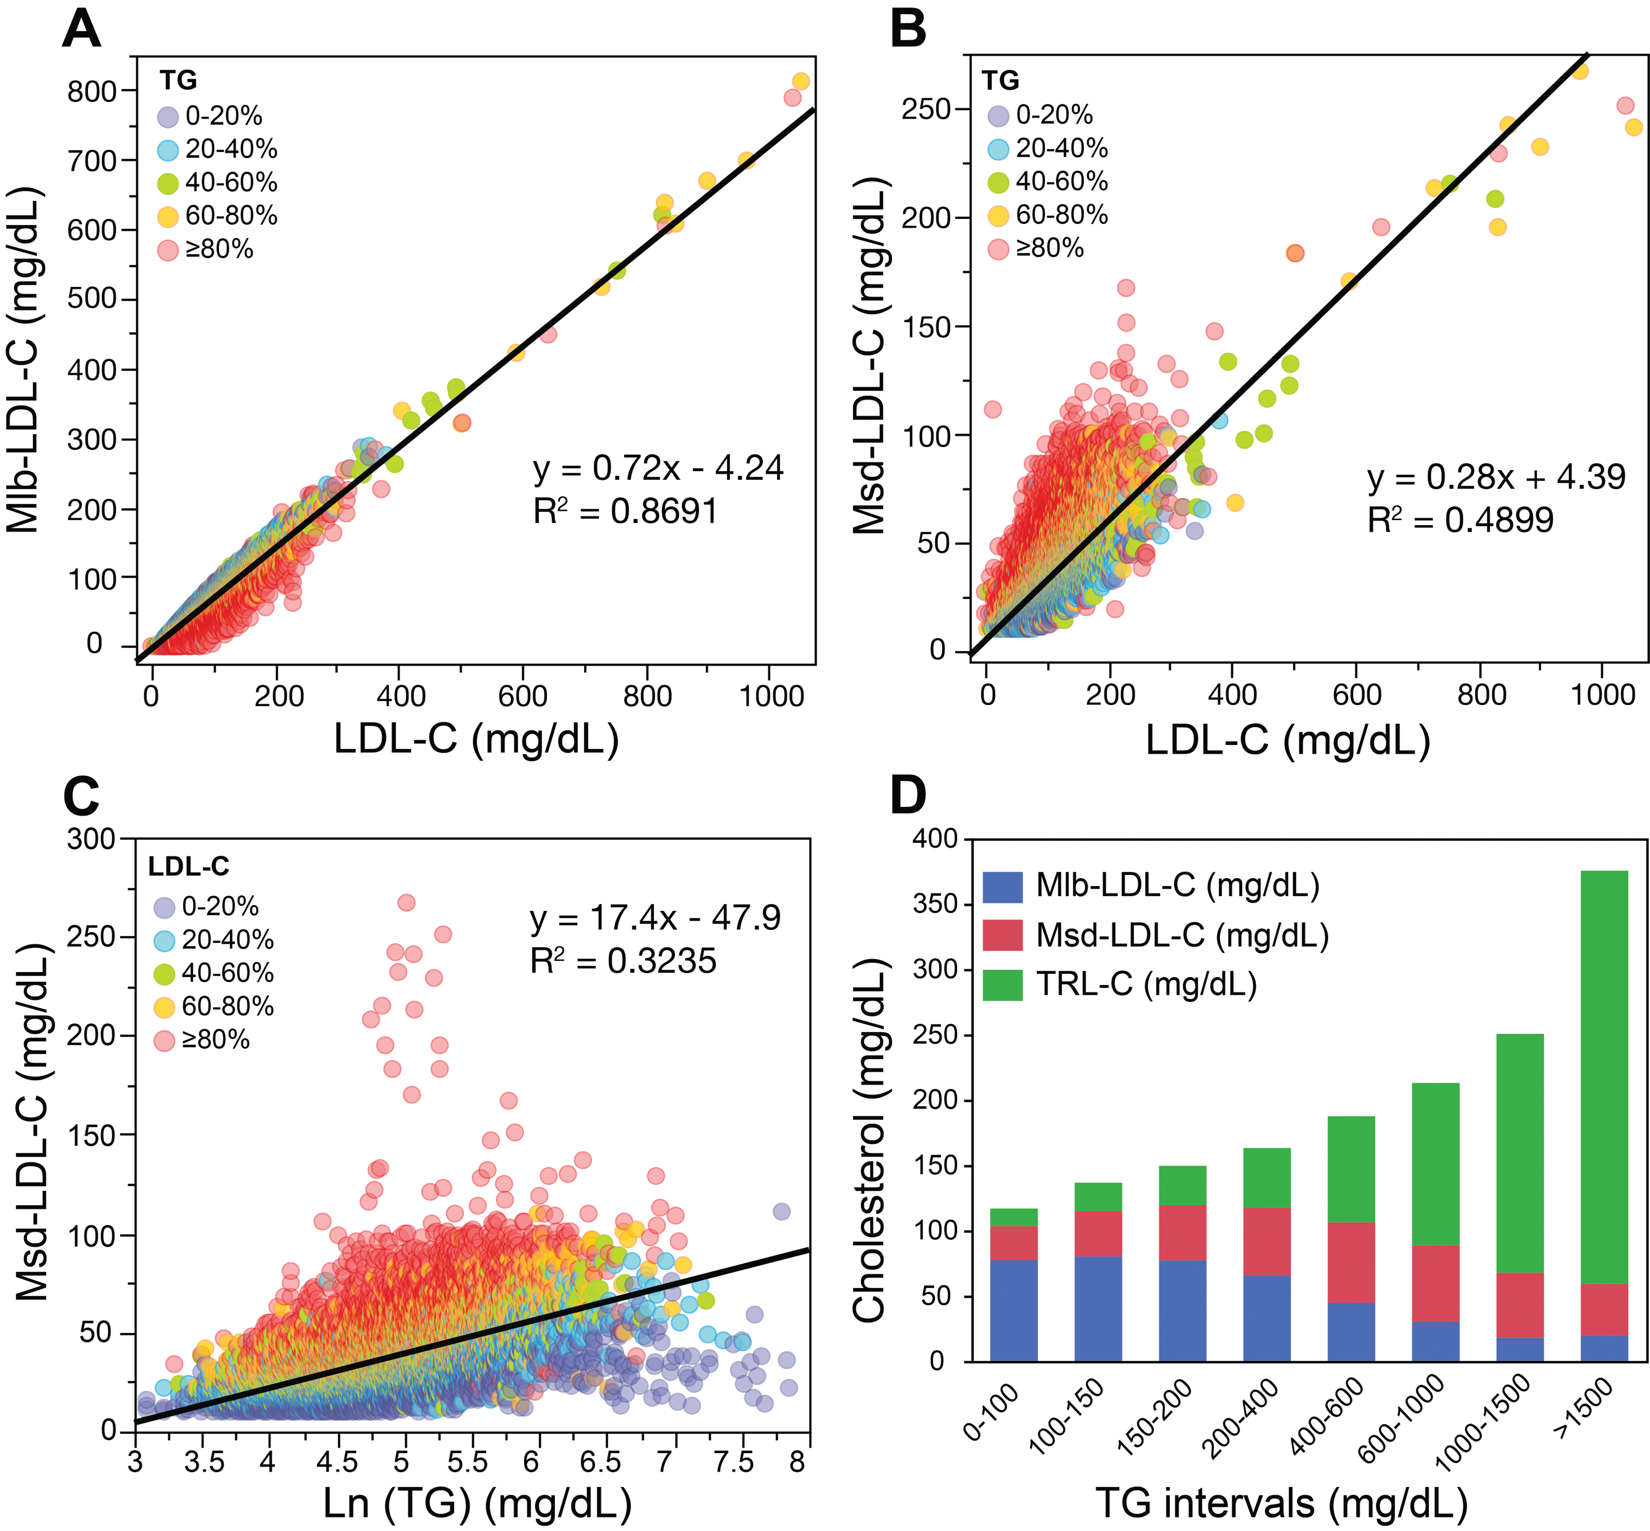
Distribution of cholesterol on different lipoprotein
Cholesterol as measured by the direct Denka assay for lbLDL-C (A) and sdLDL-C (B) was plotted against LDL-C (n=20,171).
(C) Measured sdLDL-C (Msd-LDL-C) plotted against the natural log of TG (as a point of reference ln(150) = 5). Points on graphs are color-coded according to their TG or LDL-C percentile level as indicated in legend.
(D) Cholesterol on Mlb-LDL-C (blue), Msd-LDL-C (red) and TRL-C (green) at various TG intervals.

Slide 6

Equation-1 for lbLDL-C
$$lb­LDL­C=1.43 x LDL­C−\left(0.14 x (ln(TG) x LDL­C\right))− 8.99$$
By least-squares regression analysis, LDL-C and an interaction term between LDL-C and the natural log of TG were used to derive the equation-1.
LDL-C was calculated by the Sampson formula.
Equation-2 for sdLDL-C
$$Esd­LDL­C=LDL­C−Elb­LDL­C$$
Esd-LDL-C is calculated by subtracting Elb-LDL-C from LDL-C
6

Slide 7
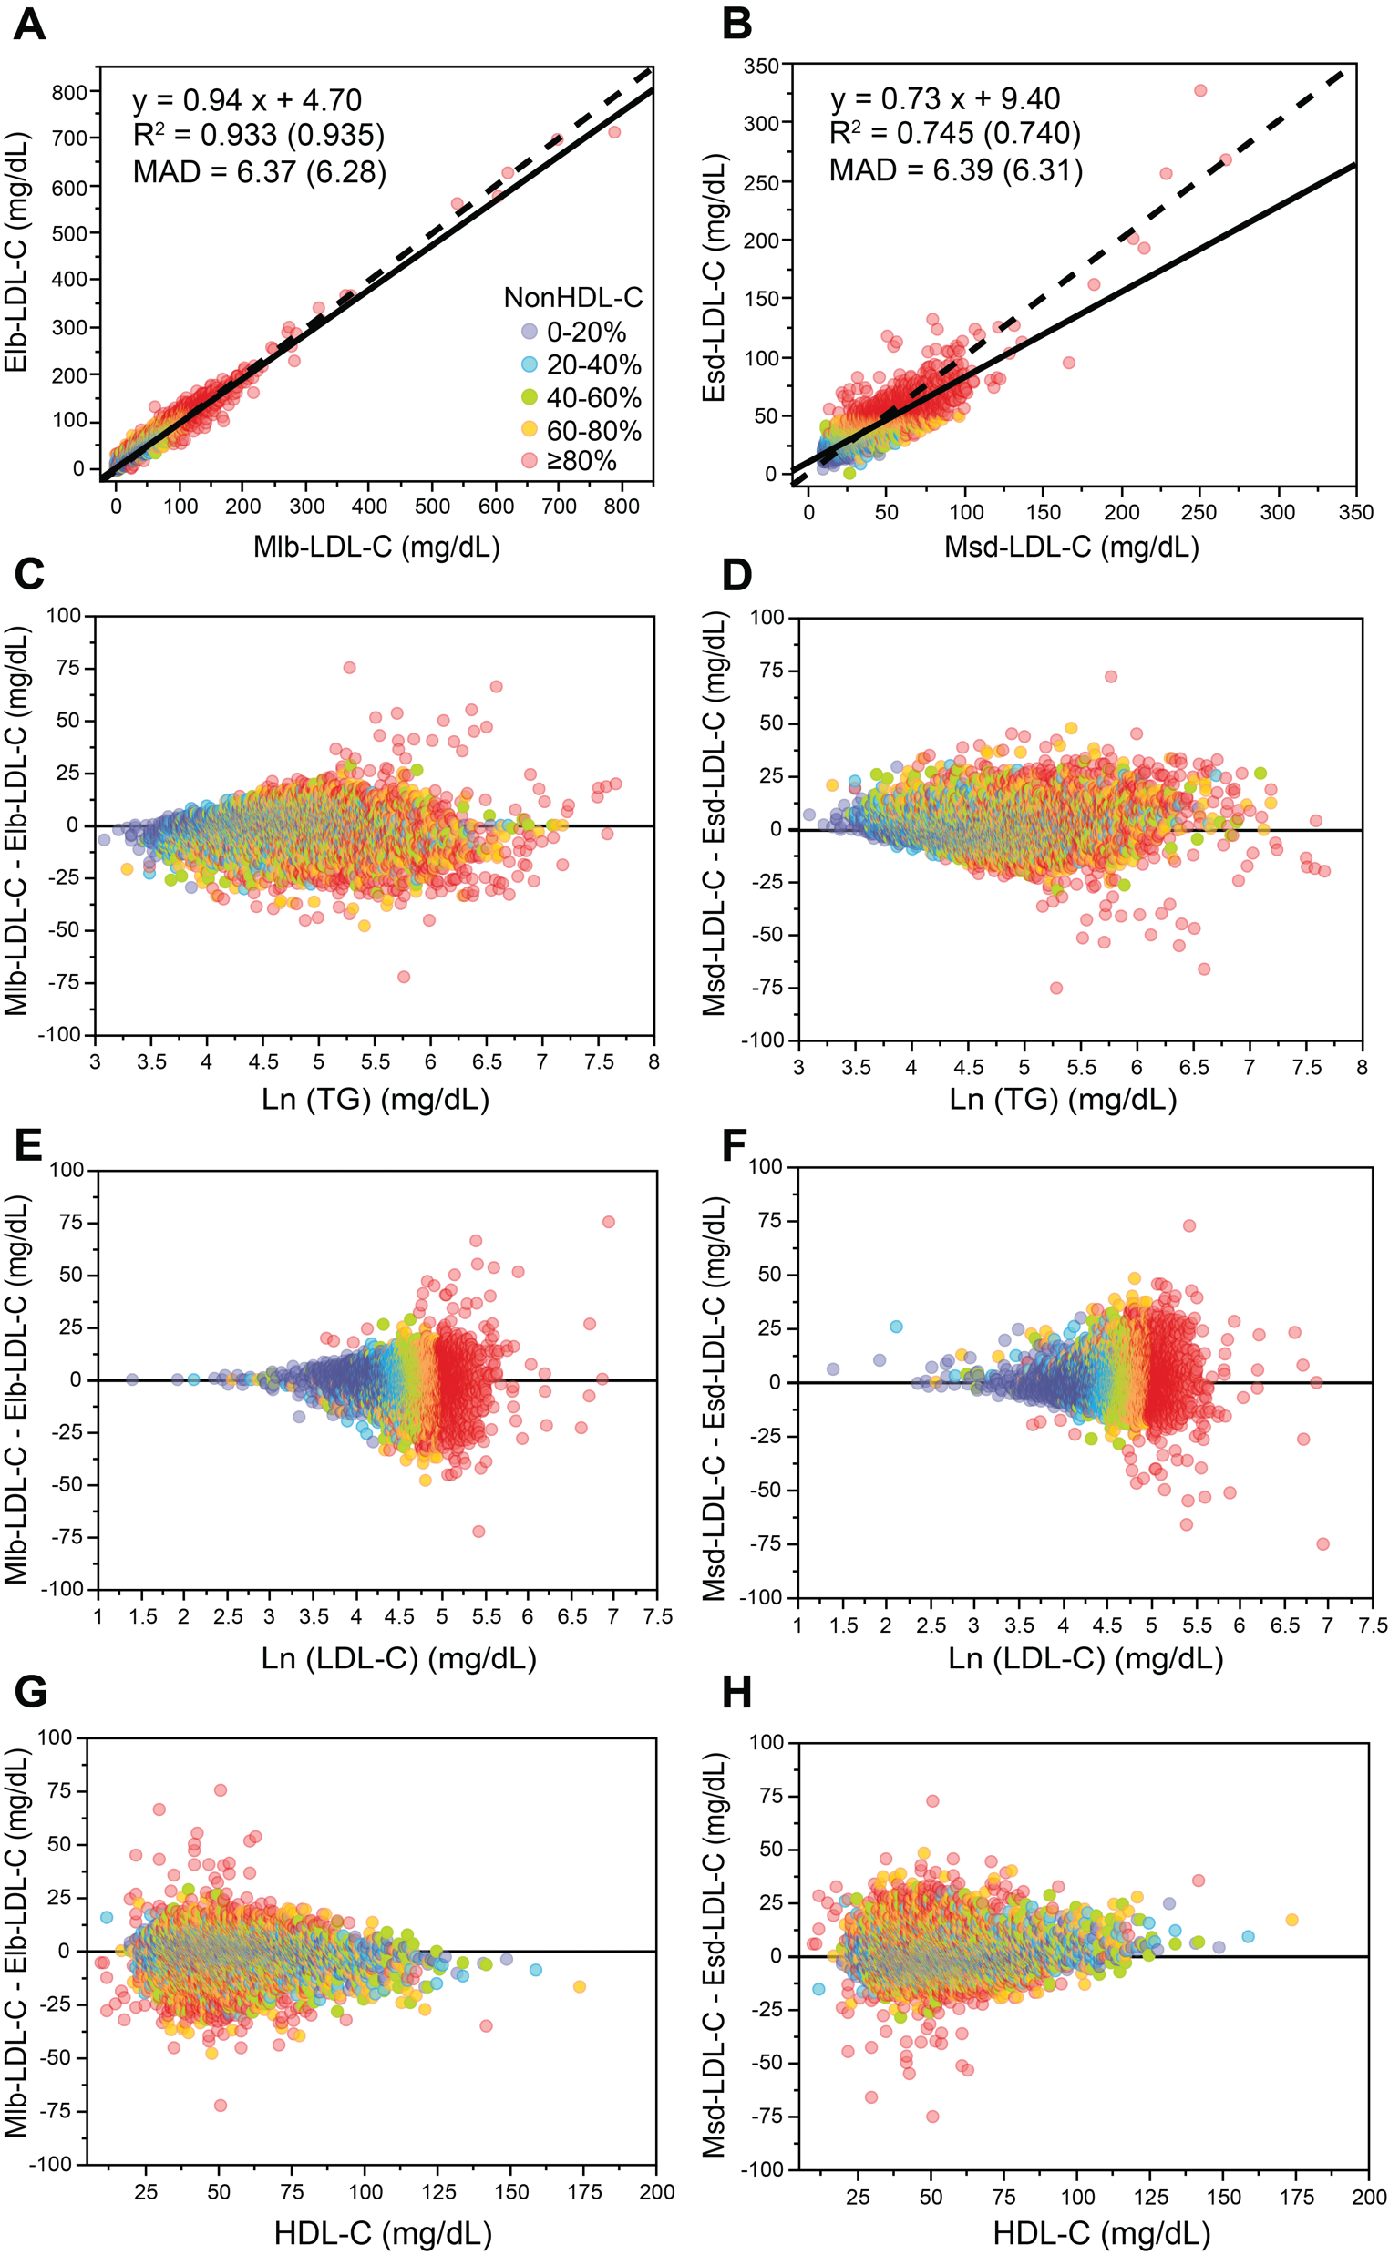
Linear regression equations for estimating lbLDL-C & sdLDL-C
7

Slide 8
Linear regression equations for estimating lbLDL-C & sdLDL-C
8

Slide 9
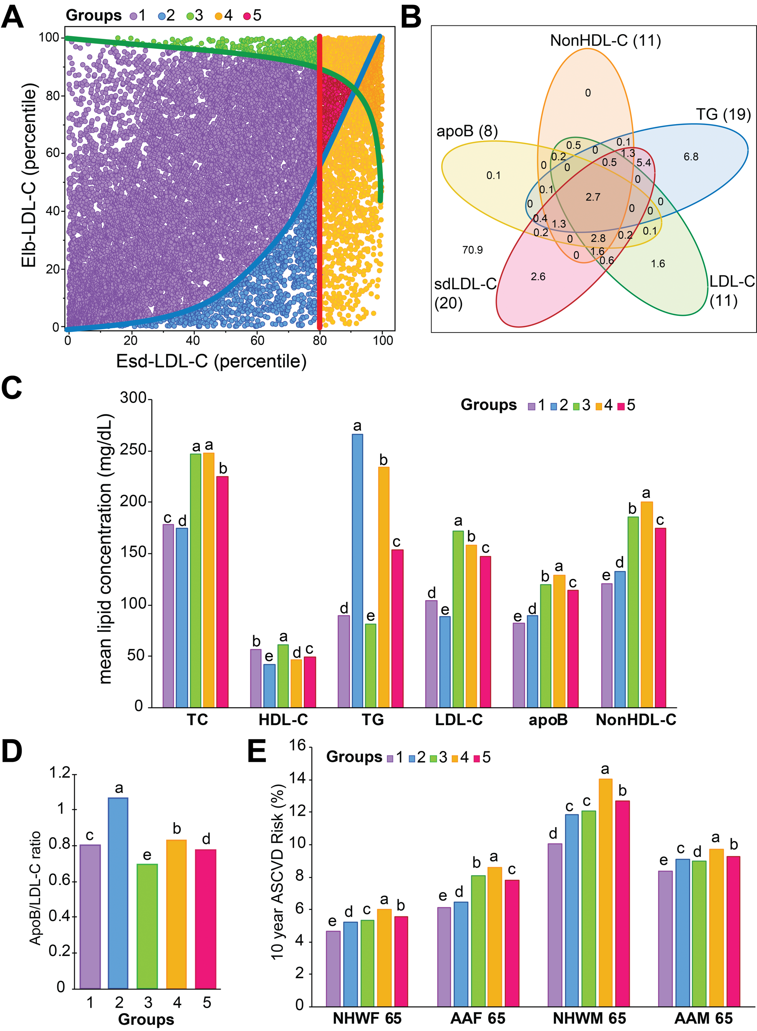
Evaluation of Esd-LDL-C as a risk-enhancer test
(A) Using a cohort representative of the US general population (NHANES), we compared Esd-LDL-C to the TG and LDL-C risk-enhancer rules recommended by the 2018-Multi-society guideline on lipid management.
(B) We show how Esd-LDL-C identified new high risk patients not detected by other risk-enhancer rules.

Slide 10
Evaluation of Esd-LDL-C as a risk-enhancer test
(C) We evaluated the mean lipid values for the different patient groups defined by these various risk-enhancer rules.
(D) We calculated the mean apoB/LDL-C (in mg/dL) ratio for indicated groups.
(E) We analysed the mean 10-year ASCVD risk score for each group, using the 4 pool-cohort risk equations for NHWF, AAF, for NHWM, and AAM for age 65, with a systolic blood pressure of 120 mm Hg and no other risk factors.

Slide 11
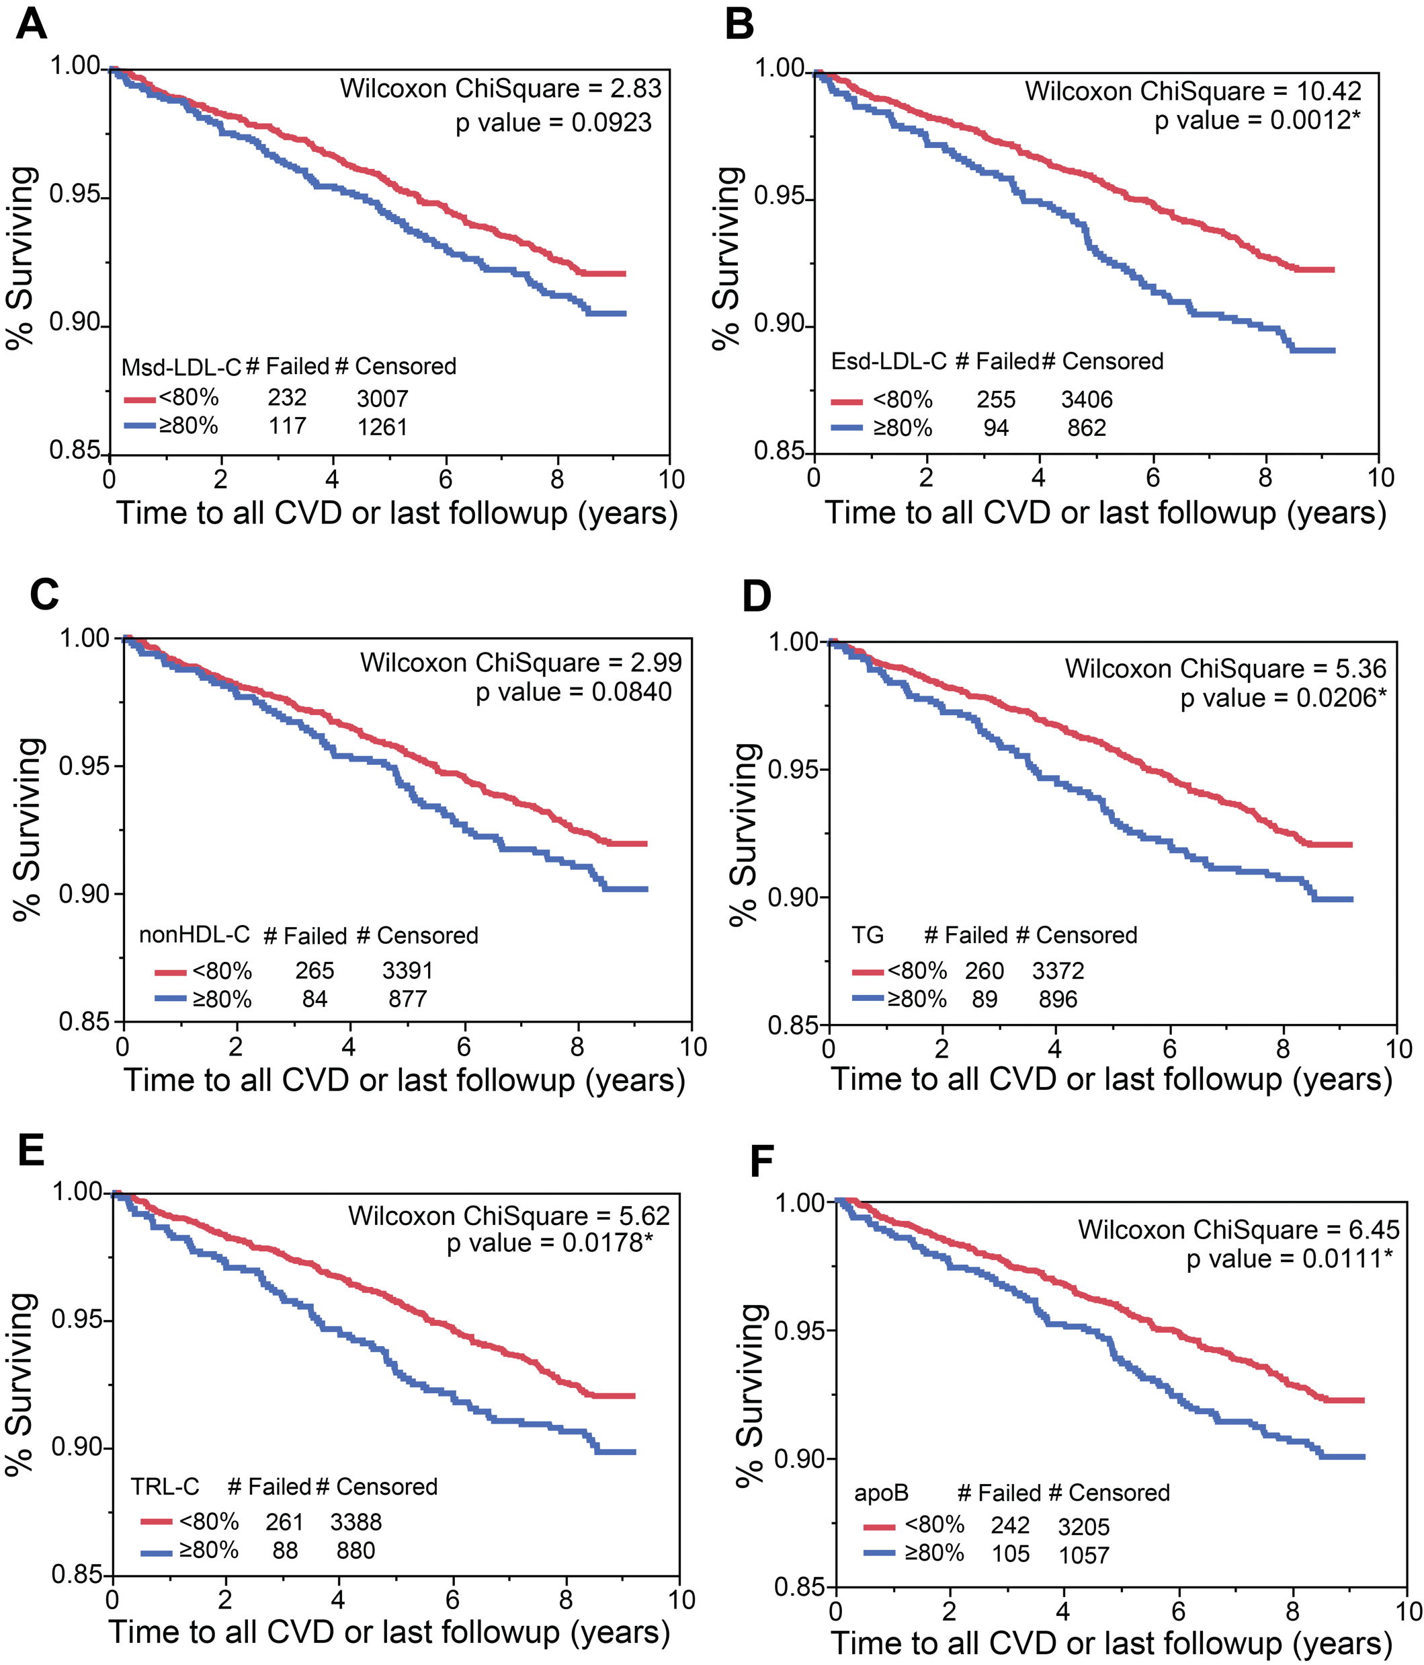
ASCVD survival curve analysis of risk-enhancer rules.
Individuals in MESA, who had an sdLDL-C test performed by the direct Denka assay (n=4,610), were divided into two groups by whether or not they had results above (blue) or below (red) the 80th percentile for the indicated risk-enhancer rule cut-points.
# failed indicates number of individuals that had an ASCVD event.
* scores with an asterisk are statistically significant.

Slide 12
Association of Esd-LDL-C and other lipid parameters with ASCVD events in MESA
Test Variables | Test p-value | Test Hazard ratio per SD (95% CI) | Overall model Chi-Square | Test Variables | Test p-value | Test Hazard ratio per SD (95% CI) | Overall model Chi-Square
Model 1 |  |  |  | Baseline Model |  |  | 364.4
Esd-LDL-C | <0.0001 | 1.28 (1.18-1.38) | 361.9 | HDL-C | <0.0001 | 0.71 (0.59-0.83)
nonHDL-C | <0.0001 | 1.22 (1.13-1.31) | 352.6 | TC | 0.0001 | 1.18 (1.09-1.28)
HDL-C | <0.0001 | 0.75 (0.63-0.87) | 350.6 | Model 2 |  |  | 368.7
LDL-C | 0.0002 | 1.18 (1.09-1.28) | 345.5 | Esd-LDL-C | 0.0537 | 1.23 (1.00-1.47)
TC | 0.0021 | 1.15 (1.06-1.25) | 341.2 | HDL-C | 0.0626 | 0.83 (0.66-1.01)
TRL-C | 0.0016 | 1.09 (1.03-1.14) | 338.6 | TC | 0.999 | 1.00 (0.78-1.22)
TG | 0.0080 | 1.08 (1.02-1.14) | 337.3 | Model 3 |  |  | 368.7
apoB | 0.0004 | 1.20 (1.09-1.31) | 287.9 | Esd-LDL-C | <0.0001 | 1.23 (1.13-1.34)
Msd-LDL-C | 0.0109 | 1.14 (1.03-1.25) | 283.7 | HDL-C | 0.01 | 0.83 (0.71-0.96)

Slide 13
Advances of our study
The main advances of this study are the following:
development of a new sdLDL-C equation that could be widely used on all patients with a standard lipid panel, without incurring additional laboratory testing costs,
demonstration of the possible value of Esd-LDL-C as a risk-enhancer test
finding that Esd-LDL-C is an independent predictor of ASCVD risk and thus could have other applications.

Slide 14
Limitations to our study
Although we used 3 large population studies in our analysis, the use of Esd-LDL-C should be investigated in other populations to determine if our results are generalizable.
The equations developed in this study were based on fasting subjects, so it will also be important to establish their accuracy on non-fasting individuals.
Prospective type studies will be needed to fully establish the clinical utility of our Esd-LDL-C as a potential ASCVD risk marker.
Additional type of studies will be needed to establish whether sdLDL-C is more atherogenic than lbLDL-C or is simply a marker for higher risk patients.

Slide 15
In a summary,
our new equation for sdLDL-C:
can be easily calculated at no additional laboratory costs,
may be valuable as a risk-enhancer test,
could be a potential ASCVD risk marker.

