Slide 1

TOP-Plus Is a Versatile Biosensor Platform for Monitoring SARS‐CoV‐2 Antibody Durability
S.E. Racine-Brzostek, M. Karbaschi, C. Gaebler, P.J. Klasse, J. Yee, M. Caskey, H.S. Yang, Y. Hao, A. Sukhu, S. Rand, A. Chadburn, Y. Shi, R. Zuk, M.C. Nussenzweig, M.M. Cushing, Z. Zhao
September 2021
https://doi.org/10.1093/clinchem/hvab069
© Copyright 2021 by the American Association for Clinical Chemistry

Slide 2
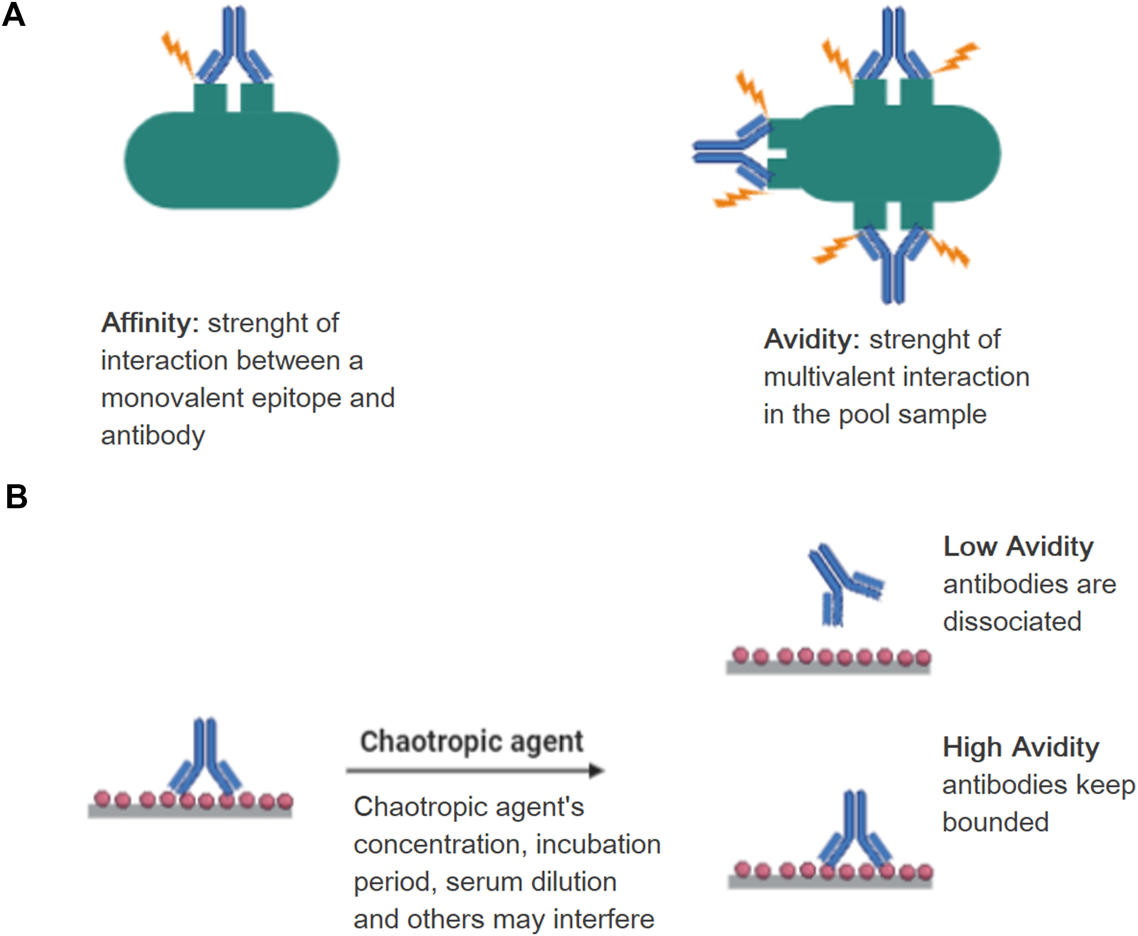
Antibody Avidity
Affinity – the monovalent interaction of a single paratope with an epitope
Avidity – the strengthening of binding through more than one point of interaction with many antigenic determinants and multivalent antibodies.
  Can be represented by a dissociation constant between the antibody and its antigen
affinity
avidity
Klasse, PJ. How to assess the binding strength of antibodies elicited by vaccination against HIV and other viruses. Expert Rev Vaccines 2016;15:295–311.
Figure adapted from Correa VA, Rodrigues TS, Portilho AI, Trzewikoswki de Lima G, De Gaspari E. Modified ELISA for antibody avidity evaluation: The need for standardization. Biomed J 2020. https://doi.org/10.1016/j.bj.2020.10.009

Slide 3
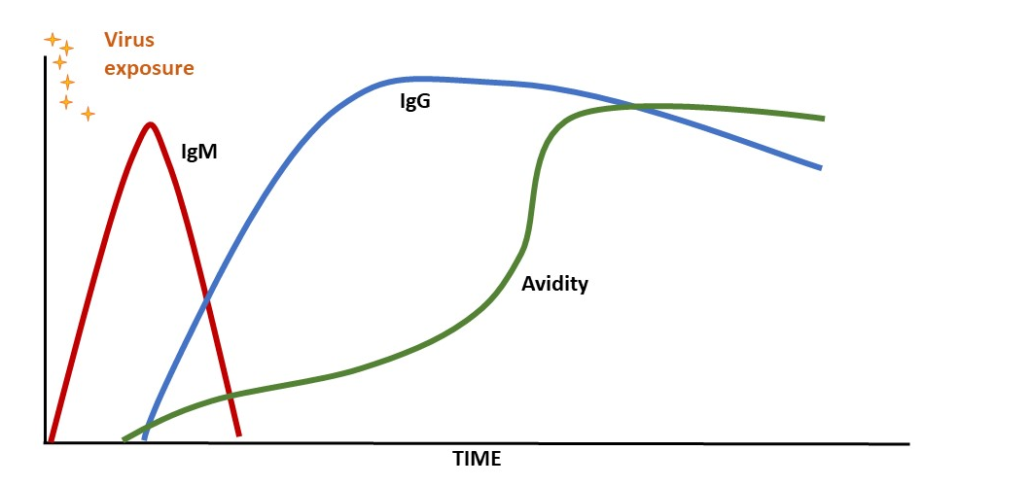
Avidity strengthens over time post infection
The “classical” antibody response after exposure to a viral infection.
Q?: Has antibody avidity been used in other contexts for other infectious agents and how has it been helpful?

Slide 4

What are various methodologies in measuring antibody avidity? (part 1)
Chaotrope-based assays
  Typically ELISA based
  Strength if binding reflected in the resistance to disruption by chaotropic ions, such as urea
Figure adapted from Correa VA, Rodrigues TS, Portilho AI, Trzewikoswki de Lima G, De Gaspari E. Modified ELISA for antibody avidity evaluation: The need for standardization. Biomed J 2020. https://doi.org/10.1016/j.bj.2020.10.009

Slide 5
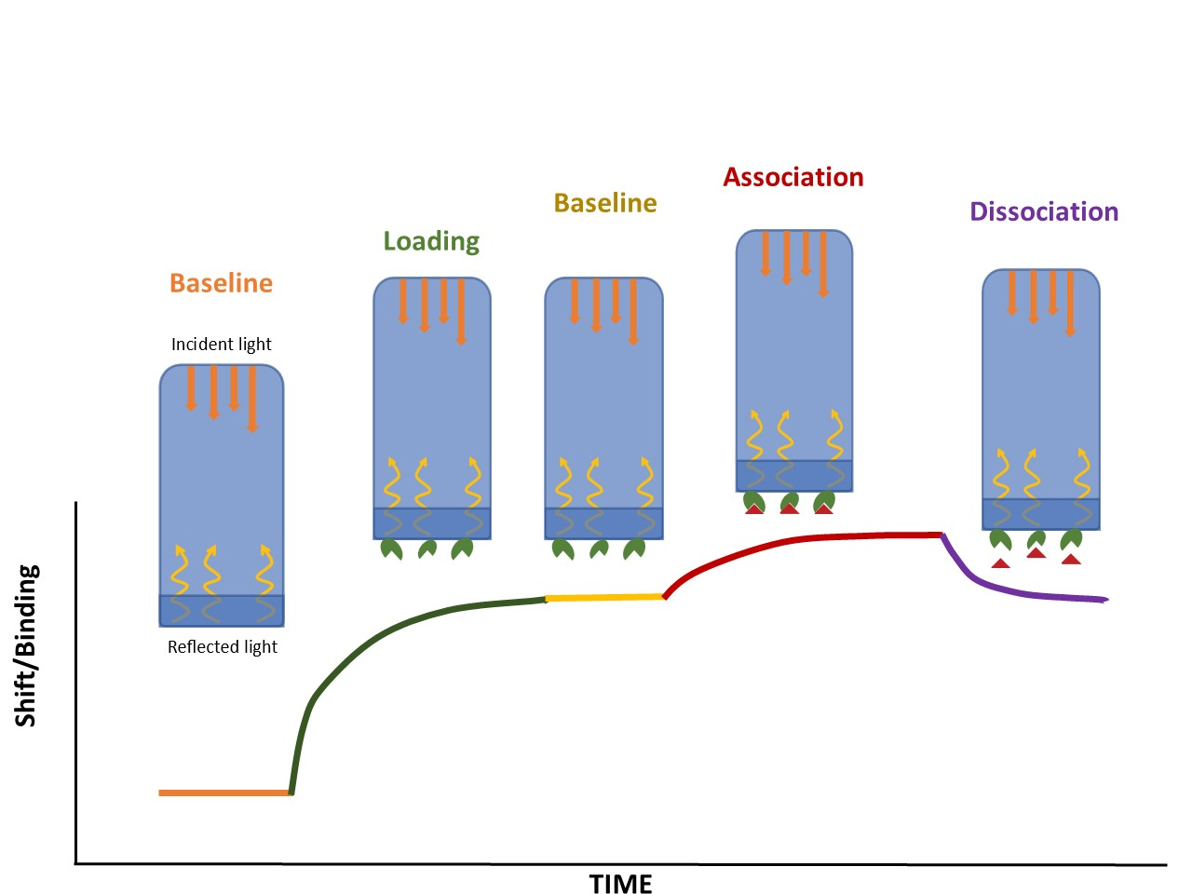
What are various methodologies in measuring antibody avidity? (part 2)
Kinetically based assay examples
  Surface plasmon resonance (SPR)
  Biolayer interferometry (BLI)
For example: BLI methodology immobilizes/loads the ligand molecule on the surface of the biosensor. The ligand-loaded biosensor is dipped into a solution containing the analyte/antibody in question (association) and then dipped into buffer (dissociation). Measurements are plotted and the binding association & dissociation rate constants are calculated along with an affinity constant (K_{d}) using mathematical equations.

Slide 6
Study Aims
Modify and validate an existing biosensor, the SARS-CoV-2 testing-on-a-probe (TOP) assay, to include a newly developed SARS-CoV-2 avidity TOP-Plus assay
Clinically validate the assay by comparing SARS-CoV-2 total antibody and neutralizing antibody activity levels with avidity in sera from previously infected individuals
Evaluate SARS-CoV-2 antibody avidity in sera from vaccinated individuals

Slide 7
Study design
Analytical validation :
  Avidity is determined by calculation the relative dissociation rate (dR)
  Comparison study to BLI method (not discussed in this Journal Club, please see paper)
  Determine avidity assay’s total antibody (TAb) concentration-independent range by titrating 4 randomly selected clinical specimen
  See supplemental data for more validation studies (e.g. interference and precision study of the avidity assay)
Clinical validation:
  SARS-CoV-2 TAb, neutralization assay (SNAb) and avidity performed on sera from clinical samples
    80 adults with prior diagnosis of COVID-19 ~1 month and 6 months post infection
    10 individuals vaccinated against SARS-CoV-2 (mRNA-1273 vaccine) ~ 1month post-vaccination

Slide 8
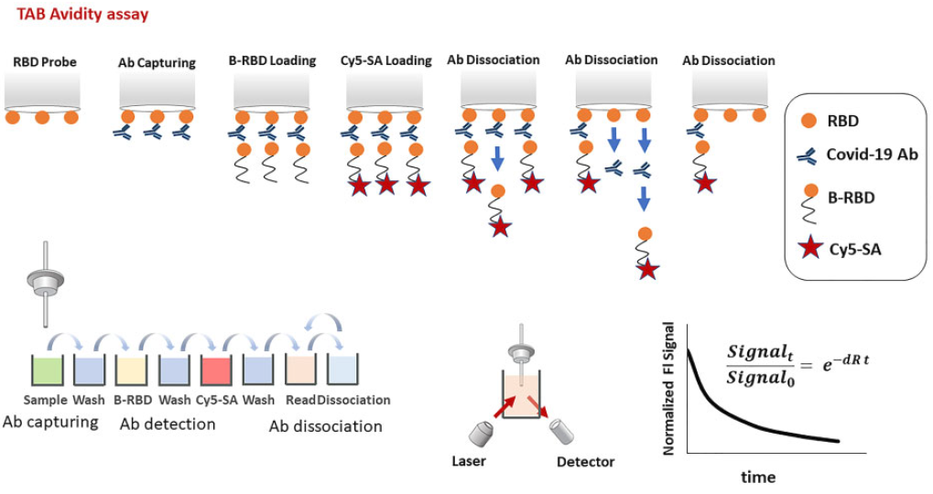
SARS-CoV-2 antibody avidity assay principle
Note: no chaotropic agent is used.
Q? Why may this be important?
Fig. 1. An RBD-precoated probe is sequentially incubated in microwells containing sample to capture SARS-CoV-2-specific antibodies, wash buffer, detection biotinylated RBD, wash buffer, and streptavidin-Cy5 conjugate. The fluorescent signal is then measured (Signal_0). After that, probe with the immobilized immunocomplex goes into repetitive dissociation cycles by multiple incubations in PBS with TweenVR -20 detergent as dissociation buffer. After each incubation, the fluorescent signal is measured (Signal_t). At the end of measurement, the dissociation curve is constructed by plotting the normalized fluorescent signal (Signal_0/Signal_t) over time. The dR is then calculated by fitting first-order reaction kinetics to the dissociation curve.

Slide 9
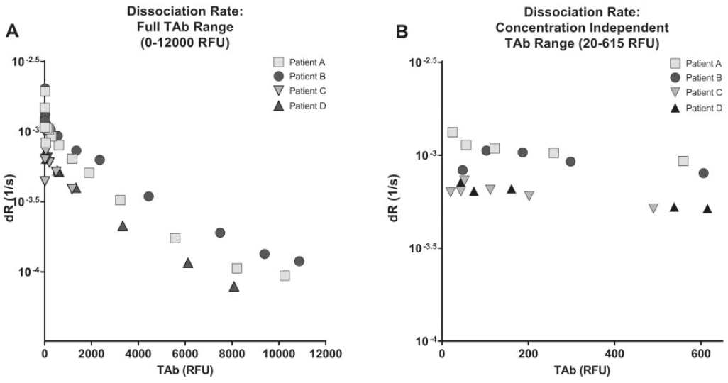
The dR was independent of TAb Concentration at 20-615 TAb RFU
Fig. 2. Determination of concentration independent range. (A), Dilution studies were performed using 4 randomly selected
specimens with high TAb measurements (1171–10 872 RFU undiluted) and plotted against the disassociation rate. (B), The dissociation rate was independent of TAb concentration between 20 and 615 RFU of TAb.
Q?: Why would you want this assay to function independently of TAb?

Slide 10
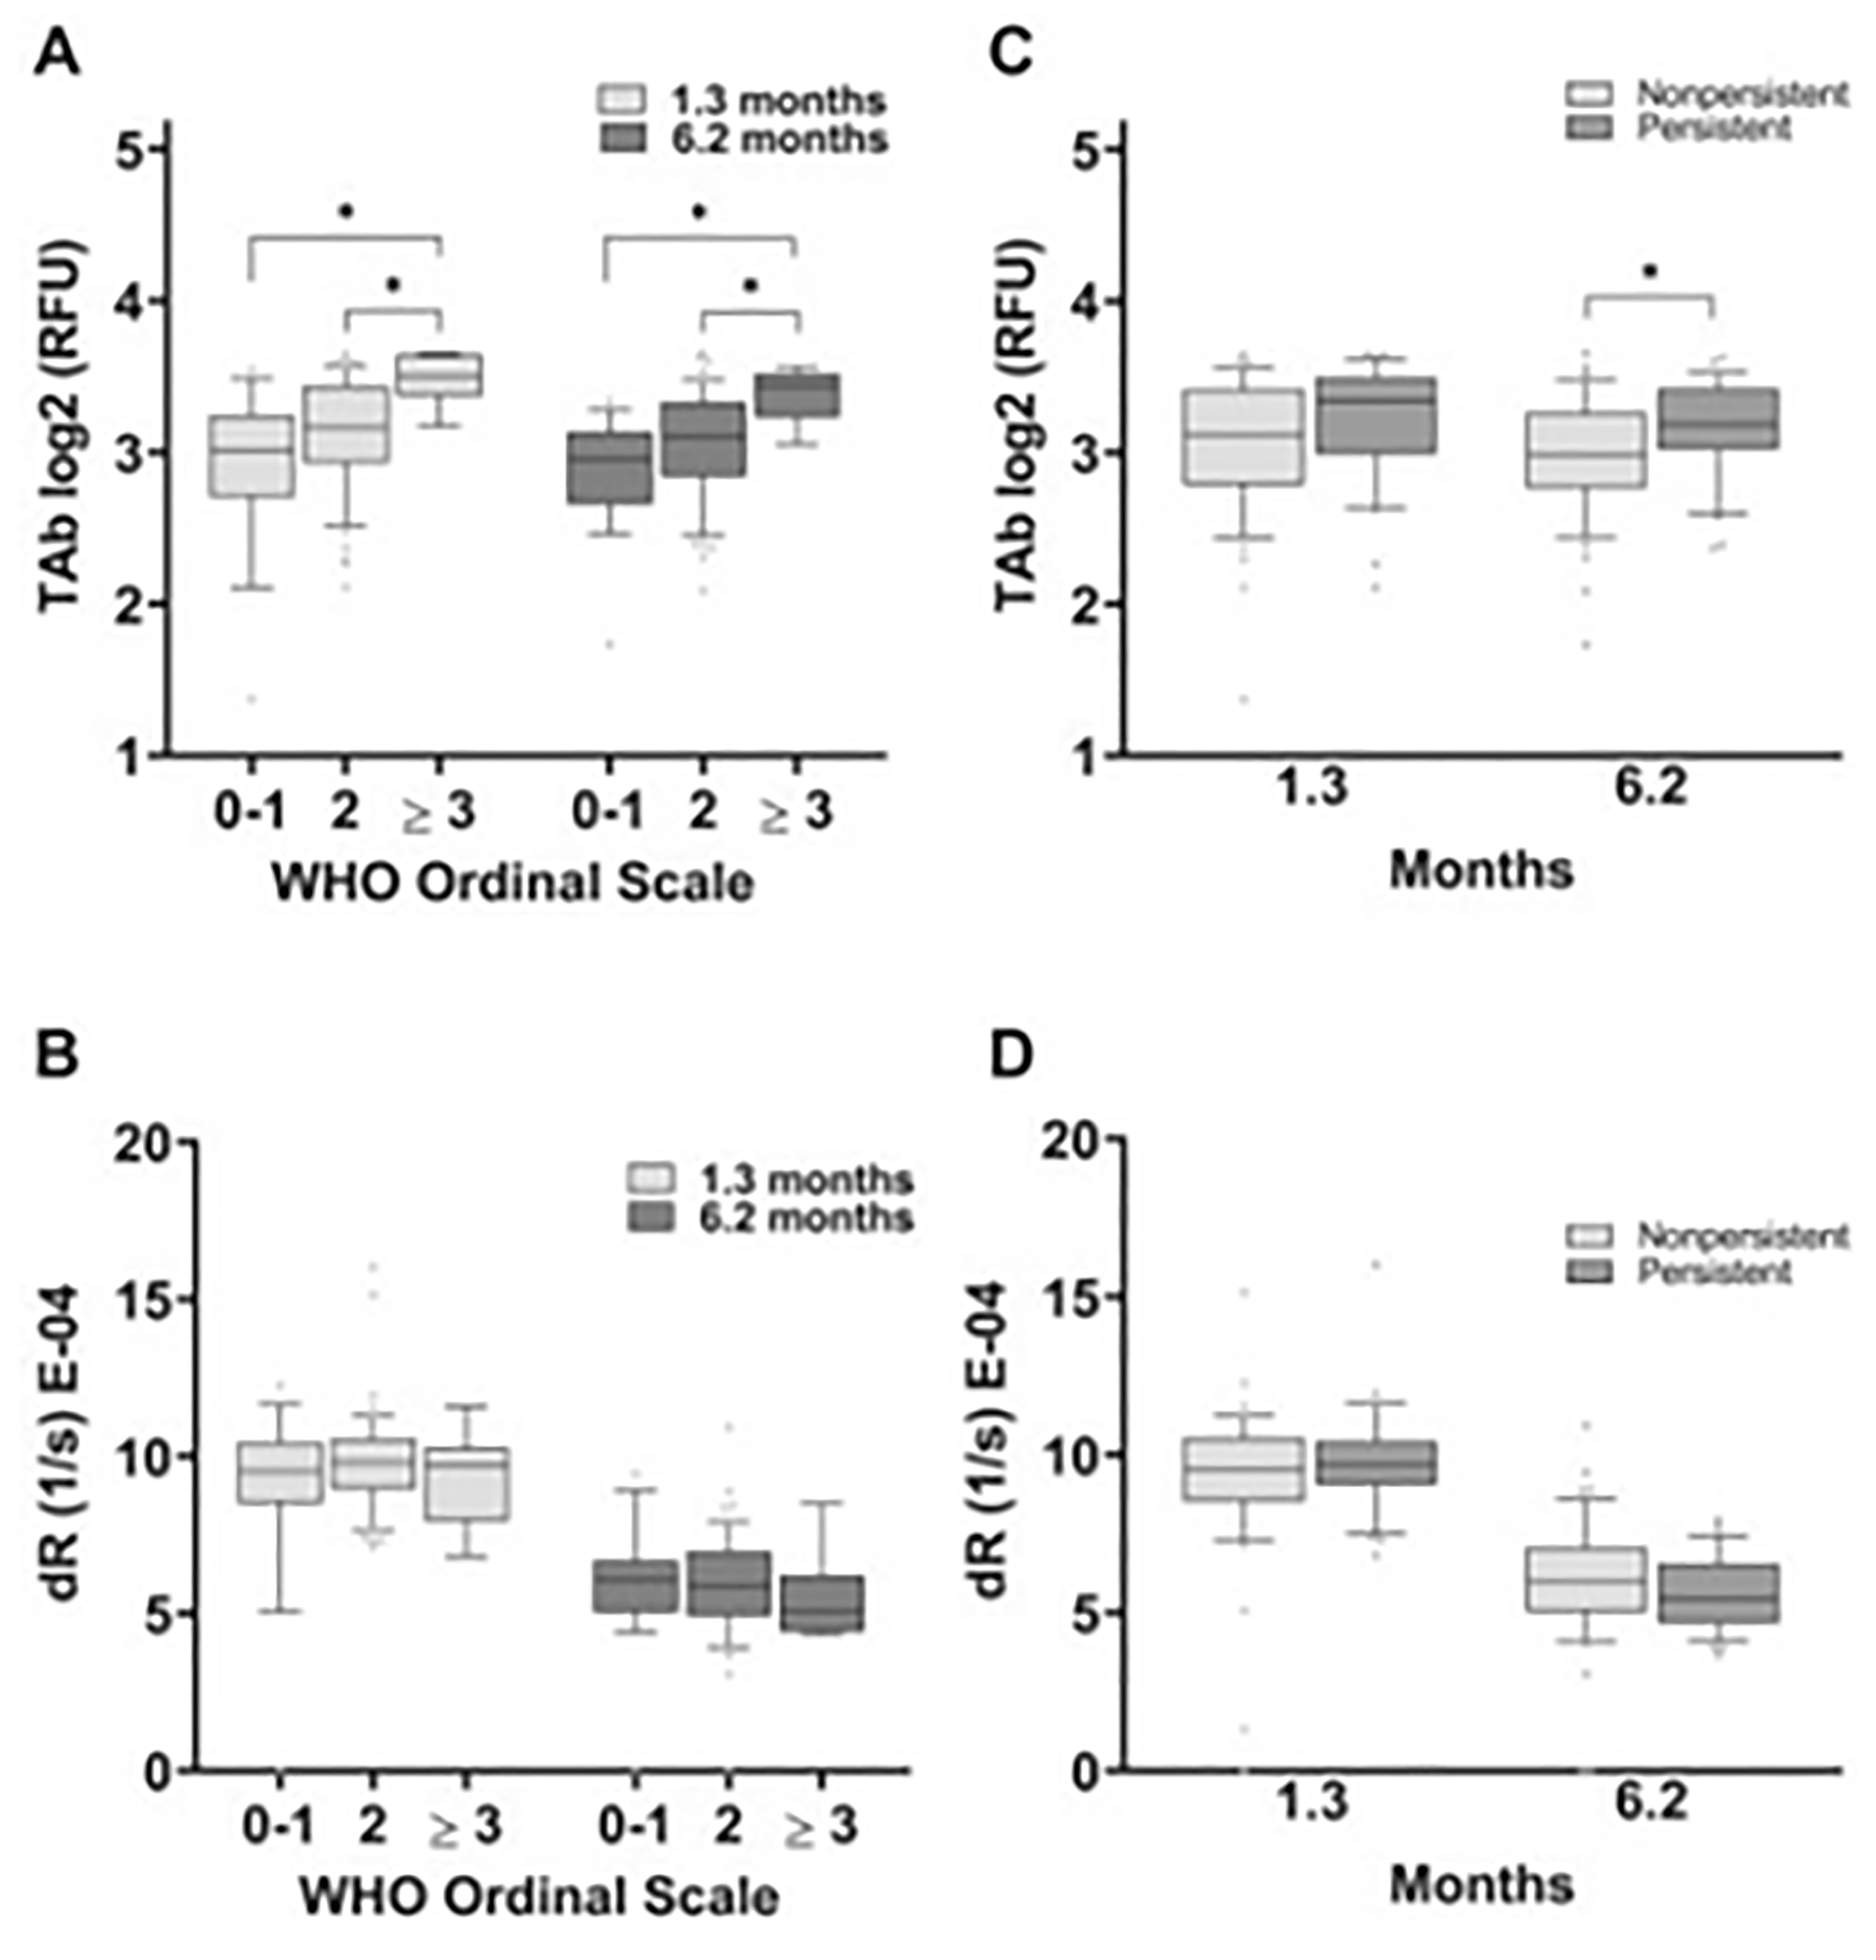
Antibody avidity is independent of prior COVID-19 severity
Fig. 4. (A), TAb levels were higher in individuals with COVID-19 who had limitations in their activities due to COVID-19 symptoms (WHO Ordinal Scale 2) and higher still in hospitalized patients (WHO Ordinal Scale >3) at 1.3 and 6.2 months after infection. (B), At 1.3 and 6.2 months after infection, TAb levels were elevated in individuals who displayed persistence of symptoms beyond 6 weeks of symptom onset compared with those without persistence of symptoms. In contrast, antibody avidity remained unchanged across all WHO Ordinal Scales (C) or with persistence of COVID-19 symptoms (D). Persistent symptoms included fatigue, dyspnea, athletic deficit, or >3 solicited symptoms beyond 6 weeks of symptom onset.
Q?: What is the advantage of having avidity levels be independent of COVID-19 disease severity?

Slide 11
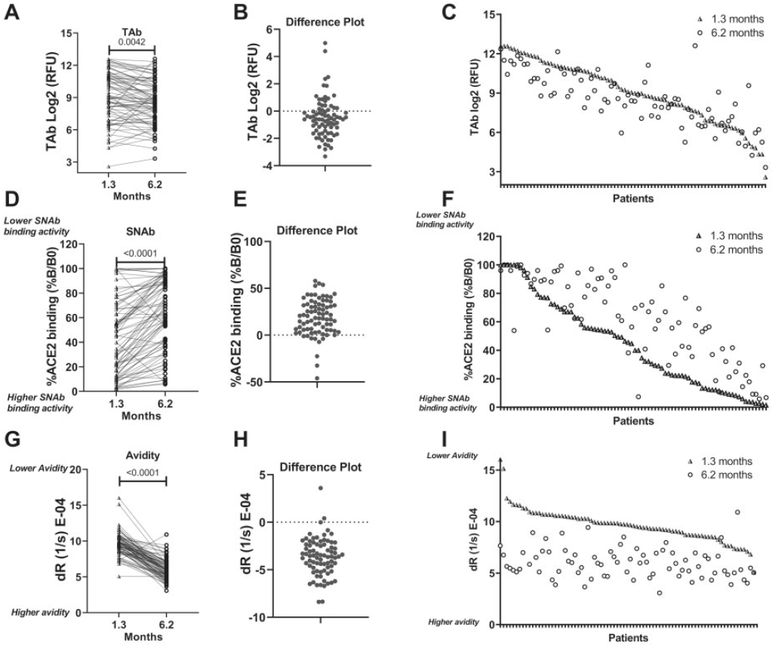
While SARS-CoV-2 TAb and neutralization activity decrease, avidity continues to strengthen over time
Fig. 5. SARS-CoV-2 antibody dynamics during early convalescence. TAb, SNAb, and antibody avidity levels of 80 individuals who were positive for COVID-19 were plotted at 1.3 and 6.2 months (A, D, G). (B, E, H), The change in TAb, SNAb, and avidity over time (1.3 to 6.2 months). (C, F, I), Individual data pairs for TAb, SNAb, and avidity. TAb and SNAb activities (inversely associated with %B/B0) in the majority of individuals decreased over time. In contrast, the avidity (inversely associated with dR) increased during this time. The SNAb assay read-out is the percentage of RBD-ACE2 binding (%B/B0), which inversely correlates with the SNAb activity. The avidity assay measures the dR of SARS-CoV-2 antibodies from the RBD, which is inversely correlated with antibody avidity.

Slide 12
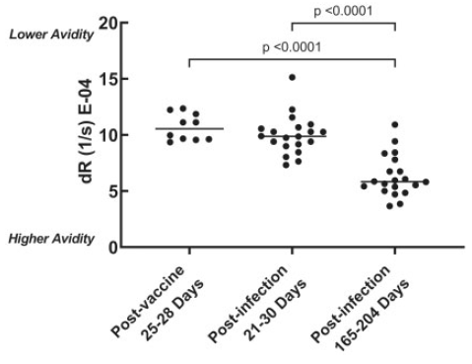
Antibody avidity in vaccinated individuals was comparable to those previously infected with SARS-CoV-2
Fig. 6. Comparison of antibody avidity in individuals previously infected compared with those who were vaccinated with the mRNA-1273 vaccine. Sera of 10 individuals, collected approximately 1 month (25–28 days after vaccination; median: 28 days) after their first dose of the mRNA-1273 vaccine, were analyzed for antibody avidity. These results were compared with those of the 20 individuals in
the previously described COVID-19–positive cohort that had specimens collected approximately 1 month after infection (21–30 days after symptom onset; median: 26 days). For further comparison, the antibody avidity at approximately 6 months after infection in these 20 individuals who were COVID-19 positive were also displayed (165–204 days after vaccination; median: 183 days).

Slide 13
Questions for discussion:
What are potential applications of the SARS-CoV-2 avidity assay?
How could this assay be further modified to aid in assessing SARS-CoV-2 antibody avidity against variants, such as the delta variant?

Slide 14
Discussion
What are potential applications of SARS-CoV-2 avidity?
Determining the “age” of the SARS-CoV-2 Antibody
  Useful for “tracing” and epidemiolocal studies
Potential to assess efficacy of COVID-19 vaccination
  Future vaccine development
  Aid in whether boosters are indicated
More real-world data is needed to understand whether higher antibody avidity correlates with better protection against SARS-CoV-2

Slide 15
Discussion
How could this assay be further modified to aid in assessing SARS-CoV-2 antibody avidity against variants, such as the delta variant?
This current iteration of the TOP-Plus avidity assay measures the antibody avidity against the initially described (wildtype) SARS-CoV-2 RBD
Capability in measuring antibody avidity against other virus variants could be extended by replacing the RBD reagent of the assay (and probe) to the corresponding RBD of other virus variants (e.g. delta variant)

