Slide 1

Highly Sensitive Detection Method of DICER1 Tumor Hotspot Mutations by Drop-off Droplet Digital PCR
R. Vibert, M. Gauthier-Villars, C. Carrière, C. Dubois d’Enghien, J. Cyrta,
A. Vincent-Salomon, D. Stoppa-Lyonnet, I. Bièche, E. Jeannot, L. Golmard
February 2022
https://doi.org/10.1093/clinchem/hvab248
© Copyright 2022 by the American Association for Clinical Chemistry

Slide 2
Introduction
DICER1 syndrome
Autosomal Dominant inherited genetic syndrome predisposing to pediatric benign and malignant tumors.
Broad surveillance required starting at birth with repeated irradiating imaging exams and sedations for young patients.
DICER1 gene, encoding a ribonuclease (RNase) involved in microRNA maturation
> 90 % tumors have an additional somatic DICER1 missense hotspot mutation as second hit
Involving one of six codons clustered in exons 24 and 25
Exons 24 and 25 encode for the RNase IIIb domain
Leading to a partial inactivation of the DICER1 protein
Question: What would be the advantages and limits of detecting the hotspot mutations by liquid biopsy in the surveillance of patients?

Slide 3
Materials and Methods
Drop-off droplet digital PCR (ddPCR):
  Selection of primers to generate amplicons of #100 bp, for compatibility with further circulating tumor DNA application, targeting the hotspot regions in exons 24 and 25
  Design of two TaqMan probes per assay:
    All probes were complementary to the wild-type (WT) sequence,
    One complementary of the hotspot region,
    One complementary to a reference sequence without polymorphisms or to another mutually exclusive hotspot region
In vitro assays on tumor DNA bearing DICER1 hotspot mutations or on synthetic oligonucleotide:
  All hotspot mutations reported in more than 15 tumors in Cosmic v91 or published were tested (Table 1 – Slides 5 and 6)

Slide 4
Materials and Methods
Determination of the performance of each assay:
  Limit of blank (LOB): analysis of 48 replicates of WT genomic DNA extracted from PBMCs or lymphoblastoid cell lines
  LOB = upper limit of the 95% confidence interval (CI) according to Poisson distribution
  Limit of detection (LOD): analysis of mutated DNA diluted by 2-fold from a minor allelic frequency (MAF) of 1% to 0.06-0.08%, in 8 replicates per dilution
  LOD = lowest expected MAF with an inferior limit of the 95% CI according to Poisson distribution, above the LOB
Question: We have chosen ddPCR to detect hotspot mutations in our study.
What other highly sensitive methods could have been tested for a future use on liquid biopsy?
What are the advantages of the drop-off system in the case of DICER1 syndrome?

Slide 5
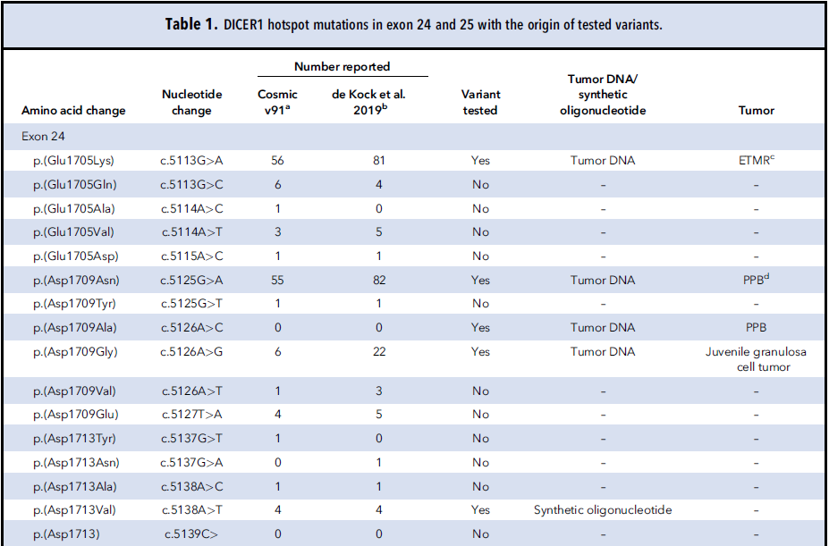
DICER1 hotspot mutations in exon 24 with the origin of tested variants

Slide 6
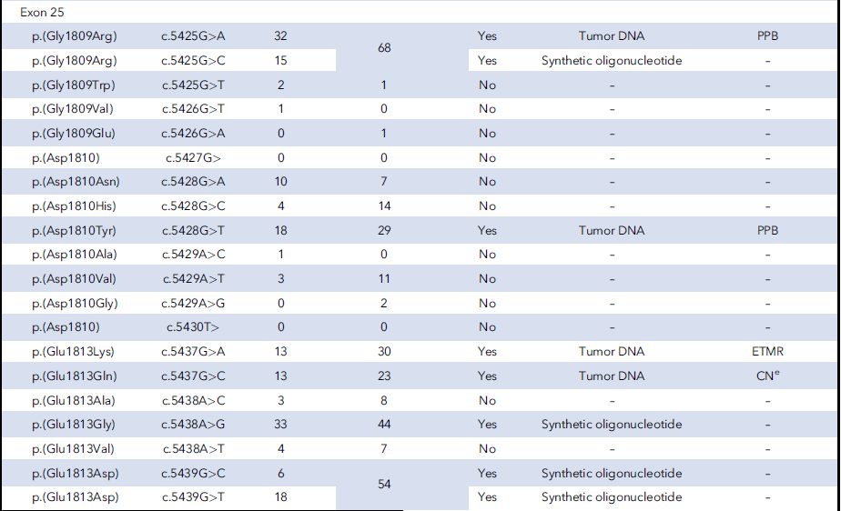
DICER1 hotspot mutations in exon 25 with the origin of tested variants

Slide 7
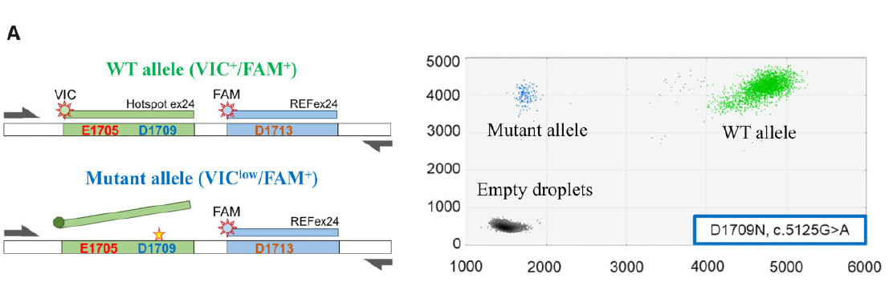
Drop-off ddPCR exon 24 assay
Figure 1. A. Schematic representation of the exon 24 assay. The green VIC⁺/6-FAM⁺ cloud represents droplets containing wild-type copies and the blue VIC^{low}/6-FAM⁺ cloud, the mutant ones. Gray clouds correspond to empty droplets.

Slide 8
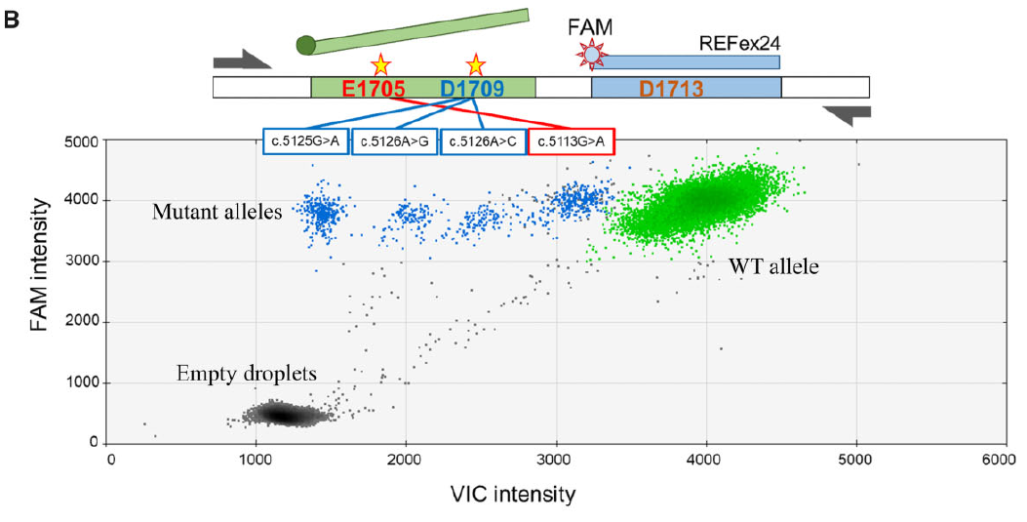
Drop-off ddPCR exon 24 assay
Figure 1. B. Blue clouds shifted differently according to the mutation. The green VIC⁺/6-FAM⁺ cloud represents droplets containing wild-type copies and the blue VIC^{low}/6-FAM⁺ cloud, the mutant ones. Gray clouds correspond to empty droplets.

Slide 9
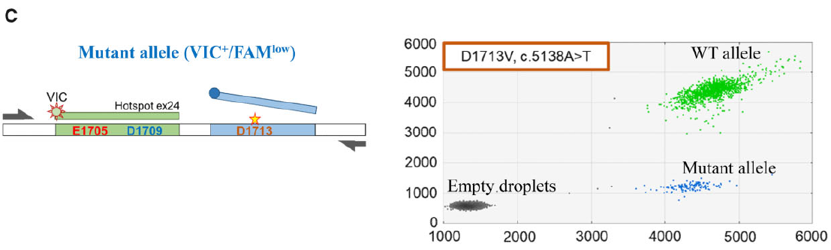
Drop-off ddPCR exon 24 assay
Figure 1. C. A p. D1713 mutation resulted in a vertically shifted blue VIC⁺/6-FAM^{low} cloud. The green VIC⁺/6-FAM⁺ cloud represents droplets containing wild-type copies and the blue VIC^{low}/6-FAM⁺ cloud, the mutant ones. Gray clouds correspond to empty droplets.

Slide 10
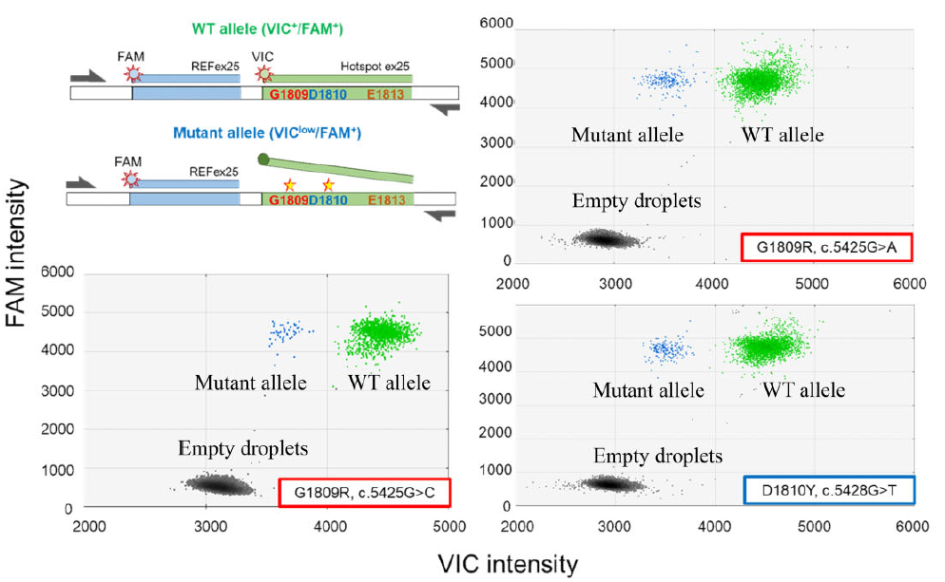
Drop-off ddPCR exon 25 forward assay
Figure 2. A. Schematic representation of the exon 25 assay, using a forward target probe to scan p. G1809 and p. D1810 hotspot codons. Green VIC⁺/6-FAM⁺ clouds represent droplets containing wild-type copies and blue VIC^{low}/6-FAM⁺ clouds, mutant droplets. Gray clouds correspond to empty droplets.

Slide 11
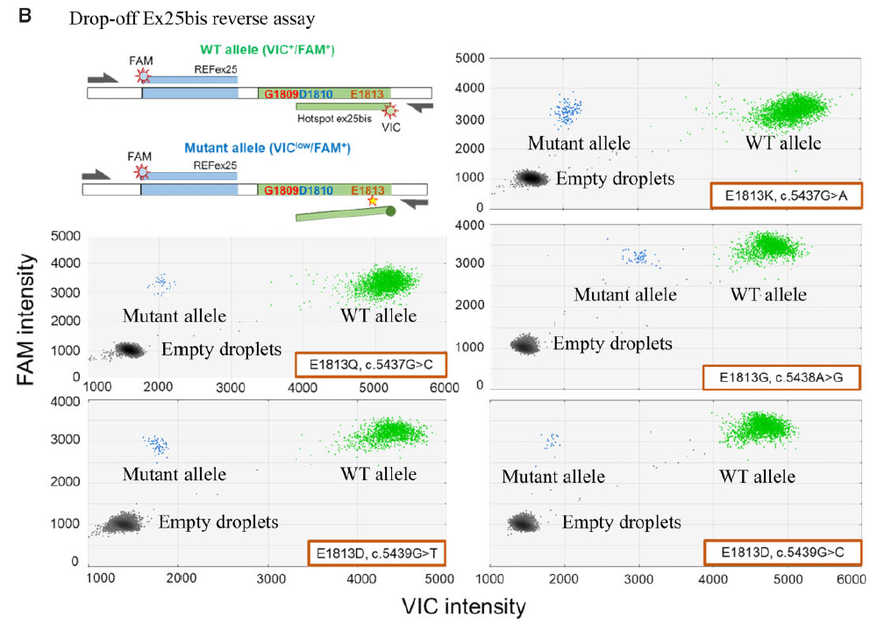
Drop-off ddPCR exon 25 reverse assay
Figure 2. B. Ex25bis assay, using a reverse target probe to scan the p. E1813 codon. Green VIC⁺/6-FAM⁺ clouds represent droplets containing wild-type copies and blue VIC^{low}/6-FAM⁺ clouds, mutant droplets. Gray clouds correspond to empty droplets.

Slide 12
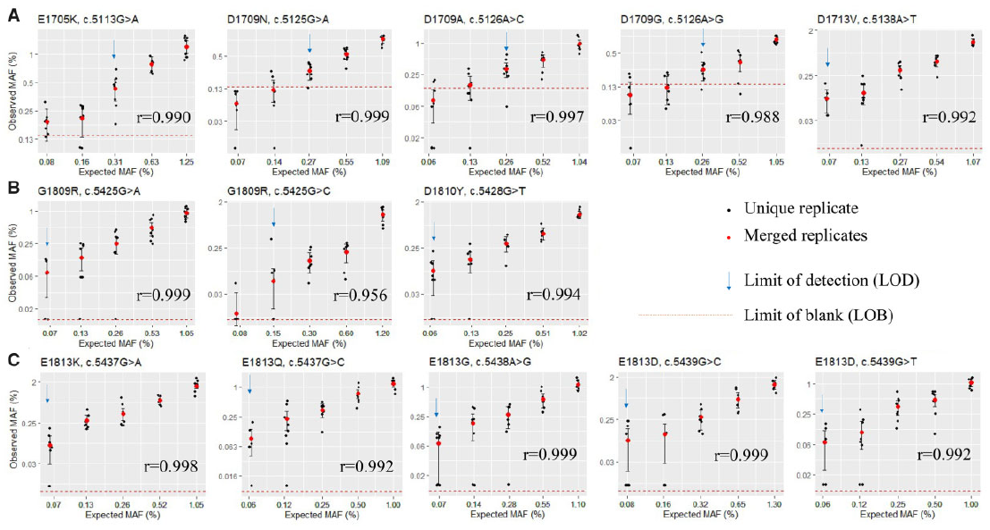
In vitro performance of the ddPCR assays
Figure 3. A. Mutations tested by Ex24 assay with the LOB represented and the LOD determined by serial dilutions, in 8 replicates, starting from a MAF around 1%. CIs are estimated according to the Poisson distribution. r: Spearman correlation coefficient. Axes are in log2. B. Mutations tested by Ex25 assay. C. Mutations tested by Ex25bis assay.

Slide 13
Summary
In this study, we developed three individual drop-off ddPCR assays that potentially detect all the DICER1 hotspot mutations within the exons 24 and 25
The three assays reached a high sensitivity compatible with circulating tumor DNA detection with a LOD ranging from 0.06% to 0.31% depending on the mutation
These drop-off assays allow fewer ddPCR assays and faster screening than with NGS
Detection of a mutated sequence will require an additional analysis to determine the exact hotspot mutation
Its application on liquid biopsy for DICER1 syndrome patient surveillance would probably limit the exposure to radiation and sedation
Its advantage for early tumor detection still needs to be addressed
Question: Could these three assays be multiplexed in a single reaction ?
What will be the next challenges in implementing these screening assays in clinical routine?

