Slide 1
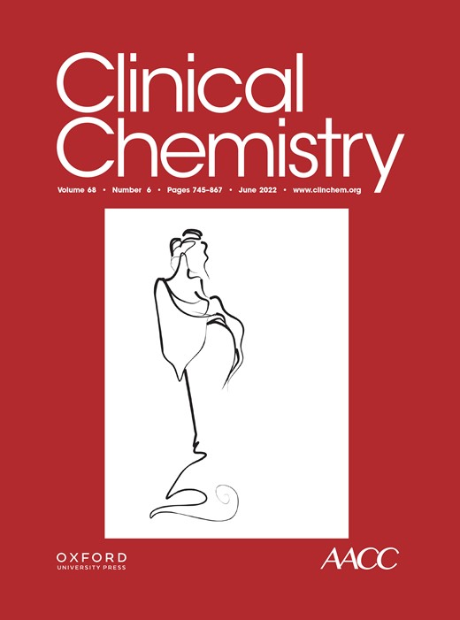
Using Both Plasma and Urine Donor-Derived Cell-Free DNA to Identify Various Renal Allograft Injuries
X.-T. Chen, J. Qiu, Z.-X. Wu, H. Zhang, T. Chen, S.-C. Yang, G.-D. Zhao, Y. He, X. Shen, J.-Q. Luo, Y. Huang, C.-X. Wang, L.-Z. Chen, C.-L. Wu, G. Huang
June 2022
https://doi.org/10.1093/clinchem/hvac053
© 2022 by the American Association for Clinical Chemistry

Slide 2
Background
Investigate the association between donor-derived cell-free DNA (dd-cfDNA) and renal allograft injuries.
Methods
Enrolled 113 adult kidney transplant recipients with kidney biopsies.
Plasma and urine dd-cfDNA was detected by target region capture sequencing.

Slide 3
Results
Flowchart of the study cohort
Figure 1. ABMR, antibody-mediated rejection; TCMR, T cell-mediated rejection; BKPyVAN, BK polyomavirus-associated nephropathy; IgAN, IgA nephropathy; IF/TA, interstitial fibrosis and tubular atrophy; CNI, calcineurin inhibitor; FSGS, focal segmental glomerulosclerosis; ATI, acute tubular injury; MPGN, membranoproliferative glomerulonephritis.

Slide 4
Comparison of dd-cfDNA
Figure 2. Comparison of (A) plasma dd-cfDNA fraction (%), (B) plasma dd-cfDNA concentration (ng/mL), (C) urine dd-cfDNA concentration (ng/mL), and (D) urine dd-cfDNA fraction (%) among various pathological phenotypes. Boxes represent median and interquartile range, with whiskers showing the min and max. Each dot depicts an individual patient sample.

Slide 5
Performance of plasma dd-cfDNA fraction for discriminating ABMR
Figure 3. (A) Plasma dd-cfDNA fraction and (B) plasma dd-cfDNA concentration in mixed rejection, isolated ABMR, and negative biopsies; (C) plasma dd-cfDNA fraction in different types of rejection.

Slide 6
Performance of urine dd-cfDNA concentration for discriminating BKPyVAN
Figure 4. (A) Urine dd-cfDNA concentration in BKPyVAN versus in negative biopsies; (B) urine dd-cfDNA fraction in BKPyVAN and negative biopsies; (C) comparison of urine dd-cfDNA concentration among BKPyVAN, TCMR, and borderline change.

Slide 7
Correlation analysis of dd-cfDNA
Figure 5. Significant positive linear correlations were observed between (A) plasma dd-cfDNA fraction and plasma dd-cfDNA concentration, as well as between (B) urine dd-cfDNA fraction and urine dd-cfDNA concentration. No significant correlation was observed between (C) plasma dd-cfDNA fraction and urine dd-cfDNA fraction or between (D) plasma dd-cfDNA concentration and urine plasma dd-cfDNA concentration. r, correlation coefficient.

Slide 8
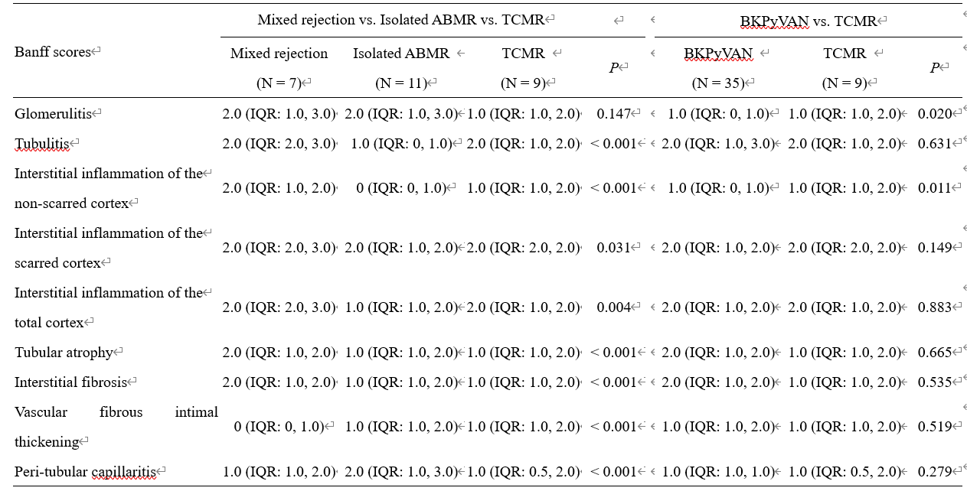
Comparison of Banff scores
Supplemental Table 2. IQR, interquartile range

Slide 9
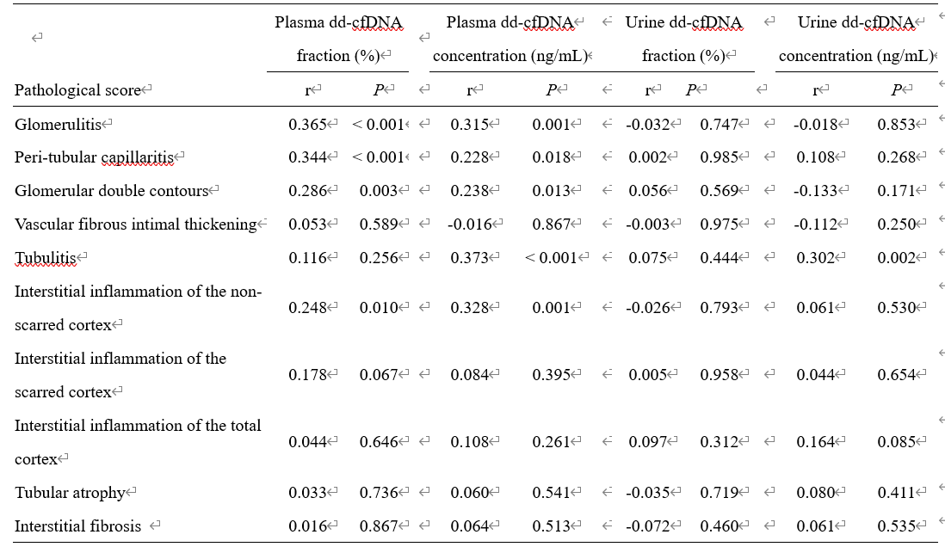
Correlation of dd-cfDNA with each Banff lesion score
Supplemental Table 3. Correlation analysis was assessed by Spearman’s rank correlation test. r, spearman’s rank correlation coefficient

Slide 10
Summary
Both plasma and urine dd-cfDNA are sensitive markers for renal allograft injuries.
The interpretation of a specific disease by dd-cfDNA should be combined with other clinical indicators.

Slide 11
Questions
How may one improve the specificity of dd-cfDNA in identifying transplanted kidney injury？
How may one distinguish between different rejection subtypes and between rejection and polyomavirus nephropathy using dd-cfDNA？
What are the respective advantages and application scenarios of plasma dd-cfDNA and urine dd-cfDNA？

