Slide 1

The Dangers of Using Cq to Quantify Nucleic Acid in Biological Samples: A Lesson From COVID-19
D. Evans, S. Cowen, M. Kammel, D.M. O’Sullivan, G. Stewart, H.-P. Grunert, J. Moran-Gilad, J. Verwilt, J. In, J. Vandesompele, K. Harris, K.H. Hong, N. Storey, S. Hingley-Wilson, U. Dühring, Y.-K. Bae, C.A. Foy, J. Braybrook, H. Zeichhardt, J.F. Huggett
January 2022
https://doi.org/10.1093/clinchem/hvab219
© Copyright 2022 by the American Association for Clinical Chemistry

Slide 2
Reverse transcription quantitative PCR
RT qPCR for SARS-COV-2 diagnosis
  Detects presence of Viral RNA in patient sample
  Automated analysis ideal for diagnostic use
  Provides quantification cycle, C_{q} (also termed cycle threshold, C_{t}), even when not used for quantification
  C_{q} provides estimate of [RNA] in samples (fewer cycles means more RNA at the beginning)
Fluorescence
Cycle
C_{q}

Slide 3
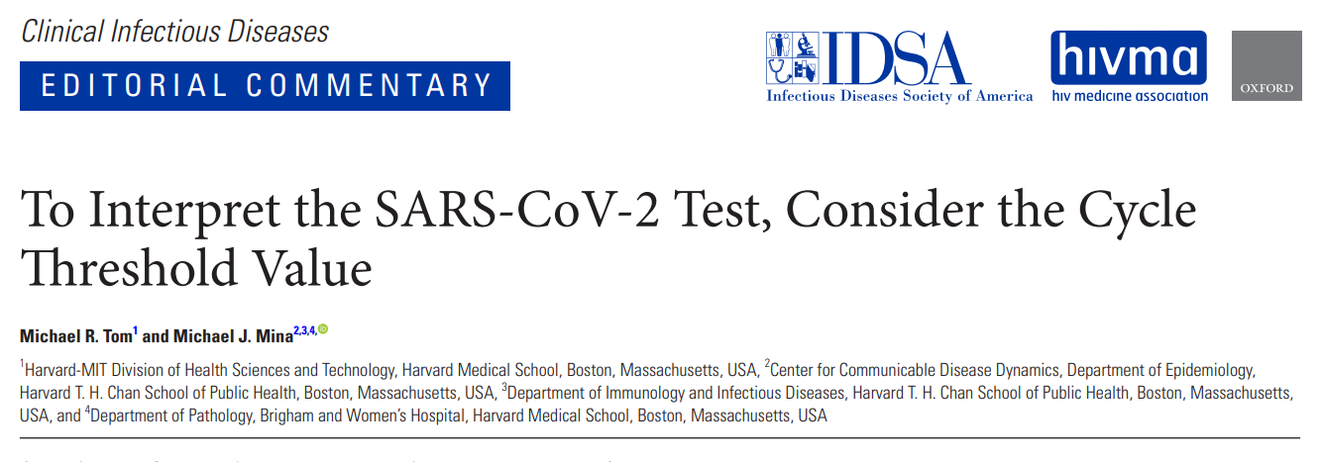
Clinical relevance
Presence of viral RNA alone cannot distinguish between infectious and noninfectious SARS-COV-2
  Quantity of RNA has been proposed as a surrogate for clinical relevance and sample quality
  C_{q} output from Rt qPCR diagnostic assays suggested as a unit for RNA quantification for:
    clinical relevance
    threshold for subsequent analysis (e.g., sequencing)
    diagnostic test performance targets (e.g., limit of detection)

Slide 4
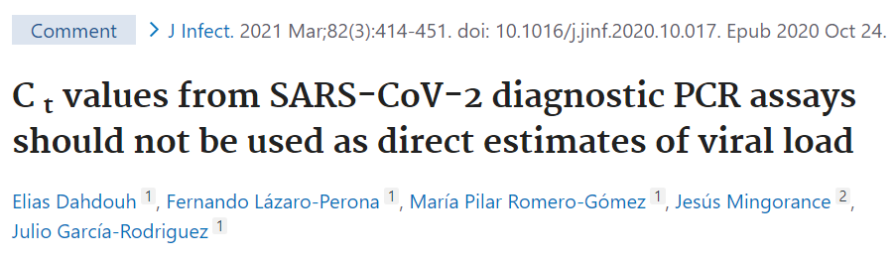
Quantification of other viral pathogens
qPCR quantification of viral genomes clinically
  established for over a decade to aid management of patients with many viral pathogens (e.g., HIV, HCV, HBV, hCMV)
  represents some of the most advanced examples of molecular measurements impacting patient care
  does not use C_{q} as a unit alone despite its availability
  uses calibrated copy-based units, like the International Unit, supported at a global level by WHO reference materials

Slide 5
Study Aims
Determine the actual quantitative error in SARS-CoV-2 copies/mL when using C_{q} alone and suitability as a unit
Explore the ranges and distribution in SARS-CoV-2 viral burden from COVID-19 patients
Design
SARS-CoV-2 EQA materials measured by >600 laboratories used to estimate the variation in copies/mL for a given Cq value
RNA distributions analyzed from >6000 patients from 3 laboratories in UK, Belgium, and the Republic of Korea
Impact of quantitative cutoffs on sensitivity assessed

Slide 6
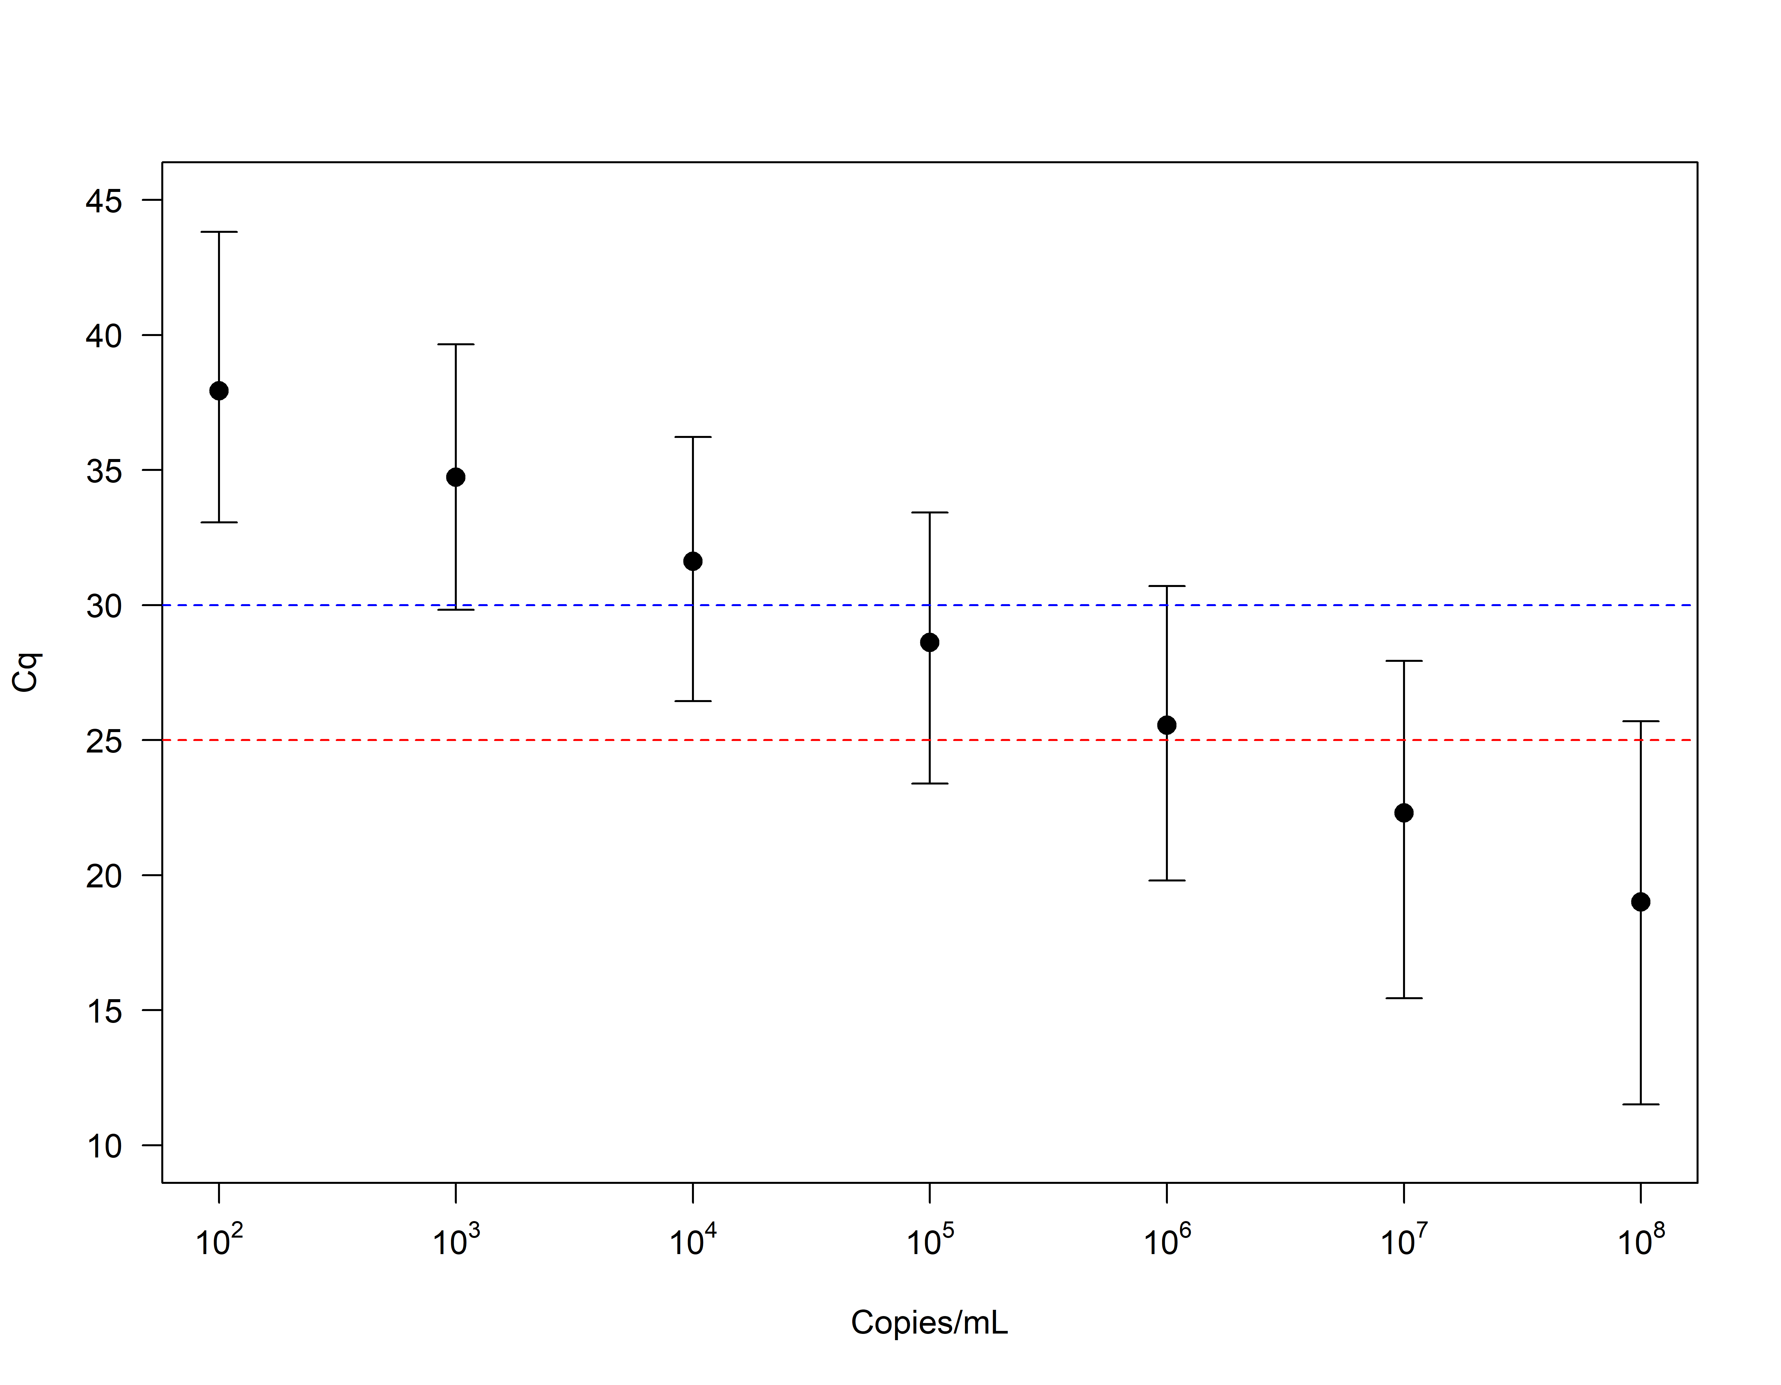
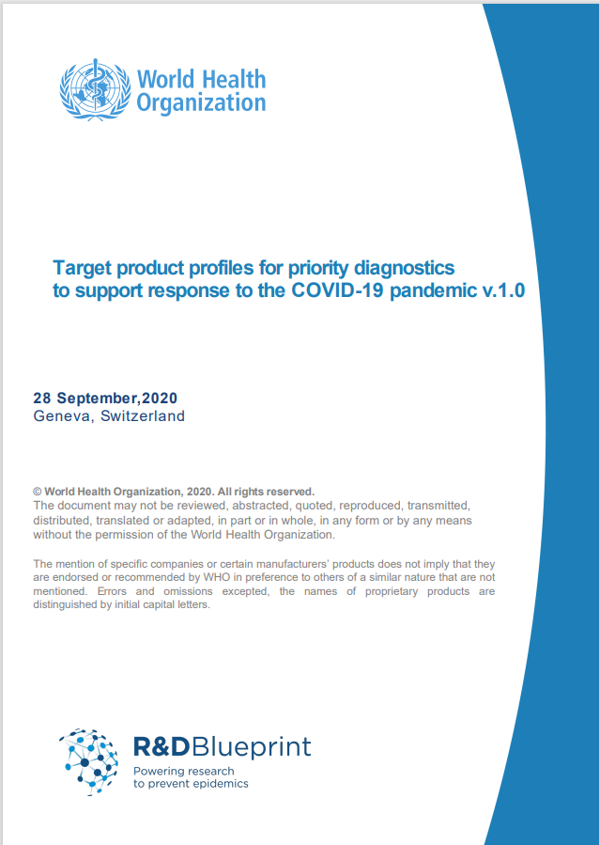
Interlaboratory error for a given C_{q}
Figure 1. Range (99% confidence) of observed C_{q} value associated with a given viral RNA concentration are >1000 fold.
Red/Blue lines indicated performance targets stipulated by WHO Target Product Profile (TPP)

Slide 7
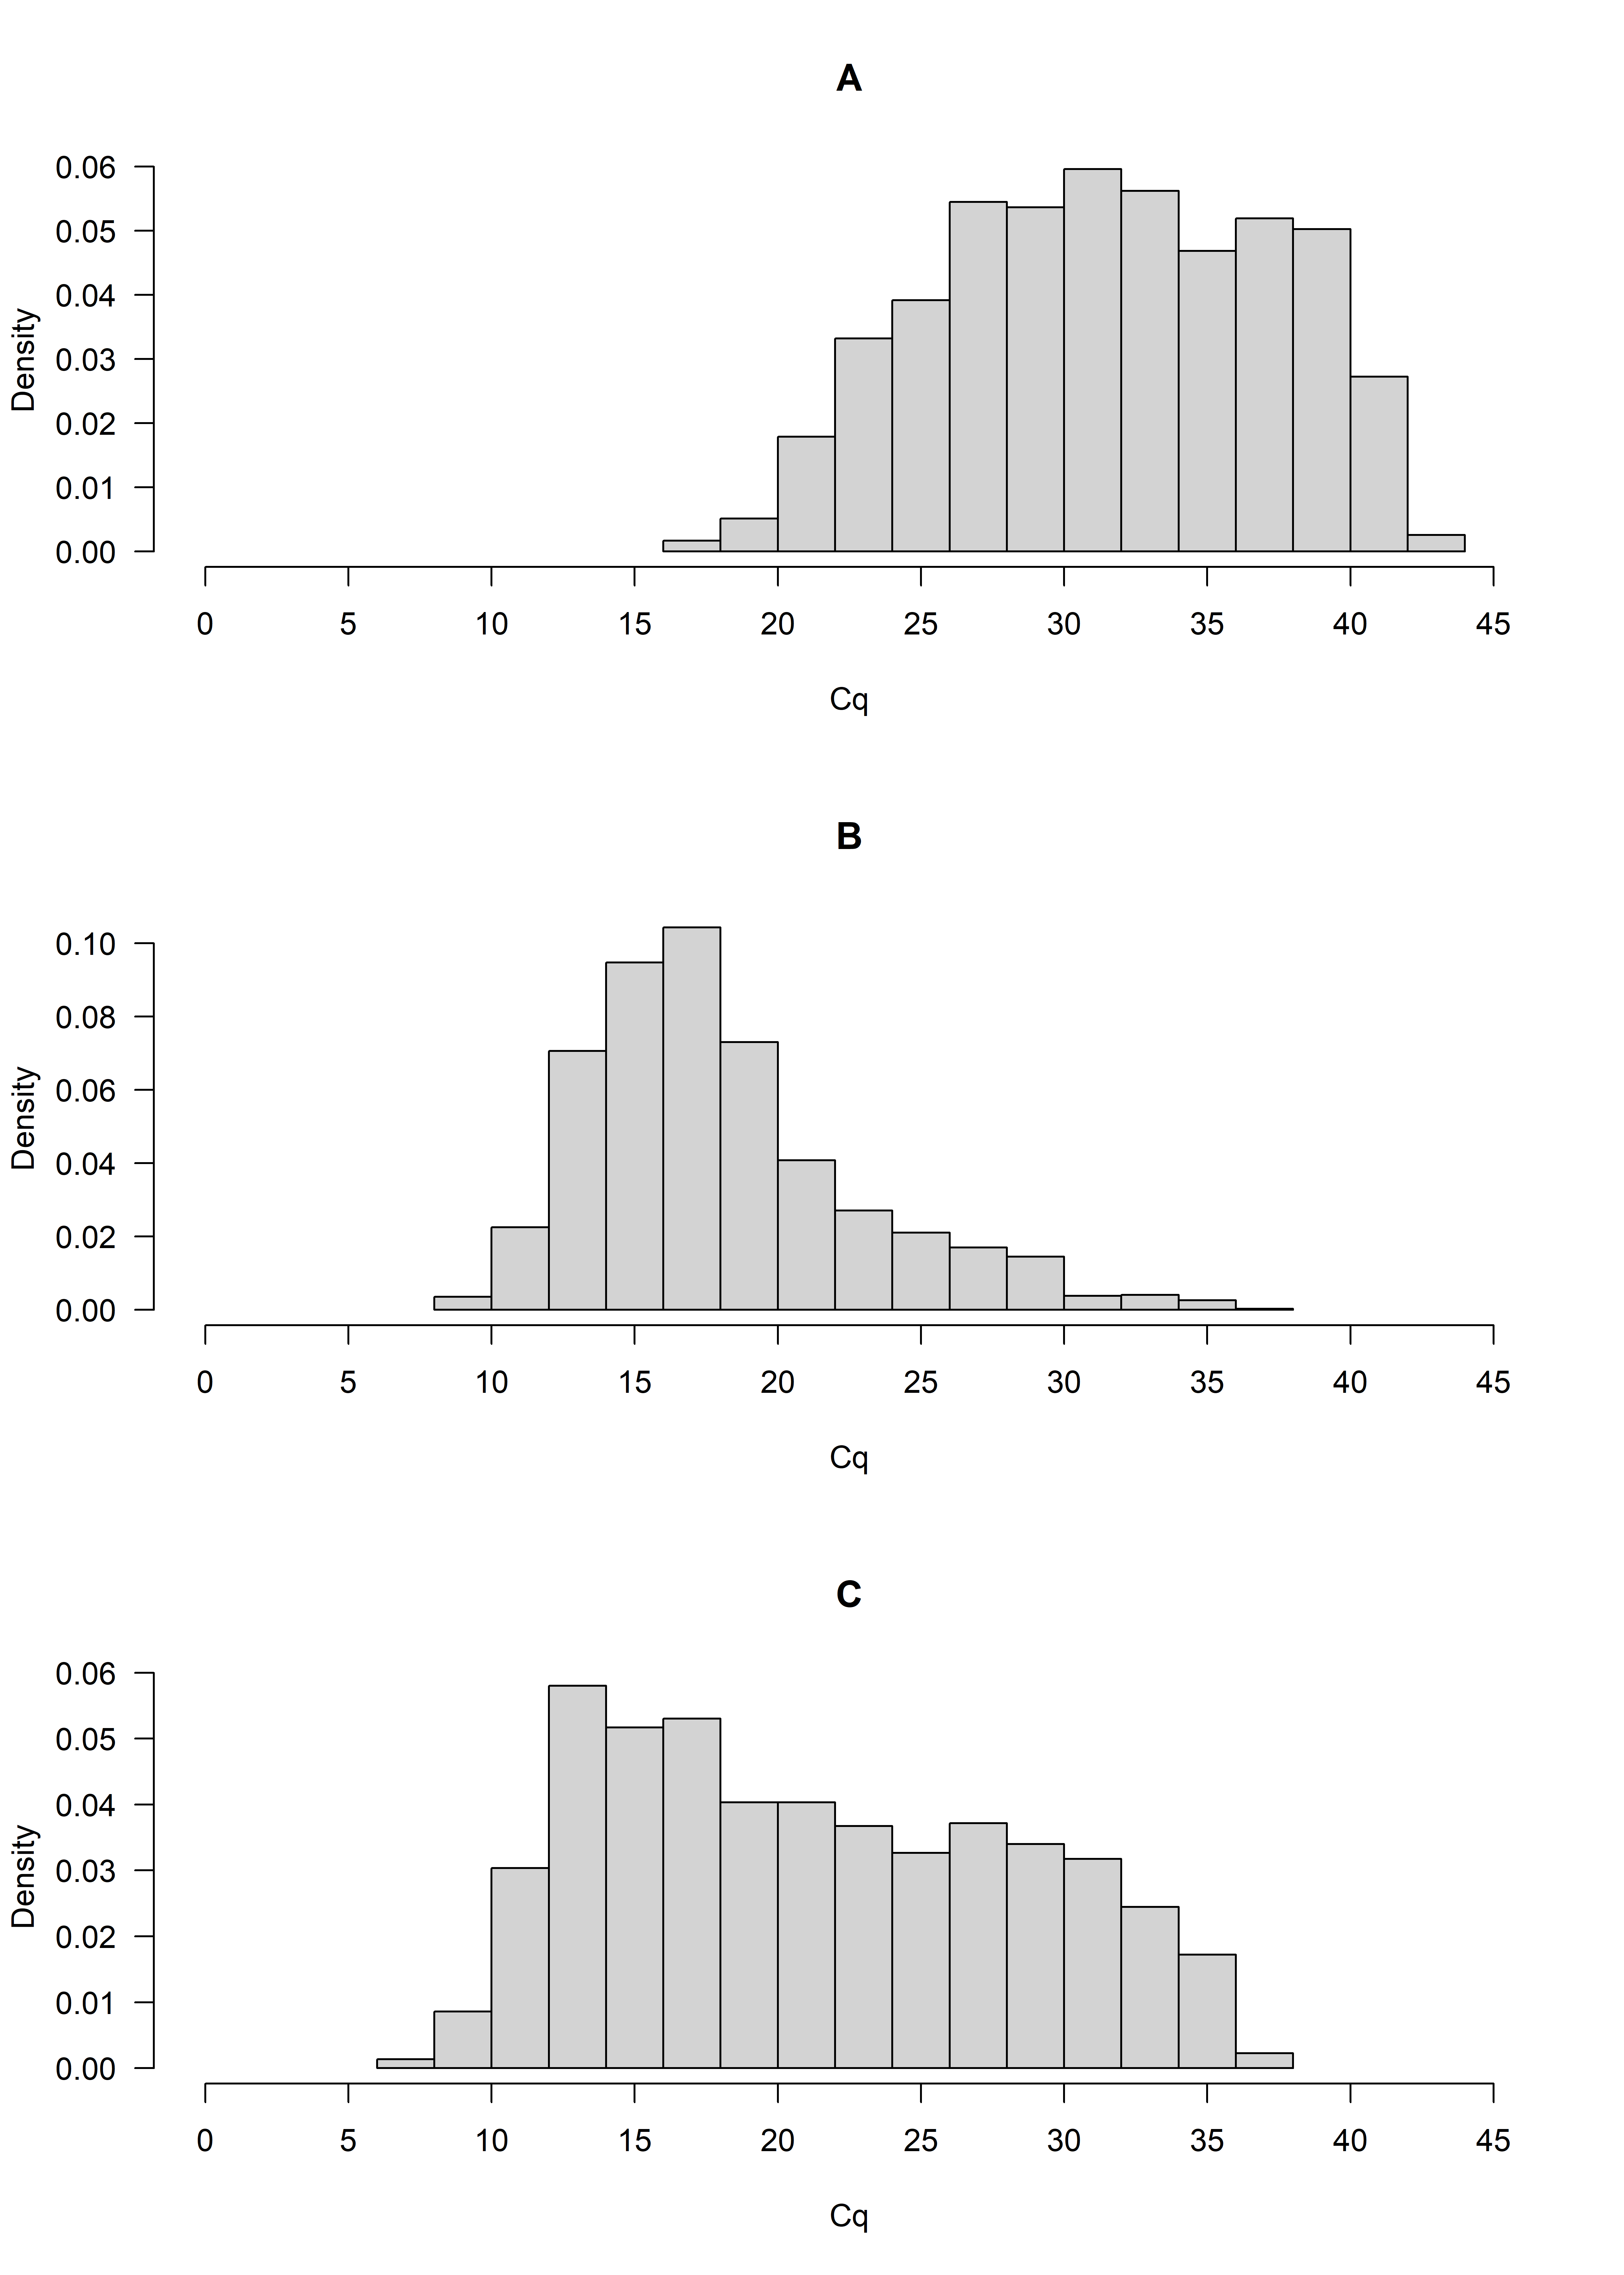
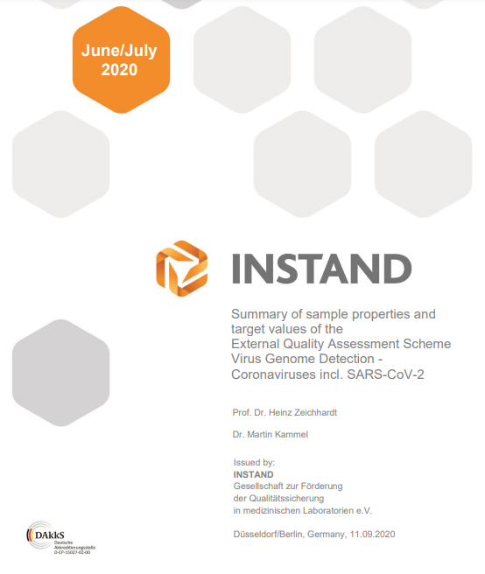
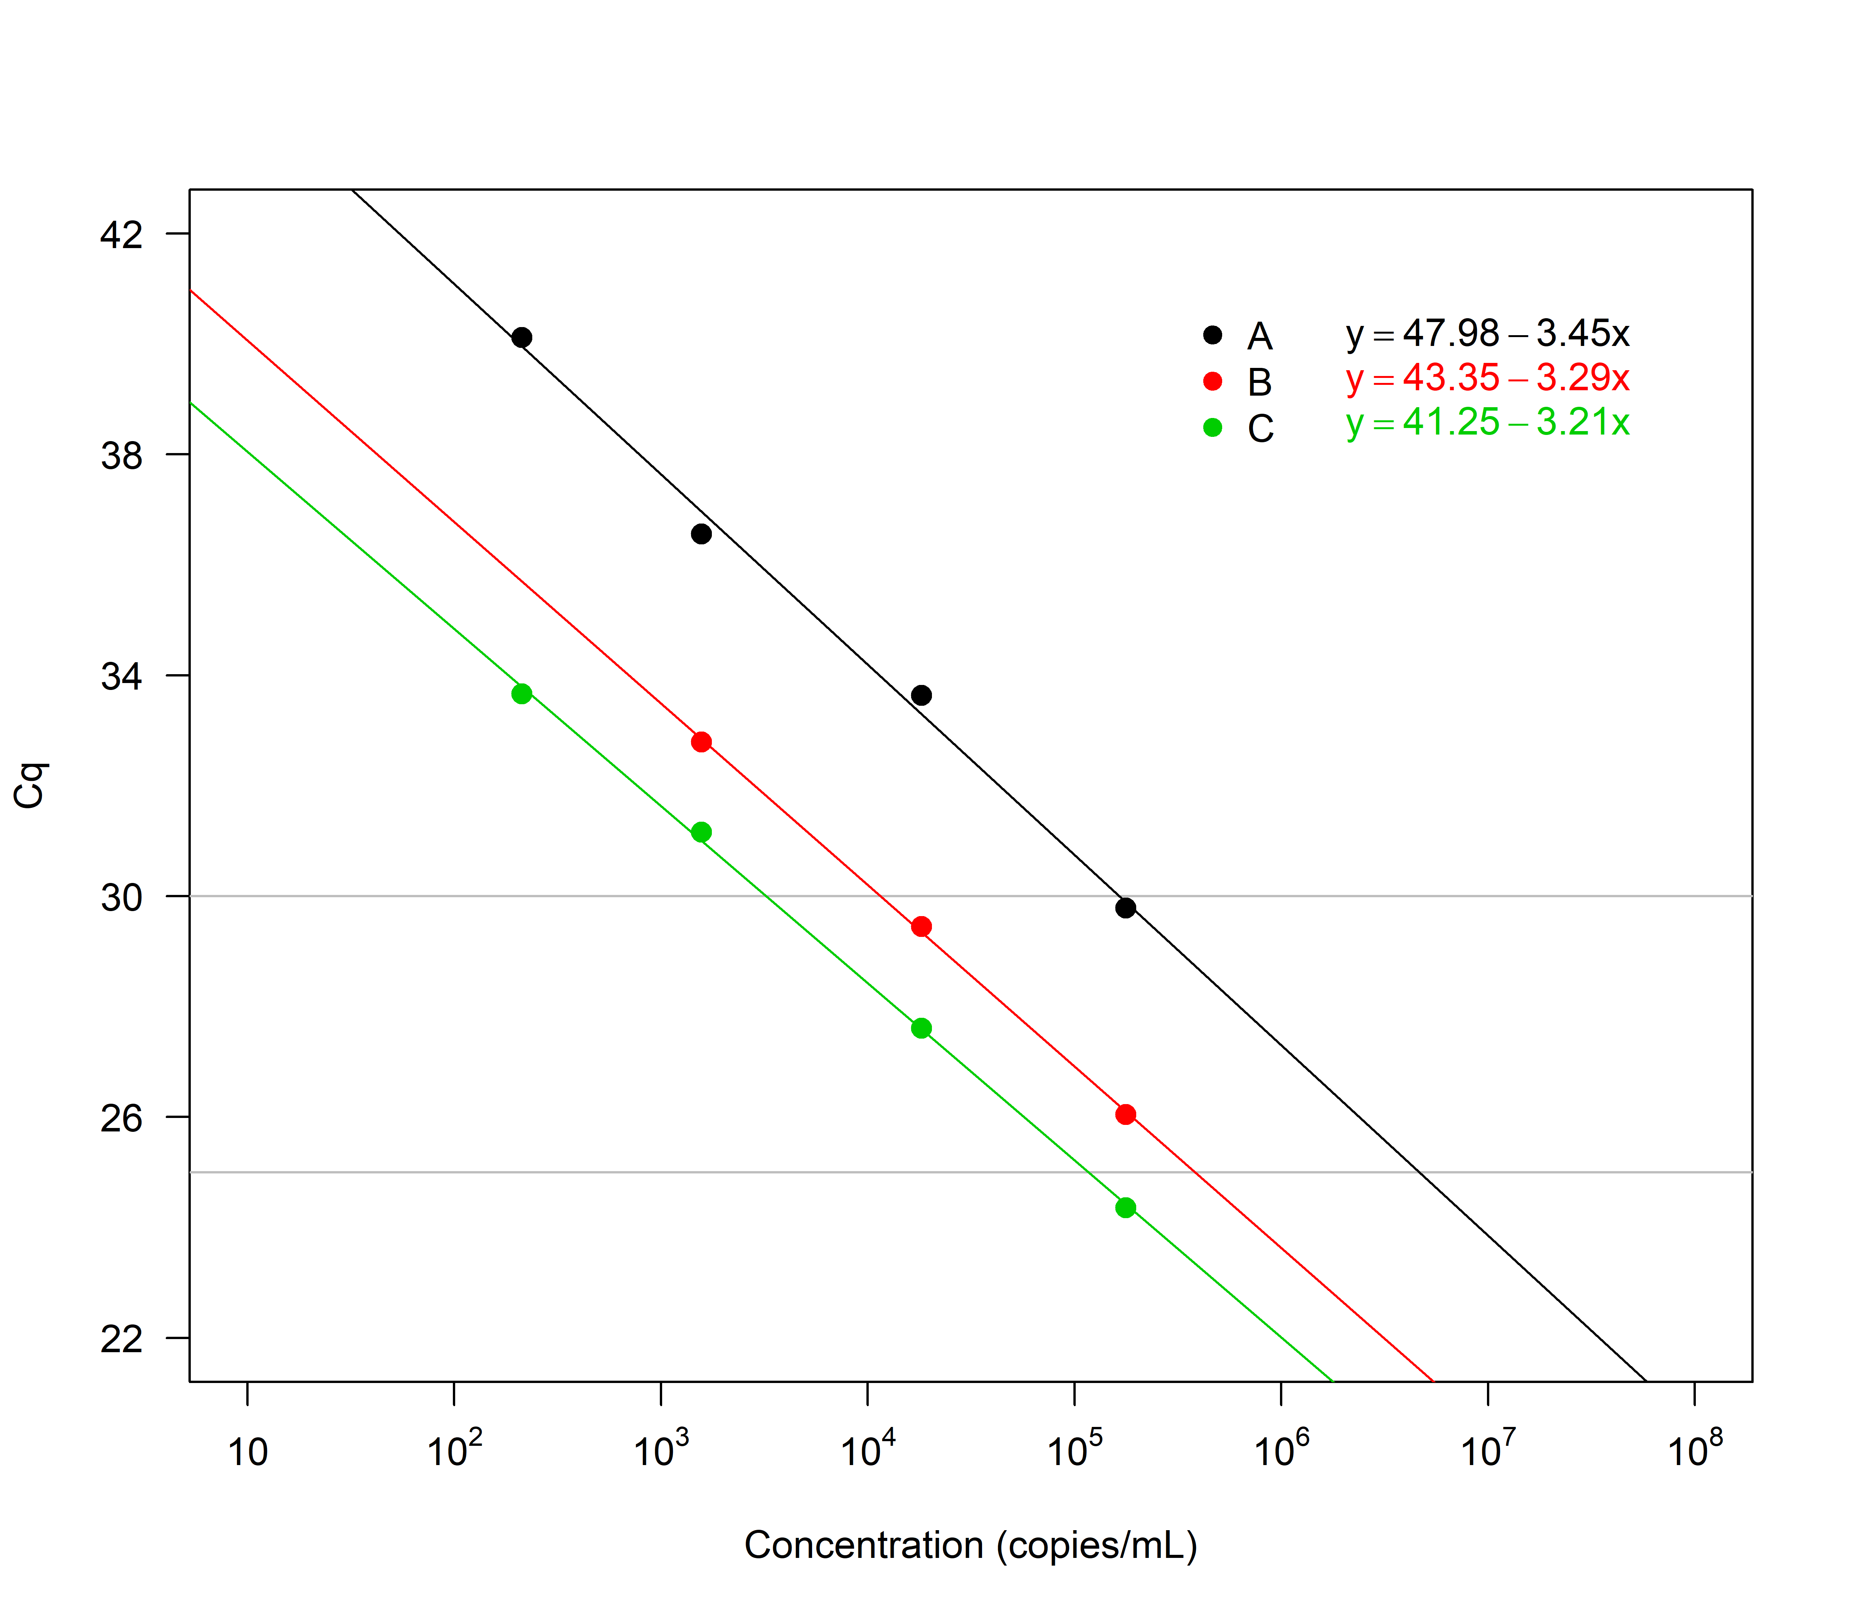
Distribution of Cq values
Figure 2. Histograms showing measured Cq values for the three different cohorts. Range varies from ~7 to ~40 cycles and three cohorts have distinctive shapes. Calibration shows ~6 cycle in Cq between difference between laboratory

Slide 8
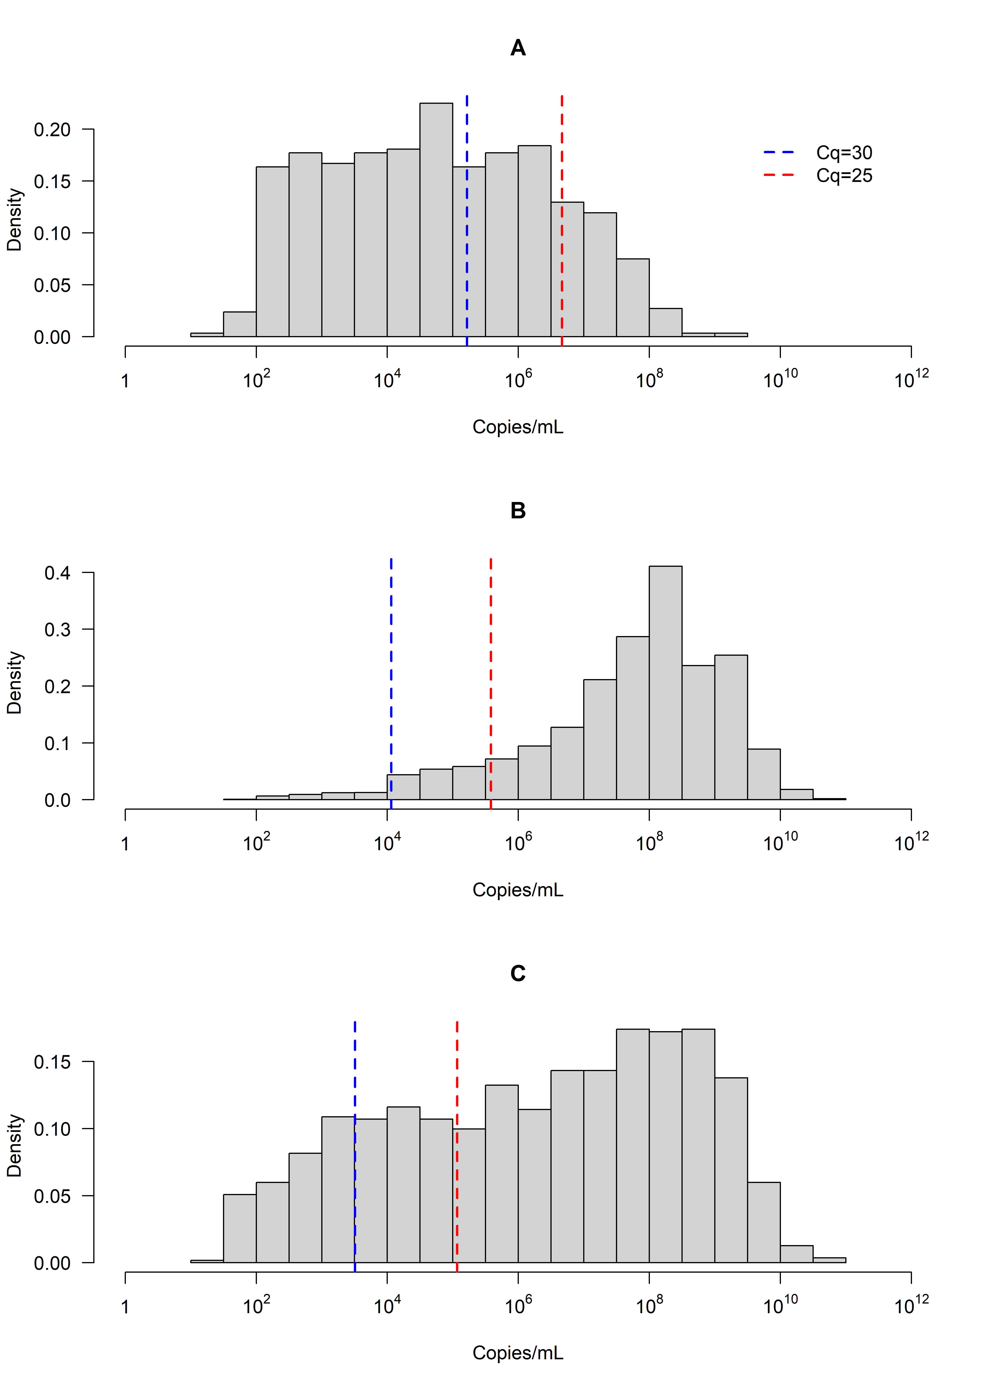
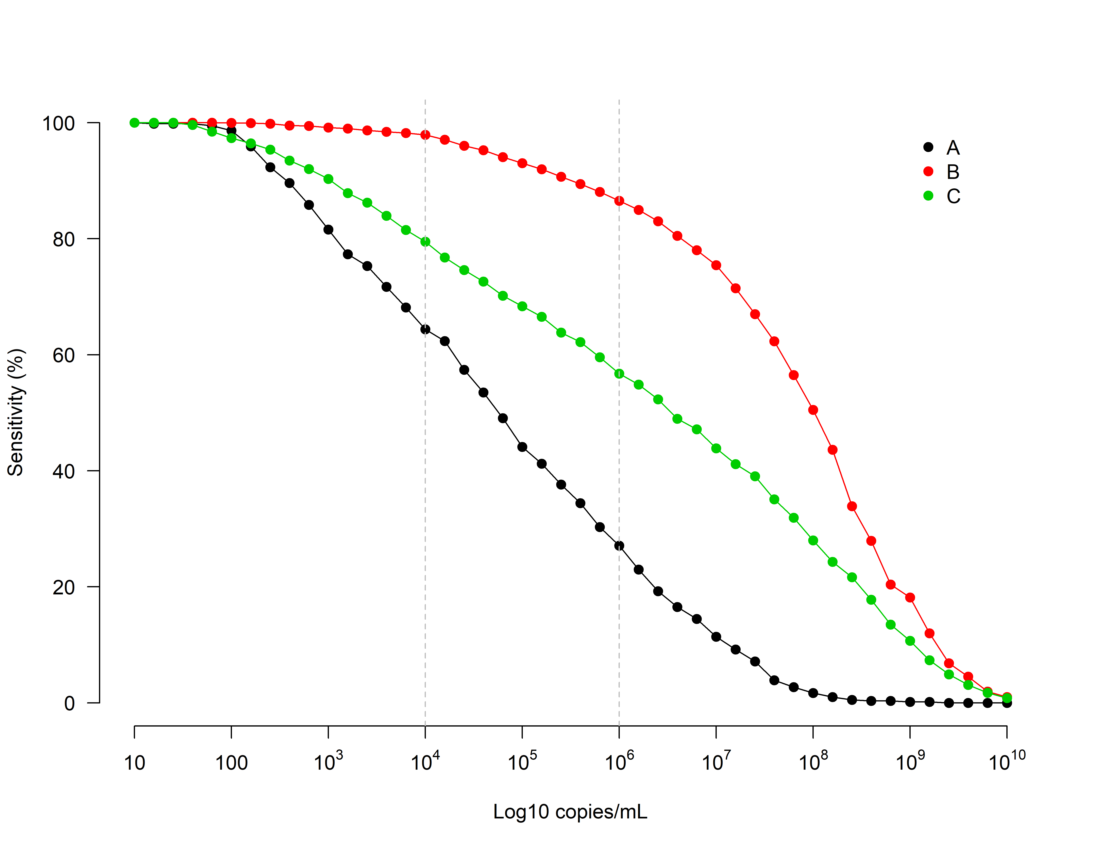
Viral burden distributions and impact on diagnosis
D
E
Copies/mL | Lab | Sensitivity %
10⁶ | A | 27.09
 | B | 86.53
 | C | 56.75
Figure 1. Histograms of calibrated copy number for the three different cohorts (A, B & C) used in the Study. D: impact of applying different copy/mL (to simulate quantitative cut-on or less analytically sensitive methods) sensitivity with table E showing the actual measured sensitivity for 10⁶ /mL (stipulated as the minimum limit of detection required for a point of care test by the WHO).

Slide 9
Questions for discussion:
Why is the distribution still so different even after calibration?
What does the wide variation mean for using C_{q} as a unit of measure?

Slide 10
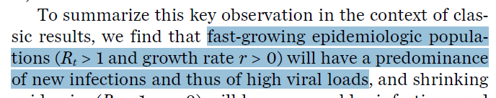
Discussion
Why is the distribution of the three cohorts still so different even after calibration?
This may be due to differences in the reproduction number for the respective populations.

Slide 11
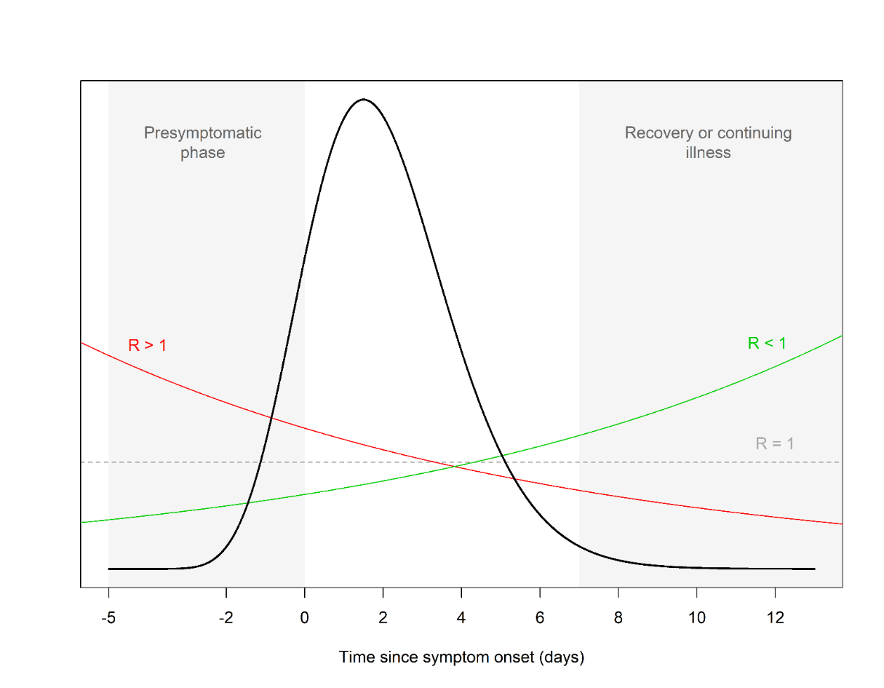
The clinical sensitivity shift
Figure 4. Schematic to illustrate how the proportions of COVID-19 patients are distributed with different reproduction numbers (R). Example of viral burden (black line) with time since symptom onset. When R > 1 (red line), there are more patients as a proportion of the total at earlier stage of infection; as early infection has higher viral burden there is more virus in this population. The reverse is the case when R < 1 (green line). This could result in a change in diagnostic performance (manifesting as a clinical sensitivity shift where Rt-qPCR is the gold standard) when using quantitative thresholds or less analytically sensitive methods.

Slide 12
Discussion
Does sensitivity shift mean anything clinically?
Further work is required to investigate potential impact, however this could mean:
  different testing formats are better at different stages of a pandemic/epidemic
  test performance during routine testing may differ from that evident during development and validation stages

Slide 13
Discussion
What does the wide variation mean for using C_{q} as a unit of measure?
C_{q} may be used for looking at trends in large data sets
Should not be used alone for quantifying (setting cut offs) viral burden to:
  stratify patients in terms of risk
  as diagnostic performance targets
  to characterize a sample for subsequent analysis (such as sequencing)

