Slide 1
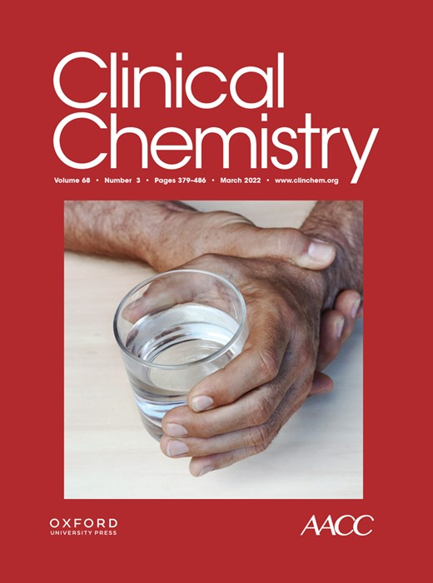
Sex-Specific Absolute Delta Thresholds for High-Sensitivity Cardiac Troponin T
L. Liu, W. Consagra, X. Cai, A. Mathias, A. Worster, J. Ma, P. Rock, T. Kwong, P.A. Kavsak
March 2022
https://doi.org/10.1093/clinchem/hvab230
© Copyright 2022 by the American Association for Clinical Chemistry

Slide 2
Introduction
High-sensitivity cardiac troponin (hs-cTn) is the preferred biomarker to aid in the diagnosis of myocardial infarction (MI), which is the presence of myocardial injury in the setting of evidence of acute myocardial ischemia.
  Myocardial injury is defined when there is at least one hs-cTn value above the 99th percentile upper-reference limit (URL) of a healthy reference population.
  A rise and/or fall pattern beyond an acceptable range (i.e., delta threshold) is required for the diagnosis of acute myocardial infarction (AMI).
  Delta thresholds for a 0h/3h hs-cTn algorithm have not been provided by the new 2020 European Society of Cardiology (ESC) guideline for the diagnosis of AMI.

Slide 3
Introduction
Sex-specific difference in hs-cTn concentrations and in the AMI diagnosis has been recognized.
  Women have significantly lower hs-cTn concentrations compared to men in presumably healthy populations.
  Women tend to have atypical clinical presentations of AMI, which complicates recognition of symptoms.
  These observations have prompted the recommendation of the use of sex-specific hs-cTn 99th percentile URLs for the diagnosis of AMI.
QUESTION 1: In addition to sex-specific hs-cTn 99th percentile URLs, what other criteria may be useful to rule-in and rule-out AMI?

Slide 4
OBJECTIVES
To assess sex difference in hs-cTnT concentrations in patients presenting to the emergency department (ED).
To evaluate and validate the use of sex-specific delta thresholds for hs-cTnT from samples collected 3 h apart (i.e., 0h/3h) in the ED for AMI diagnosis.

Slide 5
METHODS
Study population
  Derivation cohort (cohort 1)
    18,056 adult ED cases with 0h/3h hs-cTnT results from a US medical center
    Retrospective
    Outcome: type 1 AMI diagnosis at discharge
  Validation cohort (cohort 2)
    1,137 adult ED cases with 0h/3h hs-cTnT results from a Canadian medical center
    Prospective, patients with symptoms suggestive of acute coronary syndrome were enrolled
    Outcome: type 1 or type 2 AMI diagnosis within 7 days after ED presentation

Slide 6
METHODS
hs-cTnT assays
  Cohort 1: Roche Cobas 602 with Elecsys Troponin T Gen 5 STAT reagent
    LOQ: 6 ng/L
    The coefficient of variation (CV) is 2.59% at 16 ng/L and 2.06% at 98 ng/L.
  Cohort 2: Roche Modular E170 platform
    LOD: 3 ng/L
    The CV is 2.3% at 30 ng/L and 2.1% at 2253 ng/L.
QUESTION 2: Given the differences between the two patient populations and the different analytical instruments used, will the same delta threshold be useful for both cohorts?

Slide 7
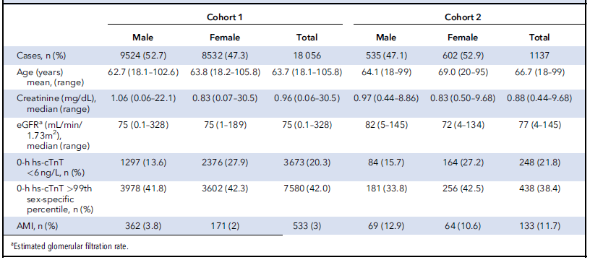
Age and biochemical profiles for both Cohort 1 and Cohort 2
Table 1. Age and biochemical profiles for both Cohort 1 and Cohort 2.

Slide 8
Sex-specific difference in 0-h hs-cTnT concentrations
Figure 1. Comparison of 0-h hs-cTnT results between male and female in all patients (A), patients without AMI (B), patients with AMI (C), and patients with NSTEMI (D) by nonparametric Mann–Whitney U test.

Slide 9
Sex-specific difference in absolute delta hs-cTnT
Figure 2. Comparison of absolute delta hs-cTnT between male and female in all patients (A), patients without AMI (B), patients with AMI (C), and patients with NSTEMI (D) by nonparametric Mann–Whitney U test.

Slide 10
Relationship between 0-h and absolute delta hs-cTnT in male and female patients
Figure 3. Relationship between absolute delta changes and 0-h hs-cTnT concentrations in patients with AMI in log scales with locally weighted scatterplot smoothing curve and 95% CIs grouped by male and female.

Slide 11
Diagnostic performance of percentage and absolute delta hs-cTnT in male and female patients
Figure 4. Receiver operating characteristic (ROC) curve and area under curve (AUC) of percentage delta and absolute delta change to predict acute myocardial infarction in male and female patients.

Slide 12
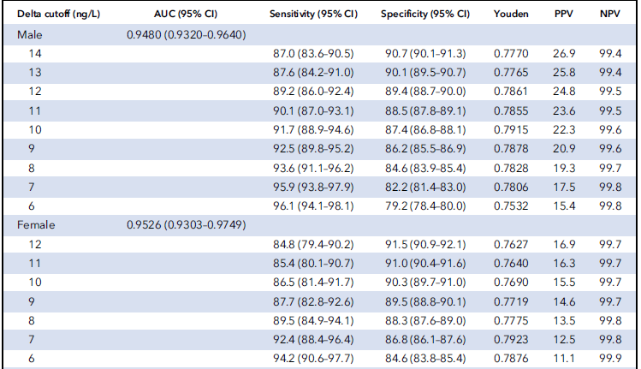
Performance of absolute delta thresholds by ROC analysis for ruling in acute myocardial infarction in cohort 1 population

Slide 13
RESULTS AND DISCUSSION
Delta thresholds based on the 90% specificity benchmark (≥14 ng/L in males, ≥11 ng/L in females) provided optimal performance and reached a diagnostic accuracy of 91%, in both males and females.
Threshold analysis in cohort 2 confirmed that males require a higher absolute delta to achieve a comparable specificity as in females. In cohort 2, 11 ng/L for females resulted in a sensitivity of 52.5%, specificity of 98.6%, PPV of 77.8%, and NPV of 95.8%; while 14 ng/L for males reached comparable performance with a sensitivity of 50.0%, specificity of 98.4%, PPV of 79.3%, and NPV of 94.1%.
Specifically, in cohort 2, a delta of 14 ng/L for males and a delta of 11 ng/L for females both yielded specificity estimates >90% and PPV estimates >75%, with both these parameters having been proposed as targets for ruling-in AMI for other algorithms.

Slide 14
QUESTION 3: For hs-cTn assays, which deltas (absolute versus relative), provide the highest diagnostic accuracy for AMI in ED patients presenting with symptoms suggestive of acute coronary syndrome?

Slide 15
KEY MESSAGES AND CONCLUSIONS
The high percentage of ED patients presenting with 0-h hs-cTnT above the 99th percentile URL emphasizes the importance of dynamic changes to differentiate acute from chronic cardiac conditions.
Male patients had significantly higher 0-h hs-cTnT and absolute delta changes than female patients who present to the ED with acute symptoms but without AMI.
Sex-specific absolute delta thresholds increase specificity and diagnostic accuracy, especially in male patients, and are robust across different study populations.
Delta thresholds of 14 ng/L in males and 11 ng/L in females are optimal for ruling in AMI using a hs-cTnT 0-h/3-h algorithm.

