Slide 1

High-Sensitivity Cardiac Troponin I and T Kinetics Differ following Coronary Bypass Surgery:
A Systematic Review and Meta-Analysis
E.J. Denessen, S. Heuts, J.H. Daemen, W.P. van Doorn, W.H. Vroemen, J.-W. Sels, P. Segers, A.W. Van‘t Hof, J.G. Maessen, O. Bekers, I.C. Van Der Horst, A.M. Mingels
December 2022
https://doi.org/10.1093/clinchem/hvac152
© 2022 by the American Association for Clinical Chemistry

Slide 2
Introduction
Coronary artery disease is a leading cause of death worldwide, potentially leading to myocardial infarction (MI)
  MI is treated medically by percutaneous intervention or surgically by coronary artery bypass grafting (CABG)
  Risk for procedural-related MI, for CABG called MI type 5 (MI-5)
  High-sensitivity cardiac troponin I (hs-cTnI) and T (hs-cTnT) are the biomarkers of choice for diagnosing MI
Various definitions of MI-5 have been proposed for the first 48h after CABG
  Proposals by the Society for Cardiovascular Angiography and Intervention and the Fourth Universal Definition of Myocardial Infarction (UDMI-4)
  Arbitrarily chosen cutoffs, with or without additional ECG or imaging findings
  No differentiation between cTnI and cTnT and type of surgery
  Goal: investigation of kinetics of hs-cTnI and hs-cTnT in the post-operative phase in patients undergoing isolated CABG

Slide 3
Introduction
Question: When diagnosing post-operative MI >48 h after CABG, guidelines advise using the definition for diagnosing type 1 MI. What would be a reason for this?

Slide 4
Methods
Search and study selection
  MEDLINE and EMBASE databases, cross-reference article search.
  Search terms: “coronary artery bypass grafting,” “high-sensitivity cardiac troponin,” and alternative spelling.
Data extraction and outcomes
  All study characteristics
    Type of isolated CABG (on-pump or off-pump)
  Primary outcomes: hs-cTnI and/or hs-cTnT concentrations
  Secondary: MI-5 incidence and in-hospital or 30-day mortality
  Stratification of hs-cTn concentrations: pre-operative, 0-4h, 6-8h, 10-12h, 16-24h,
  36-48h, and 72h post-operatively
  Normalizing hs-cTn concentration to upper reference limit (URL) of each assay
  Sub-analysis:
    Type of assay
    Sex-specific URLs
    Type of surgical procedure
  Risk of bias assessment and heterogeneity assessment

Slide 5
Methods
Question: A sub-analysis was performed for the type of assay, sex-specific URLs, and type of surgical procedure. Would there be more characteristics that need a sub-analysis, and why would a sub-analysis be needed?

Slide 6
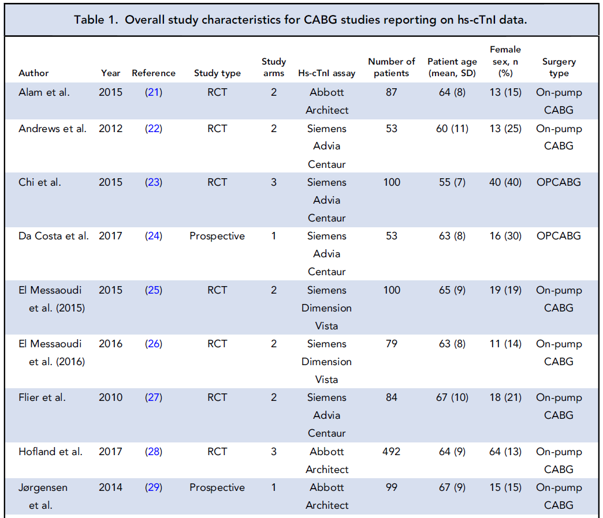
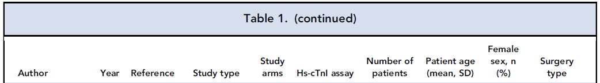
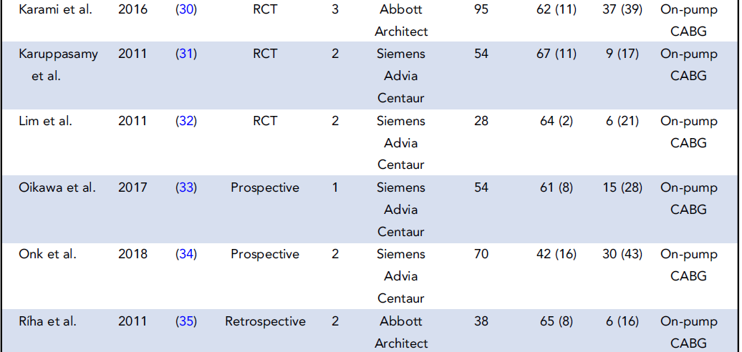
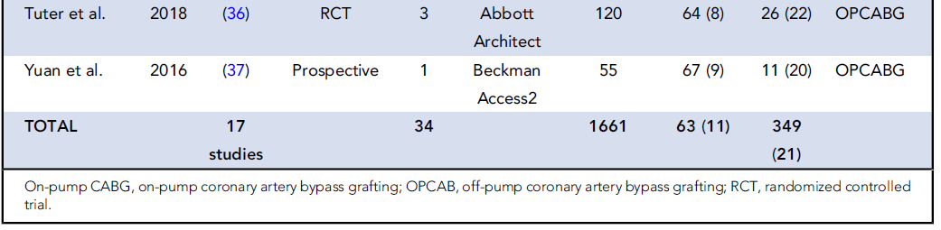
Study characteristics

Slide 7
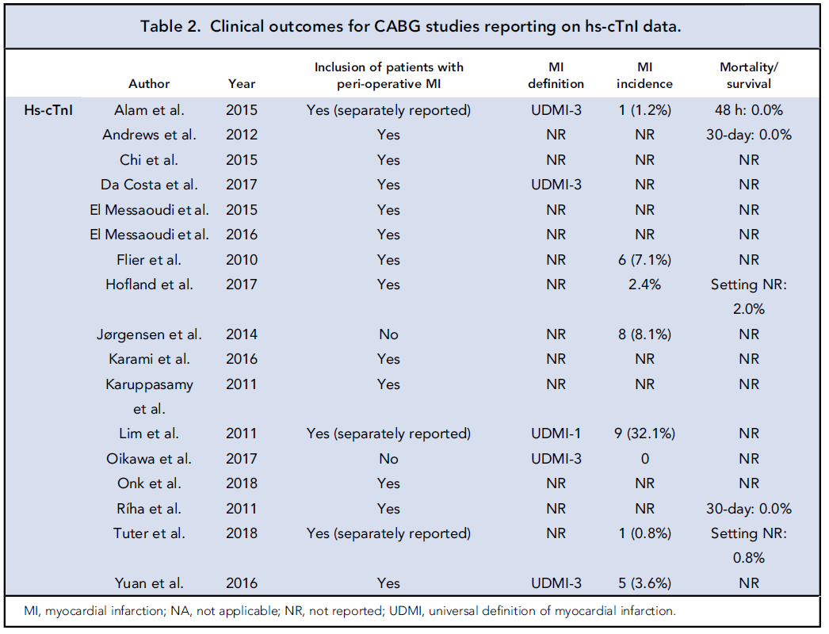
Clinical outcomes

Slide 8
hs-cTnI and hs-cTnT both exceed most definitions of MI-5 with almost 3-fold higher values for hs-cTnI
hs-cTnI
hs-cTnT
Figure 1. Normalized hs-cTnI and hs-cTnT values after CABG in the total study population in relation to current definitions of MI-5. The solid line represents the mean; the lighter zones depict 95% CI of the mean. Orange represents hs-cTnI; blue represents hs-cTnT.

Slide 9
All hs-cTn assays reached peak 6-8h post-CABG; however, peak height was assay-dependent
hs-cTnI – Siemens Advia Centaur
hs-cTnI – Abbott Architect
hs-cTnT – Roche Diagnostics
Figure 2. Normalized hs-cTnI and hs-cTnT values after CABG in the total study population, specified per assay (if at least 3 studies are available), in relation to current definitions of MI-5. The orange, gray, and blue striped lines represent the mean; the lighter zones depict 95% CI of the mean. Orange color represents hs-cTnI assay—Siemens Advia Centaur; gray color represents hs-cTnI—Abbott Architect; blue color represents hs-cTnT—Roche Diagnostics.

Slide 10
Peak height was also dependent on the URL used
URL based on male/female distribution
Male URL
Female URL
Figure 3. Normalized hs-cTnI values after CABG in the total study population, presented by different applied URLs (male, female, male-female ratio) in relation to current definitions of MI-5. Gray, blue, and orange lines represent the mean; the lighter zones depict 95% CI of the mean. Gray color represents male URL; blue color represents the female URL; orange color represents the URL based on the male/female distribution (per included study).

Slide 11
On-pump CABG caused higher hs-cTn compared to off-pump CABG
A. On-pump CABG
B. Off-pump CABG
hs-cTnI
hs-cTnT
Figure 4. Normalized on-pump CABG (A) and off-pump CABG (B) hs-cTnI and hs-cTnT values, in relation to current definitions of MI-5. Solid lines represent the mean; 95% CI of the means are depicted by the lighter zones. Orange represents hs-cTnI and the blue represents hs-cTnT.

Slide 12
Results and Discussion
hs-cTnI and hs-cTnT peaks exceeded most definitions for diagnosing MI-5, implying many of these patients would fulfill MI-5 criteria
Peak hs-cTnI concentrations were almost 3-fold higher than hs-cTnT, although hs-cTnI kinetics were highly dependent on the hs-cTnI assay used
Definitions of MI-5 propose that baseline concentrations should be <URL; however, a preoperative hs-cTnI of 6.1×URL was found, while for hs-cTnT only a slight elevation of 1.2×URL was observed
A shift in peak heights was observed when varying between sex-specific URLs. This may indicate that diagnosis of MI-5 is dependent on baseline value, gender, age, kidney function, and other risk factors
Incidence of MI-5 <48h post-CABG was 5.7% for hs-cTnI and 2.7% for hs-cTnT, although definitions were unclear, while early mortality did not seem to differ. Higher hs-cTnI might result in overestimation of MI-5 incidence in hs-cTnI studies
hs-cTnI and hs-cTnT release after on-pump vs off-pump CABG was different, both for peak height and peak location, indicating the need for surgical procedure-specific cutoff values

Slide 13
Results and Discussion
Questions: All definitions of MI-5 propose that baseline concentrations should be below URL. Why is it important that baseline pre-operative cTn concentrations should be below the URL of the hs-cTn assay used? And is it feasible for these types of patients?

Slide 14
Limitations
Lack of head-to-head comparison
Some interesting studies did not report on absolute numerical postoperative values, so these could not be included
cTn release is dependent on, e.g., age, sex, and comorbidity, which could have influenced results
All types of studies were included, e.g., multiple-armed or single-armed RCTs, retrospective or prospective studies
All studies had different anesthesia protocols or cardioplegia types that might influence cTn release
A lot of heterogeneity between included studies, although this underlines that a universal cut-off might not be applicable for diagnosing MI-5
Clinical implications: These results should raise clinicians’ awareness of differences in hs-cTnI and hs-cTnT concentrations in patients post-CABG. hs-cTn assays cannot be used interchangeably in different study populations and are dependent on surgical strategy.

