Slide 1
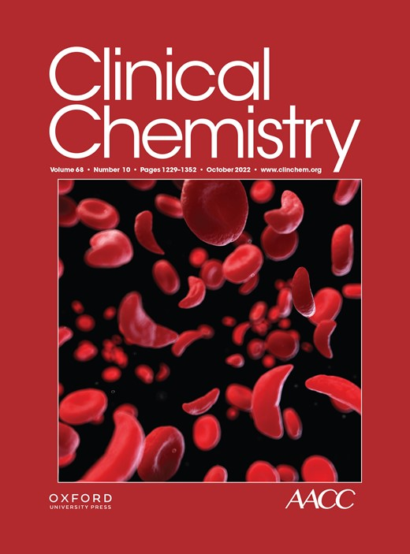
Estimated Atherosclerotic Cardiovascular Disease Risk Score: An Automated Decision Aid for Statin Therapy
M. Sampson, A. Wolska, M. Amar, M. Ueda, R. Dunbar, D. Soffer, A.T. Remaley
October 2022
https://doi.org/10.1093/clinchem/hvac120
© 2022 by the American Association for Clinical Chemistry

Slide 2
Introduction
Cardiovascular diseases (CVDs) are the most common cause of mortality among adults worldwide.
The best treatment for CVD is the prevention of events by modifying risk factors thanks to the accurate atherosclerotic CVD (ASCVD) risk assessment.
The latest US multi-society guideline* on lipid management for primary prevention recommends that such ASCVD risk be calculated on everyone between age 40 and 75 to determine the necessity of treatment with statins.
Assessment of ASCVD involves collecting and entering relevant information for its calculation into a computer.
Why is it important to screen for ASCVD risk in patients?
*2018 AHA/ACC/AACVPR/AAPA/ABC/ACPM/ADA/AGS/APhA/ASPC/NLA/PCNA Guideline on the Management of Blood Cholesterol: A Report of the American College of Cardiology/American Heart Association Task Force on Clinical Practice Guidelines, https://doi.org/10.1161/CIR.0000000000000625

Slide 3
eASCVD, estimated ASCVD risk score
  We developed a simplified estimated ASCVD (eASCVD) lipid risk score that can be automatically calculated by the clinical laboratory information systems on all patients tested with a standard lipid panel.

Slide 4
Methods
  We assembled a test cohort of 6,021 individuals 40–75 yo (excluding those with diabetes or on lipid-lowering drugs) from fasting patients from NHANES. Using this dataset we developed regression equations to generate an eASCVD risk score that provides estimates similar to standard ASCVD score in 4 race/sex groups: Non-Hispanic White men (NHWM)/ women (NHWW) and Black men (BM)/women (BW), using TC, HDL-C, TG, and age. We also randomly divided the dataset into training (25%, N=1,505) and validation (75%, N=4,516) datasets.
  Standard 10-year ASCVD risk was calculated with the four pooled cohort equations (PCEs), using Excel. Low-density lipoprotein-cholesterol (LDL-C) was calculated by the Sampson equation.
  The new eASCVD score was externally validated in the ARIC study (N=14,742) and its mean absolute difference (MAD) as compared to the standard ASCVD risk score was evaluated for any association with clinical ASCVD events (N=14,742).

Slide 5
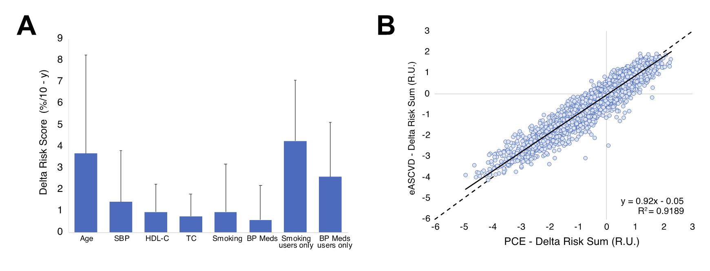
Development of new equations for calculating an eASCVD lipid risk score
Figure 1. Development of eASCVD equations. (A) Bars indicate mean absolute difference (MAD) plus 1SD of difference between 10-year ASCVD risk score by PCE with all true variables used vs. risk score re-calculated by pooled cohort equations (PCE) after replacement of the one variable indicated on X-axis with mean population value. For cigarette and BP med use, risk was calculated with and without variable present for whole population (smoking and BP meds) or for just those with two risk factors (smokers only and BP meds only). Results were generated with NHANES dataset (N=6,027) (B) Comparison of the sum of risk factors in exponent of PCE minus mean of 4 race/sex cohorts for the PCE and eASCVD equations when the assumption is that nobody smokes or takes BP meds.

Slide 6
Comparison of eASCVD to standard risk score
No risk factors
(SBP>130, BP Meds, Smoking)
Plus risk factors
False
Negatives
False
Negatives
Figure 2. Comparison of 10-year ASCVD risk by PCE and eASCVD equations. (A) Risk scores by PCE versus eASCVD equations calculated on NHANES validation dataset for just those patients that did not have hypertension, use cigarettes, or use BP meds (N=1,952). (B) Risk scores by PCE versus eASCVD equations calculated on NHANES validation dataset, which included patients that did have hypertension, use cigarettes, or use BP meds (N=4,516). The number of risk factors are indicated by the symbols listed. Dotted lines are lines of identity.

Slide 7
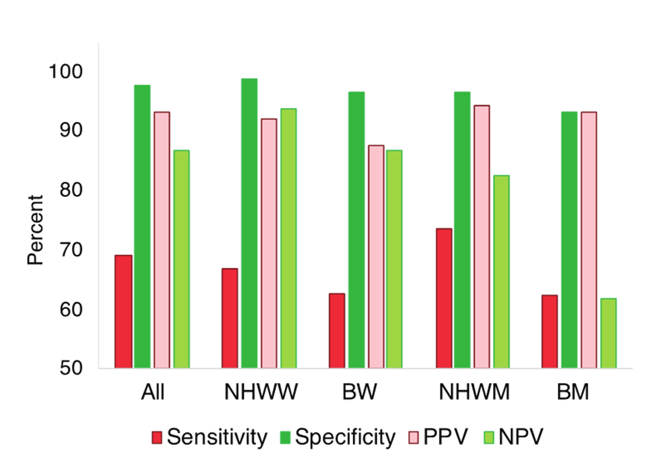
Comparison of eASCVD to standard risk score
C
Figure 2C. Comparison of 10-year ASCVD risk by PCE and eASCVD equations. Sensitivity, Specificity, Positive Predictive Value (PPV), and Negative Predictive Value (NPV) were calculated in the NHANES validation dataset with all true risk factors present for using an eASCVD risk score cut-point of 7.5%/10-year for identifying patients of at least intermediate risk with a standard risk score by PCE>7.5%/10-year for the whole population (All) or for the separate four race/sex cohorts indicated.

Slide 8
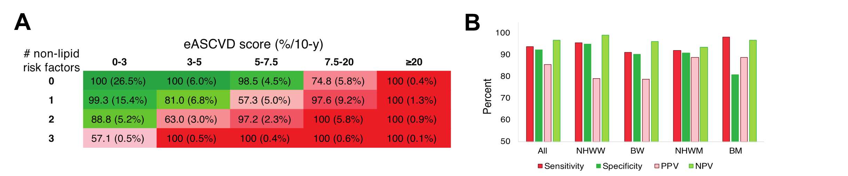
Adjustment of eASCVD risk score by number of non-lipid risk factors present
Risk factors: SBP>130, BP Meds, Smoking
Figure 3. eASCVD test performance after adjustment for risk factors. (A) Grid showing how eASCVD risk score is adjusted for number of risk factors present for classifying patients at intermediate or greater using NHANES validations dataset (N=4,516). Numbers in red cells indicate Positive Predictive Value (PPV), whereas numbers in green indicate Negative Predictive Value (NPV). (B) Sensitivity, Specificity, PPV, and NPV was calculated in NHANES validation dataset with all true risk factors present for using an eASCVD risk score cut-point of 7.5%/10-year after adjustment for number of risk factors for identifying patients at least intermediate risk with a standard risk score by PCE>7.5%/10-year for the whole population (All) or for the separate four race/sex cohorts indicated.

Slide 9
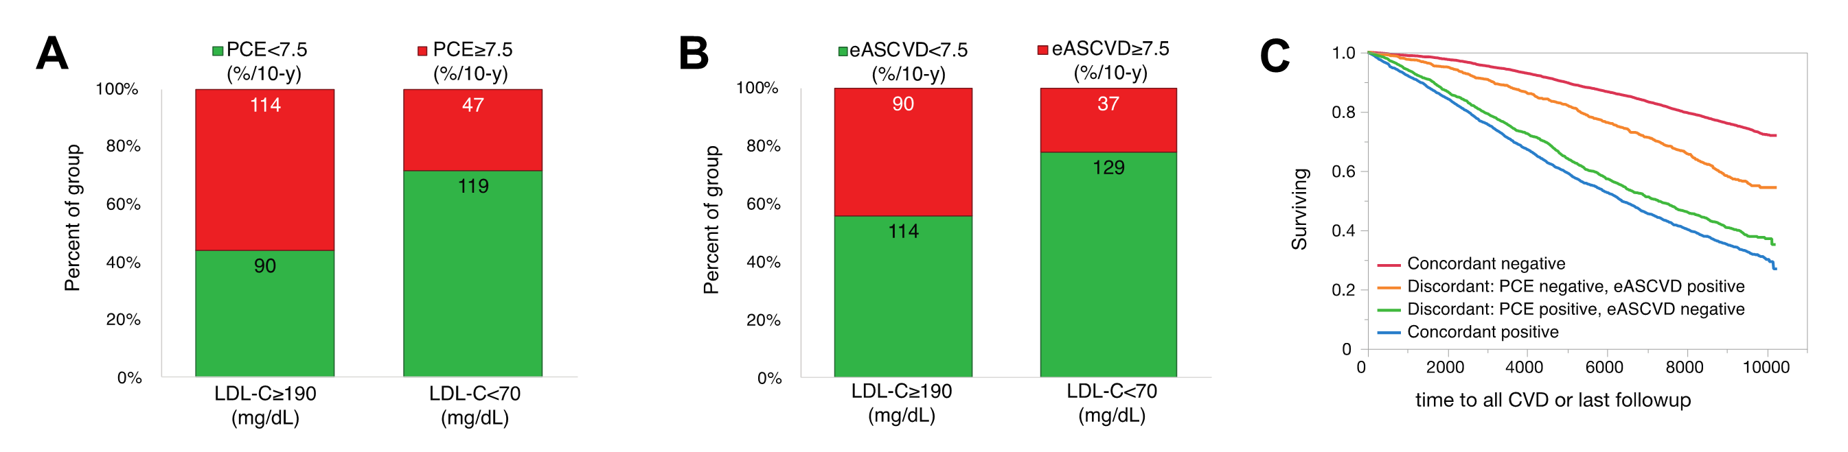
Association of eASCVD risk score
with low, high LDL-C levels and ASCVD events
Figure 3. Classification of patients with low versus high LDL-C into risk categories. Patients with indicated level of LDL-C (≥190 mg/dL or <70 mg/dL) were classified by PCE (A) or by eASCVD (B) into lower (green, <7.5%/10-year) or higher (red, ≥7.5%/10-year) risk categories. Numbers in bar indicate total number of individuals in each category. Survival curves in ARIC (N=14,742) for all ASCVD events were calculated for the indicated concordance groups (C). For ARIC only baseline lipid results from the first study visit were used for analysis and ASCVD was defined as including the following: fatal and non-fatal myocardial infarction and stroke.
What is the advantage of your new approach versus the currently available ASCVD 10-year risk calculator?

Slide 10
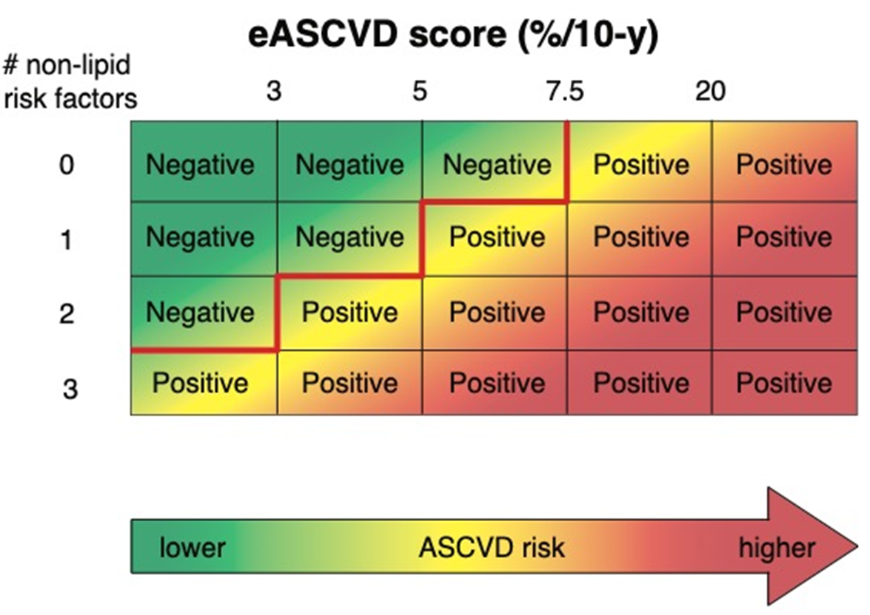
Utilization
eASCVD<7.5% / 0 Risk Factors: No action
eASCVD<3% / 1 Risk Factor: No action
eASCVD>7.5%: Send alert to perform PCE calculation
eASCVD>20%: Lipid-lowering therapy
eASCVD reporting could also alert patients when to seek medical consultation/care
What studies need to be performed so the method of estimated ASCVD lipid risk score is ready for use in clinical labs?

Slide 11
Conclusions
The eASCVD risk score:
can be automatically calculated at no additional expense by clinical laboratories for all fasting patients just from a standard lipid panel,
enables identification of the great majority of statin-eligible patients at the time of reporting lipid test results,
identifies individuals for whom a more careful consideration of non-lipid risk factors is warranted, and
can be used as an adjunct primary prevention tool of CVD and as a decision aid for increasing awareness and compliance with statin therapy guidelines when used together with the PCE.

Slide 12
eASCVD lipid risk score
  You can access the free eASCVD lipid risk score calculator at: https://figshare.com/articles/software/Sampson_eASCVD_equation_calculator/14222852

