Slide 1

Multiplex Fragment Analysis for Flexible Detection of All SARS-CoV-2 Variants of Concern
A.E. Clark, Z. Wang, E. Ostman, H. Zheng, H. Yao, B. Cantarel, M. Kanchwala, C. Xing, L. Chen, P. Irwin, Y. Xu, D. Oliver, F.M. Lee, J.R. Gagan, L. Filkins, A. Muthukumar, J.Y. Park, R. Sarode, J.A. SoRelle
August 2022
https://doi.org/10.1093/clinchem/hvac081
© 2022 by the American Association for Clinical Chemistry

Slide 2
Why test for a COVID-19 variant?
Epidemiology
  Tracking and tracing emerging variants
  Isolate outbreaks faster
Clinically
  Predict severity of disease: Delta hospitalized more patients
  Direct antibody treatment
    Omicron (BA.1) resistant to Regeron and Lily monoclonal antibodies
      Use sotrovimab for BA.1
    Omicron (BA.2) is resistant to sotrovimab
      Use bebtelovimab for BA.2

Slide 3
Challenges of Variant Detection
SARS-CoV-2 Genome
Turn around time
2-4 weeks
$
Bioinformatic skills
Cost
$150-300/ sample
CT< 28-30

Slide 4
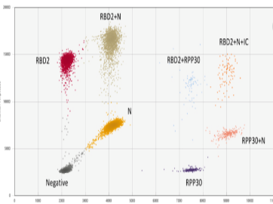
Genotyping methods for Variant detection.
Current approaches
  SNP based primer/probes, melt curve analysis
  Pro: Fits into current workflows, fast
  Cons: Limited adaptability (4-5 targets), constantly changing mutations
Melt-curve analysis
ddPCR

Slide 5
Discussion Question 1
What were the barriers to implementing COVID-19 Variant testing at your institution?

Slide 6
Our Approach: Multiplex Fragment Analysis
Capillary electrophoresis
  Separate targets by size and color
  Detects multiple deletion mutation sizes
  RT-PCR with fluorescently labeled primers
Fragment Analysis

Slide 7
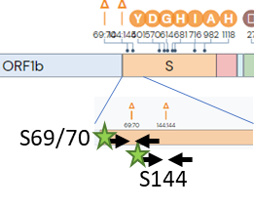
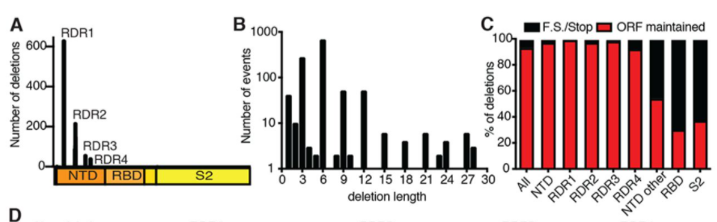
Recurrent Spike Gene in-frame Deletions
4 Recurrently Deleted Regions (RDR) in N-terminus
  Alpha: RDR1- ∆6bp RDR2- ∆3bp
  Beta: RDR4- ∆9bp
  Gamma: None
  Delta: RDR2- ∆6bp
  Omicron: RDR1- ∆6bp RDR2- ∆9bp

Slide 8
Recurrent Spike Receptor Binding Domain SNPs targeted
3 Recurrent SNPs that affect viral fitness: N501Y, E484K, and L452R
  Allele-specific primers detect Wild type or Mutant allele
  Mismatch mutations added near 3’ end for specificity
N501Y
cDNA: GTTAGTATACCAAAGGTTGGGTGA AC
PRIMER: CAATCATATGGTTTCCAACCCACT[A>T]
A
G
T
3’
Destabilizing mutations
A
C
G
2’

Slide 9
Discussion Question 2
Are there other tests that you currently use that utilize fragment analysis?
Would this technique make some tests easier?

Slide 10
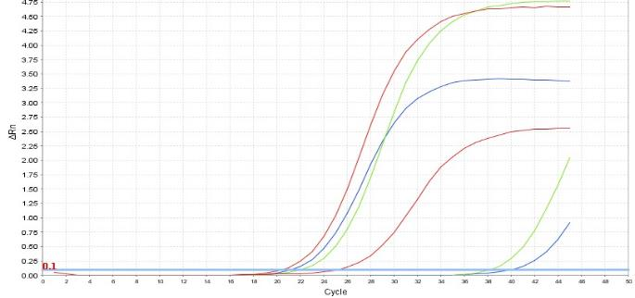
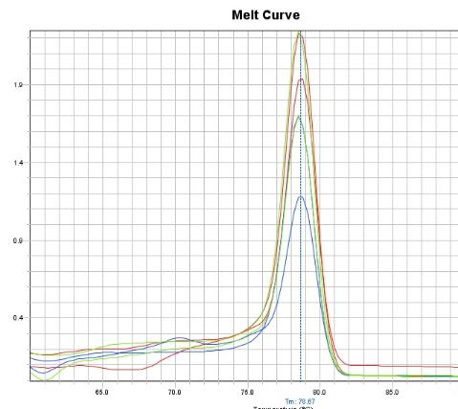
qPCR of Mismatch primers vs. full Match
WT-specific mismatch primers = strong amplification
  Non-mismatch mutant primer (L452R_MUT) still amplifies
  Mismatch L452R primers (2’G/ 3’G) = weak amplification
qPCR on WT DNA
WT
WT_2’G
WT_3’G
L452R_Mut
L452R _2’G
L452R _3’G
Melt Curve = 1 PCR product

Slide 11
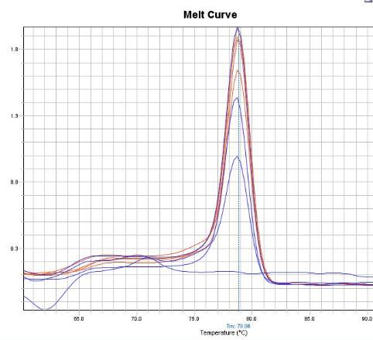
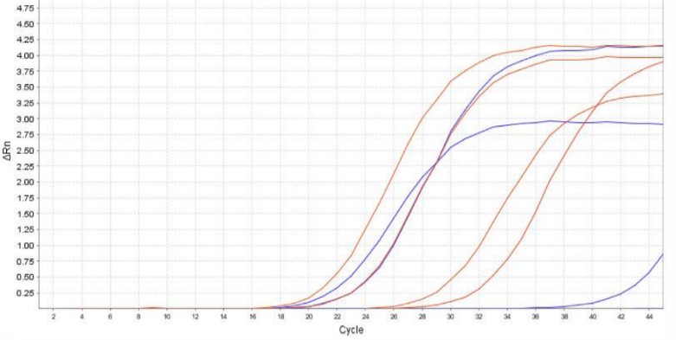
qPCR of Mismatch primers vs. full Match
MUT-specific mismatch primers = strong amplification
  Non-mismatch WT primer (WT) still amplifies
  Mismatch WT primers (2’G) = very weak amplification
qPCR on Mutant DNA
L452R_3’G
L452R_Mut
WT_2’G
WT
Melt Curve = 1 PCR product

Slide 12
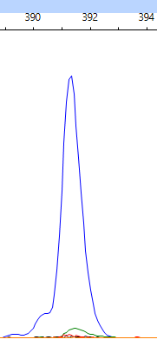
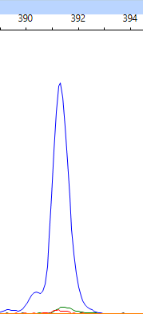
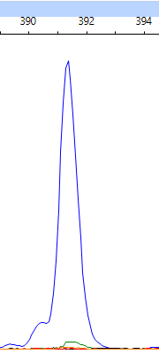
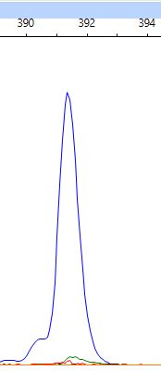
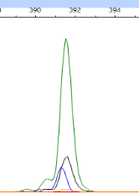
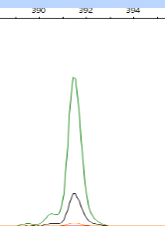
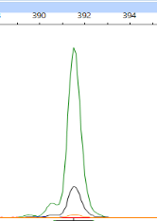
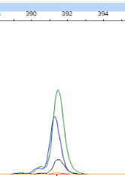
Lastly, Confirm primer combinations in Capillary Electrophoresis
WT_3’G + L452R_3’G
WT_3’G+ L452R_Mut
L452_WT+ L452R_3’G
L452_WT+ L452R_Mut
Wild Type
L452R

Slide 13
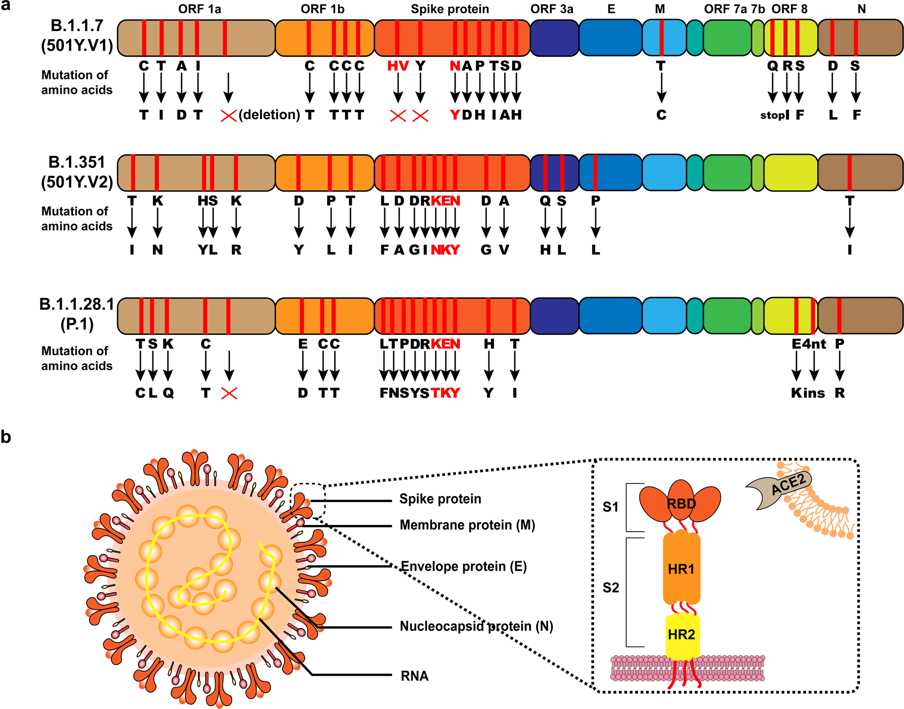
ORF1 and 8 targets added for indels
Figure credit Zhou and Wang, under a CC-BY-4.0 license https://doi.org/10.1038/s41392-021-00644-x
Notes:
Figure credit: Zhou W, Wang W. Fast-spreading SARS-CoV-2 variants: Challenges to and new design strategies of COVID-19 vaccines. Signal Transduct Target Ther 2021;6. https://doi.org/10.1038/s41392-021-00644-x
Figure use is licensed under CC-BY-4.0, https://creativecommons.org/licenses/by/4.0/ . No changes have been made to the figure.

Slide 14
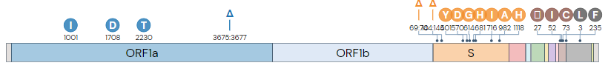

Complete 8-plex panel
Design frozen April 2021
  Adaptable to subsequent variants with no modification
L452R
E484K
N501Y
ORF1A
ORF8
RDR1
RDR3-4
RDR2

Slide 15
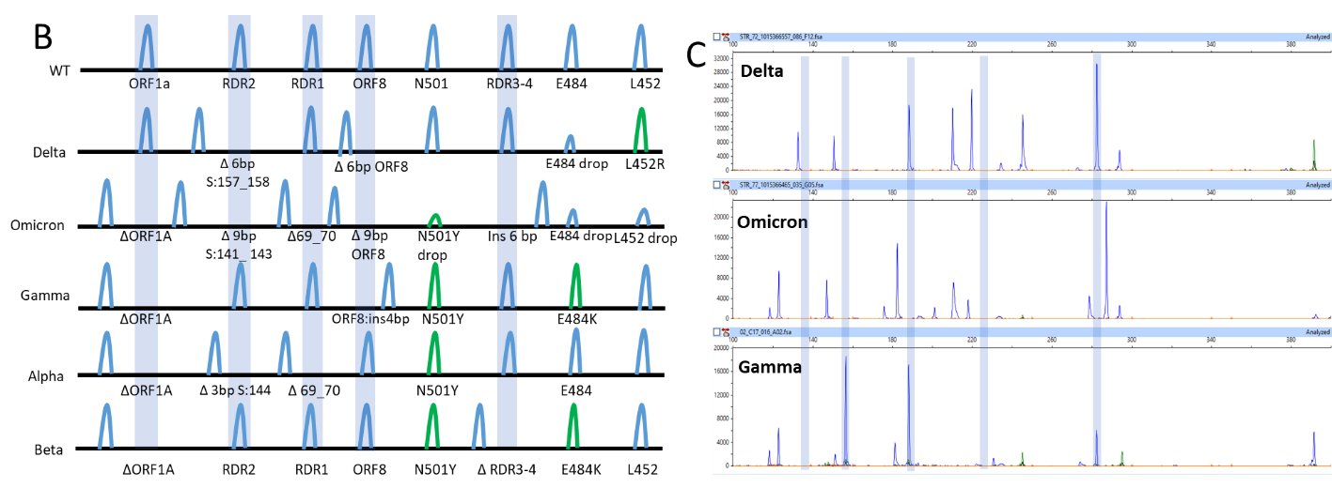
Unique Mutational Signatures
Current approaches
  All major Variants of Concern detected & differentiated
  Simple interpretation: Blue vs. Green?; Shifted or not?

Slide 16
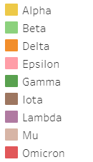
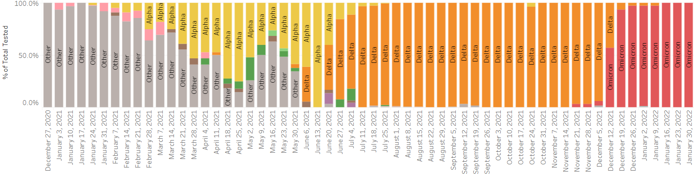
Validation
3,544 specimens tested
  Reference method: Whole genome sequencing
  96% Sensitivity 99% Specificity
  LoD: 5 copies/ reaction (60% > LoD at CT = 34-35)
Delta (n=2820), Mu (n=6), Lambda (n=6), and Omicron (n=309)

Slide 17
Discussion Question 3
When would you considering bringing on COVID-19 variant testing?
Which method would be preferred for your patient population?

