Slide 1

Machine Learning to Assist in Large-Scale, Activity-Based Synthetic Cannabinoid Receptor Agonist Screening of Serum Samples
L.K. Janssens, D. Boeckaerts, S. Hudson, D. Morozova, A. Cannaert, D.M. Wood, C. Wolfe, B. De Baets, M. Stock, P.I. Dargan, C.P. Stove
July 2022
https://doi.org/10.1093/clinchem/hvac027
© 2022 by the American Association for Clinical Chemistry

Slide 2

Introduction
  The often high activity of SCRAs at the CB₁ cannabinoid receptor frequently results in intoxication, imposing serious health risks. Hence, continuous monitoring of these compounds is important, but challenged by the rapid emergence of novel analogues.
The objective of this study:
Activity-based screening of ~1000 samples from patients presenting with recreational drug toxicity to develop a machine learning model to improve and speed up data analysis.
  Evaluate performance of activity-based screening for newly emerging SCRAs
  Improve (objectify & standardize) a manual scoring procedure
  Develop and evaluate computer-assisted scoring of results

Slide 3
Question
Why are the conventional screening techniques struggling to detect (new) synthetic cannabinoid receptor agonists (SCRAs)?
➔ What added-value can activity-based screening offer?

Slide 4
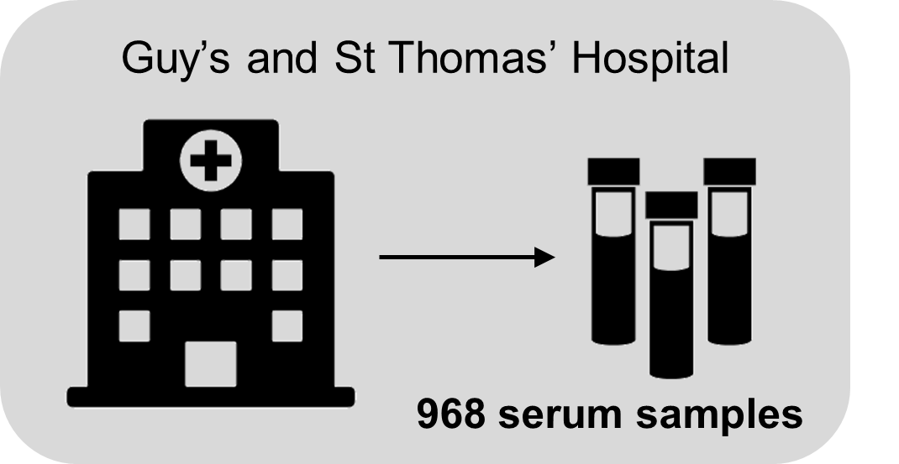
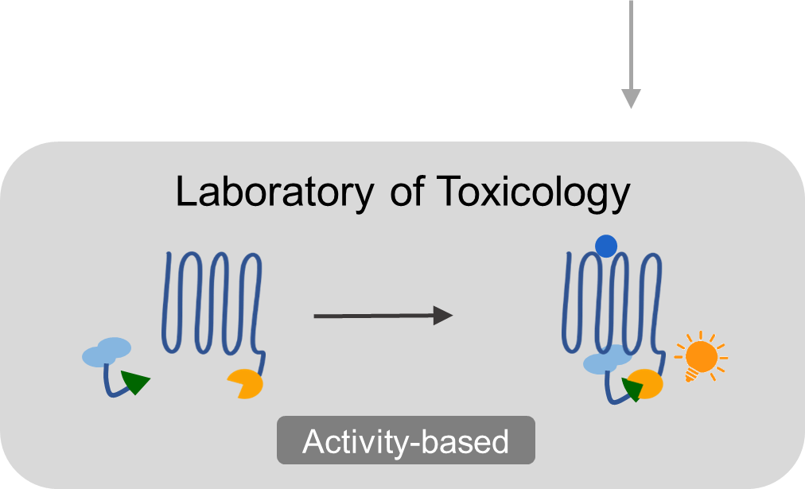
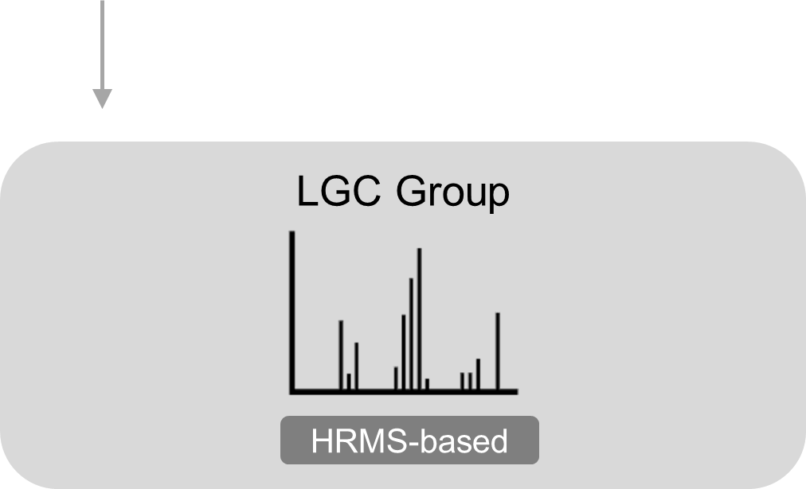

Materials & Methods
Patient recruitment:
Activity-based
screening:
Analytical detection:
Machine Learning:

Slide 5
Question
What reasons are there to spend time and resources on building a machine learning model for this application?

Slide 6


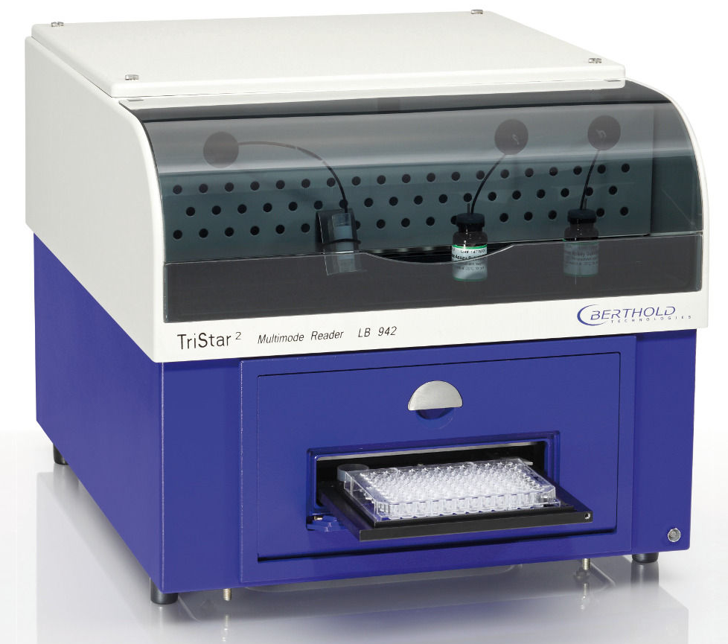
Results
Bioassay:
CB₁ receptor
CB₁ receptor
SCRA
β-arrestin 2
β-arrestin 2

Slide 7

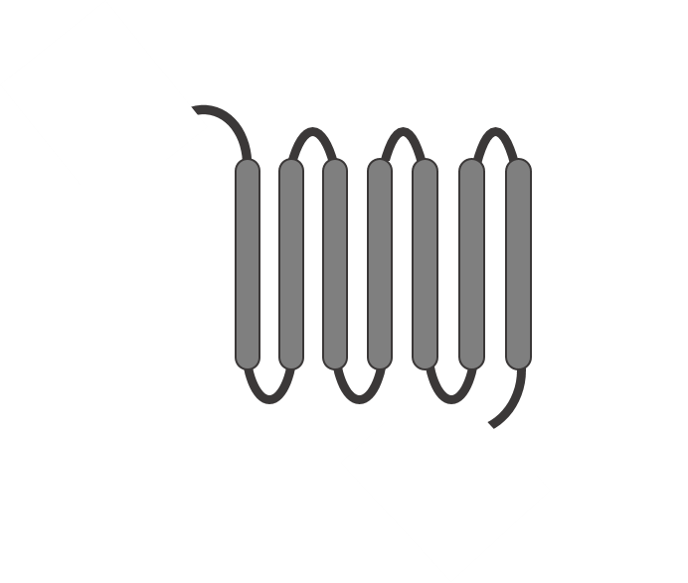
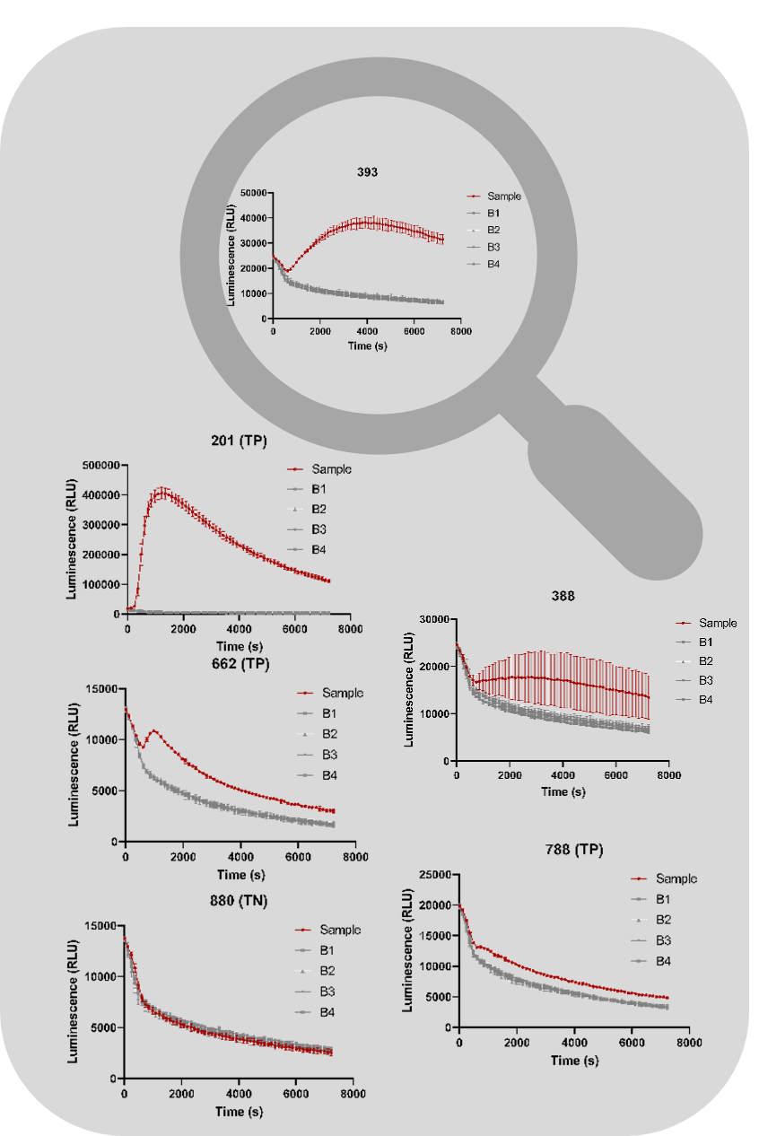

Results
Bioassay:
Bioassay outcome:
True Negative
True Positive

Slide 8
Results
Bioassay:
Bioassay outcome:

Slide 9
Results
Objectify data interpretation
Level of confidence | Negative | Positive
‘Certainly’ (α) | -α | +α
‘Likely’ (β) | -β | +β
Figure 1. Decision tree used for manual scoring as standard operating procedure, aiming at objectifying the individual and consensus expert scoring.

Slide 10
Results
Challenging true positives:
5F MDMB-PICA:
0.53 ng/ml
Desmethyl metabolite: 0.19 ng/ml
5F-MDMB-PICA
Desmethyl metabolite
0.57 ng/mL
Figure 2. Outcome of the CB1 bioassay (receptor-activation profiles) of representative obvious true positive (201, TP) and true negative (880, TN) results and more challenging true positive results (662, 788).

Slide 11
Results
Sensitivity 94.6%
Specificity 98.5%
Figure 3. Screening results (consensus) in comparison to the analytical confirmation, including the number of true positive (TP), false negative (FN), false positive (FP), and true negative results (TN).

Slide 12



Results
Building a machine learning model:
-
+
+
Prediction score
(replicates)
Features:
Time series
5th order Polynomial fit
Average
Threshold
Prediction

Slide 13
Results
Building a machine learning model:
Training:
On analytical data
On expert scoring
Cross-validation
(iteratively)
1. Analytical vs Analytical
2. Expert vs Analytical
3. Expert vs Expert
Fig. 4. ROC curves, PR curves, and AUC scores for the models trained with fifth-order polynomial fit coefficients (a, c) and tsfresh features (b, d).

Slide 14
Results
Building a machine learning model:
Training:
On analytical data
On expert scoring
Added-value of including expert knowledge
Cross-validation
(iteratively)
1. Analytical vs Analytical
2. Expert vs Analytical
3. Expert vs Expert
Fig. 4. ROC curves, PR curves, and AUC scores for the models trained with fifth-order polynomial fit coefficients (a, c) and tsfresh features (b, d).

Slide 15
Results
Building a machine learning model:
-
+
Performance
0.057
Sensitivity: 94%
Specificity: 94%
0.011
Sensitivity: 94.6%
Specificity: 81.6%
0.263
Sensitivity: 92.6%
Specificity: 98.3%
Figure 5. Sensitivity and specificity of the model trained with fifth-order polynomial coefficients, trained on expert scoring, and tested on analytical outcome (grouped, 10-fold cross-validation).

Slide 16
Question
Is the machine learning model ready to be applied in practice?

Slide 17
Conclusion
Activity-based detection
  Cell-based bioassay
  Universal untargeted detection
  Fit for newly circulating SCRAs
Machine Learning approach
  Supervised learning
  Balance sensitivity/specificity (prediction threshold)
  Reduce subjective data analysis
  Reduce time & workload
  Facilitate method transfer
  Current trade-off:
Time &
workload
Samples
to confirm

