Slide 1

Toward Clinical Application of Leukocyte Counts Based on Targeted DNA Methylation Analysis
S. Sontag, L. Bocova, W.H.G. Hubens, S. Nüchtern, M. Schnitker, T. Look, K.M. Schröder, B. Plümäkers, V. Tharmapalan, M. Wessiepe, T. Kraus, J. Kramer, L. Rink, S. Koschmieder, W. Wagner
May 2022
https://doi.org/10.1093/clinchem/hvac006
© Copyright 2022 by the American Association for Clinical Chemistry

Slide 2
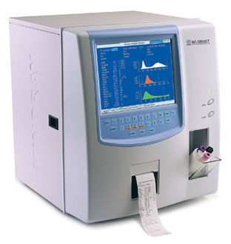
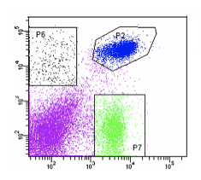
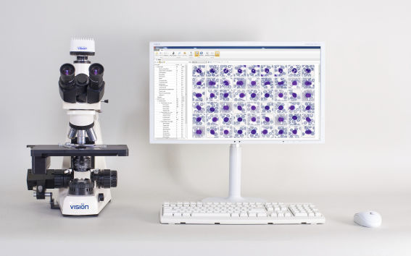
Current methods to count blood cells
1. Automated Cell Counter
→ Electrical impedance
2. Flow cytometry
→ Surface proteins
3. Microscopy/Histology
→ Cell morphology
Disadvantages:
Fresh blood required (< 24h old)
Hampered by coagulation or ineffective antibody binding
Inter-laboratory variation

Slide 3





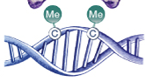
Epigenetic approach to count blood cells
Epigenetic Blood Count (Epi-Blood-Count)
→ Cell count based on DNA methylation (DNAm)
at cell type specific cytosines
 | Granulocytes | Lymphocytes | Monocytes
CpG site 1 | 0% | 100% | 100%
CpG site 2 | 100% | 0% | 100%
CpG site 3 | 100% | 100% | 0%
Advantages:
No fresh blood samples required
Samples can be (re)analyzed after years
Easier handling and shipping of blood samples
QUESTION 1. Could epigenetics be an alternative to conventional methods for leukocyte quantification?

Slide 4
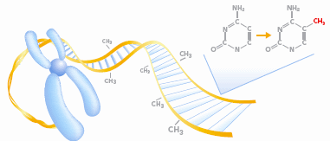
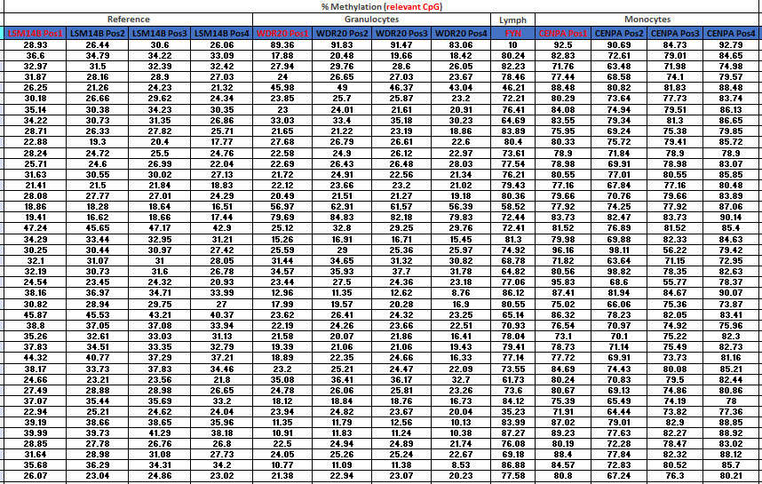
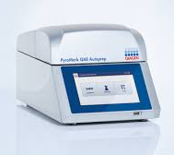
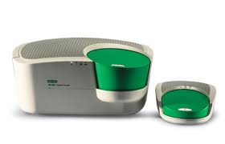


Method workflow
Methylated CpG
Unmethylated CpG
CTTACGTAC
CTTACGTAC
Bisulfite
conversion
UTTACGTAU
UTTAUGTAU
PCR
TTTACGTAT
TTTATGTAT
150µL blood
(332 healthy & 266 patients)
1. DNA isolation
2. Bisulfite conversion & PCR
5. Leukocyte deconvolution
4. Deconvolution algorithm
3. Pyrosequencing/digital droplet PCR
DNAm measurement
QUESTION 2. How does the level of DNA methylation reflect the leukocyte composition in blood?

Slide 5
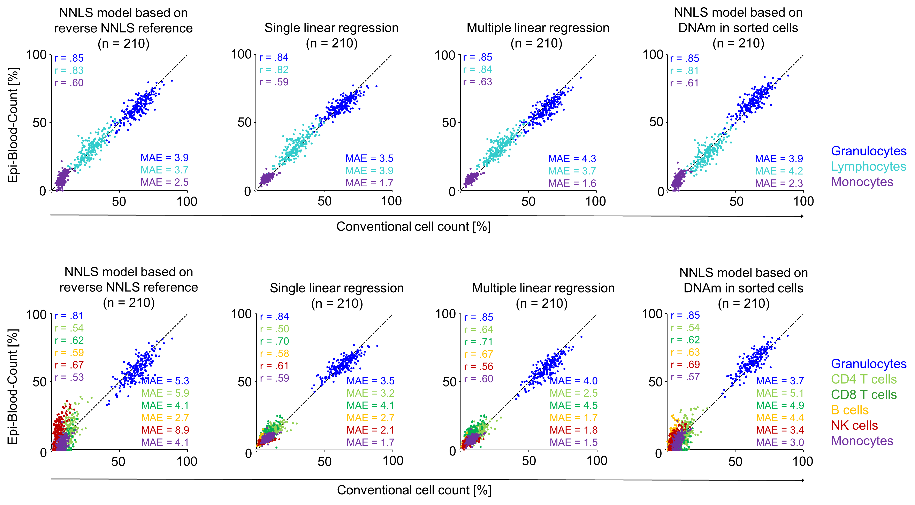
Epi-Blood-Count validation in healthy donors
(3 cell type model)
Figure 1. Validation of Epi-Blood-Counts on healthy donors.
Comparison of conventional cell counts with the Epi-Blood-Counts using 4 different mathematical approaches for a 3 cell type model. Pearson correlation r and MAE are depicted for each cell type.

Slide 6
Epi-Blood-Count validation in healthy donors
(6 cell type model)
Figure 2. Validation of Epi-Blood-Counts on healthy donors.
Comparison of conventional cell counts with Epi-Blood-Count using 4 different mathematical approaches for a 6 cell type model. Pearson correlation r and MAE are depicted for each cell type.

Slide 7
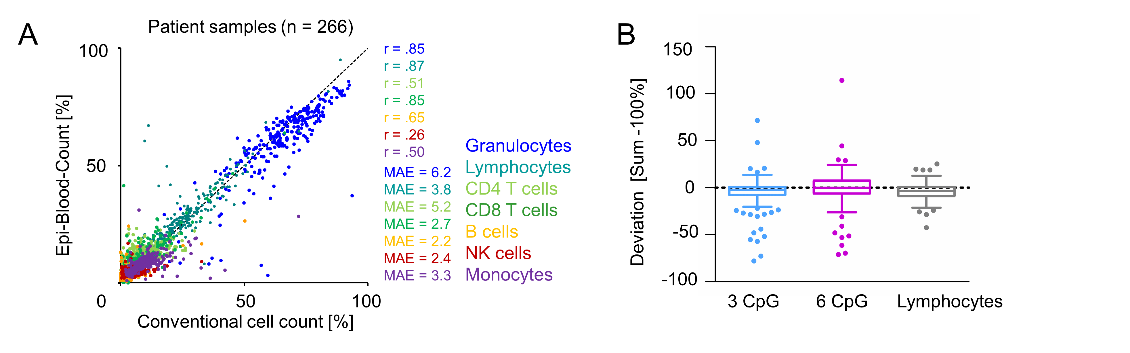
Epi-Blood-Count validation in patients
Figure 3. Epi-Blood-Counts are applicable to patients with hematological disorders.
(A) Relative Epi-Blood-Counts in comparison to conventional cell counts for 266 patients with hematopoietic malignancies. (B) Deviation of Epi-Blood-Counts to 100% in patient cohort (n=266). Light blue: Sum Epi-Blood-Counts (granulocytes + lymphocytes + monocytes) – 100. Pink: Sum Epi-Blood-Counts (granulocytes + CD4 T cells + CD8 T cells + B cells + NK cells + monocytes) – 100. Gray: Epi-Blood-Count Lymphocyte (based on lymphocyte specific CpG site) – Sum Epi-Blood-Counts (CD4 T cells + CD8 T cells + B cells + NK cells). Whiskers indicating 1.5x interquartile range.

Slide 8
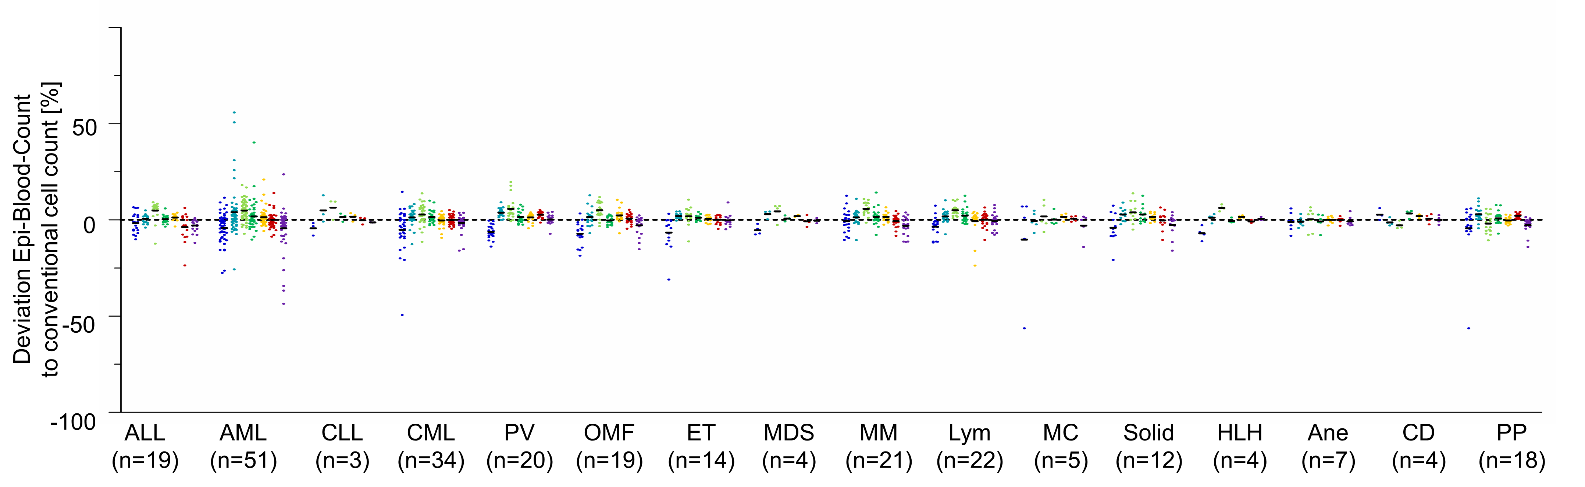
Deviation of Epi-Blood-Counts to conventional cell counts
Granulocytes
CD4 T cells
CD8 T cells
B cells
NK cells
Monocytes
Figure 4. Deviation of the Epi-Blood-Counts to conventional cell counts in patients, sorted according to the underlying diseases.
Patients with multiple pathologies were counted in multiple groups (except for AML).
ALL: acute lymphoid leukemia
AML: acute myeloid leukemia
CLL: chronic lymphoid leukemia
CML: chronic myeloid leukemia
PV: Polycythemia vera
OMF: Osteomyelofibrosis
ET: Essential thrombocythemia
MDS: Myelodysplastic syndrome
MM: Multiple myeloma
Lymp: Lymphoma
MC: Mast cell carcinoma
Solid: Solid tumor
HLH:Haemophagocytic lymphohistiocytosis
Ane: Anemia
CD: Coagulation defects
PP: Purpura.

Slide 9
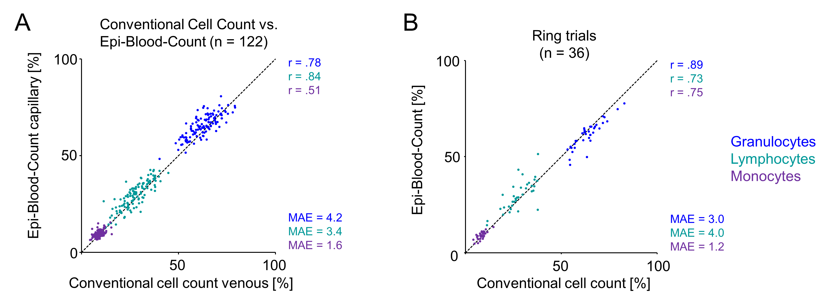
Benchmarked in ring trials
Figure 5. Epi-Blood-Count is applicable on capillary blood and shows good performance in ring trials. (A) Relative Epi-Blood-Counts of capillary blood from 122 healthy donors in comparison to conventional cell counts from venous blood. (B) Relative Epi-Blood-Counts of ring trial blood samples (n=36) in comparison to conventional cell counts (mean of all participants and devices).

Slide 10
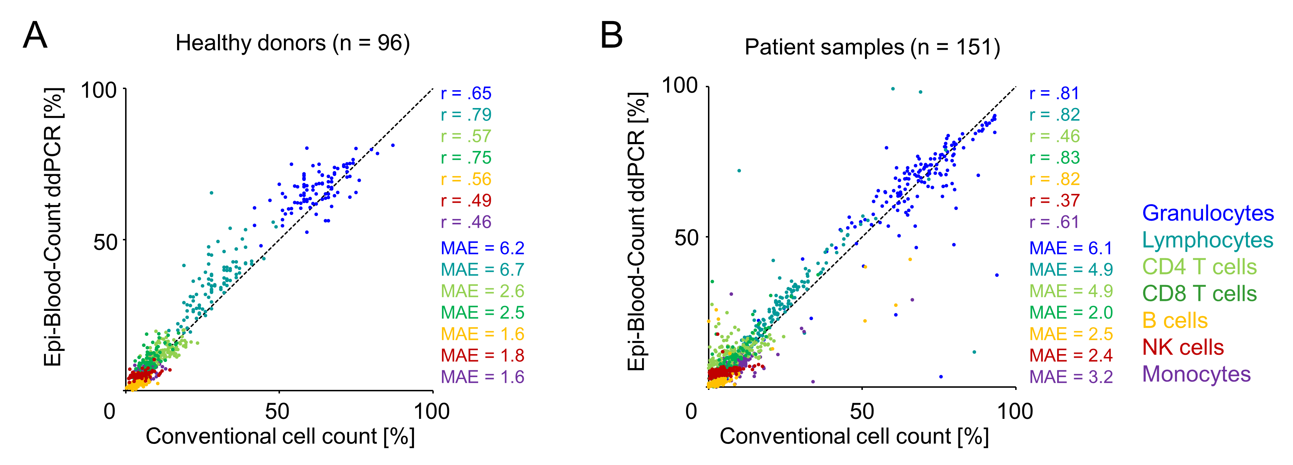
Leukocyte deconvolution with ddPCR
Figure 6. Epi-Blood-Counts can be deconvoluted based on ddPCR DNAm values.
Relative Epi-Blood-Counts with ddPCR from (A) healthy donors and (B) patients with various hematological diseases in comparison to conventional cell counts.

Slide 11
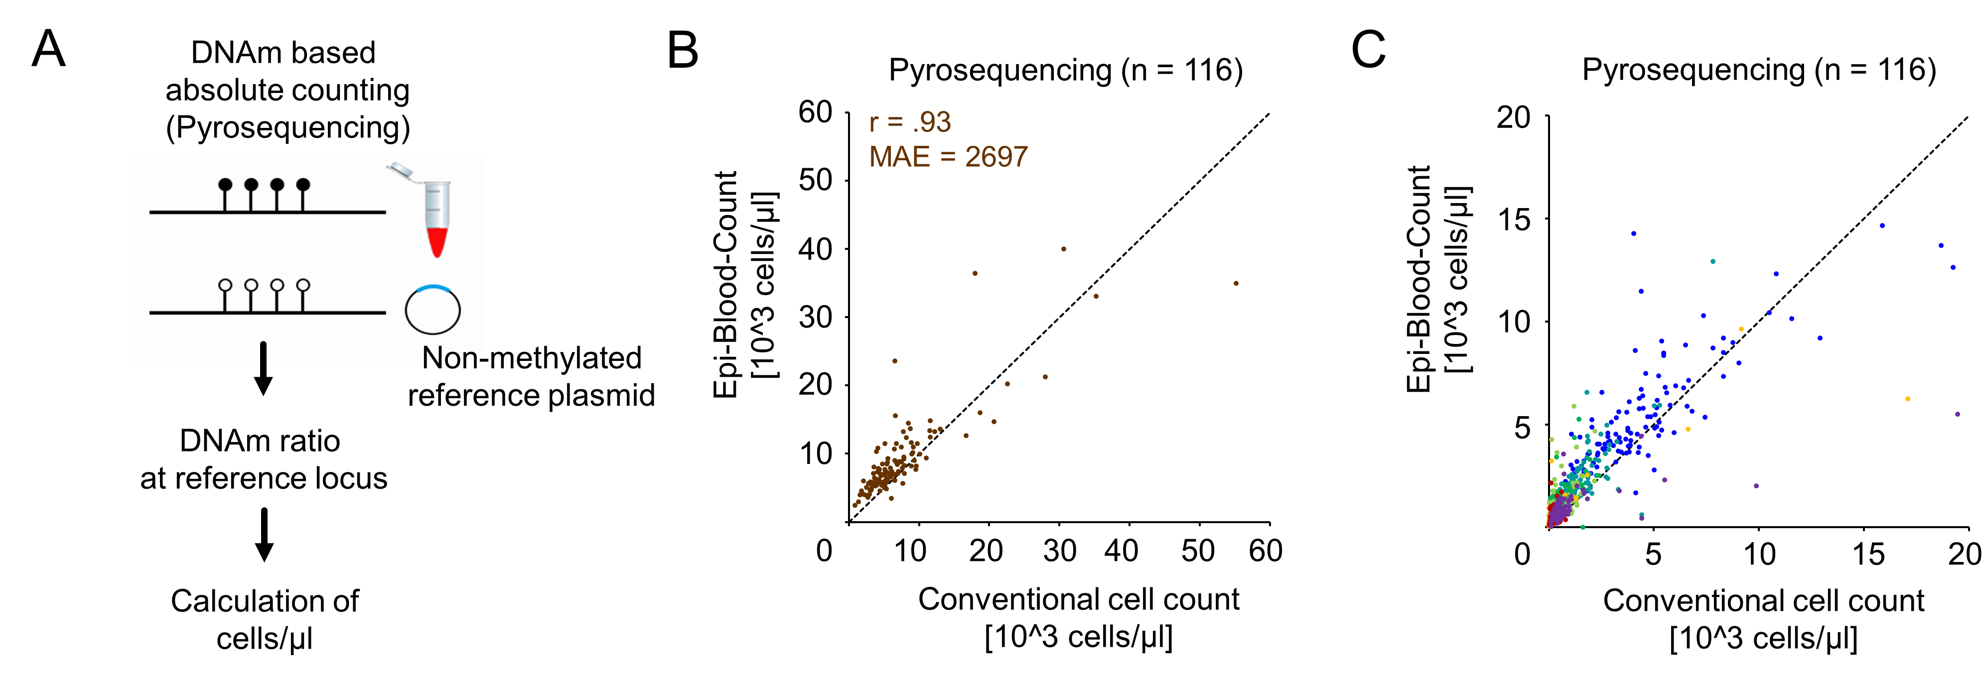
Absolute leukocyte counts with pyrosequencing
r = .87
r = .98
r = .48
r = .69
r = .98
r = .13
r = .72
MAE = 1716
MAE = 1174
MAE = 694
MAE = 547
MAE = 564
MAE = 287
MAE = 530
Granulocytes
Lymphocytes
CD4 T cells
CD8 T cells
B cells
NK cells
Monocytes
Figure 7. Absolute leukocyte quantification via pyrosequencing.
(A) Schematic visualizations of alternative approach for absolute quantification of leukocytes in blood. (B, C) Absolute Epi-Blood-Count counts (cells/mL) for (B) total leukocytes and (C) leukocyte subsets correlated with conventional counts in 116 patient samples.

Slide 12
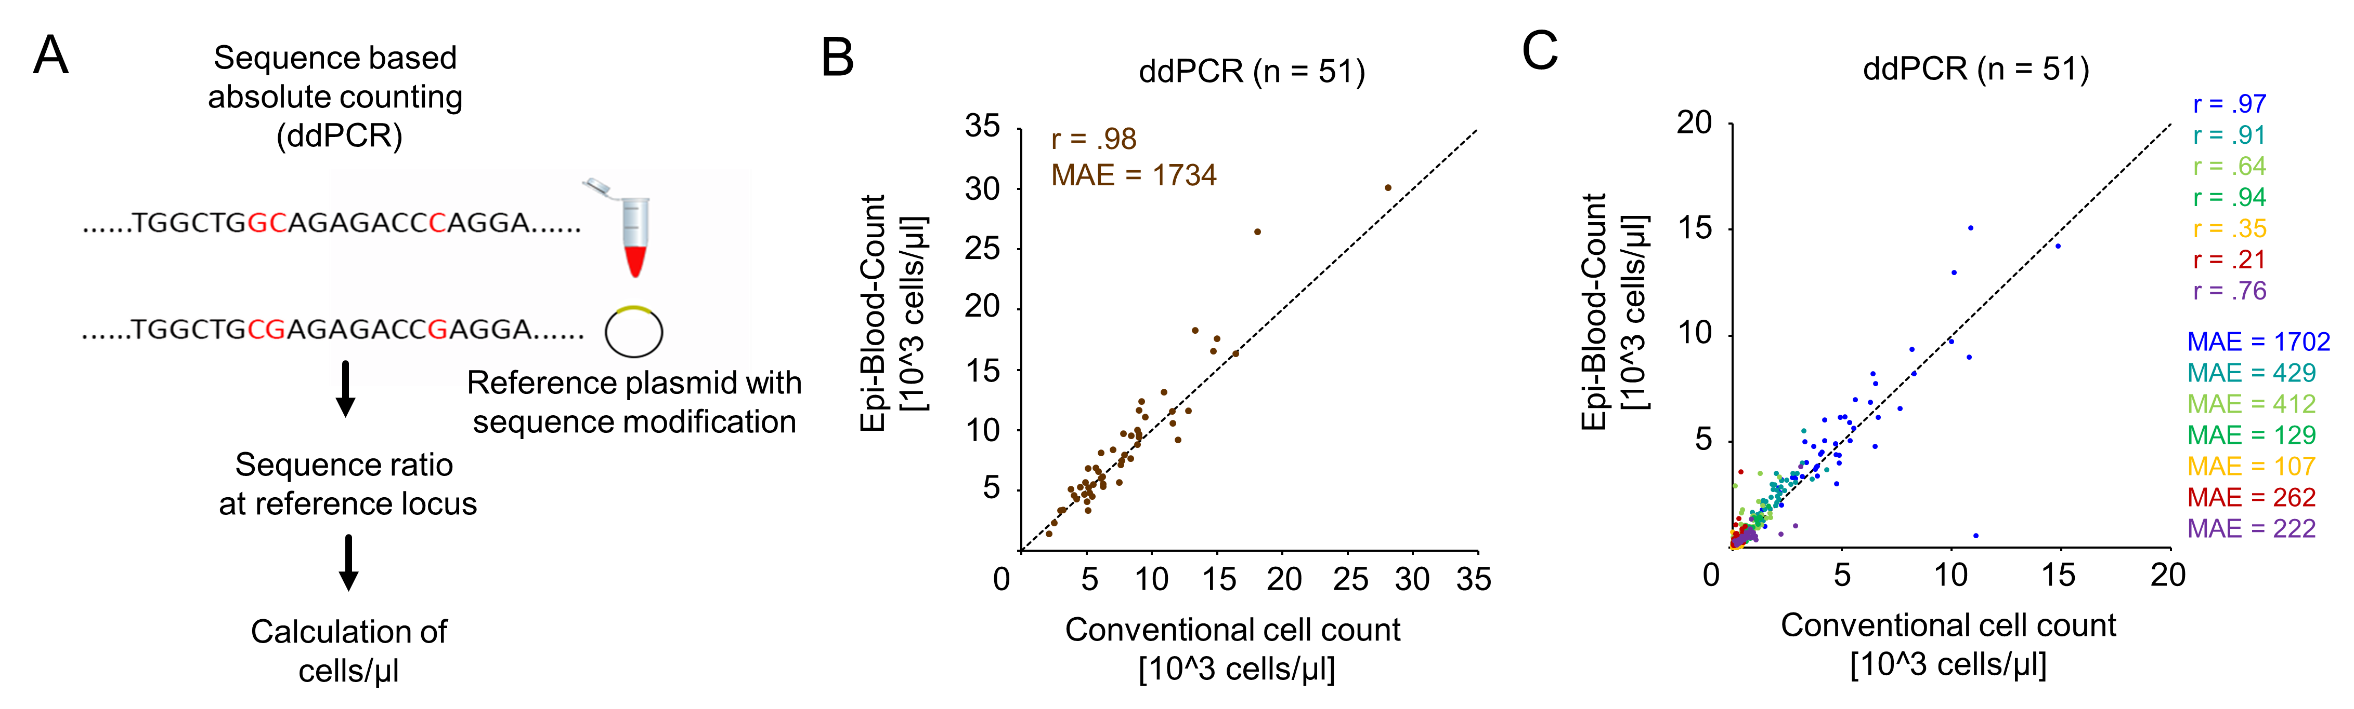
Absolute leukocyte counts with ddPCR
r = .87
r = .98
r = .48
r = .69
r = .98
r = .13
r = .72
MAE = 1716
MAE = 1174
MAE = 694
MAE = 547
MAE = 564
MAE = 287
MAE = 530
Granulocytes
Lymphocytes
CD4 T cells
CD8 T cells
B cells
NK cells
Monocytes
Figure 8. Absolute leukocyte quantification via ddPCR.
(A) Schematic visualizations of alternative approach for absolute quantification of leukocytes in blood. The ratio of methylated genomic and non-methylated reference plasmid DNA sequences is analyzed with ddPCR. (B) Absolute Epi-Blood-Count counts (cells/mL) for (B) total leukocytes and (C) leukocyte subsets correlated with conventional counts in 51 patient samples.

Slide 13
Results
We previously provided proof of concept for the Epi-Blood-Count in healthy donors.¹ Our current study:
validates these findings in larger cohorts of healthy donors;
provides proof of concept for use in patients with hematopoietic malignancies;
facilitates analysis of low blood volumes, e.g., collected from capillary blood; and
addresses several relevant aspects to pave the way for accreditation as an in vitro diagnostic procedure.
Question 3. How can Epi-Blood-Counts be further improved for certain cell subsets (e.g., Nk cells)?
¹Frobel et al. Clin Chem 2018; https://doi.org/10.1373/clinchem.2017.279935

