Slide 1
Feasibility of Targeted Next-Generation DNA Sequencing for Expanding Population Newborn Screening
B.O.V. Shum, C.J. Pretorius, L.M.F. Sng, I. Henner,
P. Barahona, E. Basar, J. McGill, U. Wilgen, A. Zournazi,
L. Downie, N. Taylor, L. Cheney, S. Wu, N.A. Twine,
D.C. Bauer, G.F. Watts, A. Navilebasappa, K.R. Kumar,
J.P.J. Ungerer, G. Bennett
August 2023
https://doi.org/10.1093/clinchem/hvad066
© 2023 American Association for Clinical Chemistry

Slide 2
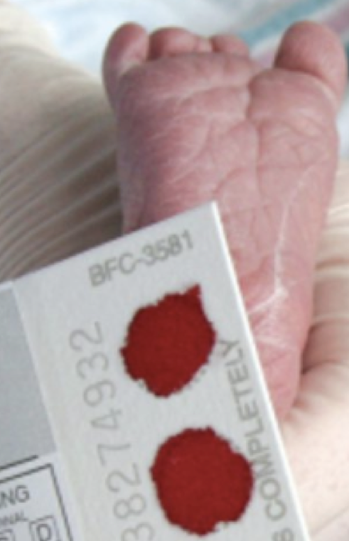
Population newborn screening
  Early identification of treatable genetic diseases
  Enables treatment to prevent death and disability
  >99% of all newborns in most developed countries
  Heel prick bloodspot test 2-3 days old
  Conditions screened vary from 33 conditions (Louisiana & Montana) to 74 conditions (California)

Slide 3
Next-generation DNA sequencing
  Allows analysis of multiple genes simultaneously
  Potentially a single test for hundreds of genetic conditions
  Whole genome sequencing and whole exome sequencing have cost, ethical, and feasibility challenges for population newborn screening
  Targeted next-generation DNA sequencing, combined with biochemical newborn screening, may overcome the challenges of genomic and exomic tests

Slide 4
Question #1
What are the challenges of using a whole genome test for newborn screening?
https://www.science.org/content/article/sequence-every-newborn-s-dna-despite-obstacles-uk-pushes-ahead

Slide 5
Aim and Methods
To investigate if targeted next-generation DNA sequencing could expand newborn screening
  We developed a targeted gene sequencing platform:
    164 genes for treatable inherited diseases
    highly specific DNA capture probes for exons and selected non-coding regions
    high throughput robotic laboratory protocols
    custom software - automates bioinformatic analysis and semi-automates clinical reporting
  An analytical validation of the assay was completed and test performance in 2552 newborns examined.

Slide 6
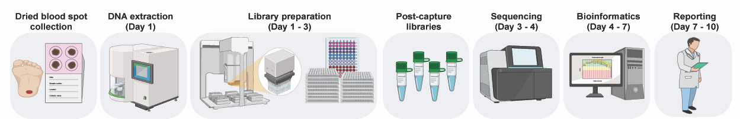
Targeted gene sequencing platform for newborn screening
Figure 1. Workflow for targeted gene sequencing to expand existing newborn screening. A heel-prick DBS sample is collected, DNA extracted, and targeted NGS library preparation is completed on a semi- automated robotics platforms in batches of 96-well plates. Samples are tagged with a molecular DNA barcode, multiplexed, and sequenced by NGS. FASTQ sequencing files are processed for variant calling and clinical reporting by custom software. Only clinically significant variants that will likely lead to disease are reported.

Slide 7
Question #2
What are the advantages of using a targeted gene sequencing platform compared to whole genome sequencing for newborn screening?

Slide 8
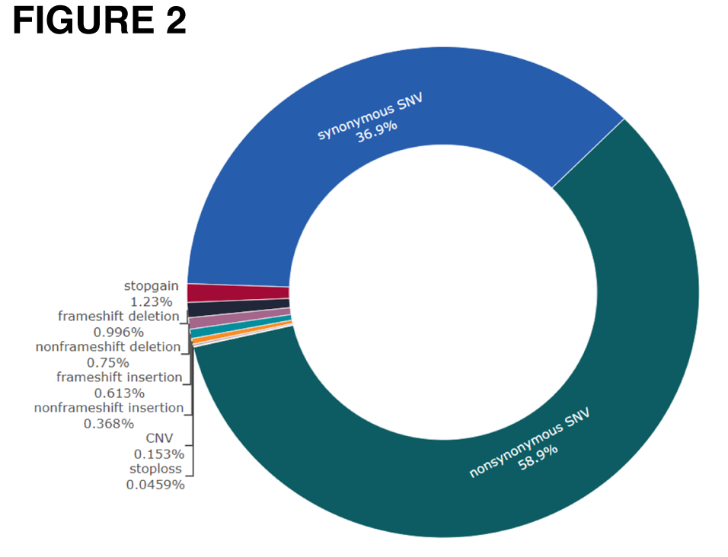
Targeted gene sequencing has high sensitivity and specificity for DNA variant detection
  Analytical validation using reference material showed ≥99% sensitivity and specificity for variant detection.
  8267 distinct genetic variants were detected in the entire cohort of 2552 individuals, with 7936 variants (96%) consisting of single nucleotide variants (SNVs) and the remainder 4% being small insertions, deletions, and copy number variants (CNVs).
Figure 2. Distribution of exonic variant functions. SNVs accounted for 96% of exonic variants (n=6519), with smaller proportions of small insertions, small deletions, indels, and copy number variants.

Slide 9
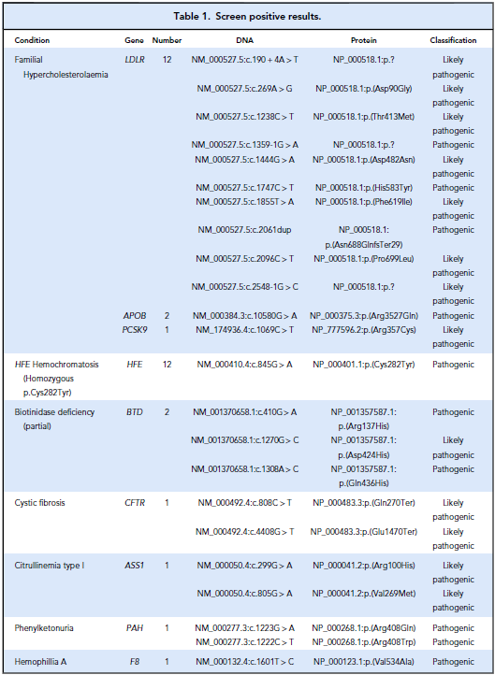
Screen positive rate 1.3%
  33 (1.3%) individuals had pathogenic or likely pathogenic variants in a disease-causing configuration.
  15 screened positive for familial hypercholesterolemia and one with X-linked hemophilia A.
  12 potential HFE hemochromatosis cases, 2 with partial biotinidase deficiency, and 1 each with citrullinemia type I, phenylkenonuria, and cystic fibrosis.

Slide 10
Targeted gene sequencing for NBS is cost effective
  Total set-up costs were USD 778,000
  Cost per test was USD 61 inclusive of reagents and labor for 60,000 samples
  Cost per positive screen for testing 60,000 newborns per year is approximately USD 5,262
  More conditions can be added over time with minimal extra cost

Slide 11
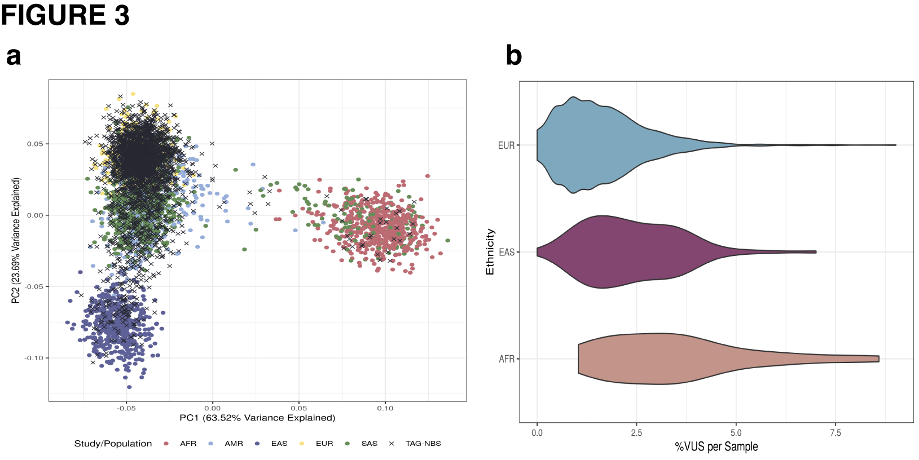
Less than 2% of DNA variants in each newborn were Variants of Uncertain Significance (VUS)
  In individuals, we observed on average 225 variants
  0.2% were classified as likely pathogenic or pathogenic
  98.0% were benign or likely benign;
  and the 1.8% remainder were variants of uncertain significance (VUS)
Figure 3. Ethnicity of samples from principal component analysis.(A), Principal component analysis was conducted with 1000 Genomes superpopulation data. PC1 and PC2 results are graphed. Crosses indicate samples from present study. EUR = European/Caucasian, AMR = South American, SAS = South Asian, EAS = East Asian, AFR = African. (B), Percentage of VUS for individuals in each ethnic group.

Slide 12
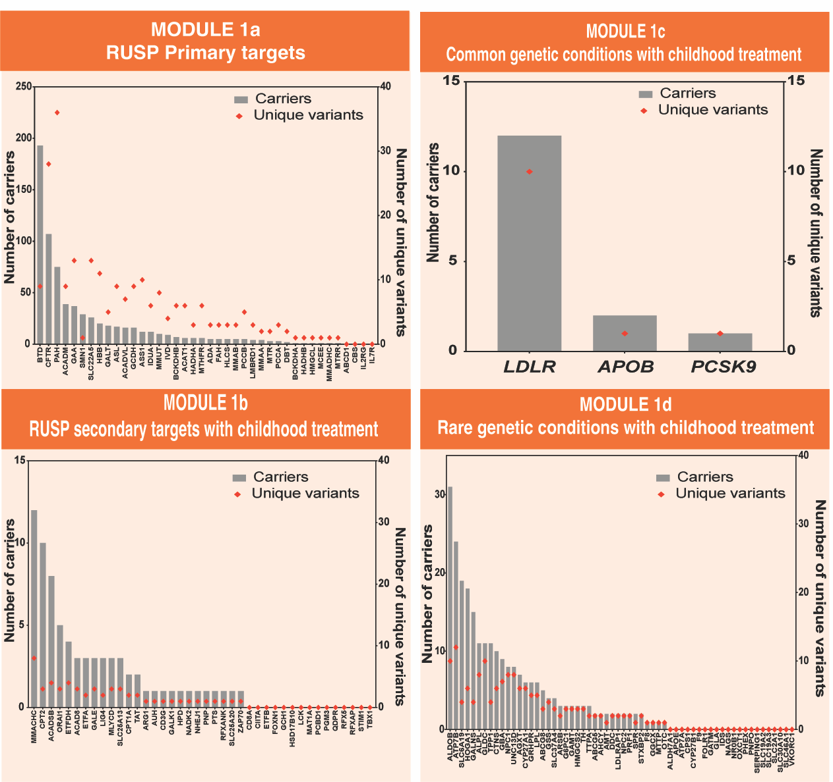
Overall carrier rate of 53.4%
  Most carriers had the NM_001370658.1:c.1270G>C (p.Asp424His) variant which can cause partial or profound Biotinidase Deficiency depending on other BTD variants that are inherited.
  A notable number of carriers for Hereditary Fructose Intolerance (ALDOB) and Wilson Disease (ATP7B) were observed.
From Fig. 4. Frequency of clinically significant variants.

Slide 13
Question #3
  Many advocacy groups support newborn screening for genetic conditions which currently do not have treatment to prevent ”diagnostic odysseys” for families. What are the individual and population health pros and cons of newborn screening for such conditions?

Slide 14
Conclusion
  We demonstrate that a Targeted Gene Sequencing (TGS) assay could be incorporated into a NBS program to increase the number of conditions screened.
  TGS is cost-effective and is likely to be more cost-effective than genomic/exomic tests which sequence > 20,000 genes.
  Our view is that TGS will be most effective for:
    first-tier testing of conditions which present in weeks to months after birth and
    second-tier confirmatory molecular genetic testing for acutely presenting conditions such as the fatty acid oxidation disorders and organic acidemias.

