Slide 1
Reducing Lipid Panel Error Allowances to Improve the Accuracy of Cardiovascular Risk Stratification
J. Cole, M. Sampson, H.E. van Deventer,
A.T. Remaley
October 2023
https://doi.org/10.1093/clinchem/hvad109
© 2023 Association for Diagnostics & Laboratory Medicine

Slide 2
The Standard Lipid Panel
  Despite great effort and major advances, cardiovascular disease (CVD) remains the leading cause of death worldwide.
  Measurement of the standard lipid panel parameters is the cornerstone of CVD risk assessment and of assessing the need for, and adequacy of, lipid-lowering therapy.
  The lipid panel consists of:
    Total cholesterol (TC)
    HDL-C measured
    Triglycerides (TG)
    LDL-C (usually calculated)
    NonHDL-C (calculated)

Slide 3
Analytical Performance of Lipid Assays
  Total analytical error = bias + 2x imprecision
  Lipoproteins and triglycerides are heterogeneous analytes. Thus, measurement of these lipids cannot be fully standardized.
  Reliable lipid measurement poses numerous challenges.
  Homogeneous assays of HDL-C and LDL-C perform poorly in highly dyslipidemic samples.
  Calculated LDL-C and nonHDL-C are subject to the additive analytical errors of the parameters used in their calculation.
  Progressive advances in technology continue to occur as the challenges to reliable measurement are tackled.

Slide 4
The 2015 Milan Hierarchy
  Analytical performance goals are determined using the best and most applicable of 3 models.
Clinical Outcomes
Biological Variability
State of
the
Art
  The current performance goals for the lipid panel were set ~28 years ago based on the state of the art at that time.
  They have not been updated despite numerous advances in technology and treatment.
  No clinical outcomes studies have been performed to date.

Slide 5
Discussion Question 1
What are the challenges and limitations in triglyceride, LDL-C, and HDL-C measurement?

Slide 6
Hypothesis
  The current analytical performance specifications allow errors in CVD risk stratification that may lead to mismanagement of a large number of individuals.
Aims
  Determine the degree to which current performance specifications may lead to misclassification of CVD risk.
  Determine the degree to which achievable improvements in analytical performance targets would reduce this.

Slide 7
Methods
  Lipid parameter measurements from 8506 individuals in NHANES were used as “true” values to stratify participants into 4 risk groups according to the US guidelines*.
  LDL-C was calculated using the Friedewald equation.
  3 hypothetical error scenarios were devised:
    maximum positive bias on LDL-C, maximum negative bias on LDL-C, no bias
    each scenario was examined with and without biological variability
  Current targets for bias and imprecision were applied to the measured parameter results and individuals were stratified based on the error-affected values.
  The same was done with slightly stricter performance targets determined by iteration and with consideration for what is achievable.
  The percentage of the cohort that changed risk groups in each scenario was compared between the two sets of targets.
*2018 AHA/ACC/AACVPR/AAPA/ABC/ACPM/ADA/AGS/APhA/ASPC/NLA/PCNA Guideline on the Management of Blood Cholesterol: A Report of the American College of Cardiology/American Heart Association Task Force on Clinical Practice Guidelines, https://doi.org/10.1161/CIR.0000000000000625

Slide 8
Discussion Question 2
When calculating total variance of an assay, variance is additive. How would you apply both analytical variability and biological variability to individual results in a simulation of reality?

Slide 9
Figure 1. A) Stratification scheme, based on the US guideline, to classify individuals into four CVD risk groups A-D. To convert to SI units: Multiply cholesterol measures by 0.02586; multiply TG by 0.01129.
B) Classification of the cohort based on original NHANES results. Colors indicate which criteria were met to be classified into each group.
Abbreviations: L, LDL-C only; LDL-C, low-density lipoprotein cholesterol; LP, LDL-C and PCE; LPT, LDL-C, PCE, and TG; P, PCE only; PCE, pooled cohort equation; PT, PCE and TG; TG, triglycerides.
Most Individuals Fall into the Lowest Risk Group
>65% of individuals are in the lowest risk group, based on a 10-year risk score <7.5%.
A small, but important percentage of individuals have LDL-C <70 mg/dL.

Slide 10
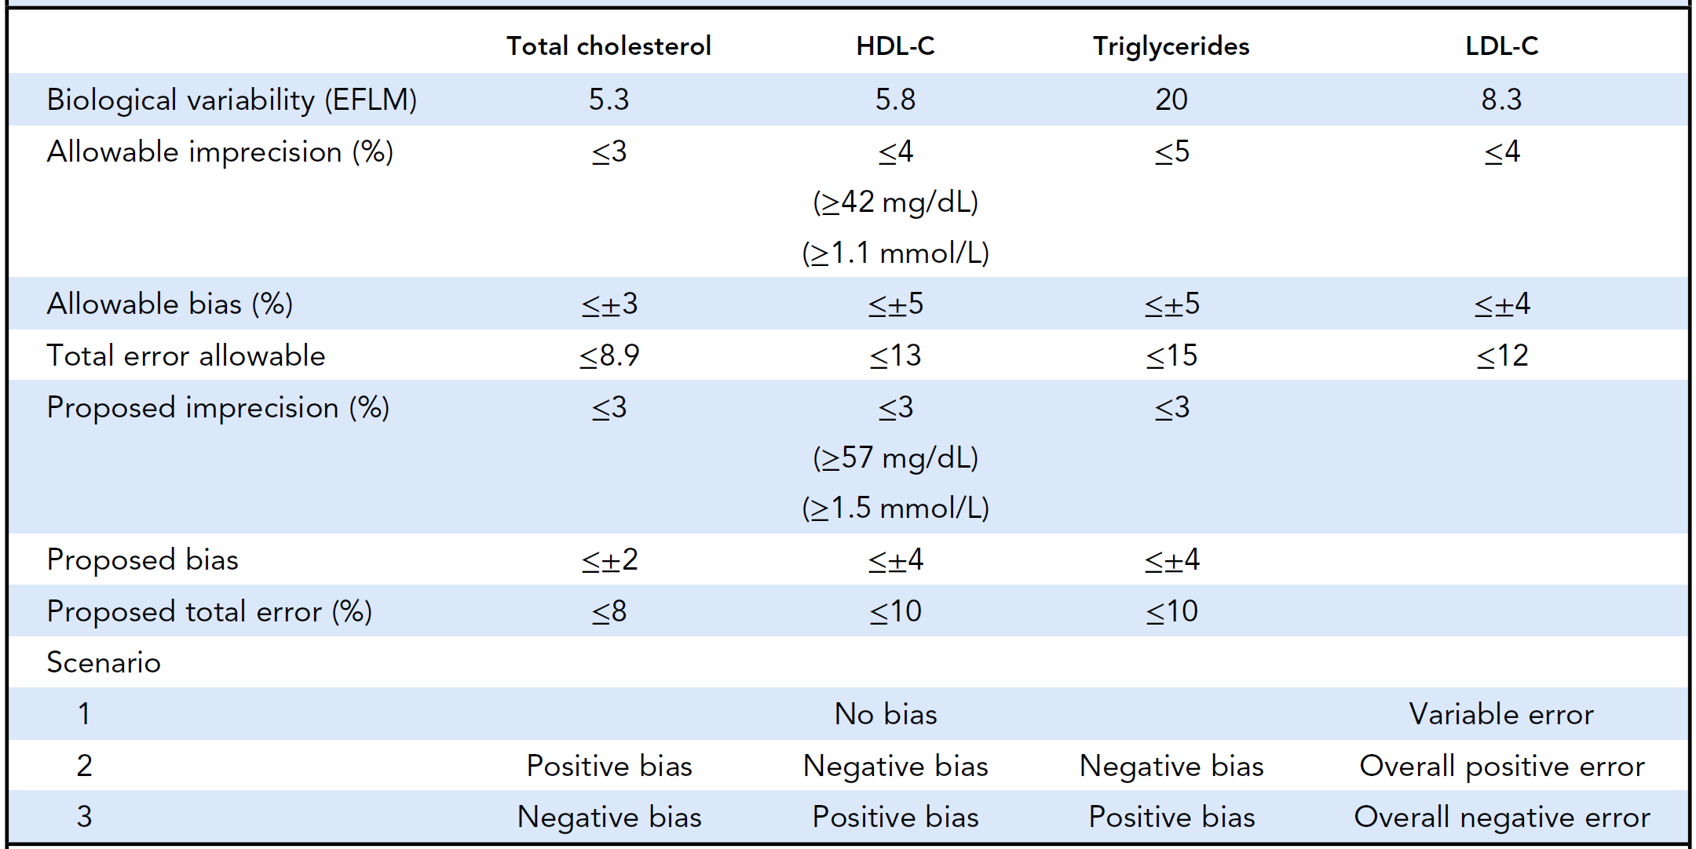
Table 1. Three error scenarios were simulated using two sets of performance targets: the National Cholesterol Education Program recommendations, and proposed targets that were determined through iteration. Biological variability was taken from the European Federation of Clinical and Laboratory
Medicine Biological Variability database.
Abbreviations: HDL-C, high-density lipoprotein cholesterol; LDL-C, low-density lipoprotein cholesterol.
NCEP and Proposed Analytical Performance Recommendations and Hypothetical Error Scenarios

Slide 11
Figure 2. A) Average percent of individuals misclassified if the current NCEP performance recommendations for lipid panel assays are met and used to calculate LDL-C by the Friedewald equation.
Each row represents one hypothetical scenario, and the columns show results without and with biological variability (BV). The average of 50 replicates of each scenario is displayed, as well as the worst of the 50 replicas in scenario 2.
Colors indicate the “true” risk group classifications of those erroneously classified into each group.
Misclassification Using Current Targets
Up to 10% of individuals were misclassified in the worst-case scenario.
Some individuals that were at lowest risk were classified into the highest risk group, and vice versa.

Slide 12
Figure 2. B) Average percent of individuals misclassified if the proposed performance recommendations for lipid panel assays are met and used to calculate LDL-C by the Friedewald equation.
Each row represents one hypothetical scenario, and the columns show results without and with biological variability (BV). The average of 50 replicates of each scenario is displayed, as well as the worst of the 50 replicas in scenario 2.
Colors indicate the “true” risk group classifications of those erroneously classified into each group.
Misclassification Using Proposed Targets
An absolute reduction of ~1% in misclassifications was achieved in the worst-case scenario.
The average misclassifications were reduced in all scenarios by up to 10% of the original misclassification rate.

Slide 13
Figure 3. Each scenario was simulated 50 times, and the distributions of results are shown. Imprecision has a minimal role in risk misclassification. NonHDL-C was less-affected by error and its use resulted in fewer misclassifications than cLDL-C.
Bias and BV Account for Most Errors
Abbreviations: BV, biological variability; cLDL_new, calculated LDL-C, proposed criteria; cLDL_old, calculated LDL-C, current criteria; dLDL, direct LDL-C; HDL-C, high-density lipoprotein cholesterol;
LDL-C, low-density lipoprotein cholesterol; NHDL_new, non-HDL-C, proposed criteria; NHDL_old,
non-HDL-C, current criteria.

Slide 14
Serial Sampling Reduces the Impact of Biological Variability
There was a 1.7% absolute reduction in misclassifications using cLDL-C-based risk stratification if sampling was repeated once.
Figure 4. B) Sample replicates were simulated to determine the effect of serial sampling on misclassification rates.
Abbreviations: cLDL-C, calculated low-density lipoprotein cholesterol; dLDL-C, directly measured low-density lipoprotein cholesterol; nonHDL-C, non-high-density lipoprotein cholesterol.

Slide 15
Summary
We used accurate CVD risk classification as an indirect clinical outcome to evaluate and propose performance specifications for lipid assays.
Using the current NCEP performance targets resulted in up to 10.1% of individuals’ being misclassified.
Achievable reductions in allowable bias (by 1%) and imprecision (to 3%) in all assays would have a clinically meaningful impact for many patients.
Serial sampling or using less-error prone risk markers, such as nonHDL-C or apolipoprotein B, instead of LDL-C could further reduce risk misclassification due to analytical errors and biological variability.

Slide 16
Discussion Question 3
What steps would you take to promote and bring about change, such as adjusting performance targets, encouraging serial testing or introducing an alternative risk marker in your clinical practice?

