Slide 1
A Machine Learning Model for the Routine Detection of “Wrong Blood in Complete Blood Count Tube” Errors
C-J. Farrell, C. Makuni, A. Keenan, E. Maeder,
G. Davies, J. Giannoutsos
September 2023
https://doi.org/10.1093/clinchem/hvad100
© 2023 Association for Diagnostics & Laboratory Medicine

Slide 2
Wrong blood in tube (WBIT) errors are a significant problem for clinical laboratories
‘WBIT error’ - the blood in a specimen tube is not from the patient identified on the label
WBIT errors are low prevalence
  Approximately 1 in every 3000 samples (estimates vary)
WBIT errors are high impact
  Leading cause of laboratory-related patient safety events
  May cause misdiagnoses, inappropriate treatment decisions, or life-threatening transfusion reactions

Slide 3
WBIT errors are challenging to detect
As a single episode of testing, results are consistent with valid patient results
Detection depends on identifying suspicious changes in previous results for the patient
  A combination of delta checks and review by laboratory staff is typically used
  It is often difficult to distinguish WBIT errors from genuine changes in results

Slide 4
Machine learning (ML) appears well-suited to detecting WBIT
ML models can learn complex relationships
  WBIT detection is complex – assessment of changes in multiple analytes in the context of the patient’s age and sex
ML models perform best when trained on large data sets
  Large data sets can be generated by computer simulation of WBIT errors
ML models can be used to make binary predictions
  Model learns to predict probability that error is present
  Predicted probabilities converted into binary prediction using a threshold (e.g., probability >0.50 ‘WBIT error present’)

Slide 5
Proof-of-concept studies have demonstrated the potential of ML for WBIT error detection
Compared to current procedures, ML models
  Outperformed delta checks
  Outperformed laboratory staff
Among ML models, best performance from
  More complex ML algorithms
  Models applied to complete blood count (CBC) results rather than common biochemistry panels
An extreme gradient boosting model applied to CBC results was used for this study

Slide 6
The models developed in proof-of-concept studies have practical limitations
They had no strategy for handling missing values
  This is a frequent event in practice, e.g., platelet count not reported due to platelet clumping
  Proof-of-concept studies had to exclude samples with one or more missing values
The models would have very low positive predictive value (PPV) in practice
  Expected to be 3%, at best
  Low PPV caused by the low WBIT error prevalence

Slide 7
Discussion question 1
What general strategies can be used to improve the positive predictive value of a test?

Slide 8
Two approaches to missing values were evaluated
1. Entirely exclude from the model parameters that often have missing values, if they do not significantly contribute to performance
  Monocyte and neutrophil count could be excluded (together contributed 19% of missing values)
2. Imputation for remaining parameters
  Mean, median, and k-nearest neighbors imputation were evaluated
  Mean imputation demonstrated the best performance

Slide 9
The model was applied prospectively to routine CBC samples over 22 weeks
  Daily extract of all reported results (i.e., had passed all routine checks)
  Samples with previous CBC results (within 6 days) given to the model
  Model’s predicted probability of WBIT for each sample recorded
  Each week, the five samples given the highest probabilities were flagged for further investigation*
    *Further investigation involved blood group testing ± red cell
    phenotyping the patients’ current and previous samples

Slide 10
Discussion question 2
What is the minimum positive predictive value that would make the model useful in your laboratory?

Slide 11
The model outperformed standard procedures
ML model
  110 samples were flagged for further investigation
  12 WBIT errors were identified. These had all been missed by standard procedures
Standard procedures
  2 WBIT detected errors during the study period*
  Of the 12 WBIT errors that were missed
    Delta checks did not flag for 6
    Laboratory staff review failed to detect the other 6
  *Results from these samples were not reported and
  therefore, were not extracted for analysis by the model

Slide 12
What threshold of probability should trigger real-time investigation of samples?
Prioritizing sensitivity, >0.914
  All WBIT errors were above this threshold
  Positive predictive value of at least 12%
  Flags 0.26% of routine samples
Prioritizing specificity, >0.996
  9/12 (75%) WBIT errors were above this threshold
  Positive predictive value 60%
  Flags 0.04% of routine samples

Slide 13
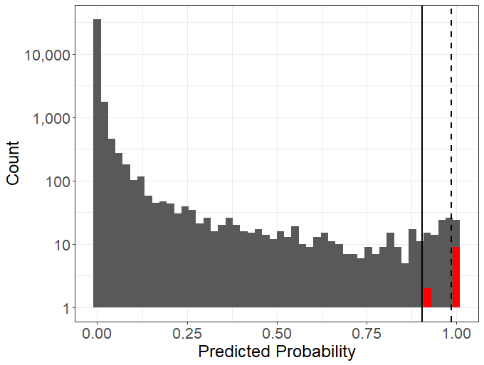
Histogram of the predicted probability of WBIT error assigned by the model to all samples during the study
Figure 1. Probabilities assigned to confirmed WBIT errors are shown in red. Solid vertical line - sensitivity threshold, 0.914; dashed vertical line - specificity threshold, 0.996.

Slide 14
Discussion question 3
What issues need to be addressed before the model is ready for routine use?

