Slide 1
The Vitamin D Metabolite Ratio (VMR) is a Biomarker of Vitamin D Status That is Not Affected by Acute Changes in Vitamin D Binding Protein
A. Dugar, A.N. Hoofnagle, A.P. Sanchez, D.M. Ward, J. Corey-Bloom, J.H. Cheng, J.H. Ix, C. Ginsberg
July 2023
https://doi.org/10.1093/clinchem/hvad050
© 2023 Association for Diagnostics & Laboratory Medicine

Slide 2


25-Hydroxyvitamin D [25(OH)D]
Key Functions
  Calcitriol (active vitamin D) precursor
  Regulation of calcium and phosphate absorption
Limitations as a biomarker
  Inconsistently associated with clinical outcomes like fracture
  Largely protein bound (~85% to Vitamin D Binding Protein), which can be highly variable between individuals
Ginsberg et al. Bone (2018)
Ginsberg et al. Clin Chem (2021)

Slide 3
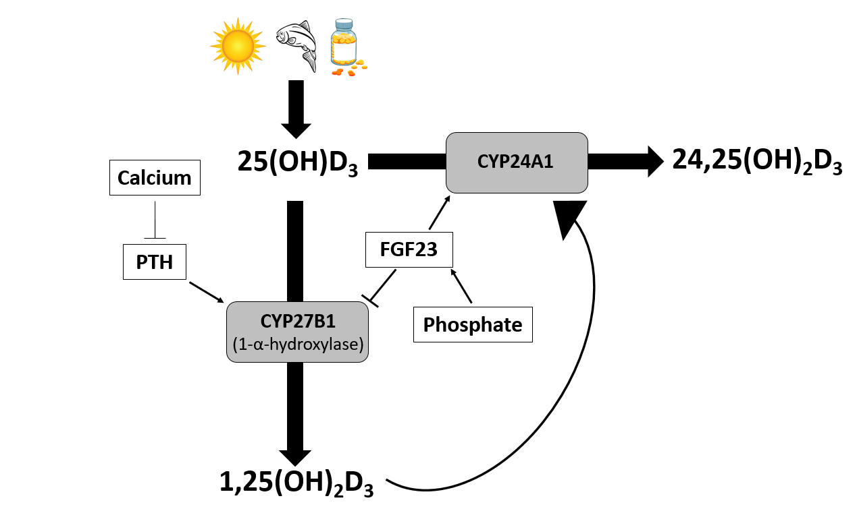
24,25-Dihydroxyvitamin D [24,25(OH)₂D]
Key Functions
  Catabolic product of 25-hydroxyvitamin D
  Produced to prevent 1,25(OH)₂D (calcitriol) toxicity
  May reflect underlying vitamin D receptor activity
Limitations as a biomarker
  Also largely protein bound (Vitamin D Binding Protein or VDBP), which can be highly variable between individuals

Slide 4
The Vitamin D Metabolite Ratio Hypothesis
  The vitamin D metabolite ratio (VMR) is the ratio of 24,25(OH)₂D to 25(OH)D
  VMR is a surrogate marker of Vitamin D status that is strongly associated with fracture risk, changes in bone density and mortality
  Independent of VDBP variability in observational study

Slide 5
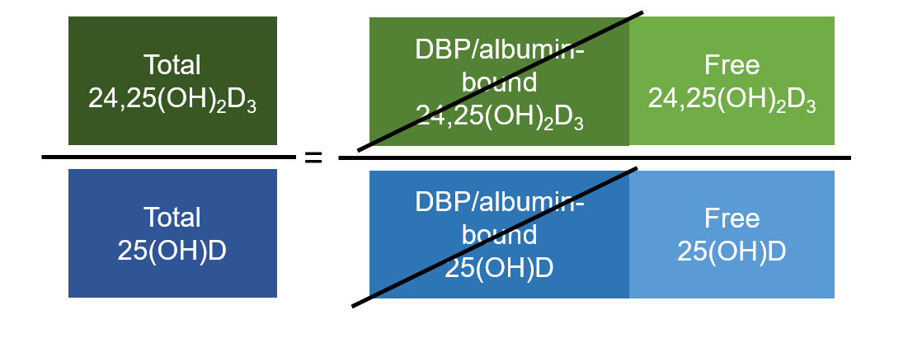
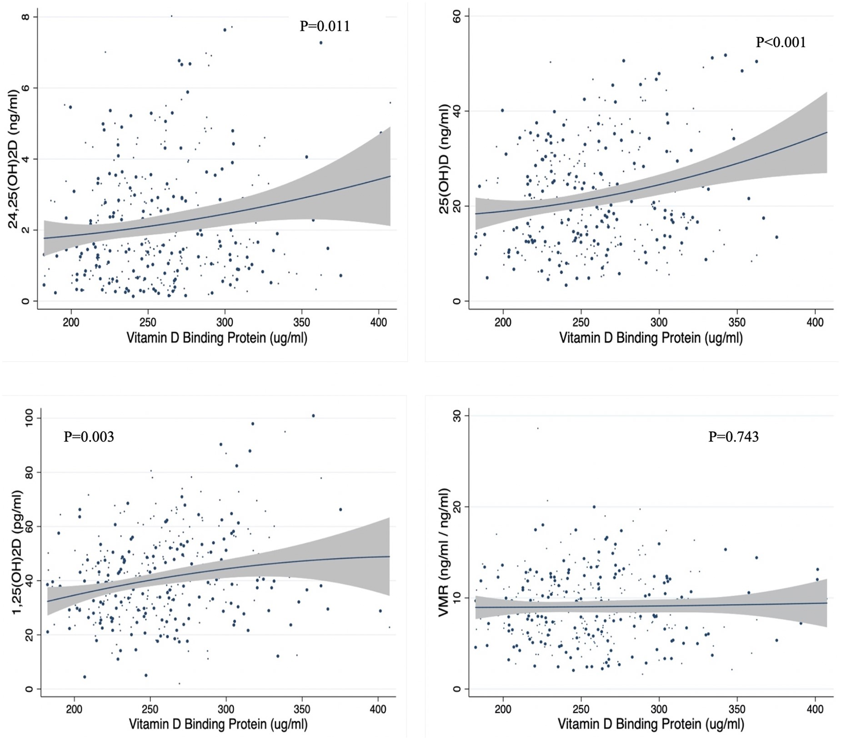
The Vitamin D Metabolite Ratio Hypothesis
Figure 1: The VMR is Theoretically Independent of VDBP
Figure: Regression curves of vitamin D metabolites and the VMR vs. vitamin D binding protein in older adults*
The effect of VDBP in numerator and denominator may cancel out
In an observational study of older adults the VMR, unlike 25(OH)D, was not associated with VDBP
*Ginsberg C, Hoofnagle AN, Katz R, Becker JO, Kritchevsky SB, Shlipak MG, et al. The vitamin D metabolite ratio is independent of vitamin D binding protein concentration. Clin Chem 2021;67:385–93.

Slide 6
Therapeutic Plasma Exchange (TPE)
  Procedure in which plasma layer is separated from rest of blood and removed
  Plasma is replaced with albumin and rarely fresh frozen plasma
  Generally used to treat autoimmune disorders (antibody removal with plasma layer)
  VDBP theoretically removed and not replaced

Slide 7
Discussion Question #1
Is the VMR independent of acute changes in VDBP within an individual?

Slide 8
Methods
  Prospective analysis of changes in vitamin D metabolites from before to after a single TPE
  25(OH)D, 24,25(OH)₂D, 1,25(OH)₂D, VDBP, measured with LC-MS/MS before and after TPE
  45 participants enrolled
  Paired t-test to evaluate changes during TPE
  Linear regression to assess association of changes in VDBP with changes in vitamin D metabolites

Slide 9
Discussion Question #2
How much do vitamin D metabolites change in response to replacement of plasma, including VDBP, with albumin?

Slide 10
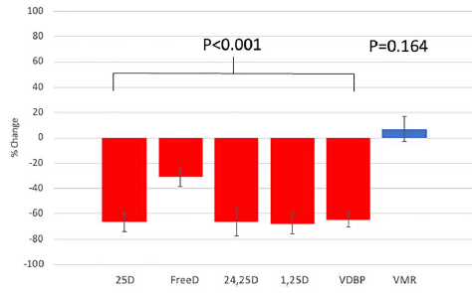
Figure 2. Changes in Vitamin D Metabolites, VDBP, and VMR during TPE (N=45)
TPE acutely lowers VDBP and Vitamin D metabolites
TPE did not affect the VMR

Slide 11
Table 2: Association of Changes in Vitamin D Binding Protein with Changes in Vitamin D Metabolites in 45 Persons Undergoing Therapeutic Plasma Exchange
 | 25D |  | Free D |  | 24,25D |  | 1,25D |  | VMR
 | % Change per 10% change in VDBP(95% CI) | P | % Change per 10% change in VDBP(95% CI) | P | % Change per 10% change in VDBP(95% CI) | P | % Change per 10% change in VDBP(95% CI) | P | % Change per 10% change in VDBP(95% CI) | P
Decline | 6 (3, 9) | <0.001 | 6 (-7, 18) | 0.337 | 6 (3, 10) | 0.002 | 9 (5, 12) | <0.001 | -3 (-37, 30) | 0.838

Slide 12
Summary
  TPE acutely lowers VDBP concentration to approximately 1/3 of its starting concentration
  TPE acutely lowers all protein bound vitamin D metabolites to a similar degree as VDBP
  Changes in VDBP mirror changes in vitamin D metabolites
  The VMR is not affected by TPE and is not associated with changes in VDBP
  The VMR is independent of VDBP

Slide 13
Discussion Question #3
Considering associations of the VMR with clinical outcomes and bone health, and its independence of VDBP variability, what barriers exist to utilizing the VMR in clinical practice?

Slide 14




Thank you for participating in this month’s
Clinical Chemistry Journal Club.
Additional Journal Clubs are available at
www.clinchem.org
Follow us

