Slide 1
Within-Person and Between-Sensor Variability in Continuous Glucose Monitoring Metrics
E. Selvin, D. Wang, M.R. Rooney, M. Fang,
J.B. Echouffo-Tcheugui, S. Zeger, J. Sartini, O. Tang,
J. Coresh, R.N. Aurora, N.M. Punjabi
February 2023
https://doi.org/10.1093/clinchem/hvac192
© 2023 American Association for Clinical Chemistry

Slide 2
Introduction
Growing use of continuous glucose monitoring (CGM) technology for diabetes management
  Majority of studies are in type 1 diabetes
  Limited data in type 2 diabetes
  Few studies documenting within-person and between-sensor variability of CGM metrics
Within-person error and between-sensor variability in CGM data are important for:
  Interpretation of CGM data by patients and providers
  Use of CGM metrics for management of diabetes

Slide 3
Study Population
The Hyperglycemic Profiles in Obstructive Sleep Apnea (HYPNOS) randomized clinical trial
  186 participants with type 2 diabetes who were not receiving insulin therapy and who had sleep apnea.
  2 weeks of CGM data at baseline and after 3-months using 2 different CGM devices (worn simultaneously).

Slide 4
Study Objective
To characterize how CGM metrics compare within and across sensors in adults with type 2 diabetes who were not receiving insulin.
CGM metrics:
mean glucose
time in range
time above range

Slide 5
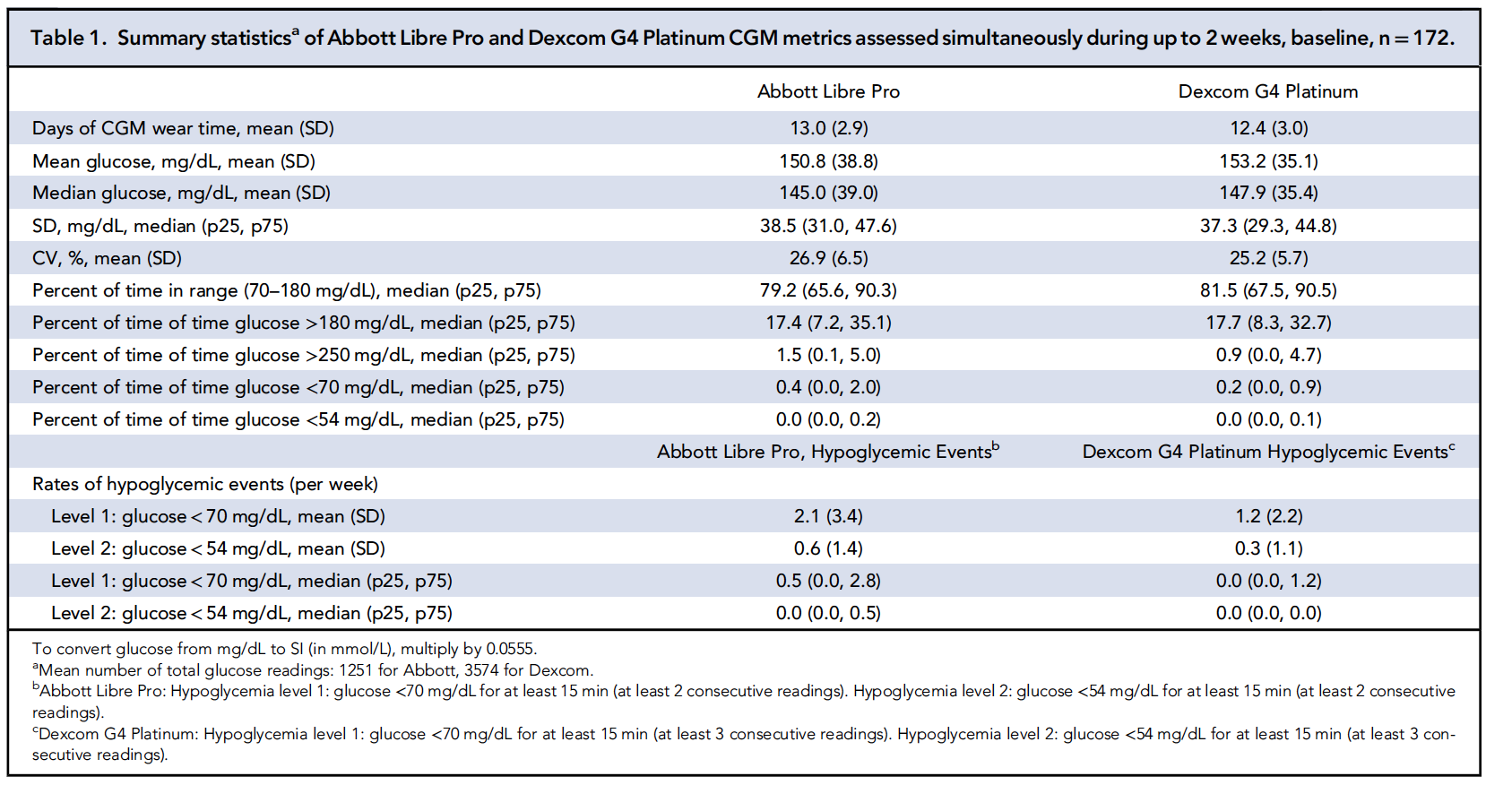
Title 1. Summary Statistics of Data from Abbott and Dexcom CGM Sensors

Slide 6
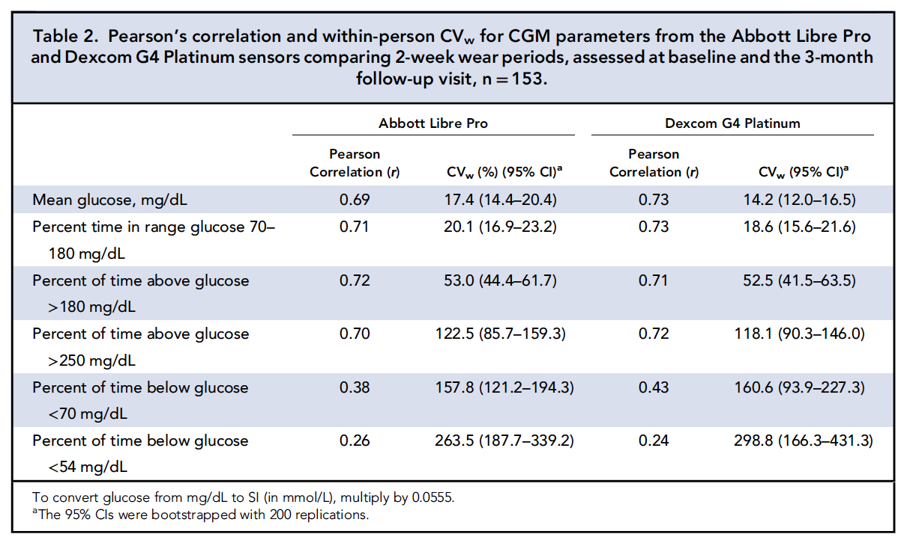
Table 2. Pearson Correlations and within-person coefficient of variation (CVw)

Slide 7
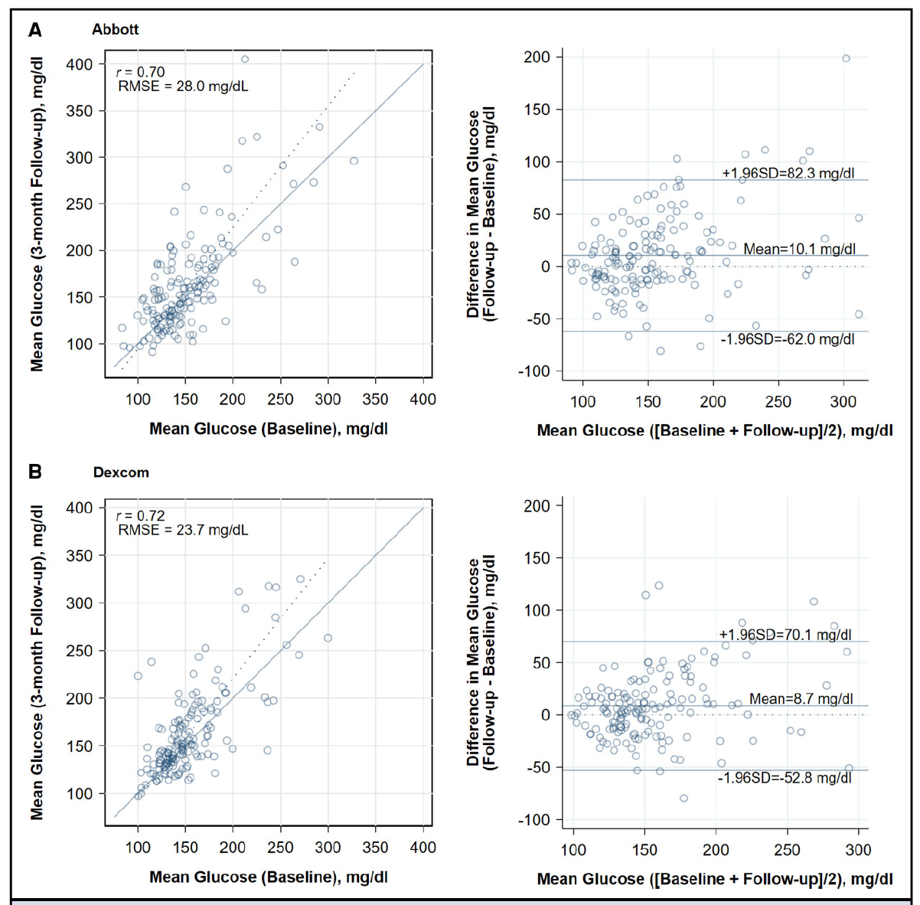
Fig 1. Scatterplots and BA Plots
Scatterplots and Bland-Altman (BA)
Within-person variability in CGM mean glucose.
Comparison
of two 2-week wear periods, 3 months apart, Abbott Libre Pro and Dexcom G4 Platinum sensors, n=153.

Slide 8
Fig 1 (cont’d).
Scatterplots and Bland-Altman plots of the within-person variability in CGM mean glucose (comparison of two 2-week wear periods, 3 months apart), Abbott Libre Pro and Dexcom G4 Platinum sensors, n= 153.
Two weeks of data at baseline (mean wear time 12.4 days; SD 3.0 days) is compared to 2 weeks of data at follow-up (mean wear time 12.3 days; SD 3.1 days).
Mean glucose from the Dexcom sensor was calculated, on average, from 3572 readings (every 5 min) at baseline and 3542 readings (every 5 min) at follow-up. Mean glucose from the Abbott sensor at baseline was calculated from 1190 readings (every 15 min) at baseline and 1181 readings (every 15 min) at follow-up. In the scatterplots, the errors-in-variables regression line (dotted blue) and line of identity (solid blue) are shown.
Panel A (Abbott), errors-in-variables regression line: Mean glucose, mg/dl (at 3 months) = 1.304 x Mean glucose, mg/dl (at baseline) – 36.012.
Bland-Altman: Mean (SD) of difference in mean glucose: 10.1 (36.8) mg/dl. Panel B (Dexcom), errors-in-variables regression line: Mean glucose, mg/dl (at 3 months) = 1.263 x Mean glucose, mg/dl (at baseline) – 31.712.
Bland-Altman: Mean (SD) of difference in mean glucose: 8.7 (31.4) mg/dl.
To convert glucose from mg/dL to SI (in mmol/L), multiply by 0.0555.
RMSE, root mean squared error.

Slide 9
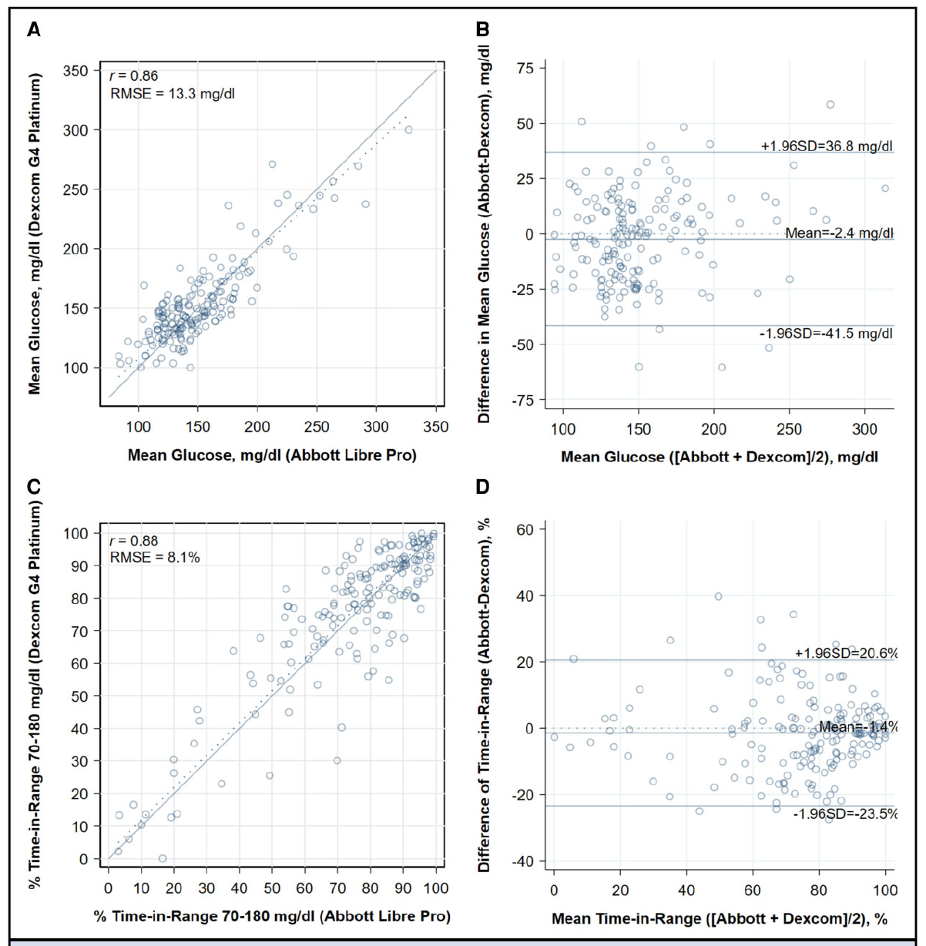
Fig 2. Scatterplots and BA Plots
Scatterplots and Bland-Altman (BA)
Mean glucose and percent time in range (glucose 70–180 mg/dL) from 2 CGM devices worn simultaneously (approximately 2 weeks), n=172.

Slide 10
Fig 2 (cont’d).
Scatterplots and Bland-Altman plots of mean glucose and percent time in range (glucose 70–
180 mg/dL) from 2 CGM devices worn simultaneously (approximately 2 weeks), n=172.
Two weeks of data (mean wear time 12.4 days; SD 3.0 days). Mean glucose and percent time in range (70–180 mg/dL) from the Dexcom sensor was calculated, on average, from approximately 3572 readings (every 5 min). Mean glucose and percent time in range (70–180 mg/dL) from the Abbott sensor was calculated, on average, from approximately 1190 readings (every 15 min). Errors-in-variables regression line (dotted blue) and line of identity (solid blue) are shown.
(A), Errors-in-variables regression: Mean glucose (Dexcom), mg/dl=0.904 x [Mean glucose (Abbott), mg/dl]+ 16.906;
(B), Bland-Altman: Mean (SD) of difference in mean glucose (Abbott minus Dexcom)=−2.4 (20.0) mg/dl;
(C), Errors-in-variables regression: Percent time in range (Dexcom)=0.993 x [Percent time in range (Abbott)]+ 1.981;
(D), Bland-Altman: Mean (SD) of difference in percent time in range (Abbott minus Dexcom)=−1.4 (11.2).
To convert glucose from mg/dL to SI (in mmol/L), multiply by 0.0555.
RMSE, root mean squared error.

Slide 11
Findings
Mean glucose (2-week) from 2 different CGM sensors worn simultaneously, had a strong correlation (r =0.86) but high variability:
  RMSE, 13.3 mg/dL [0.7 mmol/L] (Fig. 2, Panel A).
  SD of the differences, 20.0 mg/dL (1.1 mmol/L) (Fig. 2, Panel B).
High variability for glucose readings from the 2 sensors matched on time of occurrence:
  71% of the Abbott (or Dexcom) CGM individual sensor readings were within 20% of the Dexcom (or Abbott).
NOTE: Food and Drug Administration standards of accuracy for CGM sensors are roughly based on reading being within ±15-20% of reference glucose values.

Slide 12
Findings
For the same sensor worn at 2 different time points,
3 months apart:
Typical differences in mean glucose were ±29 and 23 mg/dL (±1.6 and 1.3 mmol/L) for the Abbott and Dexcom sensors.
Within-person CVs were 17.4% and 14.2% for the Abbott and Dexcom sensors.
Within-person CVs for time in range was ~20% for the Abbott and Dexcom sensors.

Slide 13
Summary of Findings
There was meaningful within-person variability (same sensor, 2 assessments, approximately 3 months apart) across the systems in mean glucose, time in range, and time above range.
There were no major differences in within-person performance for the Abbott and Dexcom sensors (similar results for each).
When comparing two different CGM sensors, there were high correlations of mean glucose and individual glucose values, but the RMSE and standard deviation of the differences was high and % agreement was relatively low.

Slide 14
Conclusions
The extent of variability within and across CGM sensors is not well recognized.
  We document clinically significant within- and between-sensor variability.
Underlying reasons for variability are poorly understood but reflect limitations of CGM technology
  Lack of standardization of interstitial glucose methods
  Different approaches to calibration and proprietary algorithms which generate glucose readings
  Nonglycemic factors that may influence interstitial glucose (e.g., sensor placement, blood flow, and other local conditions ).

Slide 15
Implications
Our study demonstrates clinically significant random error in CGM metrics.
CGM technology has revolutionized diabetes management for many patients on insulin therapy, especially patients with type 1 diabetes.
CGM summaries from 2 different sensors are highly correlated, but substantial variation was observed within and across sensors.
Clinicians should be aware of this variability when using CGM technology to make clinical decisions.

