Slide 1
Generalizability of a Machine Learning Model for Improving Utilization of Parathyroid Hormone-Related Peptide Testing across Multiple Clinical Centers
H.S. Yang, W. Pan, Y. Wang, M.A. Zaydman,
N.C. Spies, Z. Zhao, T.A. Guise, Q.H. Meng, F. Wang
November 2023
https://doi.org/10.1093/clinchem/hvad141
© 2023 Association for Diagnostics & Laboratory Medicine

Slide 2
Parathyroid hormone-related peptide (PTHrP)
90% of total hypercalcemia cases are diagnosed as primary hyperparathyroidism and malignancy-related hypercalcemia.
Malignancy-related hypercalcemia, most frequently caused by malignant solid organ tumors, is primarily mediated by PTHrP which stimulates calcium resorption from bone and reabsorption in the kidneys.
A logical, systematic approach to the workup of a patient with hypercalcemia involves confirmation of elevated calcium, followed by measurement of intact PTH. PTHrP testing is necessary when the cause of the hypercalcemia is unclear.
Mundy GR and Edwards JR, J Am Soc Nephrol 2008; 19 (4): 672-5

Slide 3
Poor utilization of the PTHrP testing
PTHrP testing can aid in diagnosing hypercalcemia of malignancy when the source of elevated calcium is not evident.
However, PTHrP is often ordered on patients with a low pretest probability of this condition.
Many institutes use a manual, rule-based approach to identify inappropriate PTHrP orders (e.g., high calcium levels and high PTH levels), which is a labor-intensive and time-consuming approach.
This results in increased healthcare costs, wastes laboratory resources, and can trigger unnecessary patient anxiety.

Slide 4

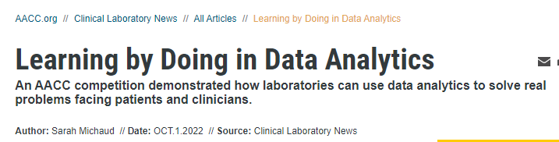
“The purpose of this competition was to see if a machine-learning approach could better predict test outcomes compared to the traditional manual approach that many clinical laboratories use, reviewing calcium and PTH results to identify potential inappropriate PTHrP orders, thereby improving the PTHrP test utilization. ”

Slide 5
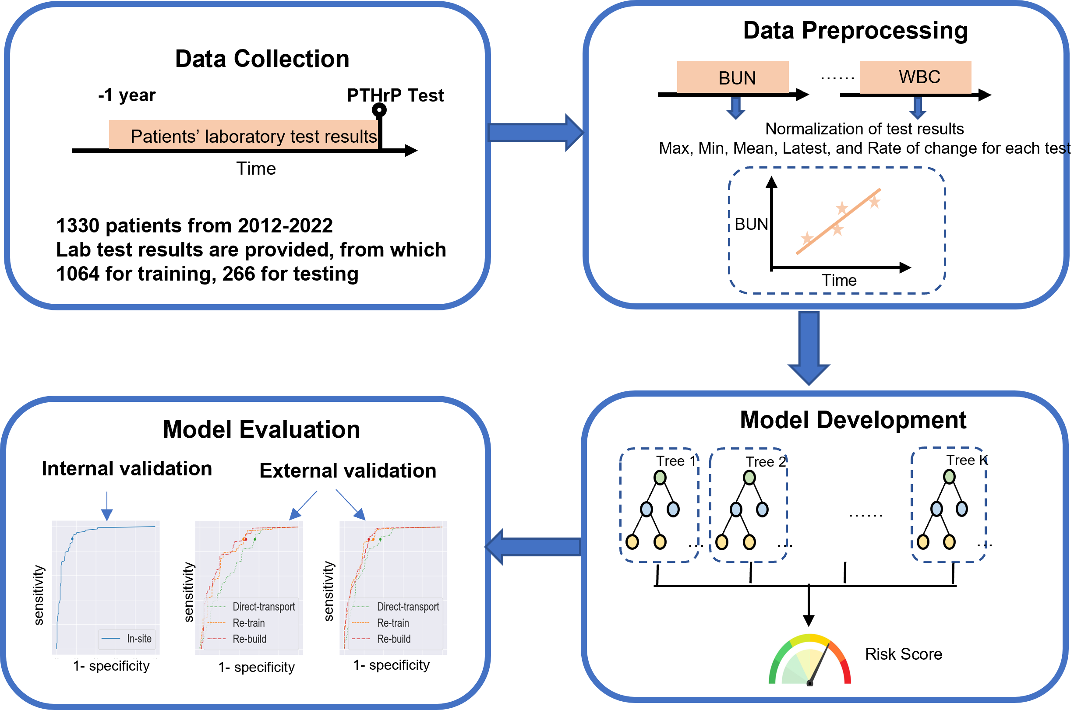
Overall Workflow of PTHrP Model Development and Evaluation
Figure 1. Illustration of the modeling workflow.

Slide 6
Dataset overview
A real, de-identified dataset consisting of 1330 PTHrP orders from 2012-2022 along with patients’ other lab results available at the time of PTHrP order was provided by Washington University School of Medicine (WUSM).
PTHrP testing offered by WUSM was performed by Mayo Clinic Laboratories.
Percentage of abnormal PTHrP results is 17.5% in this dataset.
The dataset was anonymously divided into training set (1064 patients) and testing set (266 patients).
Results of other lab tests were used to establish a feature set as described on the next slide

Slide 7
Data preprocessing and feature selection
Lab test values were normalized based on their respective reference ranges
Five statistics for each lab test were calculated in the observation window (1 year).
  Min, max, mean, latest results
  Rate of the change
  Missing values were imputed using the median value across all patients.
  159 Lab statistics were selected based on a missing rate of < 50% during the observation window and a statistical comparison of PTHrP normal and abnormal patients (p value after false discovery rate correction < 0.05)

Slide 8
Model selection and training
Four classifiers, including the random forest (RF), support vector machine (SVM), extreme gradient boosting (XGBoost), and multi-layer perceptron (MLP) models, were evaluated on the WUSM dataset.
For each model, the appropriate hyperparameters were determined through a standard 5-fold cross-validation of the training data.
The XGBoost model outperformed random forest (RF), support vector machine (SVM) and multi-layer perception (MLP) models in the cross-validation of training data.

Slide 9
Discussion question #1
What are the criteria for evaluation of a model’s performance?

Slide 10
Model’s performance should be evaluated using a diverse set of criterial
  Quantitative performance metrics
    Receiver operating characteristic curve, sensitivity, specificity, accuracy, precision, recall, F1 score
  Interpretability
  Generalizability in independent external datasets

Slide 11
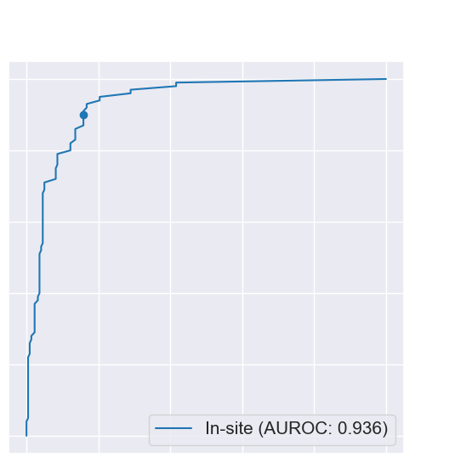
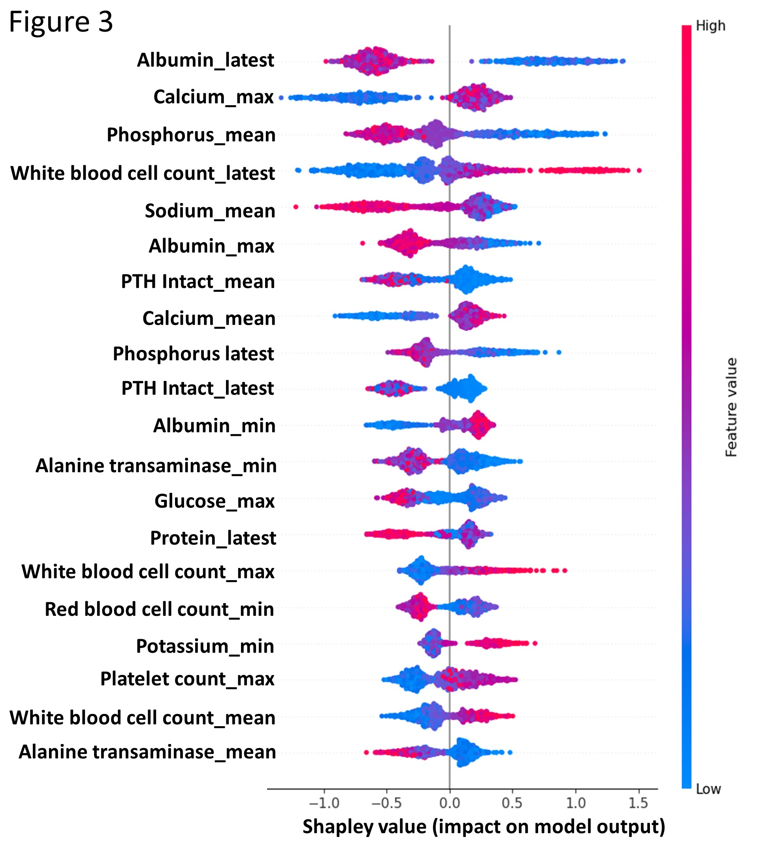
Evaluation of the XGBoost model in the WUSM internal test set
Figure 2A
1.0
Sensitivity = 0.900
Specificity = 0.842
Precision = 0.539
0.8
0.6
Sensitivity
0.4
0.2
0.0
0.0
0.2
0.4
0.6
0.8
1.0
1 - specificity
SHAP value
Abnormal
Normal
Figure 2. Evaluation of the XGBoost mode’s performance using the receiver operating characteristics (ROC) curve of the model.
Figure 3. Impact of each laboratory test statistics on the predictive performance of the model using the Shapley Addictive Explanation (SHAP) technique.

Slide 12
Discussion question #2
  Generalizability is the ability of a ML model to perform well on independent datasets collected from different geographic or demographic populations or different hospital setting.
  What factors affect a model’s generalizability?

Slide 13
Factors that Affect Model Generalizability
Patient demographic characteristics
Geographic features
Instrument platforms
Sample handling protocols and other pre-analytical factors
Testing methodologies
Send-out laboratories

Slide 14
Directly transported the PTHrP model to independent external datasets
  The PTHrP model’s performance was assessed in two independent external datasets collect from Weill Cornell Medicine (WCM) and M.D. Anderson Cancer Center (MDA).
  The rate of abnormal PTHrP results were 16.9% in WCM and 23.9% in MDA, compared to 17.5% in WUSM.
  When the ready-made model was directly applied “as-is” to the two independent datasets, its performance moderately deteriorated in MDA (AUROC = 0.838) but substantially in WCM (AUROC = 0.737).
  The performance drop was due to the shift of data distribution from the original dataset to the new dataset.

Slide 15
Discussion question #3
  If a model cannot be directly transported to external datasets, what strategies can be used to improve its performance?

Slide 16
Strategies to improve model generalizability
Strategy 1: Re-training the XGBoost model using site-specific data with the same model architecture, feature sets, and hyperparameters
Strategy 2: Re-building the model using site-specific data including feature selection, hyperparameter tuning and model parameter learning
Strategy 3: Fine-tuning the model in hospitals with limited training data

Slide 17
Model’s performance in external datasets
Method | AUROC | Partial AUROC given sensitivity ≥ 0.9 | Specificity given sensitivity = 0.9 | Precision (or PPV) given sensitivity = 0.9
Testing: WUSM
In-site test | 0.936 | 0.068 | 0.842 | 0.539
Testing: WCM
Direct-transport the model | 0.737 | 0.037 | 0.441 | 0.235
Re-train the model | 0.819 | 0.044 | 0.559 | 0.281
Re-build the model | 0.837 | 0.046 | 0.532 | 0.269
Testing: MDA
Direct-transport the model | 0.838 | 0.050 | 0.633 | 0.435
Re-train the model | 0.889 | 0.061 | 0.705 | 0.490
Re-build the model | 0.891 | 0.064 | 0.753 | 0.534
Table 1. A summary of the extreme gradient boosting (XGBoost) model performance using different training and test datasets.

Slide 18
Take Home Messages
The development of ML models for laboratory data analysis requires four major components; data collection, data preprocessing, model development, and model evaluation.
It is recommended to evaluate model generalizability in independent, external datasets.
Directly transporting a ready-made model to external datasets may lead to performance deterioration due to data distribution shift. Model re-training or re-building could improve generalizability when there are enough local data, whereas model fine-tuning may be a favorable strategy when site-specific data is limited.

