Slide 1
Exploration of a Novel Noninvasive Prenatal Testing Approach for Monogenic Disorders Based on Fetal Nucleated Red Blood Cells
X. Li, D. Zhang, X. Zhao, S. Huang, M. Han, G. Wang, Y. Li,
D. Kang, X. Zhang, P. Dai, Y. Yuan
December 2023
https://doi.org/10.1093/clinchem/hvad165
© 2023 Association for Diagnostics & Laboratory Medicine

Slide 2
Introduction
There are a small amount of fetal nucleated red blood cells (fNRBCs) in the maternal peripheral blood circulation, which may be used as a source of DNA for non-invasive prenatal testing (NIPT).
Through methods such as FISH or quantitative fluorescence PCR, fNRBCs can be used to detect fetal sex and chromosomal aneuploidy diseases.
However, stable and universally applicable methods for detecting autosomal recessive monogenic diseases with fNRBCs are still absent.
Current studies for monogenic diseases based on fNRBCs generally lack positive cases or are only suitable for a specific disease type.

Slide 3
Introduction
The application of fNRBCs in the NIPT of monogenic diseases needs to overcome four limitations:
Improve the purity of fNRBCs and eliminate maternal contamination. Until now, fNRBCs with 100% purity could not be achieved by enrichment technologies. One alternative solution is to select individual cells and complete the subsequent sequencing and analysis at the single-cell level.
Identify candidate cells as fetal or maternal origin at the single-cell level. This procedure should not be limited by the fetal sex.
Improve the quality of single-cell whole genome amplification, reduce allelic drop-out (ADO) rate and increase coverage to the whole genome.
Explore single-cell DNA sequencing and data analysis methods.
Question 1: Are there any other single-cell separation methods besides micromanipulation and laser capture microdissection?

Slide 4
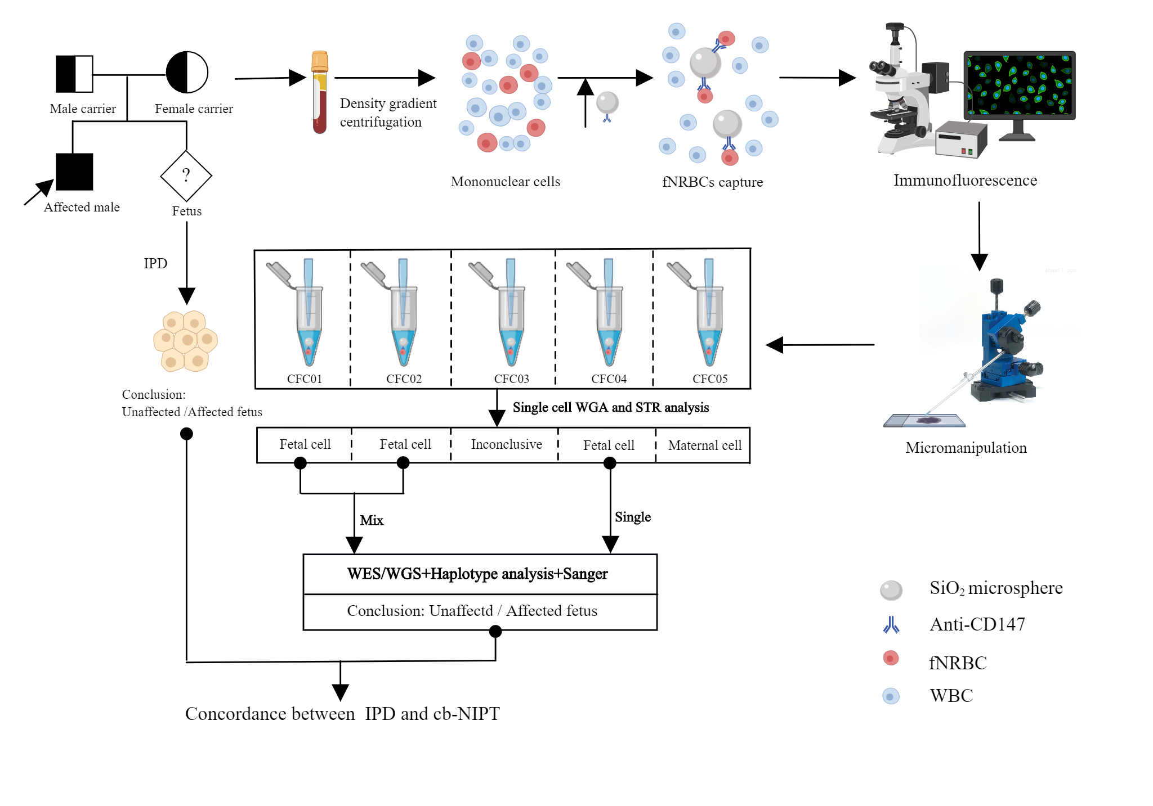
Materials & Methods
Fig. 1. Overall flowchart.

Slide 5
Materials & Methods
Step 1. Patient recruitment [11 pedigrees: 10 autosomal recessive (AR), 1 autosomal dominant (AD); 8 to 25 pregnancy weeks]; and sample collection [maternal peripheral blood (2~3 mL) for fNRBC capture and amniotic fluid or chorionic villous samples for invasive prenatal diagnosis (IPD).
Step 2. Obtain fNRBCs by density gradient centrifugation, CD147 antibody coated SiO2 microsphere capture, tricolor immunofluorescence identification, and micromanipulation.
Step 3. Perform whole genome analysis (WGA) and short tandem repeat (STR) analysis at the single-cell level.
Step 4. For cells derived from fetuses, whole exome or whole genome sequencing (WES or WGS) was performed. The effects of single cell and pooled WGA product on sequencing quality were compared.
Step 5. Compare the success rates of different sequencing methods (WES, WGS, WES-based haplotype analysis, WGS-based haplotype analysis, and Sanger) .
Step 6. Compare the results of fNRBC-based NIPT(cb-NIPT) with those of IPD.
Question 2: Is there a method for fNRBC capture and identification that does not require the use of paraformaldehyde fixation?

Slide 6
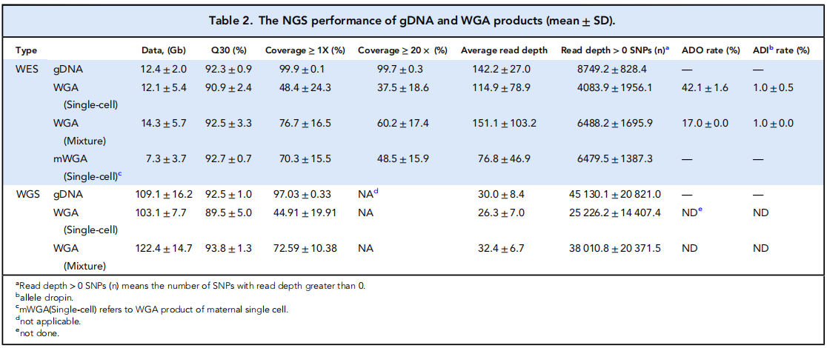
Main Results
FNRBCs were harvested and identified in 81.8% (9/11) of families.
The results of cb-NIPT were consistent with those of IPD in 8 families; the family coincidence rate was 88.9% (8/9).
The overall NGS performance of pooled WGA products (“Mixture”) was better than that of single-cell.

Slide 7
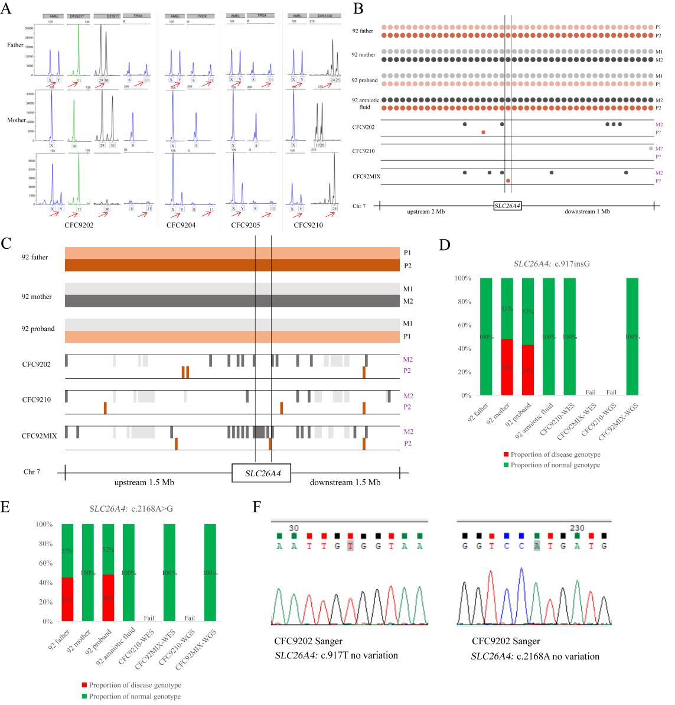
Main Results
Fig. 2. cb-NIPT results from P92. (A), STR analysis. Red arrows indicate the paternal specific STR loci; (B), WES haplotype analysis. Each dot represents an informative SNP(44 in total [20 upstream, 1 target gene region, and 23 downstream]). Red indicates P2, pink indicates P1, black indicates M2, grey indicates M1, purple represents the inferred results for the key SNPs, and vertical lines indicate the location of the target gene loci; (C), WGS haplotype analysis. Each small rectangular block represents an informative SNP(229 in total [166 upstream, 7 target gene regions, and 56 downstream]). Light orange indicates P1, brown indicates P2, grey indicates M1, black indicates M2, and purple represents the inferred results from key SNPs; (D) and (E), Variant allele fraction (%); (F), Sanger sequencing of the WGA products.

Slide 8
Main Results from Figure 2
A：CFC9202, CFC9204, CFC9205, and CFC9210 were identified as fetal cells by STR analysis.
B: The WES haplotype analysis of CFC9202 and CFC92MIX showed that the maternal haplotype was wild-type, but the paternal haplotype was uncertain.
C: The WGS haplotype analysis results of CFC9202, CFC9210, and CFC92MIX showed that both maternal and paternal haplotypes were wild-type.
D and E: CFC9210 WES analysis: SLC26A4: c.917T no variation and c.2168 not detected; CFC92MIX WES analysis: SLC26A4 : c.917 not detected and c.2168A no variation. CFC92MIX WGS analysis: SLC26A4: c.917T no variation and c.2168A no variation; CFC9210 WGS analysis: failed.
F: CFC9202 Sanger sequencing: SLC26A4: c.917T no variation and c.2168A no variation.

Slide 9
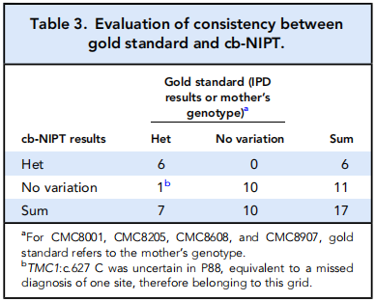
Main Results
Compared with IPD, the cb-NIPT method had a family coincidence rate of 88.9% (8/9), allele coincidence rate of 94.1% (16/17), sensitivity of 85.7% (6/7), specificity of 100%, false negative rate of 14.3%, and false positive rate of 0%.

Slide 10
Main Results
Comparison of success rates of various sequencing and analysis methods:
The success rate of direct sequencing of WES was 68.57% (24/35);
The success rate of haplotype analysis based on WES was 30.77% (8/26);
The success rate of direct sequencing of WGS was 53.33% (8/15)ª;
The success rate of haplotype analysis based on WGS was 77.78% (14/18)^{b};
The overall consistency between WES direct sequencing and WGS direct sequencing was 84.62% (11/13)^{c};
The success rate of Sanger sequencing was 61.76% (21/34), the error rate was 14.71% (5/34), and the failure rate was 23.53% (8/34). Sanger sequencing was not sensitive to detect <15% low variant allele frequencies (VAF).
^{a,b,c:} The sample size of the WGS method used in this study was relatively small, so there may be bias in the calculation.

Slide 11
Summary & Conclusions
This study explored the feasibility of utilizing fNRBCs for NIPT for the detection of monogenic disorders. Consistent results with IPD were obtained in 88.9% of families. The following conclusion can be drawn:
(a) Single fetal cell isolation can achieve 100% cell purity and avoid maternal contamination;
(b) Pooled WGA products from multiple fetal cells identified by STR had a better success ratio in detecting the target gene loci than single-cell WGA products and the direct mixture of fetal cells;
(c) WGS was significantly better than WES in haplotype analysis because it had more key informational single nucleotide polymorphisms (SNPs) in the upstream and downstream regions of the target gene loci;

Slide 12
Summary & Conclusions
(d) WES, WGS, SNP-haplotype analysis, and Sanger sequencing all had a certain degree of diagnostic error detection failure rates. By combining these analysis strategies and pooling multiple fetal cell’s WGA products, the problem of insufficient genome information in a single-cell was remedied;
(e)To ensure the success of cb-NIPT, multiple samples should be tested instead of just a single sample;
(f) This method has promising prospects in the field of NIPT for the detection of other monogenic disorders.
Question 3: Is there any other more stable and economical method for fetal single-cell DNA sequencing?

