Slide 1
A Single Reference Interval for Interpreting Serum Free Light Chains across Patients with Varying Renal Function
V. Azimi, M. Slade, M. Fiala, J.M. Fortier,
K. Stockerl-Goldstein, J.L. Frater, J.R. Brestoff, R.Jackups, M.A. Zaydman
June 2023
https://doi.org/10.1093/clinchem/hvad043
© 2023 American Association for Clinical Chemistry

Slide 2
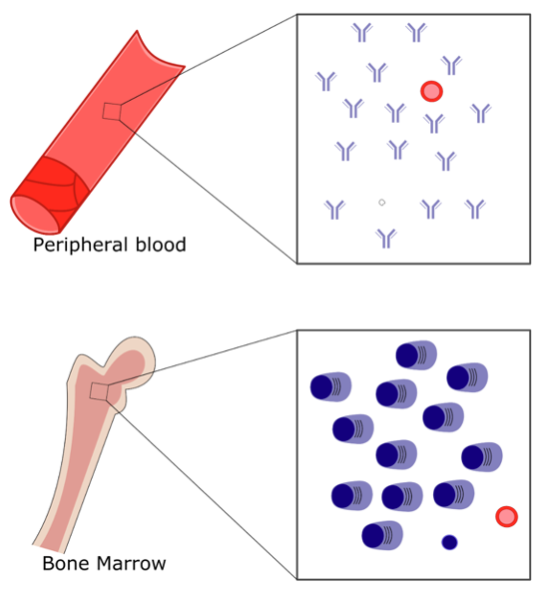
The Serum Free Light Chain (sFLC) Assay Is Important for Detecting and Managing Monoclonal Gammopathies
Monoclonal gammopathies (MGs) are diseases of clonal plasma cell proliferation
The kappa to lambda sFLC ratio provides an indirect measure of bone marrow plasma cell clonality
The sFLC assay aids in diagnosing, prognostication, and monitoring of MGs
Dispenzieri A et al. Leukemia 2009;23:215–24
Keren DF et al. Arch Pathol Lab Med 2022;146:575–90
Kyle RA and Rajkumar SV. Br J Haematol 2007;139:730–43
Rajkumar SV et al. Lancet Oncol 2014;15:e538–48
Kumar S et al. Lancet Oncol 2016;17:328-e46
Notes:
-

Slide 3
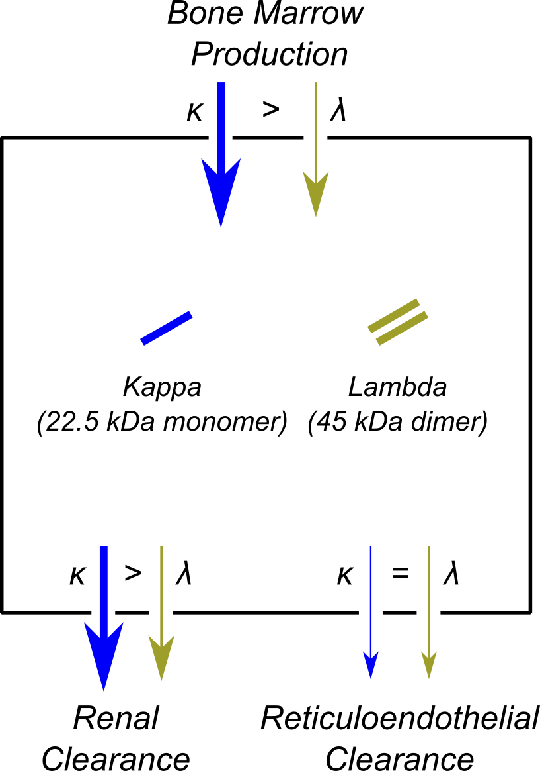
The sFLC Ratio Increases with Decreasing Renal Function
sFLC concentrations reflect a balance between production and clearance
Renal clearance of kappa monomers is faster than lambda dimers
sFLC-ratio (kappa/lambda) increases as biased clearance wanes with decreasing renal function
Molina-Andujar 2020 BMC Nephrology 21:111
Abadie 2009 Am J Clin Path 131:166-171
Hutchison 2008 BMC Nephrology 9:11
Hutchison 2008 Clin J Am Soc Nephrol 3:1684-1690
Long 2022 Blood Cancer J. 12, 133 (2022)

Slide 4
Standard-of-practice Reference Interval Has High False Positive Rate for Patients with Renal Impairment
For the most widely used sFLC assay (FREELITE), the manufacturer’s suggested sFLC-ratio reference interval was developed using a cohort with intact renal function
Katzmann Clin Chem 2002;48:1437–44
Renal impairment is common among patients at risk for MGs
Several studies have developed renal-specific sFLC reference intervals
Most laboratories still use the manufacturer’s interval, leading to a high rate of false positives among patients with impaired renal function
Molina-Andujar 2020 BMC Nephrology 21:111
Abadie 2009 Am J Clin Path 131:166-171
Hutchison 2008 BMC Nephrology 9:11
Hutchison 2008 Clin J Am Soc Nephrol 3:1684-1690
Long 2022 Blood Cancer J. 12, 133 (2022)

Slide 5
Discussion Question 1
What are barriers to implementing renal-specific reference intervals?

Slide 6
Goal/Hypothesis
Goal: Develop a single sFLC reference interval for patients of varying renal function
Hypothesis: If the sFLC-ratio is not assumed to be constant and equal to 1, “normal” sFLC variation can be approximated in a data-driven manner using principal component analysis (PCA), a type of unsupervised machine learning.

Slide 7
Methods
Retrospective, observational study
Single academic medical center (Barnes Jewish Hospital, BJH) 11/1/2019 - 1/1/2022
Cohorts
non-MG cohort (n=295)
  Negative serum protein electrophoresis, immunosubtraction, and/or immunofixation
  Lack of MG-associated ICD-10 code
MG cohort (n=185)
  Patient on MG clinical registry
  sFLC result available at time of diagnosis
Analysis
  PCA used to define normal variation (PC1) in non-MG dataset
  Deviation away from PC1 defined by PC2
  Validated PC2-based interval for MG diagnosis

Slide 8
Discussion Question 2
What are advantages and disadvantages of developing reference intervals using retrospective patient data instead of a formal prospective reference cohort?

Slide 9
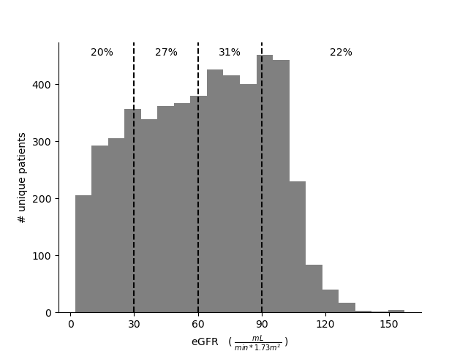
Renal Impairment Is Common among sFLC Tested Patients
47% of all patients subjected to sFLC-testing at BJH during the study period had eGFR <60 mL/min/1.73m²
Supp. Fig. 4: Distribution of eGFR results for 5,119 unique patients subjected to sFLC testing at Barnes-Jewish Hospital between 1/1/2019-1/1/2022. The percentage of patients in each eGFR interval is shown at the top of the figure.

Slide 10
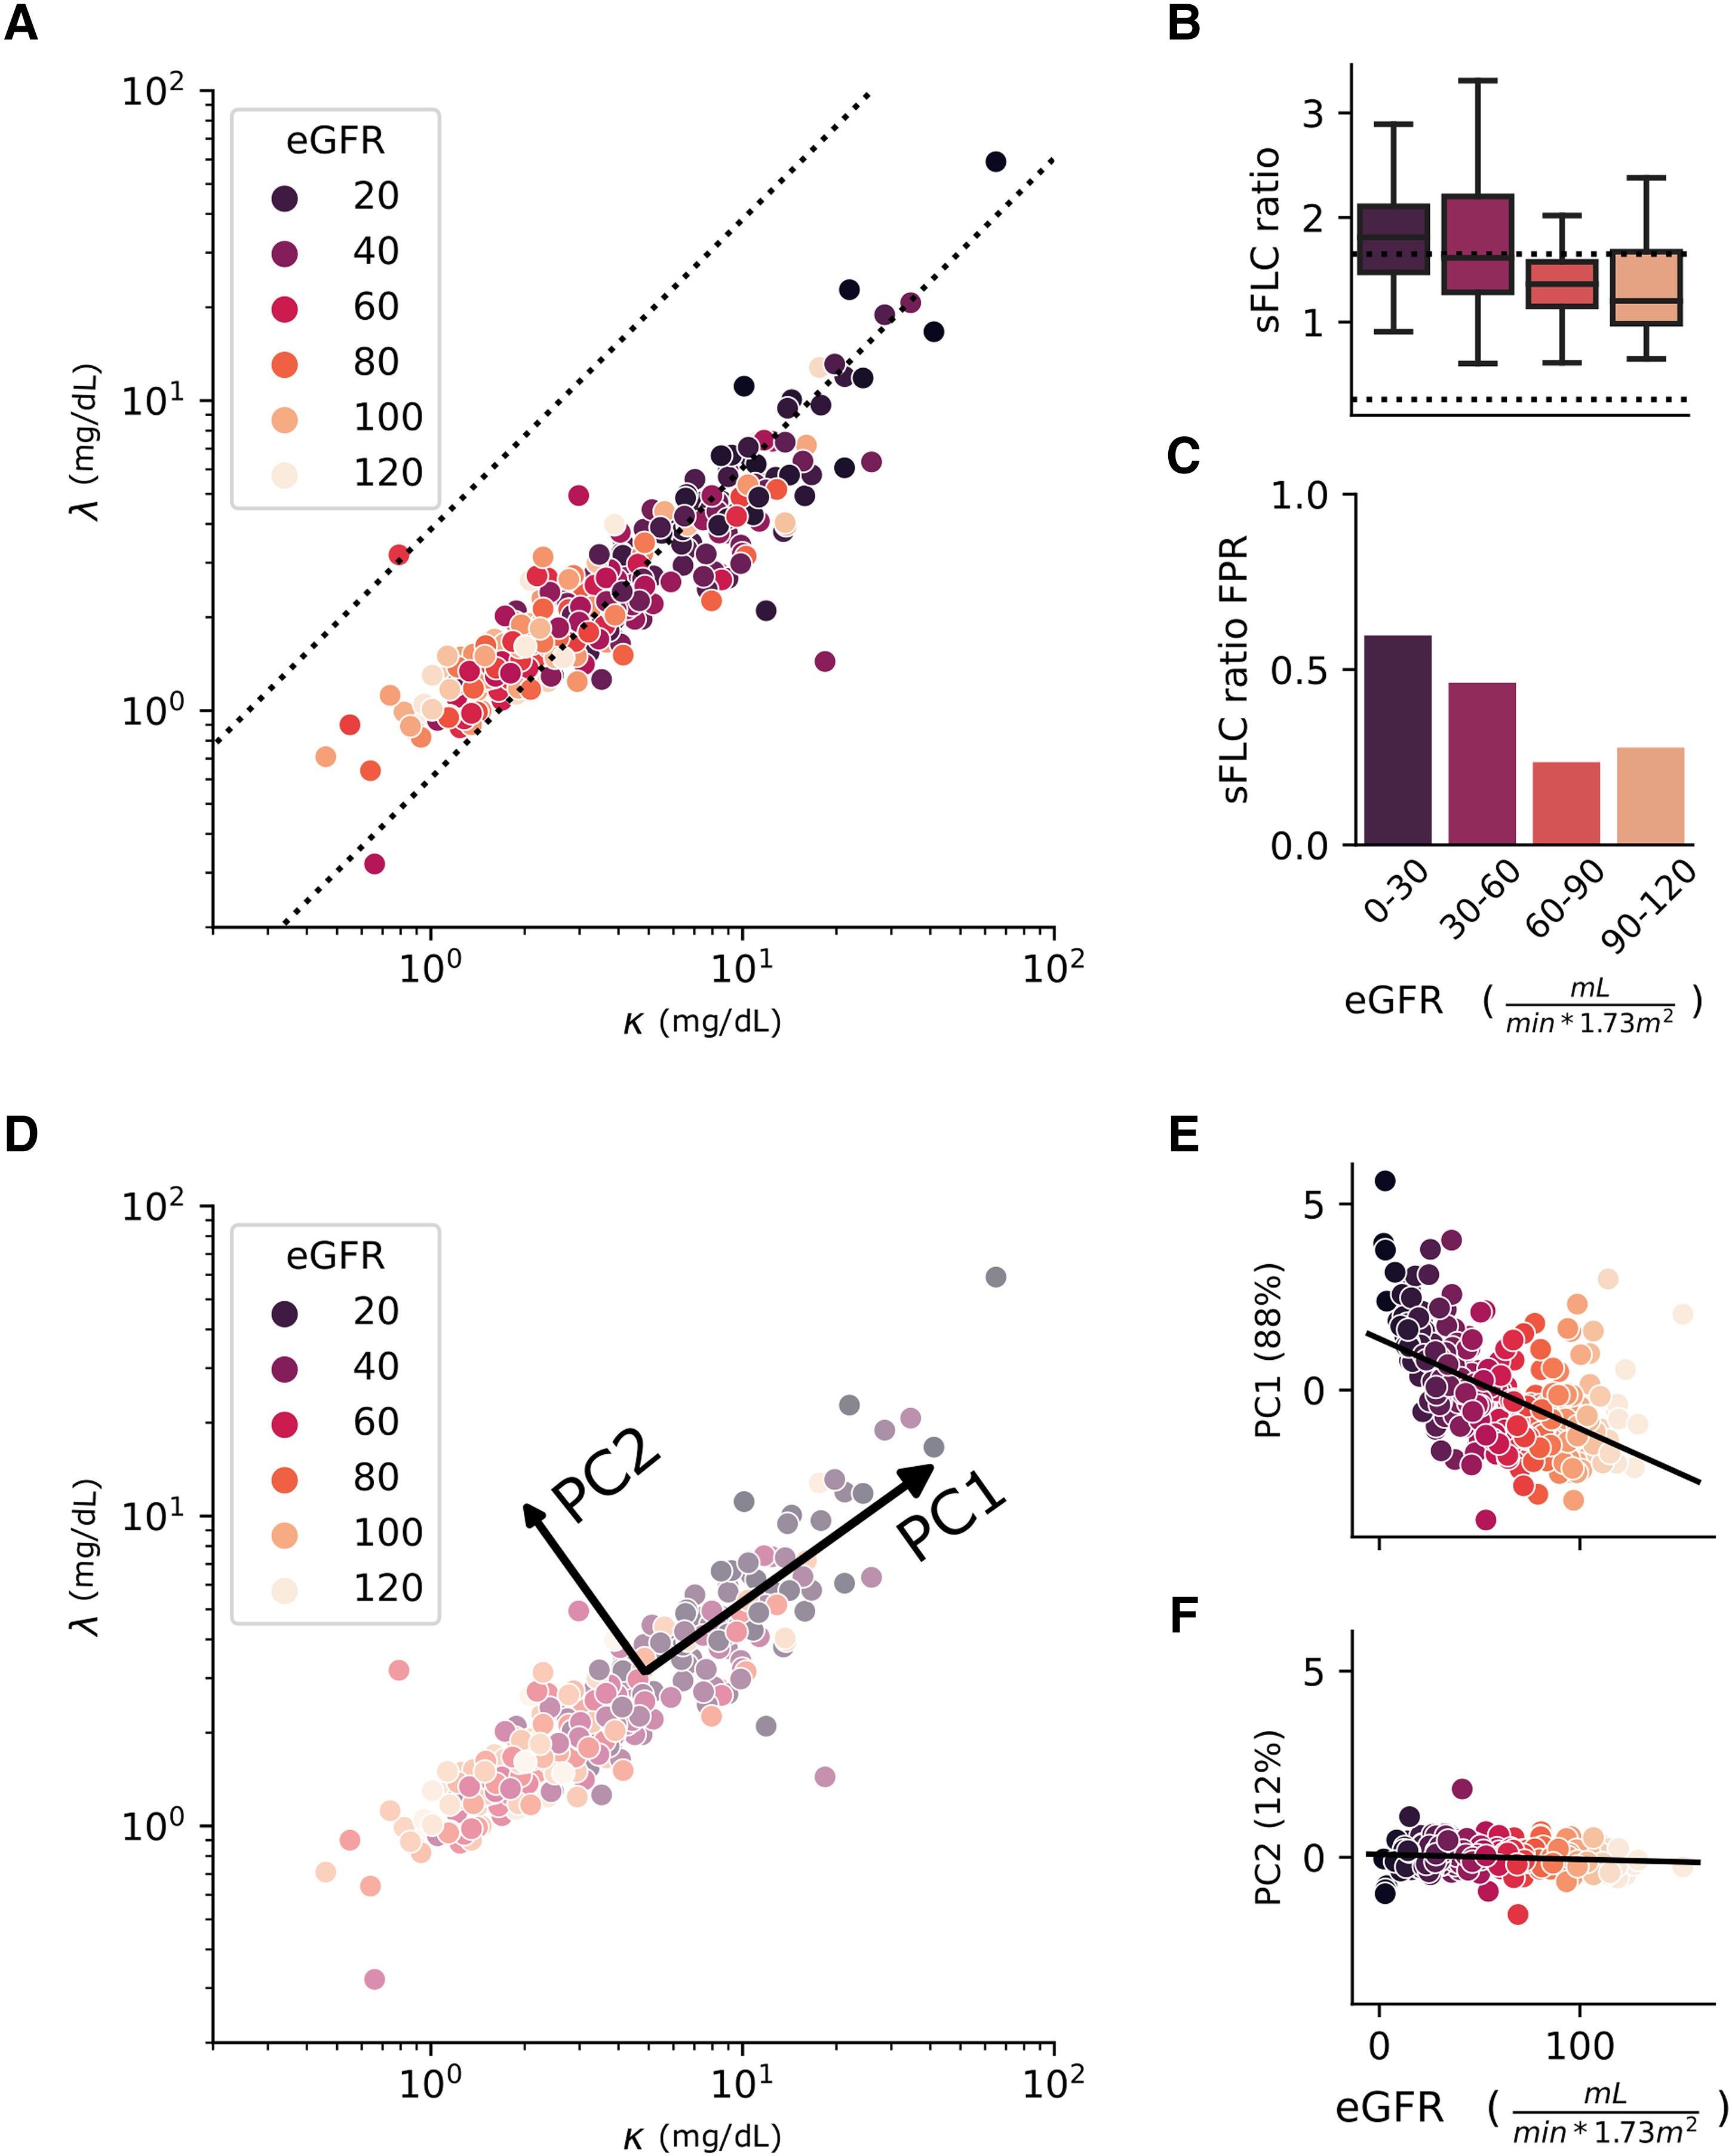
False Positive Rate (FPR) Increased as Renal Function Decreased
sFLC-ratio and FPR increased with decreasing renal function
60% of non-MG patients with eGFR < 30 were falsely positive using the manufacturer’s suggested interval
Fig. 1A-C: Principal component analysis isolates renal variation. sFLC concentrations for non-MG patients, shaded by eGFR (A). sFLC-ratio (B) and FPR (C) vs. eGFR for manufacturer’s interval (A, B dotted lines).

Slide 11
Using Principal Component Analysis (PCA) to Isolate ‘Normal’ sFLC Variation Due to Renal Function
PCA identified two axes of variation, Principal Component 1 (PC1) and Principal Component 2 (PC2)
PC1 explained most (88%) of the variation in the non-MG cohort dataset
PC1 was strongly correlated with eGFR
PC2 explained little (12%) of the variation in the non-MG cohort
PC2 was insensitive to renal function
Fig. 1D-F: Principal component analysis isolates renal variation. sFLC concentrations for non-MG patients, shaded by eGFR (D). Principal axes (D). PC1 (E) and PC2 (F) vs. eGFR with regression shown.

Slide 12
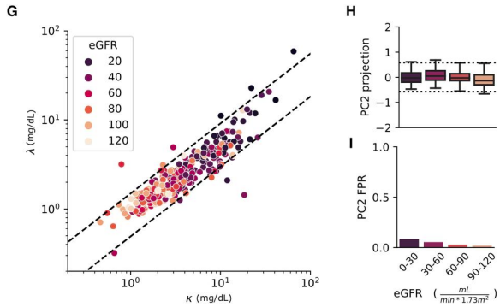
PC2-Based Reference Interval Demonstrates Low FPR across Patients with Varying Renal Function
PC2-based 95% reference interval (dashed lines) closely enclosed the non-MG cohort dataset
PC2 metric was relatively insensitive to variation in eGFR
PC2-based reference interval had low FPR for patients with varying levels of renal function
Fig. 1G-I: Principal component analysis isolates renal variation. sFLC concentrations for non-MG patients, shaded by eGFR (G). PC2 (H) and FPR (I) vs. eGFR for PC2 interval (G, H dashed lines)

Slide 13
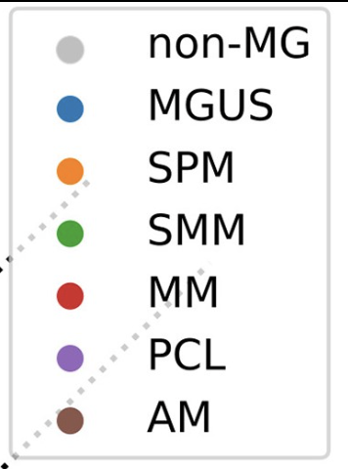
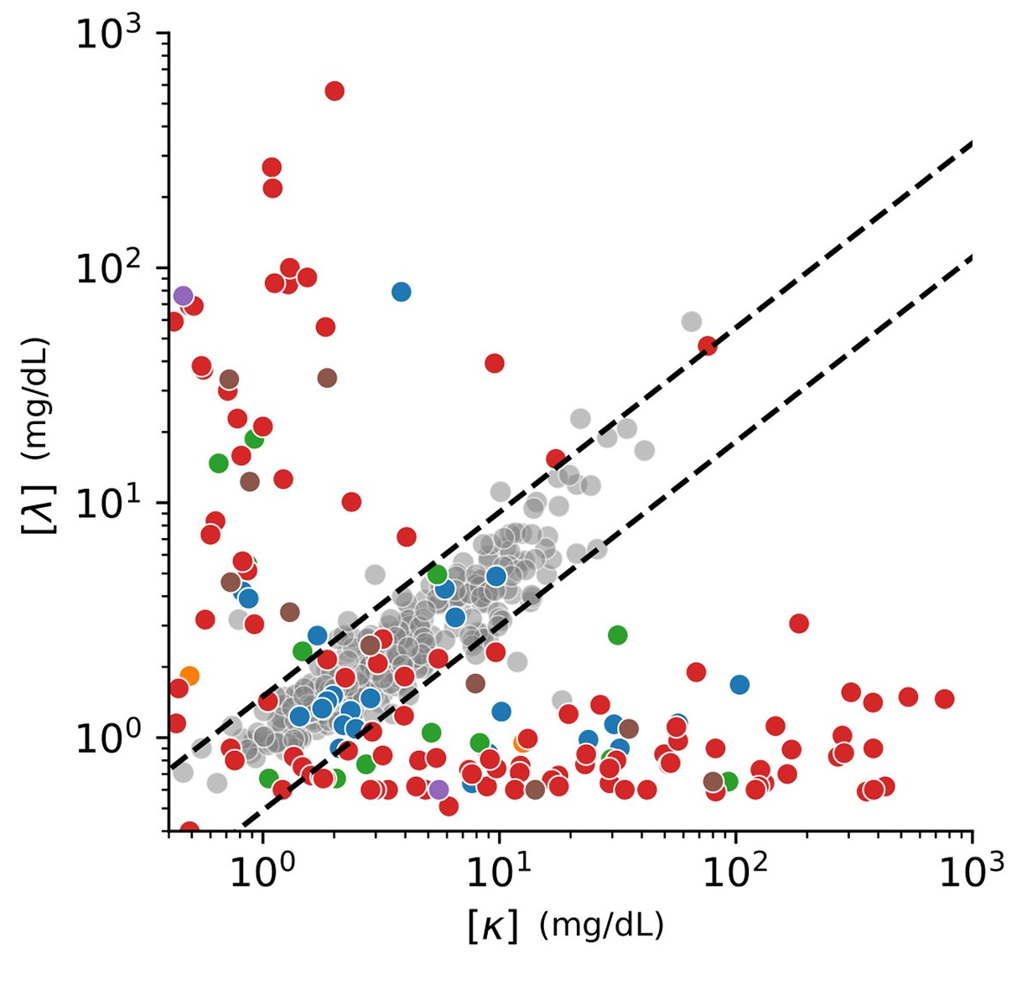
PC2-Based Interval Maintains Sensitivity for MG Diagnosis
The sensitivity of the PC2-based reference interval was not significantly different from that of the manufacturer’s sFLC-ratio-based reference interval for MG diagnosis
Fig. 2B: PC2 interval is as sensitive as the manufacturer’s sFLC-ratio-based interval. sFLC concentrations for non-MG patients (grey) and MG patients (colored, see legend for subtype). Broken lines – PC2 interval.

Slide 14
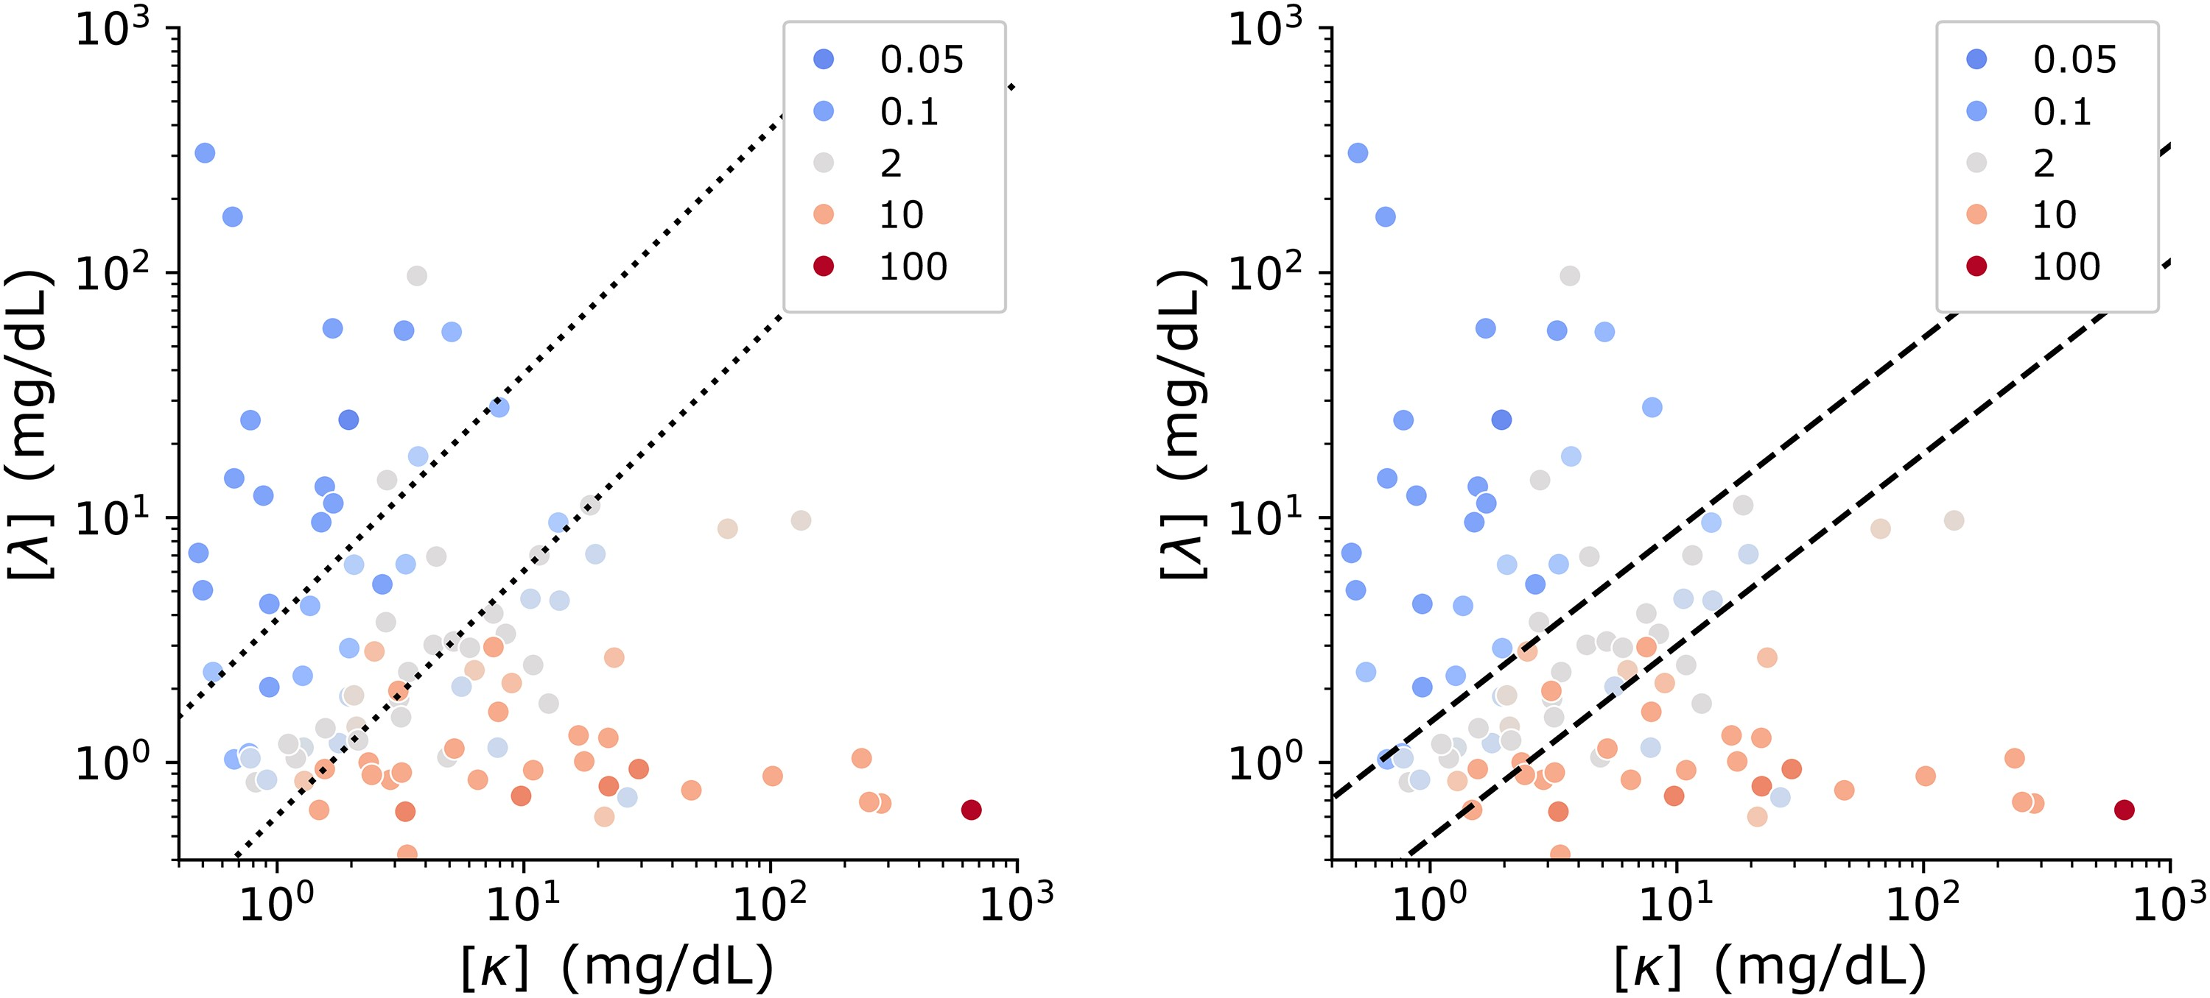
PC2-Based Interval Better Correlated with Bone Marrow Studies
Manufacturer’s interval
PC2-based interval
Results of Kappa and Lambda in-situ hybridization (ISH) studies from time-matched bone marrow biopsies mined from the anatomic pathology laboratory information system
PC2-interval better separated the samples with monotypic and polytypic hybridization patterns compared to the manufacturer’s sFLC-ratio based interval
K:L hybridization ratio
K:L hybridization ratio
Fig. 3: sFLC concentrations for 99 patients with contemporaneous bone marrow biopsy ISH and sFLC results (left, right). Broken lines represent either the manufacturer’s sFLC-ratio-based interval (left) or the PC2 interval (right). Points colored by kappa:lambda ratio determined by ISH.

Slide 15
Summary
Renal impairment is common among sFLC-tested patients
The conventional sFLC-ratio-based reference interval has a high false positive rate for renally-impaired patients
Application of PCA to the non-MG dataset provides a data-driven model of “normal” (PC1) and “abnormal” (PC2) sFLC variation
A PC2-based 95% reference interval provides improved specificity and robustness to variation in renal function while maintaining equivalent sensitivity to the established sFLC-ratio-based interval

Slide 16
Discussion Question 3
What are some potential benefits and/or challenges associated with implementing the PC2-based reference interval?

