Slide 1
Classification of Brain Tumors by Nanopore Sequencing of Cell-Free DNA from Cerebrospinal Fluid
A.-K. Afflerbach, C. Rohrandt, B. Brändl, M. Sönksen, J. Hench, S. Frank, D. Börnigen, M. Alawi, M. Mynarek, B. Winkler, F. Ricklefs, M. Synowitz, L. Dührsen, S. Rutkowski, A.K. Wefers, F.-J. Müller, M. Schoof, U. Schüller
January 2024
https://doi.org/10.1093/clinchem/hvad115
© 2024 Association for Diagnostics and Laboratory Medicine

Slide 2
CNS Tumors
Tumors of the central nervous system
  Over 80 different entities – glioblastoma, medulloblastoma, ependymoma
Molecular classification important
  Influence surgical strategy – no surgery, biopsy, or total resection
  Influence therapeutical strategy
  Prognosis very different
Current diagnosis with stainings, molecular analyses like sequencing and methylation arrays

Slide 3
Aim of the Study
Neuropathological diagnosis relies on availability of tumor tissue
  Histological analysis
  Molecular analysis – methylation and sequencing
  Not always feasible for children and difficult to reach anatomical sites
New minimally invasive molecular analysis needed
  Cerebrospinal fluid routinely collected for many brain tumor entities
  Supernatant not used in clinical routine → liquid biopsy

Slide 4
Liquid Biopsies
Analysis of bodily fluids
Usually for plasma
  Already established methods in plasma for some cancer entities
  CSF for brain tumors
Several analytes possible
  CTCs, proteins, RNA, EVs
  cfDNA → perhaps most information about tumor, analyte of choice for this study

Slide 5
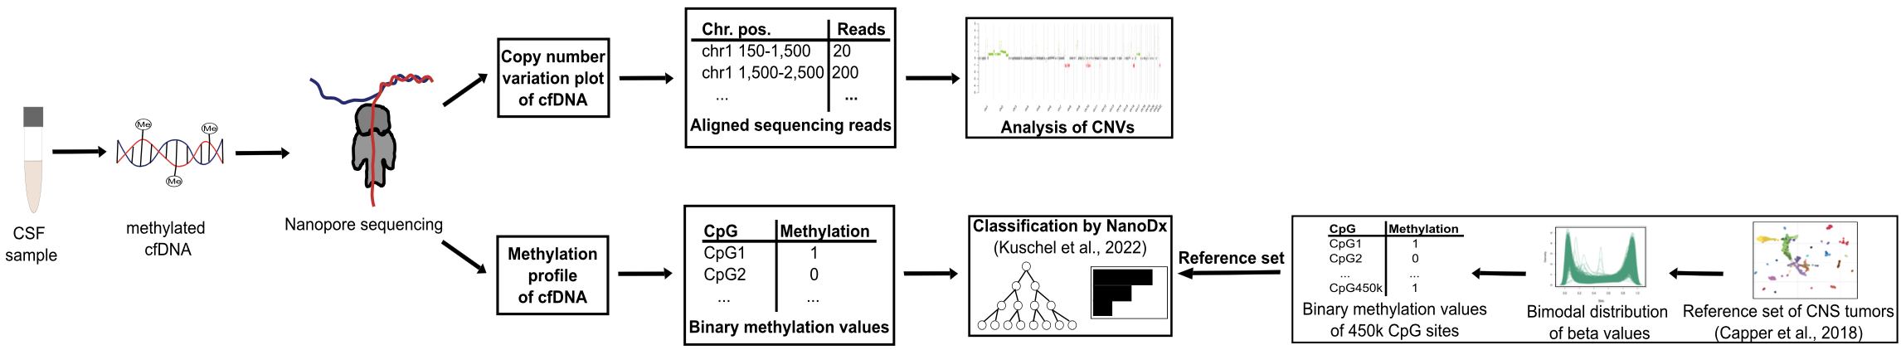
Nanopore Sequencing
Based on engineered nanopore
  Nucleic acid pulled through the pore – changes in current can be translated into base
Simultaneous collection of sequencing and methylation data
Drawbacks: initially developed for long reads and relatively more error-prone than other sequencing approaches
Figure 1. Workflow of Nanopore sequencing.

Slide 6
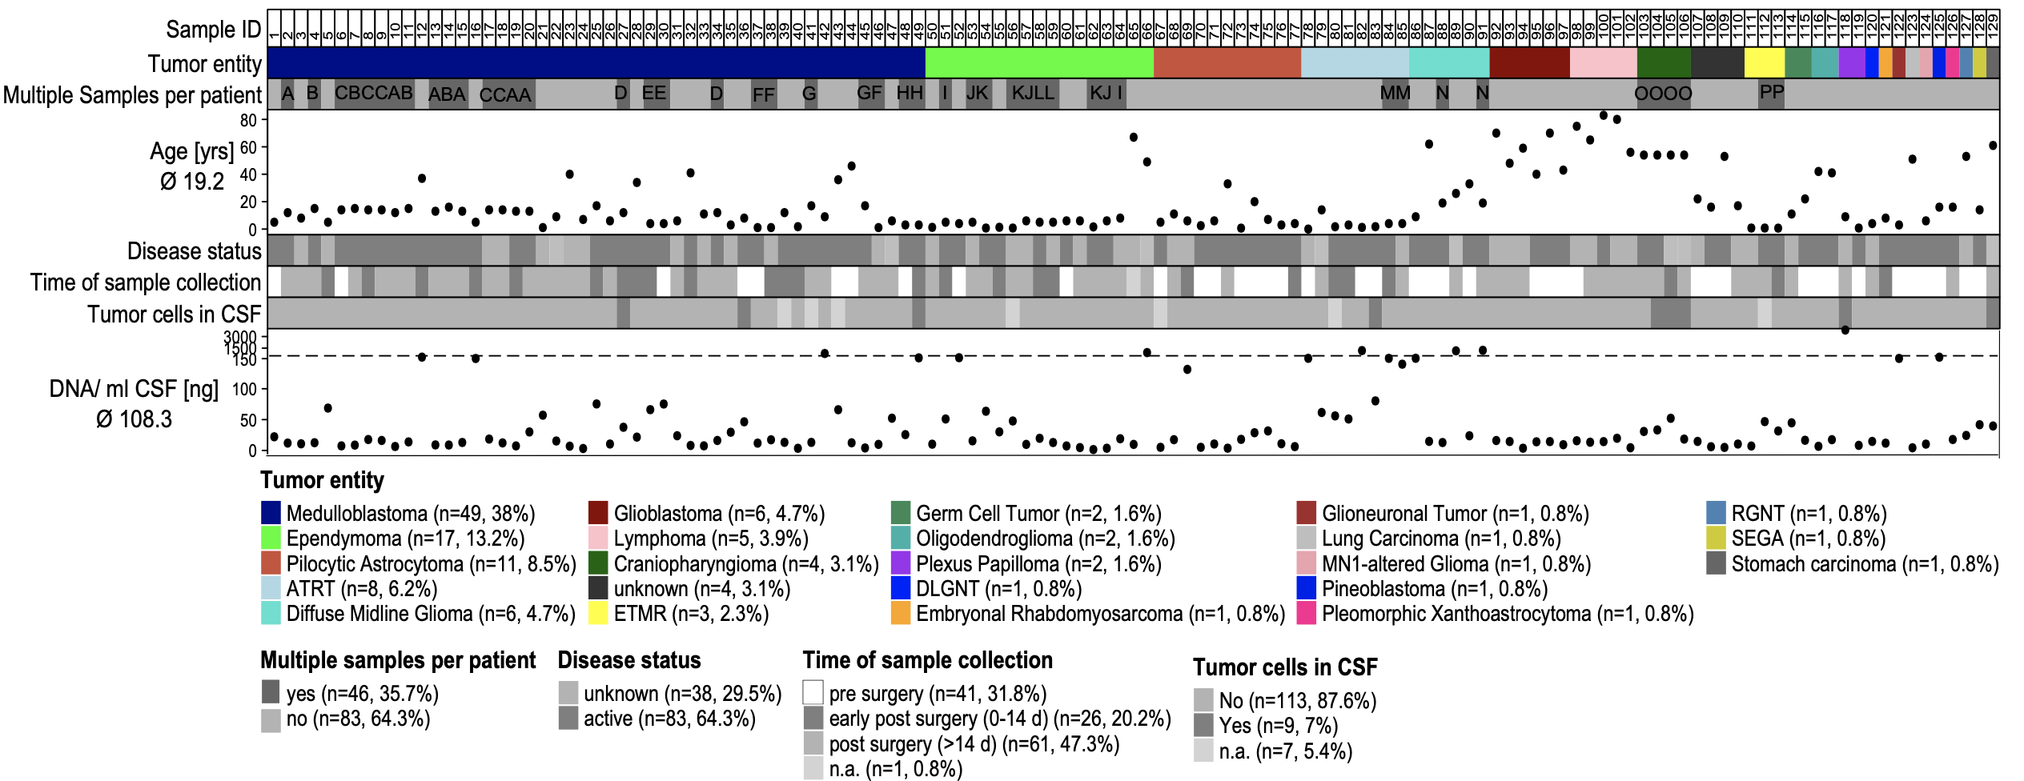
Sample Cohort
Figure 2. Overview of sample cohort.

Slide 7
Sample Cohort
Mixed cohort
  129 CSF samples from 99 patients
  22 entities
9% of samples with tumor cells in cytology
Mean of 108.3 ng DNA / mL CSF
1.77 Gb per sequencing run – coverage of 0.5x

Slide 8
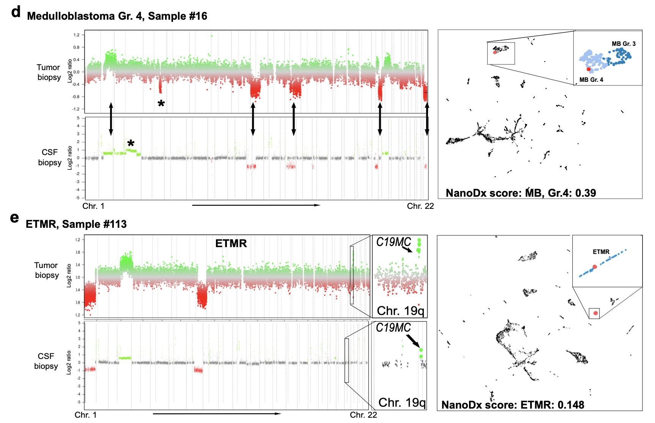
Nanopore Sequencing Can Diagnose Brain Tumors
Figure 3. Exemplary results of Nanopore sequencing of cfDNA.

Slide 9
Nanopore Sequencing Can Diagnose Brain Tumors
CNV profiles of the CSF by nanopore sequencing match those of the tumor tissue from methylation arrays
NanoDx can classify the tumor accurately, with scores of ≥ 0.07 considered significant
Visualization of methylation data is possible via UMAP

Slide 10
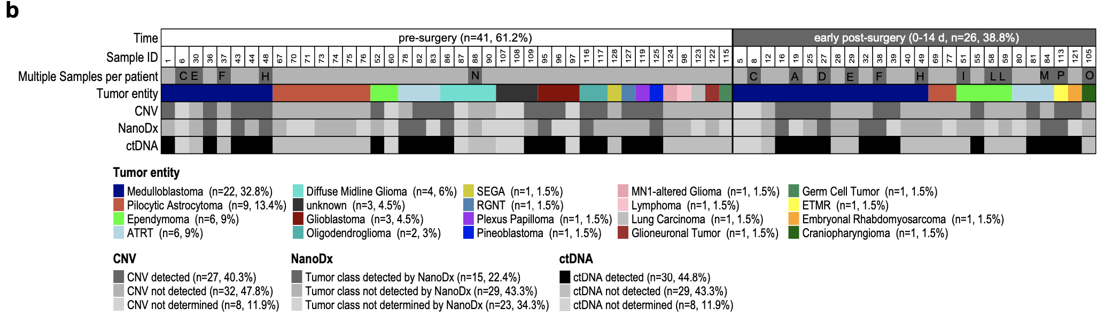
ctDNA Detection in Pre- and Early Post-Surgery Samples Is Possible in 45% of Samples
Figure 4. Results of pre- and early post-surgery samples.

Slide 11
ctDNA Detection in Pre- and Early Post-Surgery Samples Is Possible in 45% of Samples
67/129 CSF samples pre- and early post-surgery
ctDNA detection 45% of cases
  22% CNV alone
  18% both methylation and CNV
  5% methylation alone
2 cases wrongly classified

Slide 12
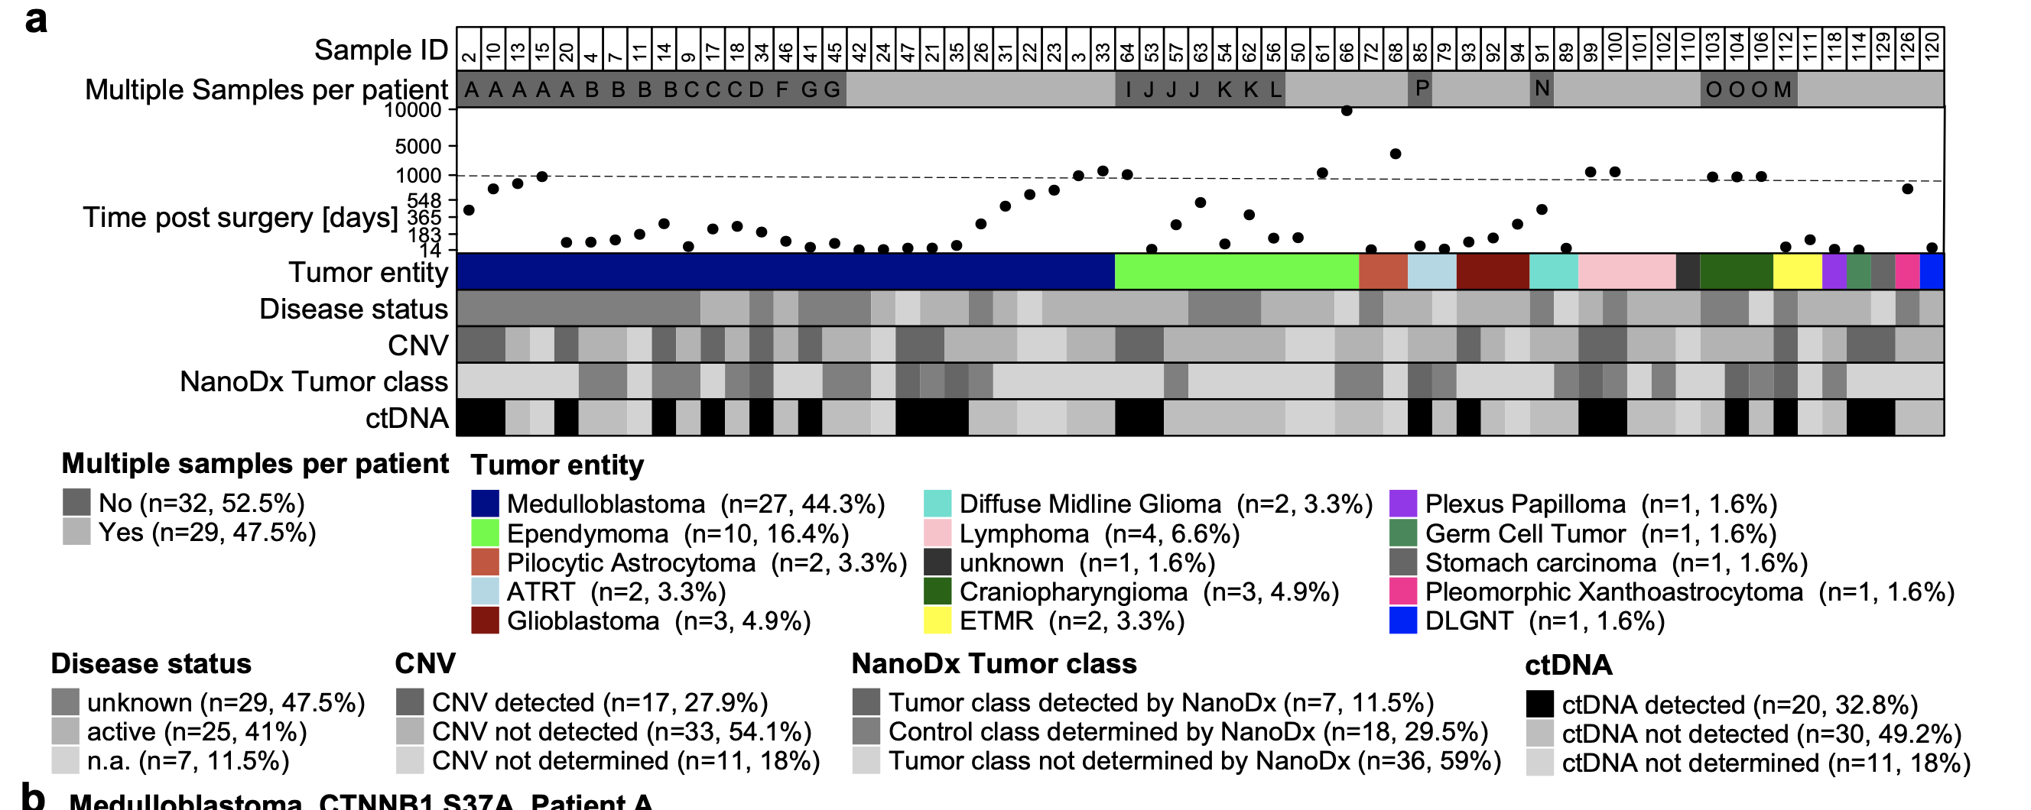
ctDNA Detection Is Possible in Post-Surgery Samples
Figure 5. Results of post-surgery samples.

Slide 13
ctDNA Detection Is Possible in Post-Surgery Samples
32.8% cases with detectable ctDNA in post-surgery samples
Variable times after surgery
  Detection of minimal residual disease
  Disease status often unknown
Detection by CNV more successful than by methylation

Slide 14
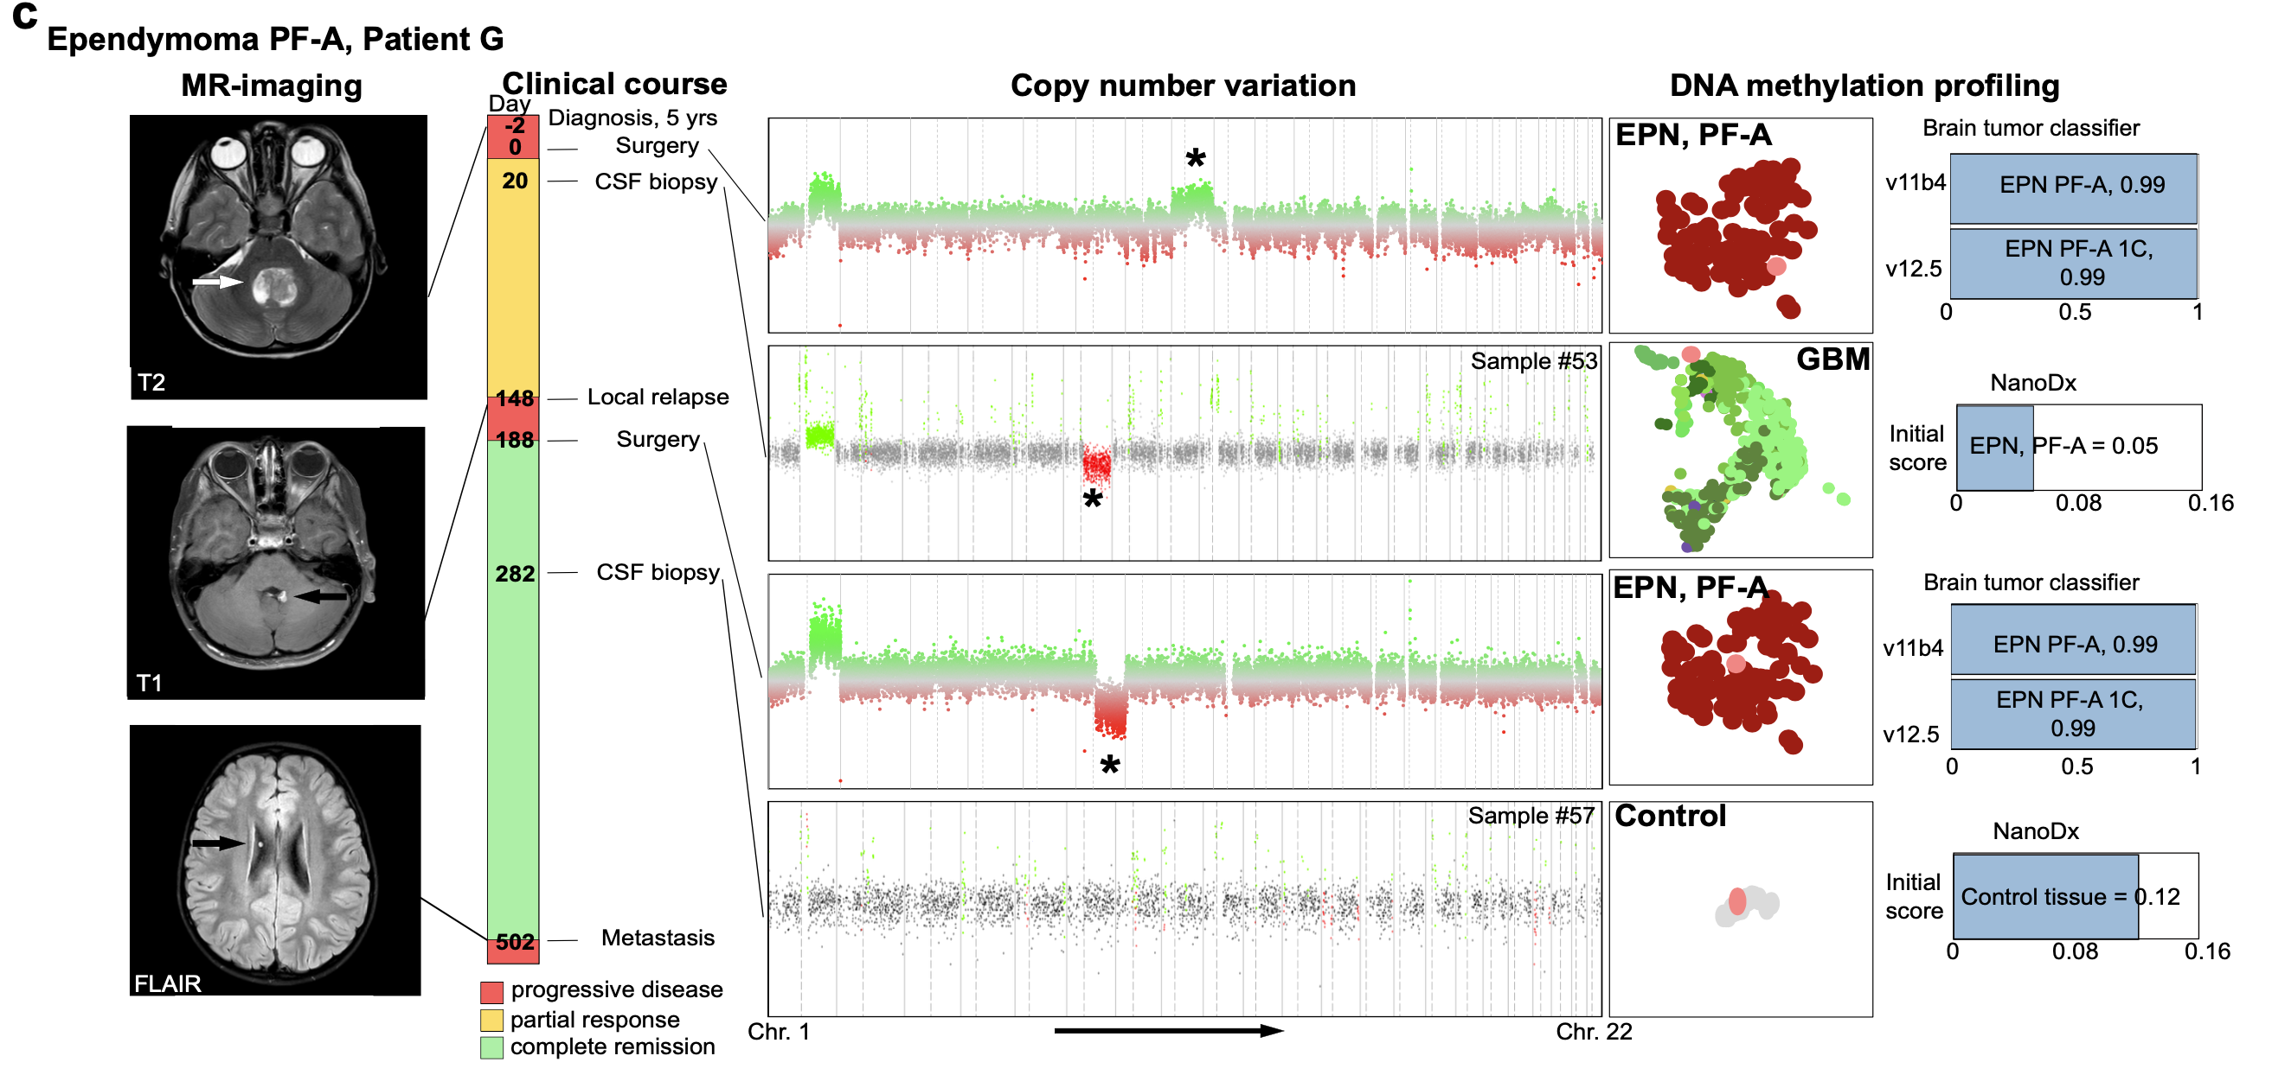
Nanopore Sequencing Allows Longitudinal Monitoring of Patients.
Figure 6. Longitudinal monitoring of PF-A ependymoma patient.

Slide 15
Nanopore Sequencing Allows Longitudinal Monitoring of Patients
CNV from CSF was able to show additional aberration not seen in tissue
Relapse tissue showed aberration seen in prior CSF sample
Remission phase only contained control DNA
Similar case for medulloblastoma
  Additional aberration found in CSF
  Aberration found in tissue of metastasis
  Methylation classification of CSF for medulloblastoma, group 3

Slide 16
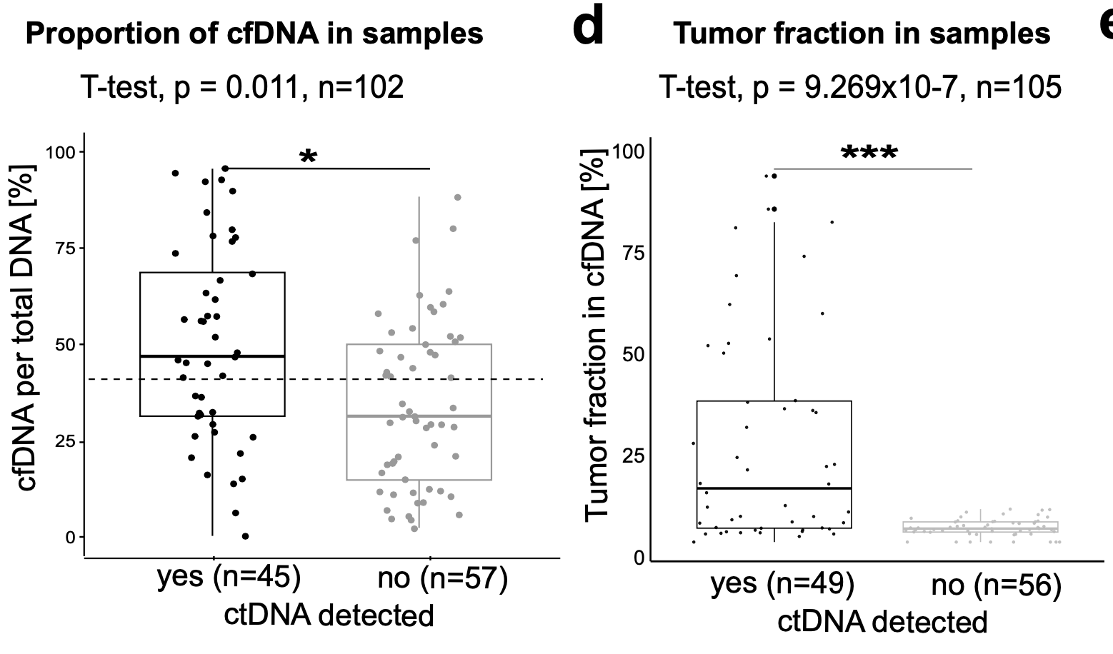
cfDNA Proportion and Tumor Fraction Is Higher in Samples with Detectable ctDNA
Figure 7. Proportion of cfDNA in samples analyzed and tumor fraction in cfDNA of samples analyzed.

Slide 17
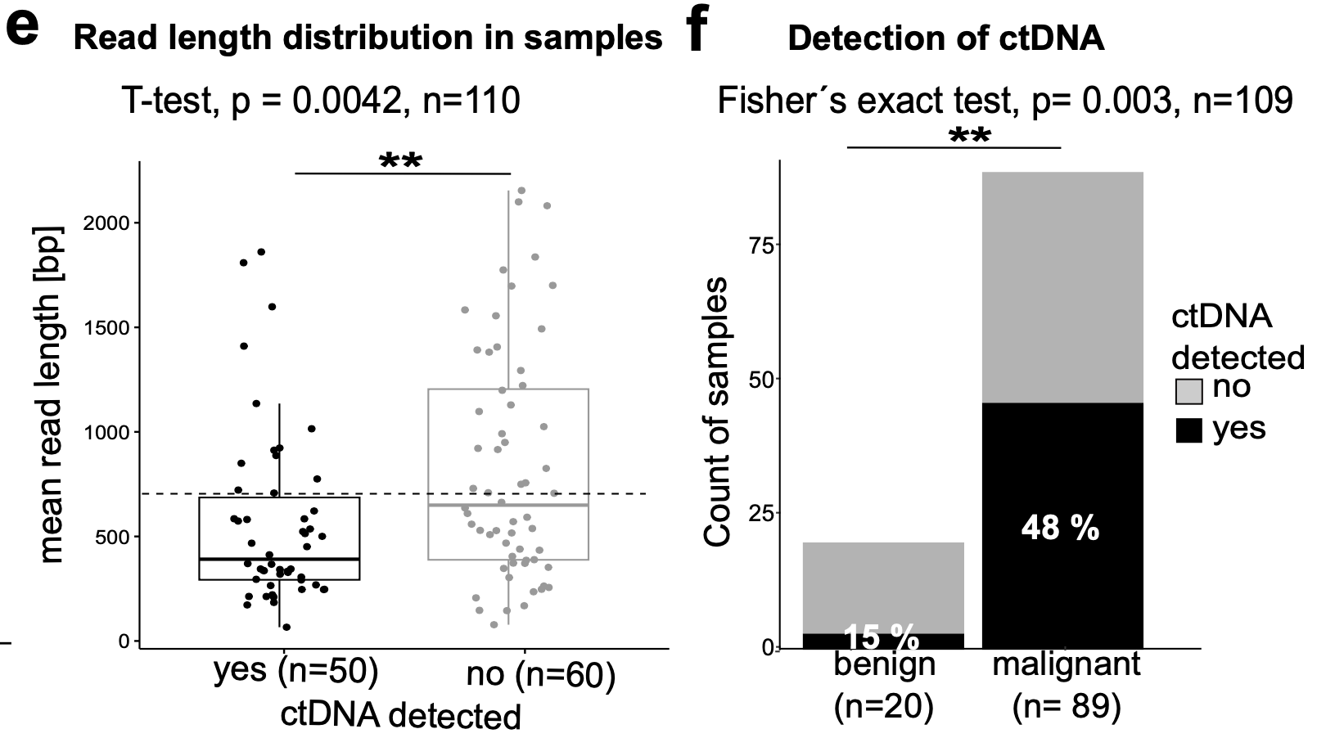
ctDNA More Often Detected in Shorter Reads and in Malignant Samples
Figure 8. Read length distribution of cfDNA in samples analyzed and malignancy of samples analyzed.

Slide 18
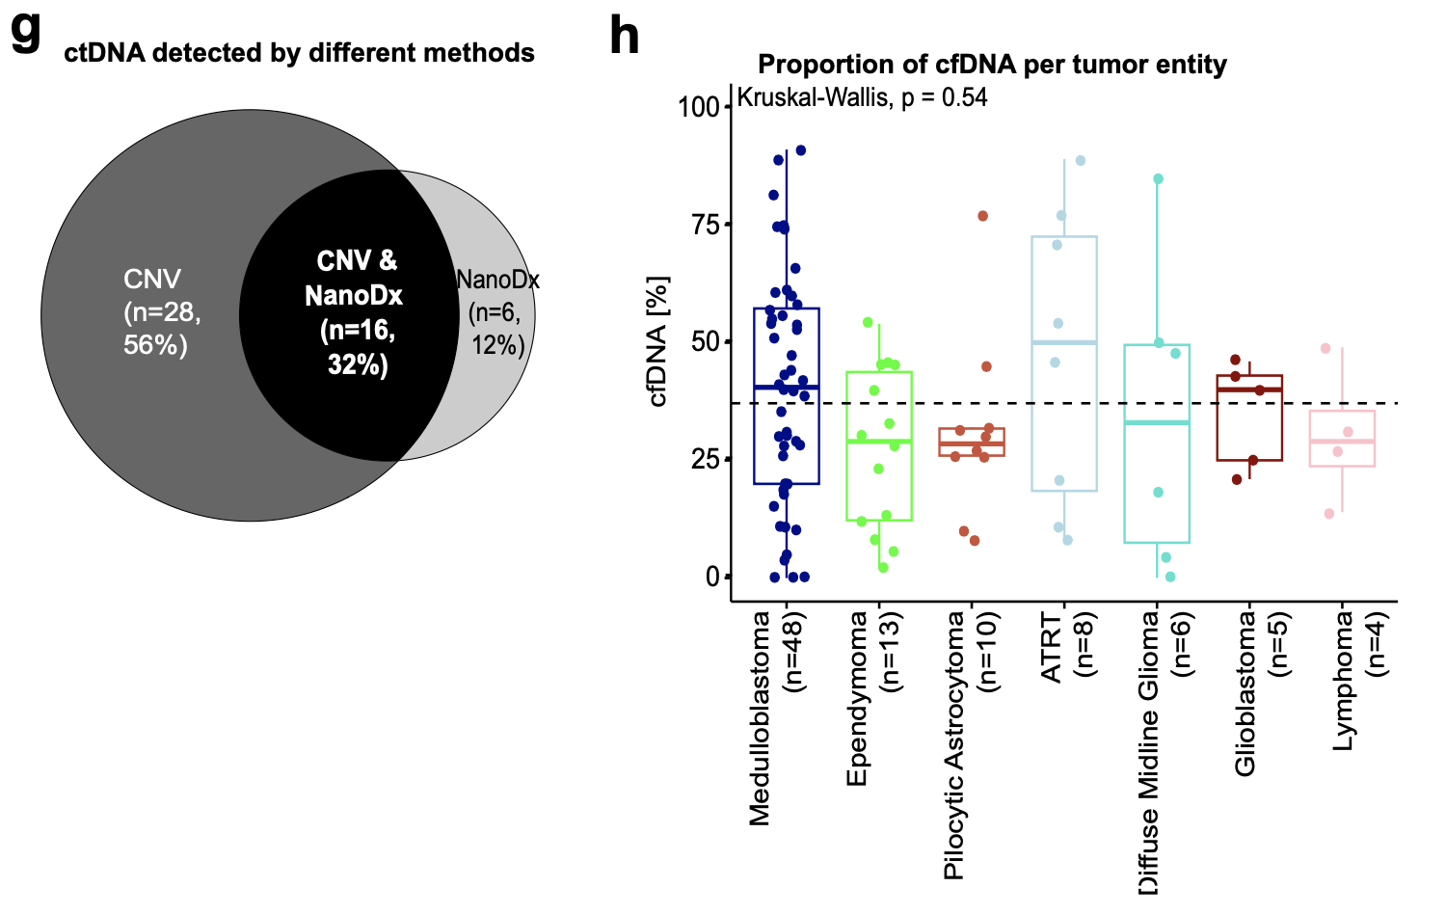
ctDNA More Often Detected by CNVs; Entity Does Not Play a Role for cfDNA Proportion
Figure 9. ctDNA detection per analysis method and proportion of cfDNA per tumor entity for largest groups of cohort.

Slide 19
Summary
CSF of brain tumor patients contains ctDNA that can be analyzed
cfDNA can be analyzed by Nanopore sequencing for sequence and methylation
ctDNA possible in 50/129 samples total; in 50/110 samples that worked technically
CNVs find ctDNA more often, but both analyses relevant
Longitudinal monitoring possible

Slide 20
Further Questions
What could be done to increase coverage?
How could the classifier be improved to improve classification by methylation?
What are advantages and disadvantages about both CNV and methylation profiling?
What is the potential of nanopore sequencing compared to tissue biopsy analysis?

