Slide 1
Investigating the Current Harmonization Status of Tumor Markers Using Global External Quality Assessment Programs: A Feasibility Study
H.H. van Rossum, S. Holdenrieder, B.E.P.B. Ballieux, T.C. Badrick, Y.-M. Yun, C. Zhang, D. Patel, M. Thelen, J. Song, N. Wojtalewicz,
N. Unsworth, H.W. Vesper, W. Cui, L.V. Ramanathan, C. Sturgeon, Q.H. Meng
April 2024
https://doi.org/10.1093/clinchem/hvae005
© 2024 Association for Diagnostics and Laboratory Medicine

Slide 2
Introduction – Tumor Markers
Various tumor markers are routinely used to support the diagnosis and monitoring of various types of cancer.
These include:
α-fetoprotein (AFP): Hepatocellular carcinoma, testicular cancer
Cancer Antigen (CA)125: Ovarian cancer
CA15-3: Breast cancer
CA19-9: Gastrointestinal cancers
Carcinoembryonic antigen (CEA): Colon cancer, breast cancer, lung cancer
Prostate specific antigen (PSA): Prostate cancer

Slide 3
Introduction – Clinical Use of Tumor Markers
For some: specific decision limits are applied for:
PSA: For prostate cancer screening, determine diagnostic triage, follow-up & monitoring
CEA: For follow-up of colon cancer
AFP: To support diagnosis, staging, and follow-up of hepatocellular carcinoma and testicular cancers
For others: primary use is in follow-up and monitoring:
CA15-3, CA125 & CA19-9: To support follow-up & monitoring of advanced cancers
Note: there is an increasing need for “tumor markers” in clinical oncology!
To identify cancer relapse after curative treatment
To monitor response to (systemic) treatments

Slide 4
Introduction – Harmonization
For optimal clinical use, including the use of general clinical decision limits, appropriate harmonization of the measurement procedures (MP) is essential!
In general, harmonization of most tumor markers is complicated by:
Heterogeneity of circulating tumor markers & lack of knowledge about which isoform is most clinically relevant
Differences in immunoassay design and epitope recognition of MP used clinically
Lack of accurate calibration against an appropriate, universal, and commutable International Standard (IS)
  → For 3 of the mentioned tumor markers (AFP, CEA, and PSA) an international standard (IS) is available

Slide 5
Introduction – Harmonization Status
For most tumor markers the harmonization status of today’s MPs is not quantified
Therefore, a study was initiated to investigate the use of EQA to investigate and quantify the harmonization status of AFP, CA15-3, CA19-9, CA 125, CEA, and PSA

Slide 6
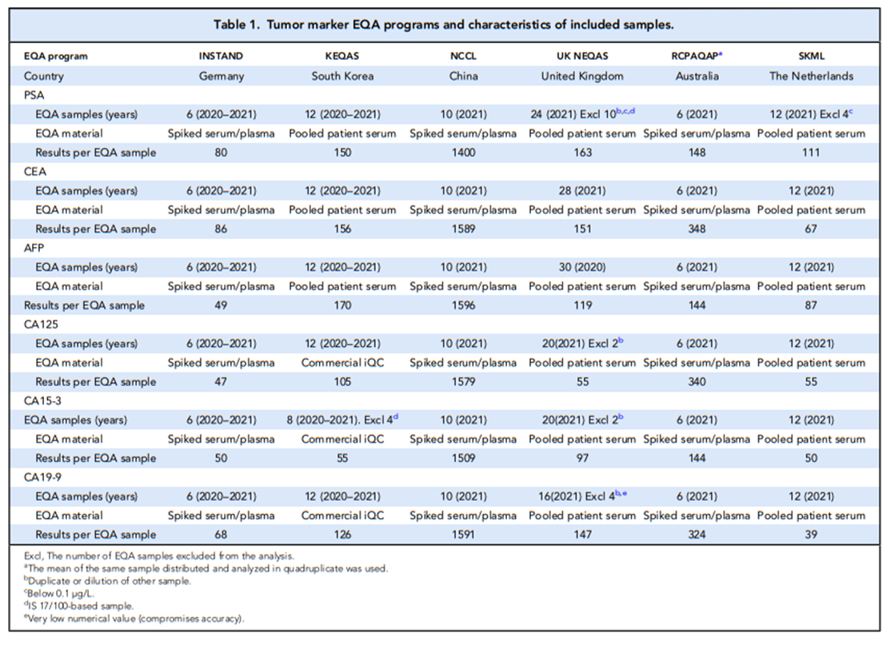
Methods – EQA Data
EQA data (2020-2021) from 6 EQA programs were used :
INSTAND (Germany)
KEQAS (South Korea)
NCCL (China)
UK NEQAS (United Kingdom)
SKML (the Netherlands)
RCPAQAP (Australasia)

Slide 7
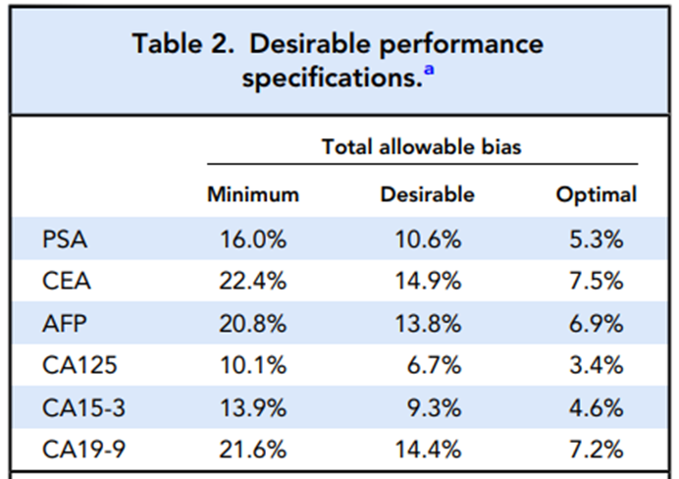
Methods – Data Analysis
Only MPs included in all EQA programs were considered
  One representative MP per manufacturer
Per EQA sample, for each included MP, the median (preferred) or mean value was used/calculated
For each EQA sample, the non-weighted consensus mean of all included MPs was used as “reference measure”
Individual EQA sample MP values were expressed as % of consensus mean
Means of all EQA samples based on leftover/patient pool materials were calculated
The results were interpreted with respect to Analytical Performance Specifications (APS) based on biological variation

Slide 8
Results – Data Analysis
Only MPs of 4 IVD suppliers were available in all EQA programs: Abbott, Beckman, Roche & Siemens
For each tumor marker, a total of 19,040 (CA15-3) to 25,398 (PSA) laboratory results were included.
The final number of individual EQA samples were (patient-pool EQA):
  AFP: 76 (54) - CA19-9: 58 (24)
  CA125 : 64 (30) - CEA: 74 (52)
  CA15-3: 60 (30) - PSA: 56 (34)

Slide 9
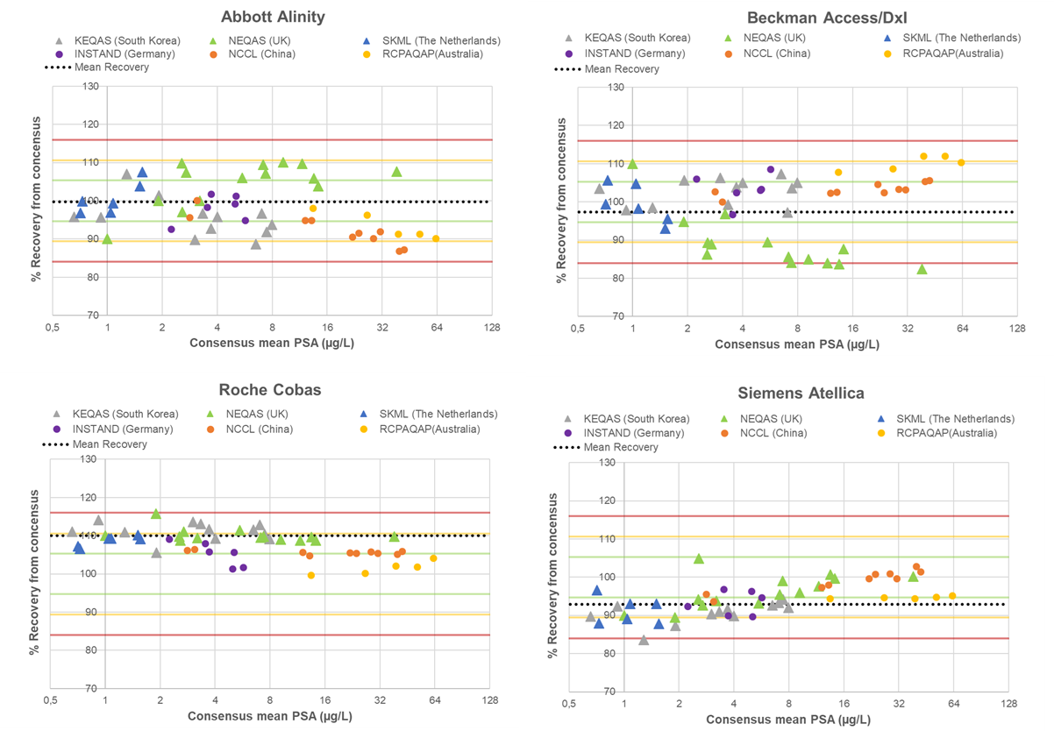
Results – PSA
All but 5 EQA results outside minimum bias criterion
Difference with consensus mean (patient-pool only):
  Abbott: -0.3%
  Beckman: -2.7%
  Roche: +10.0%
  Siemens: -7.1%
  → all within desirable bias criterion (±10.6%)
Limitation:
  Unknown calibration basis (WHO vs. Hybritech)

Slide 10
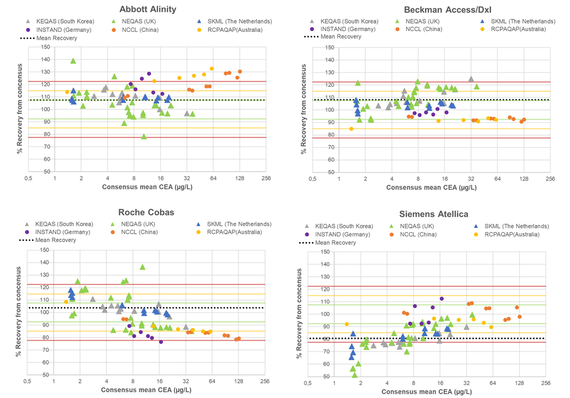
Results – CEA
Considerable scattering observed for individual EQA samples
Difference with consensus mean (patient-pool only):
  Abbott: +7.4%
  Beckman: +8.2%
  Roche: +3.7%
  Siemens: -19.4%
  → within minimum bias criterion (±22.4%)
Below <8 µg/L a trend toward increasing difference with consensus

Slide 11
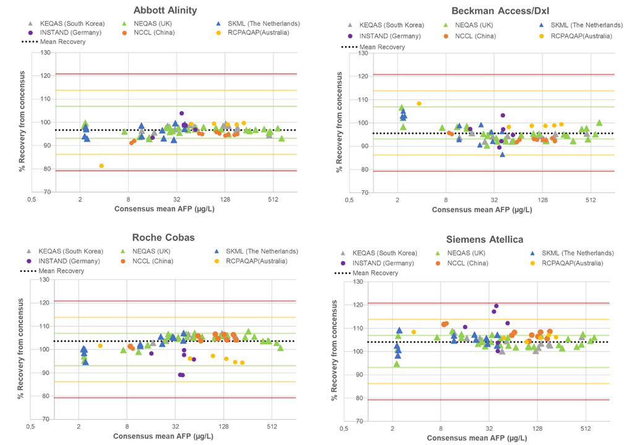
Results – AFP
All EQA samples were within the minimum bias criterion
Average difference with consensus mean (patient-pool only):
  Abbott: -3.3%
  Beckman: -4.4%
  Roche: +3.7%
  Siemens: +4.1%
  -> all within optimal bias criterion (±6.9%)

Slide 12
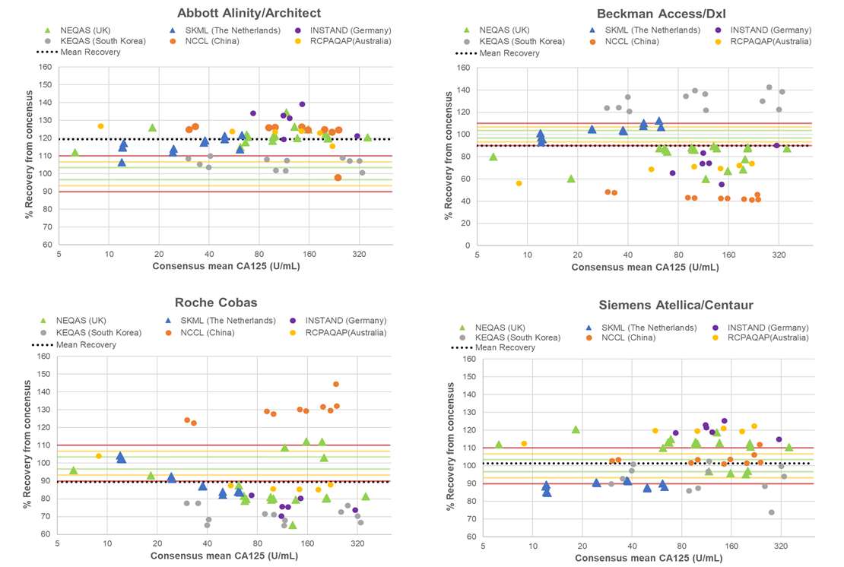
Results – CA125 (Supplemental Data)
EQA samples of different EQA programs seem to behave differently
Average difference with consensus mean (patient-pool only):
  Abbott: +19.3%
  Beckman: -9.9%
  Roche: -10.6%
  Siemens: +1.2%
  → outside minimum bias criterion (±10.1%)

Slide 13
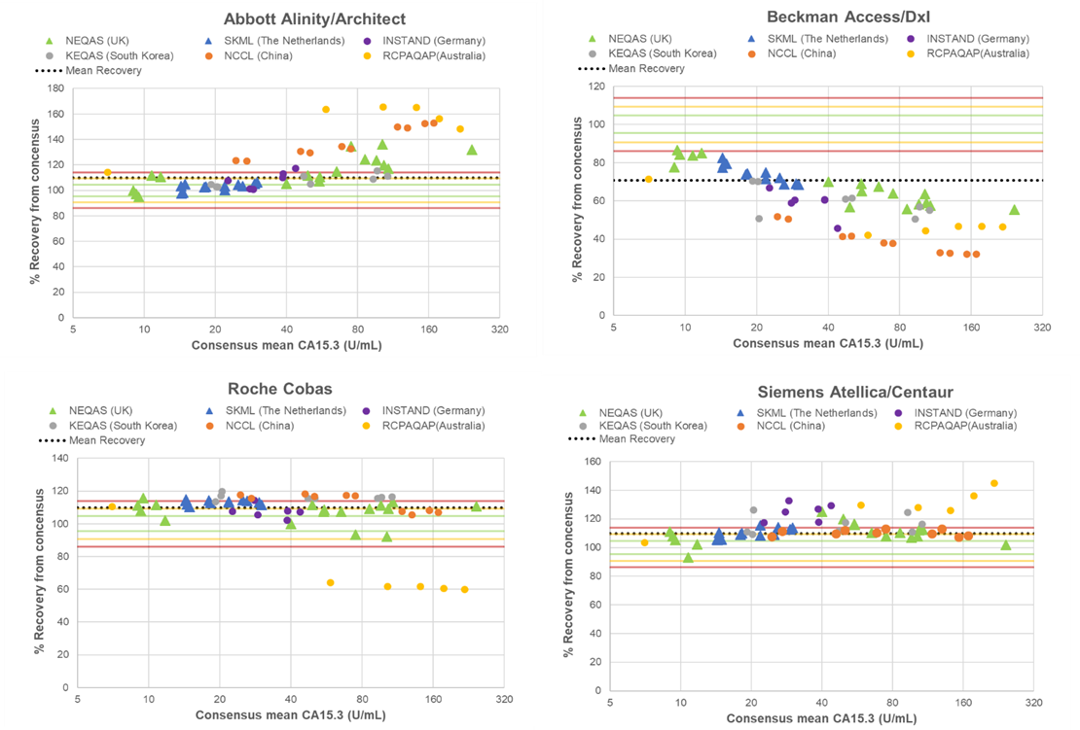
Results – CA15-3 (Supplemental Data)
EQA samples of some EQA programs seem to behave differently
Average difference with consensus mean (patient-pool only):
  Abbott: +9.8%
  Beckman: -29.3%
  Roche: +9.7%
  Siemens: +9.9%
  → outside minimum bias criterion (±13.9%)

Slide 14
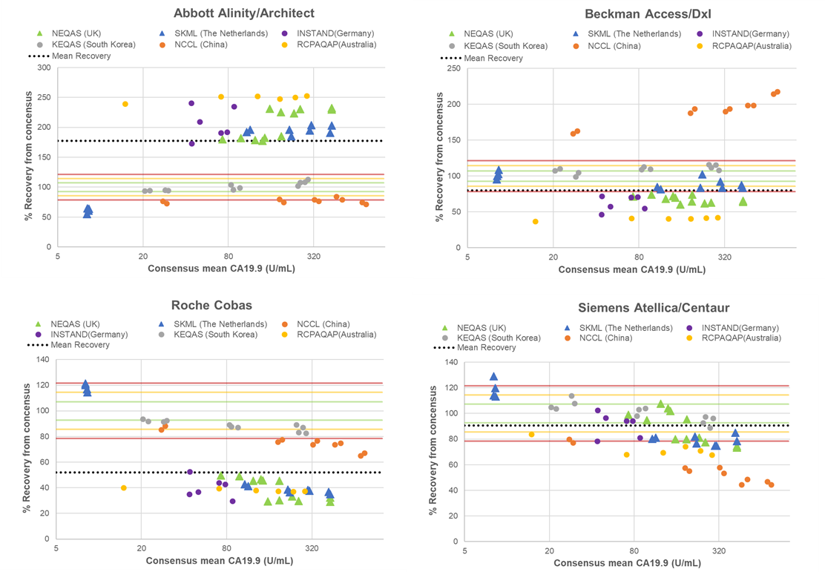
Results – CA19-9 (Supplemental Data)
Individual EQA samples as well as EQA programs seem to behave differently
Average difference with consensus mean (patient-pool only):
  Abbott: +77.6%
  Beckman: -20.2%
  Roche: -48.1%
  Siemens: -9.3%
  → outside minimum bias criterion (±21.6%)

Slide 15
Discussion – Limitations
Commutability of EQA samples has not been demonstrated:
  → It is only assumed that patient-pool based EQA share the characteristics of individual patient samples
  → Data suggest that some EQA samples behave differently than individual patient samples (are not commutable)
Only MPs that were available in all EQA programs were included in the study
The actual difference between individual MPs can exceed the criteria used
The clinical relevance of the APS criteria used:
  → The minimum bias criterion for CA125 (±10.1%) and CA15-3 (±13.9%) seem rather stringent

Slide 16
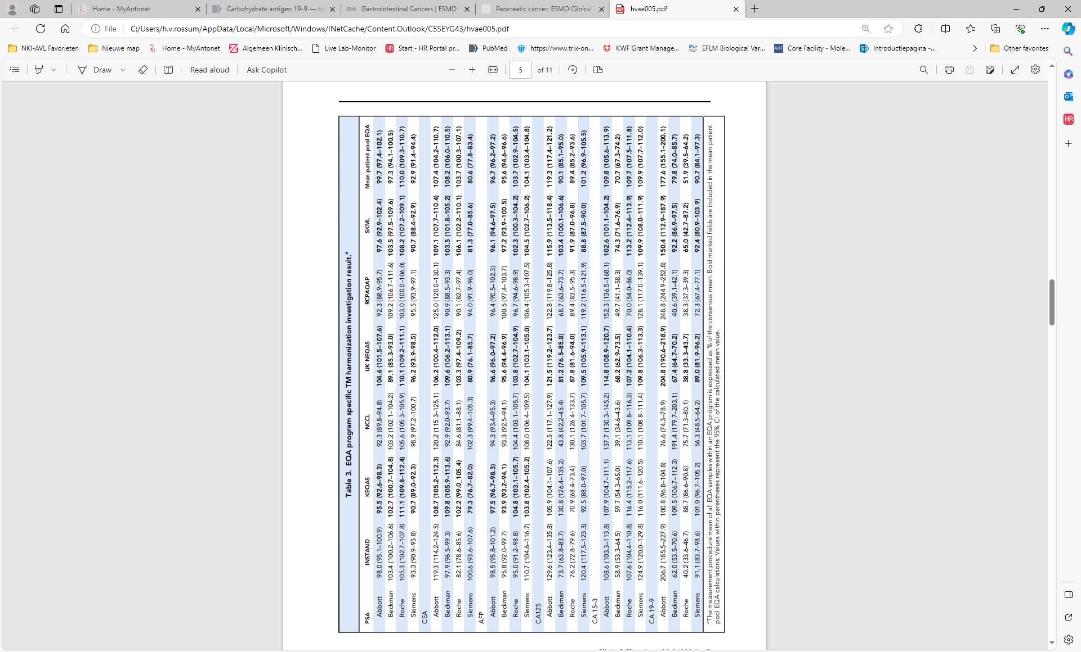
Discussion – Other
Advantages of EQA data:
  Is already available
  Most likely reflects true clinical practice
  A large number of measurements are performed per MP; allows for accurate determination of mean/median value
Study aimed to provide some guidance on:
  Current harmonization status of these 6 tumor markers
  May help to prioritize the need to harmonize these different tumor markers
  Might provide insights in potentially achievable harmonization

Slide 17
Conclusions
The study suggests:
  AFP is harmonized within the optimal allowable bias criterion
  PSA is harmonized within the desirable bias criterion
  CEA (overall) is harmonized within the minimum bias criterion, but not at the concentration range < 8 µg/L
  CA125, CA15-3 and CA19-9 seem to have a harmonization status outside the minimum bias criterion
Recommendation: Perform a follow-up study that investigates the possibility of harmonizing CEA, CA125, CA 15-3, and CA 19-9 according to ISO recommendations

Slide 18
Questions
1) Provide 3 advantages and 3 limitations of using EQA samples for investigating the harmonization status of medical tests.
2) Which tumor marker included in this study would you prioritize for a formal harmonization project and why?
3) Which other tumor marker(s) do you think would be relevant to investigate by a similar EQA-based harmonization investigation?

