Slide 1
A Comprehensive Assessment of Metagenomic cfDNA Sequencing for Microbe Detection
Z. Diao, Z Zhao, Y Han, Y Chen, T Huang, L Feng, Y Ma, J Li, R Zhang
July 2025
https://doi.org/10.1093/clinchem/hvaf044
© 2025 Association for Diagnostics & Laboratory Medicine

Slide 2


Introduction
Bloodstream infection
Endocarditis Deep fungal infections
Rapid onset
！High fever, chills, tachycardia,
within hours to 1-2 days
Fast progression
！Sepsis, SIRS, septic shock
High mortality rate
！Bloodstream infection mortality rate in
hospitalized patients: 28.7% in China
Difficult sample collection
！Difficulty in sampling from
anatomically challenging sites,
high risk of deep sampling
Clinical urgency in addressing infectious disease challenges

Slide 3


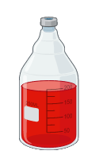
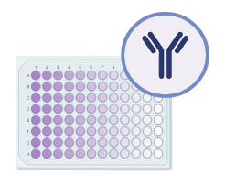

Introduction
Limitations of traditional diagnostics
Take bloodstream infection as an example:
About 35% remain undiagnosed
Limited detection scope
Prolonged testing duration
Invasive procedures
Weak differentiation capability
Blood culture PCR Immunologic test

Slide 4


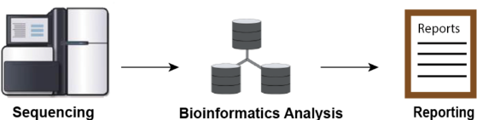
Introduction
Comprehensive detection scope
Short testing duration
Non-invasive procedures
Traceability capability
Human Bacteria Fungi Viruses Parasites
Cell-free DNA (cfDNA): from human or microbial
Metagenomic next-generation sequencing (mNGS)
Metagenomic cfDNA sequencing improves detection capabilities

Slide 5
Introduction
In urgent need of evaluation
Low abundance
(over 90% human-derived)
Complex workflow
(Involves multiple steps, increasing variability)
Accuracy
Repeatability
LoD
Linearity
Anti-interference
Highly fragmented
(low extraction and library preparation efficiency)
Insufficient evaluation
(lacks standardized assessment)

Slide 6
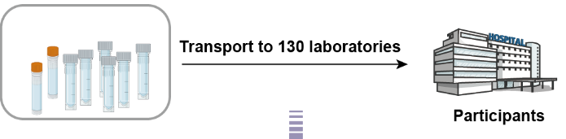
Multicenter Evaluation Framework
5 Key performance metrics
Accuracy
Repeatability
LoD
Linearity
Anti-interference
18 Reference samples
16 Simulated plasma & 2 Nucleic acid mixtures
130 Laboratories participated
Metagenomic bioinformatics pipeline

Slide 7
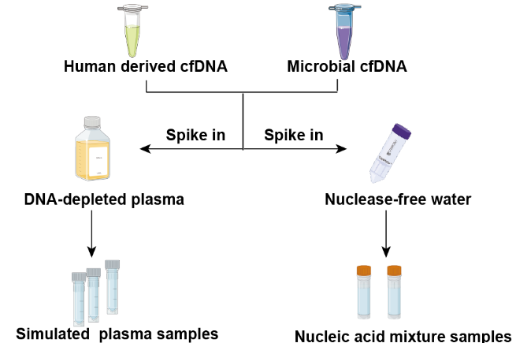
Multicenter Evaluation Framework
18 Reference samples
Microbial cfDNA:
From 14 microorganisms, ~ 60–90 bp fragments.
Human derived cfDNA:
From GM12878 cells, ~160 bp fragments.
16 Simulated plasma samples
(S1–S14, S16, and NC1)
Matrix: DNA-depleted plasma
2 Nucleic acid mixtures samples
(S15 and NC2)
Matrix: Nuclease-free water

Slide 8
Multicenter Evaluation Framework
Sample ID | Microbial cfDNA composition | Assessed performance
S1, S2, S3 | Three replicates, each with four types of microbial cfDNA | Repeatability
S4, S5, S6 | Escherichia coli : Shigella flexneri = 1:3, 1:1, 3:1 | Anti-interference (against genetically similar organisms)
S7, S8, S9 | Five pathogens, threefold serial dilution (high, medium, low concentrations) | LoD and linear correlation
S10 | Same as S8, but 3× human derived cfDNA | Anti-interference (against human nucleic acids)
*S1-S10: Underwent the whole process

Slide 9
Multicenter Evaluation Framework
Sample ID | Microbial cfDNA composition | Assessed performance
S11, S12, S13 | Three samples with one or two microbial cfDNA types | The performance of routine microbial cfDNA detection
S14, S15 | S14 and S15 shared the same cfDNA composition (S14 in a plasma matrix, S15 in Nuclease-free water) | The impact of cfDNA isolation
S16 | Anonymous negative samples | Specificity
NC1 | Negative plasma sample | Filtering background microorganisms for simulated plasma (S1-S14 and S16)
NC2 | Negative nucleic acid mixture sample | Filtering background microorganisms for nucleic acid mixture (S15)
*S11-S14, S16, NC1:Underwent the whole process
S15, NC2: Directly used for library preparation

Slide 10
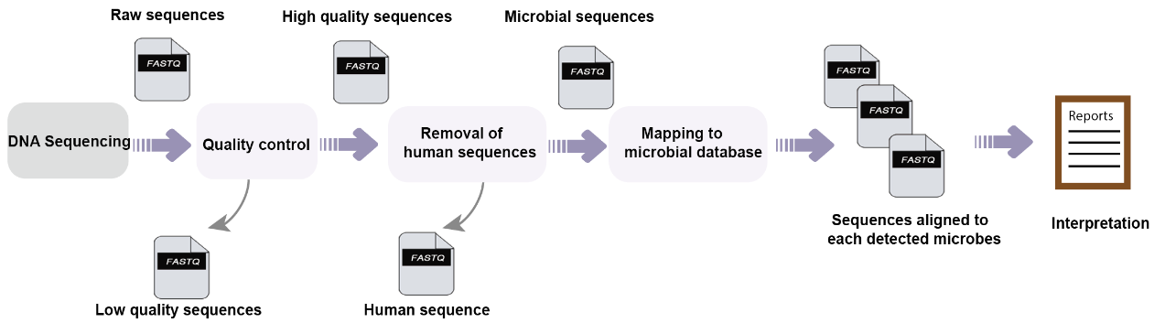
Multicenter Evaluation Framework
Metagenomic bioinformatics pipeline
(a) Detection workflows
(b) Identified microorganisms
(c) Sequencing data
130 Laboratories participated

Slide 11
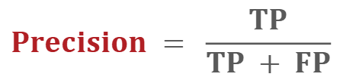
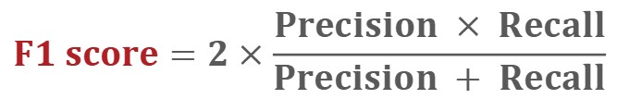
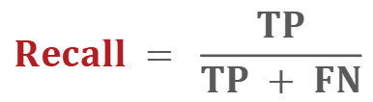
Key Performance Metrics - Accuracy
Overall accuracy
3 dependent variables: Precision, Recall, F1-score
2340 samples analyzed
(130 labs × 18 reference samples)
9.63 × 10¹³ reads generated
Average depth: 4.1 × 10⁷ reads per sample
$$Precision = \frac{TP}{TP + FP}$$
$$Recall = \frac{TP}{TP + FN}$$
$$F1 score=2×\frac{Precision × Recall}{Precision + Recall}$$
-
* True Positives (TP): Total number of spiked microorganisms detected
False Positives (FP): Total number of unexpected microorganisms detected
False Negatives (FN): Total number of spiked microorganisms not detected

Slide 12
Overall Accuracy
Overall Performance:
Average F1-score: 0.98
Average recall: 0.99
consistent with previous studies (range: 0.58–1)
Average precision: 0.98
94.62% of labs achieved precision = 1

Slide 13
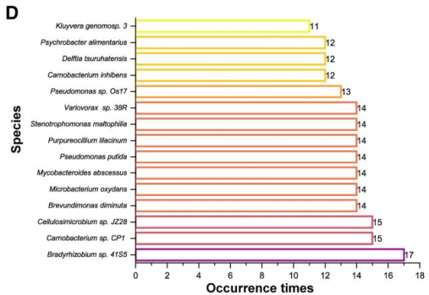
Overall Analysis of False Positives
False Positives (FPs):
Total FPs: 696 across all samples
(193 microbial species reported)
FP results were reported by only 7 labs
4 labs reported ≤3 FPs
3 labs reported >100 FPs
→ Potential issues with their protocols or
contamination control measures

Slide 14
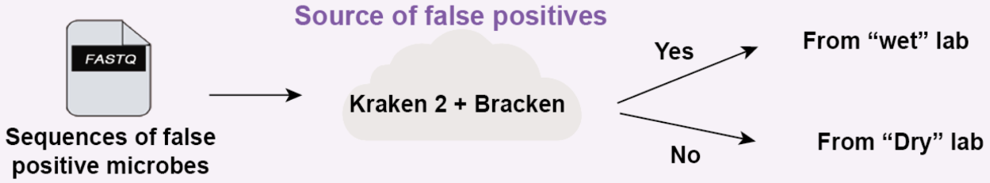



Source of False Positives
Samples: S1-S16 (696 FP results)
Software: Kraken 2, Bracken
Sequencing Files: FP microbial sequences
Criteria:
Positive match (consistent with reported FP microbes): Originates from “Wet” lab
Negative match (inconsistent with reported FP microbes): Originates from “Dry” lab

Slide 15


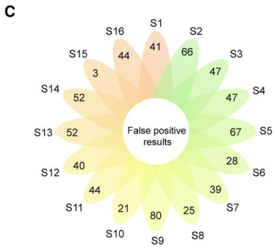
FP - “Wet” Lab
Sources of false positive results
Wet lab:
68.25% of sequences matched the originally reported FP microorganisms
→ Wet-lab process is the primary source
S15, devoid of cfDNA isolation, exhibited significantly fewer FP results (n = 3)
compared to samples requiring extraction (range 25–80)
→ Nucleic acid extraction process in the wet lab may introduce FP microorganisms

Slide 16
FP - “Dry” Lab
Sources of false positive results
Dry lab:
221/696 of the FP sequences did not match the initially reported FP microorganisms
9.05% (20/221) matched other species within the same genus
→ The limited specificity of the taxonomic classification software
90.95% (201/ 221) matched microorganisms not typically found in clinical or lab environments
→ Contaminants from reference databases rather than actual sample-derived contaminants

Slide 17
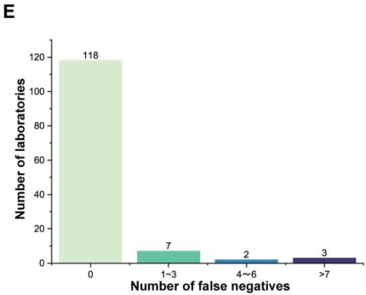
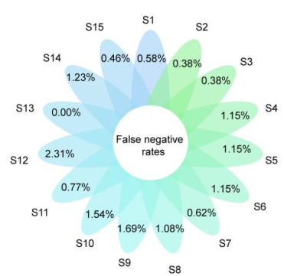
Overall Analysis of False Negatives
False Negatives (FNs):
Total FNs: 66 across 15 positive samples
12 labs (9.23%) reported between 1 and 22 FNs
S7–S9 (threefold serial dilution), S9＞S8＞S7
36.36% (24/66) at concentrations <10³ copies/mL
→ The lower the concentration, the higher the FN rate
Human mastadenovirus C, E. coli, Shigella flexneri had the highest FN rates at ≥10³ copies/mL

Slide 18
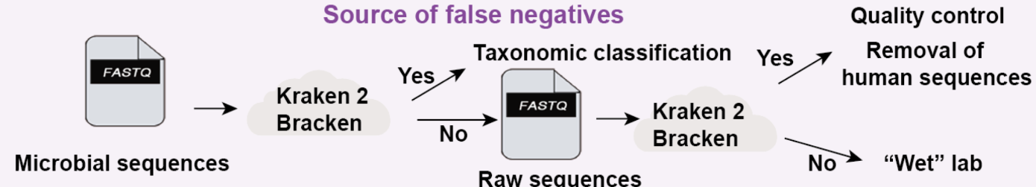
Source of False Negatives
Samples: S1-S15 (66 FN results) *S16: Anonymous negative samples
Software: Kraken 2, Bracken
Sequencing Files: Microbial sequences containing FN
Criteria:
Reanalyze FN microbial sequences (raw reads, low-quality reads, human sequences)

Slide 19
Source of False Negatives
Positive match (realigned with >10 reads): Originates from “Dry” lab
Negative match (realigned with <10 reads): Originates from “Wet” lab
Microbial Sequence
Positive match → Taxonomic classification
Raw Sequence
Positive match → QC & removal of human sequences

Slide 20
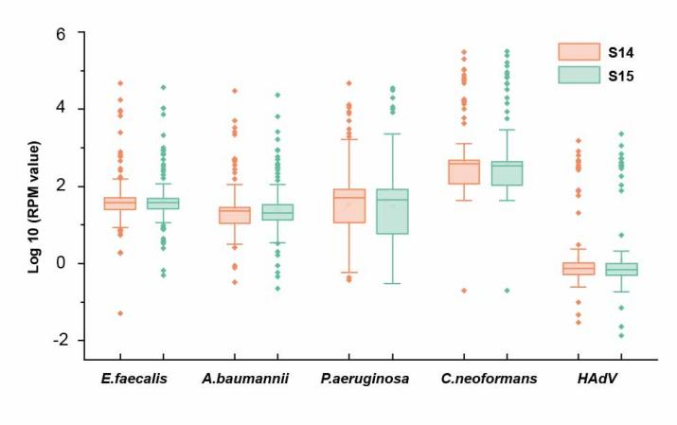
FN - “Dry” & “Wet” Lab
Sources of false negative results
Dry lab:
74.24% (49/66) of the FN microorganisms
realigned with >10 reads → Primary source lies in the dry-lab process
Wet lab:
88.24% (15/17): the raw read count for the corresponding microorganisms was already <10
→ The loss of microbial sequences during wet-lab process
S14 & S15 → cfDNA isolation efficiency was not a critical determinant

Slide 21

Multiple Linear Regression Analysis
Dependent variables
Independent variables
Precision（23.57%）
Recall（20.02%）
F1-score（21.76%）
Extraction method
Extraction kit
Sequencing platform
Classification algorithm
Sequencing mode
Read length
Automatic / Manual
Column / Dynabeads
MGI / illumina / Gene Mind / Ion Torrent / Salus
BWA / Kraken 2 / Bowtie2 / NCBI BLAST / Snap-aligner / Other/custom
Single end / Paired end
50 / 75 / 100 / 150 / 40

Slide 22


Multiple Linear Regression Analysis
Key Factors affecting the detection performance:
Magnetic bead-based extraction: ↑ ↑ ↑
F1-score (β=0.060), precision (β=0.065), recall (β =0.029)
→ Higher DNA recovery efficiency and reduced contamination
Kraken 2 classification: ↓ ↓ ↓
F1-score (β =-0.103), precision (β =-0.122), recall (β =-0.031)
→ Lower specificity compared to hybrid approaches
such as Kraken 2 + BWA or Kraken 2 + Bowtie 2
Other factors: no significant associations

Slide 23
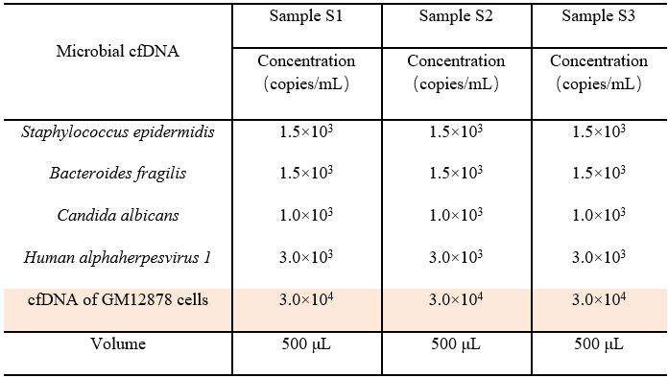
Key Performance Metrics - Repeatability
Sample: S1-S3 (containing 4 types of microbial cfDNA)
Methods:
Qualitative detection
→ The consistency of microbial detection
Quantitative determination
→ The CV of microbial reads per million (RPM) values
→ Kruskal–Wallis tests
→ Linear mixed model
(To evaluate the effects of key factors on CVs)

Slide 24
Overall Analysis of Repeatability
Qualitative Consistency: 97.69% (127/130) of labs achieved 100% repeatability
Quantitative Consistency: 83.08% (108/130) of labs reported an average CV <0.2
for microbial RPM values across replicates
→ Excellent performance in detecting 3 replicate samples
Candida albicans: best repeatability,
human alphaherpes virus: highest variability
→ Viral detection is more challenging than fungal and bacterial detection

Slide 25
Linear Mixed Model
Automated DNA extraction
Magnetic bead-based extraction kit
Lower variance (CV) compared to other technical variables
Linear mixed model
→ To evaluate the effects of key factors on CVs
Fixed effects
Extraction method
Sequencing platform
Sequencing mode
Read length
Taxonomic assignment method
Random effects for laboratory and microbial class

Slide 26
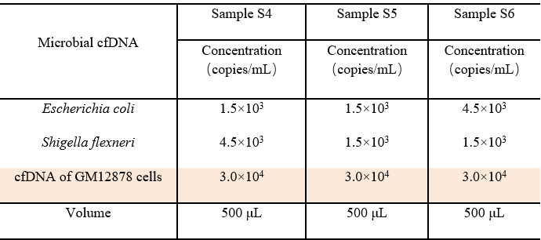
Key Performance Metrics - Anti-Interference
Anti-interference:
Impact of genetically similar organisms and human nucleic acids on microbial detection rates
Against genetically similar organisms
Sample: S4-S6
Escherichia coli : Shigella flexneri = 1:3, 1:1, 3:1
all ≥ 1500 copies/mL, sufficient for detection
Methods: Theoretical ratio & Actual detection ratio
RPM ratio (RPM_{E. coli} / RPM_{S. flexneri})

Slide 27
Anti-Interference (Genetically Similar Organisms)
0.025–222 in S4 (E.coli : S.flexneri = 1:3) * 56.92% (74/130)
0.08-101 in S5 (E.coli : S.flexneri = 1:1) * 73.85% (96/130)
0.16-181 in S6 (E.coli : S.flexneri = 3:1) * 74.62% (97/130)
→ Labs tended to classify highly homologous sequences
as E. coli rather than S. flexneri
* The ratio and the number of labs reported ratios within a 2-fold range of the theoretical value
Enhancing taxonomic classification accuracy
Improving microbial database specificity
Reduce interference

Slide 28
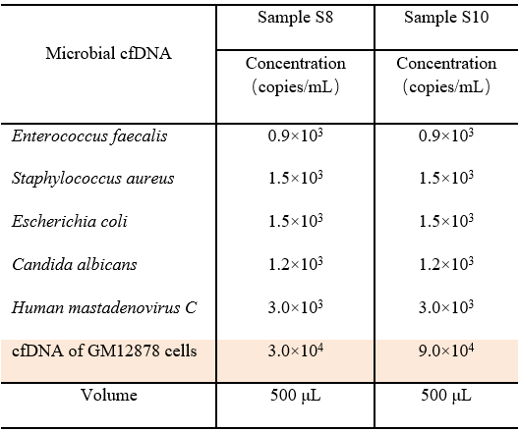
Anti-Interference (Human Nucleic Acids)
Aagainst human nucleic acids
Sample: S8 & S10 *S10: Same as S8, but 3× human derived cfDNA
Methods:
FNs (S8 &S10)
FPs (S10 & all positive plasma samples (S1– S14))
Results:
FNs: S10 (10 FNs), slightly more than S8 (7 FNs)
FPs: S10, lowest FP rate (3.02%, 21/696)
→ Elevated human cfDNA concentrations contributed to a reduction in low-abundance FPs
No significant difference in F1-scores between S8 and S10 (P =0.536)
→ Impact of high-concentration human cfDNA on microbial cfDNA detection was minimal

Slide 29
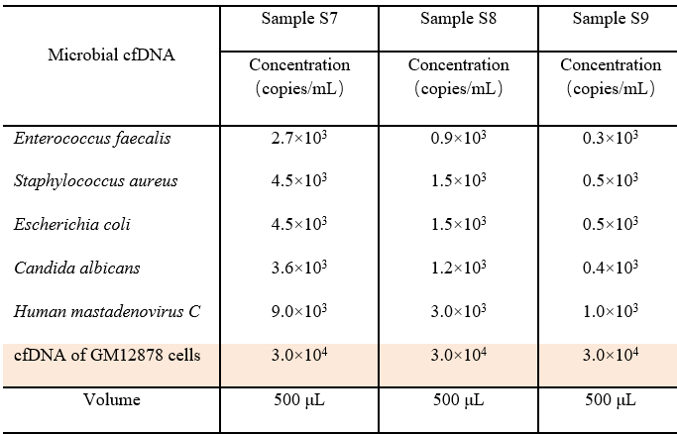
Limit of Detection and Linear Correlation
Sample: S7-S9 *Serial 3-fold dilutions of microbial cfDNA
Methods:
Limit of detection (LoD): Detection rate of microbial cfDNA at different concentrations
Linear correlation: Microbial cfDNA concentration (copies/mL) and mNGS signals (RPM) for each lab
  Spearman rank correlation coefficient
→ Assess a monotonic relationship
  Coefficient of determination (R²)
→ Assess the strength of the relationship

Slide 30
Results: LoD and Linear Correlation
LoD:
As the microbial cfDNA concentration decreased, the detection rate in labs also declined
Detection rates for all microorganisms remained above 95% within the 300-90,000 copies/mL range
Linear correlation (Greater quantitative potential):
Spearman rank correlation coefficient close to 1 for most labs (87.7-99.2%)
93.85% (122/130) of labs displaying an average correlation coefficient >0.9
C. albicans: strongest correlation (median 0.999, IQR 0.997-1.000), 400 copies/mL
Human mastadenovirus C (median 0.998, IQR 0.990–0.999), 1000 copies/mL (highest concentration)
Highest concentration, but lower correlation → Greater challenge in detecting DNA viruses

Slide 31

Discussion
Limitations:
Gaps between simulated and clinical settings
cfDNA fragment size
Degradation patterns
Background human DNA content
cfDNA isolation process
Laboratory proficiency
Key findings:
Comprehensive multicenter evaluation
Comprehensive performance assessment
Detailed error analysis
Standardization and quality control

Slide 32
Summary
The study evaluates metagenomic cfDNA sequencing performance in real-world settings, crucial for clinical use.
By identifying sources of false positives and negatives, our findings suggest strategies to improve accuracy.
The multicenter design offers a robust framework for standardized protocols and quality control measures.
These insights will help researchers identify pathogens in infectious diseases and advance cfDNA sequencing in diagnostics.

