Slide 1
ADLM High School Speaker Series
High School
Date

Slide 2
Introduction
Start the session by capturing attention and setting the tone for a deeper presentation that connects your career to the students’ learning and interests. Your introduction can include:
  Personal intro + connection
  Tie into science class
  What you do & why it matters
  Career accessibility
  Set the stage for the session
Consider using one of the introduction scripts on the following slides. Adapt to your voice and experience.

Slide 3
Option 1
“Hi, I’m [Your Name], and I work in clinical laboratory science. That means I help doctors by running tests—on blood, swabs, and more—to find out what’s happening in someone’s body.
All the biology and chemistry you’re learning? I use that every day in the lab. Whether we’re testing blood for diabetes or checking for infections, we rely on the same concepts you’re learning now.
We’re the behind-the-scenes part of healthcare, but we’re essential. Without lab results, doctors don’t have the info they need to treat patients.
You can enter this field with a 2- or 4-year degree, and there are tons of options in hospitals, biotech, and even public health.
Today I’m going to show you what a day in the lab looks like and give you a glimpse of how science becomes action in healthcare.”

Slide 4
Option 2
“Raise your hand if you’ve ever had blood drawn, a COVID test, or even a strep throat swab.
I’m a clinical laboratory scientist—and I’m the one who would analyze that sample. I work in a lab helping doctors figure out what’s going on inside your body.
Without lab results, doctors are often just guessing. According to the CDC, about 70% of medical decisions rely on lab data—and we’re the ones producing that data.
You don’t need to go to med school to work in healthcare. You can train for this career in just a few years, and you get to use science, technology, and critical thinking every day.
Today I’m going to show you what the job looks like, the tools we use, and how you can start exploring this career while you’re still in high school.”

Slide 5
What is Laboratory Medicine?
Use examples that students might relate to (e.g., strep throat, COVID testing, diabetes). Ask students if they or someone they know has ever had one of these tests.
Explain how lab results are used to make decisions- highlight the impact on patient care and why it’s important to get accurate lab results.

Slide 6
What is ADLM?
ADLM- The Association for Diagnostics & Laboratory Medicine
ADLM is a global scientific and medical professional organization dedicated to clinical laboratory science and its application to healthcare.

Slide 7
Local Section Information
Insert your Local Section Name/Logo
Explain that your Section is a regionally organized group of ADLM members.
What area does your Local Section cover?
How is your Section involved in the community? What kind of events do you have?

Slide 8
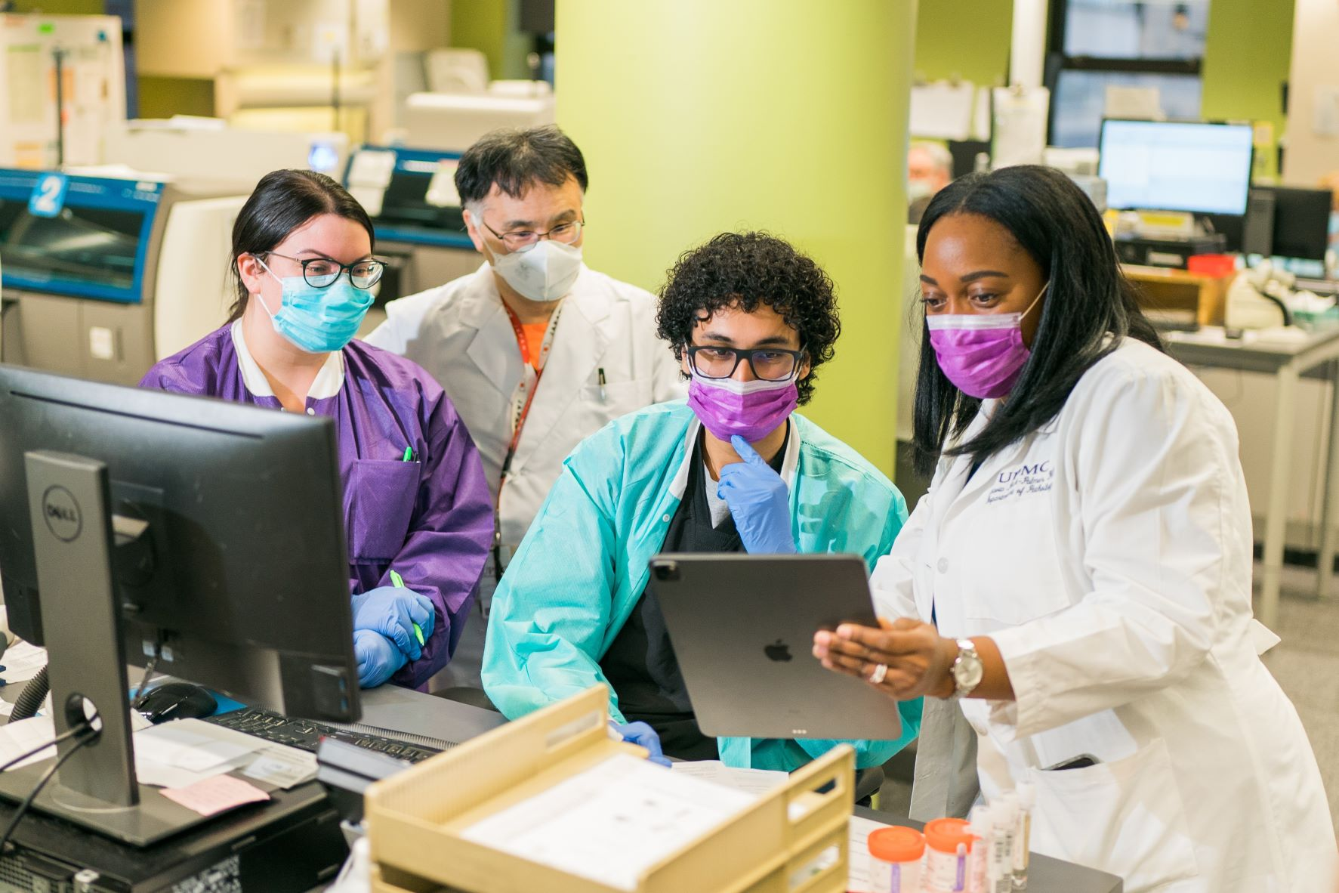
What We Do
List some career paths that clinical laboratory professionals work in, such as hospitals, research labs, forensic science, biotechnology, and more, helping to improve patient care and advance medical discoveries.
Explain how lab professionals play a critical role in diagnosing diseases, developing new tests, and ensuring the accuracy of medical results.
Use this slide as a segue for the career paths wheel (next slide)

Slide 9
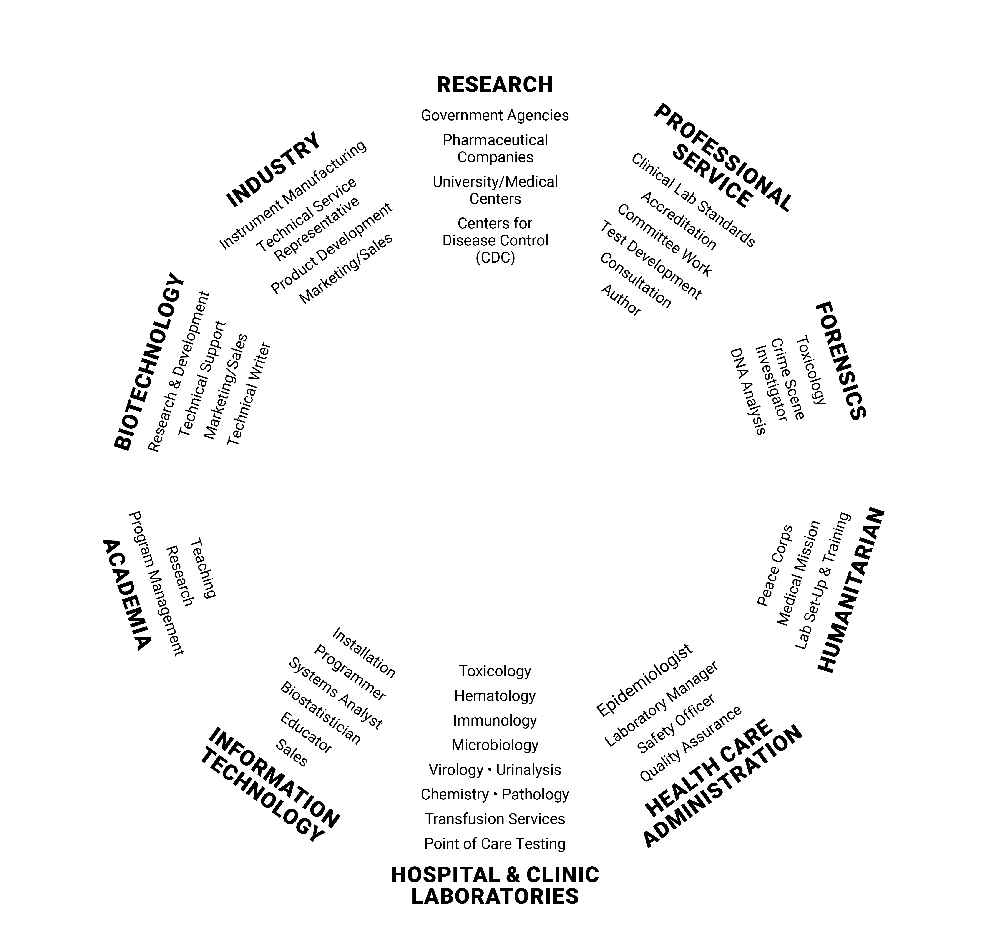
Career Paths in Medical Laboratory Sciences
Consider printing this handout for students.
Highlight 2-3 different areas, which could focus on your path or the path of another professional or college student.
For more information, visit myadlm.org/career-center
This diagram is based on Arkansas State University’s CLS Career Pathways.

Slide 10
A day in the life of a lab professional
Give a brief overview of daily tasks in different lab careers. This may bridge into what your first speaker will discuss.
Insert a short video or speaker story
  Optional showcase video: You Are What You Eat

Slide 11
Student & Professional Journeys

Slide 12
Student & Professional Journeys
Share your career path and what you do.
Consider bringing a colleague or college student talk about their journey into lab medicine.
Connect with students with real-world experiences (e.g., what college courses should they take?, did you do an internship or job shadowing?)

Slide 13
Q&A/Engagement Game
Notes:
https://quizizz.com/admin/presentation/67c76b421d58cf324c6ca677?source=live_dash_game_complete&gameType=tp&players=0

Slide 14
Q&A/Engagement Game
Make sure to leave time for Q&A/open discussion with students. Have 2-3 backup questions ready in case the students are shy.
If possible, incorporate an engagement game such as Kahoot or Quizziz

Slide 15

Thinking About a Career in Lab Medicine?
ADLM offers free college student memberships so you can explore the field, connect with professionals, and access educational resources early in your journey.
Start exploring today!

Slide 16
THANK YOU!

