Slide 1
What is ADLM?
ADLM- The Association for Diagnostics & Laboratory Medicine
ADLM is a global scientific and medical professional organization dedicated to clinical laboratory science and its application to healthcare.

Slide 2
Lab Medicine and Why It Matters
Lab medicine involves performing tests on blood, tissues, and other body fluids to help diagnose, treat, and prevent diseases.
According to the CDC, 70% of medical decisions are based on lab test results, helping to improve patient outcomes and save lives.

Slide 3
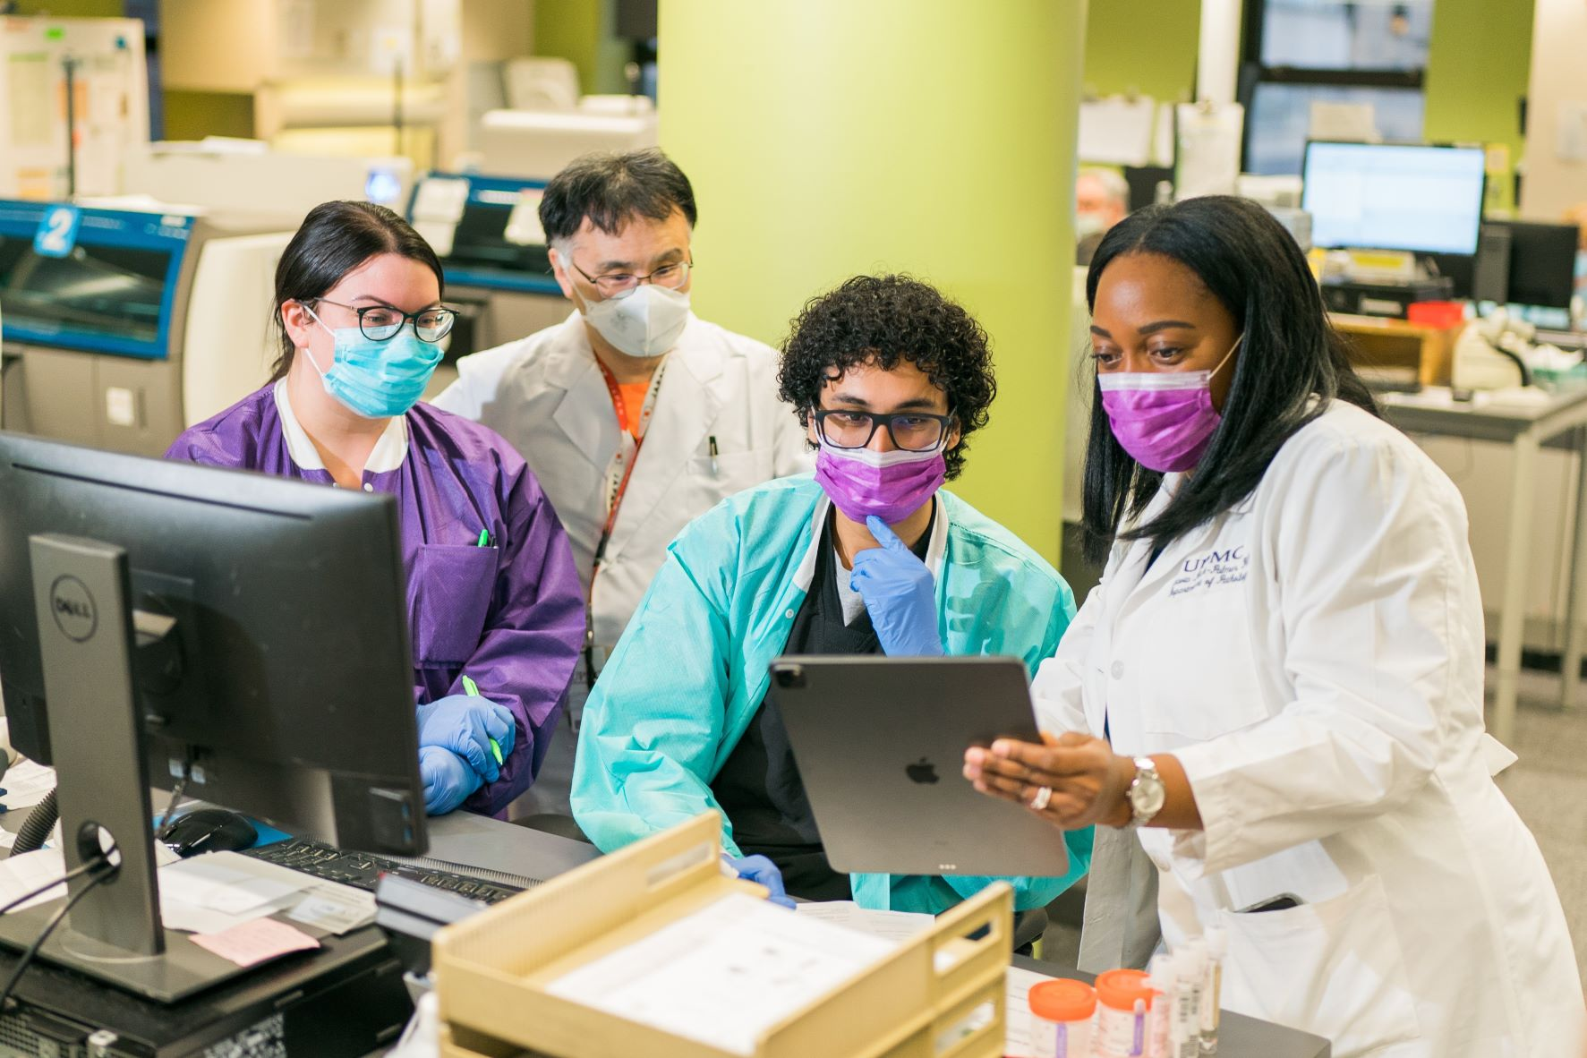
What Lab Professionals Do
Lab professionals work in hospitals, research labs, forensic science, biotechnology, and more, helping to improve patient care and advance medical discoveries.
They play a critical role in diagnosing diseases, developing new tests, and ensuring the accuracy of medical results.

Slide 4
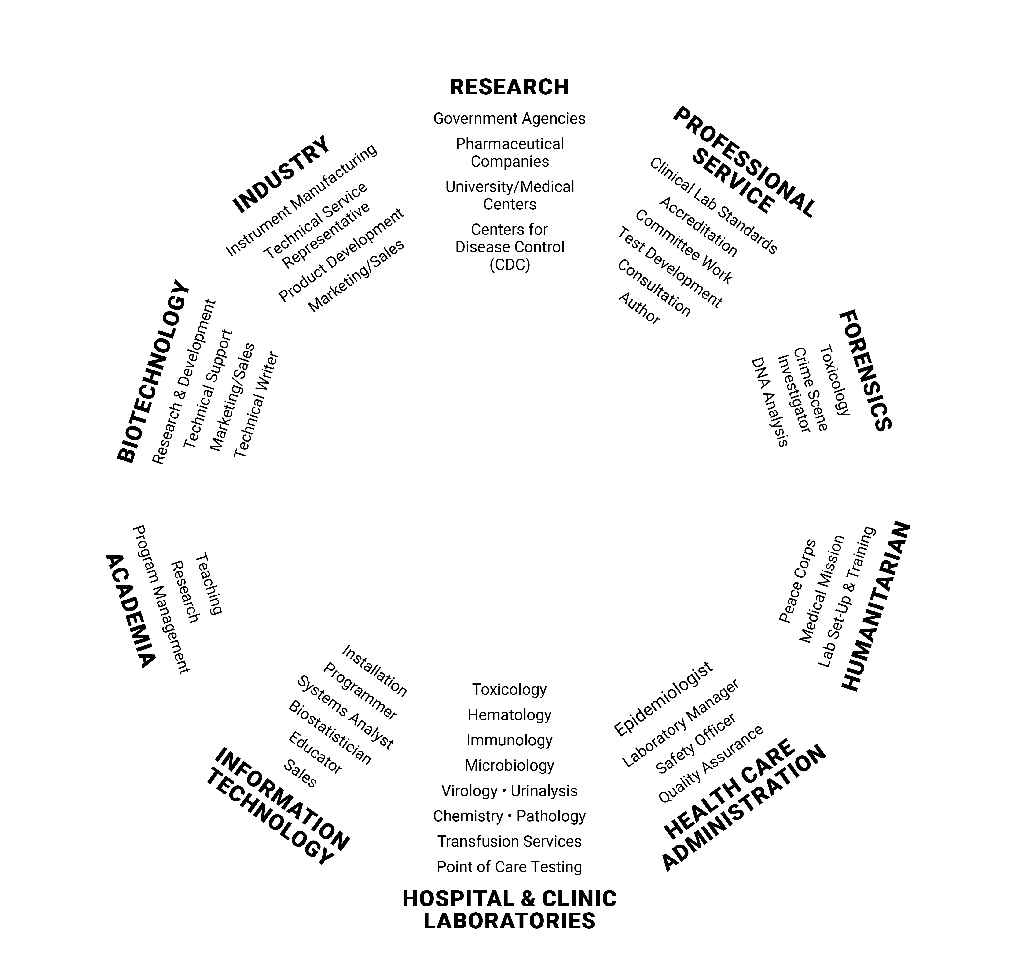
Career Paths in Medical Laboratory Sciences
Students who pursue careers in clinical laboratory science may work in many areas, such as:
  Hospitals and clinics
  Public health and epidemiology
  Forensics
  Biotechnology and research
  Informatics
For more information, visit myadlm.org/career-center.
This diagram is based on Arkansas State University’s CLS Career Pathways.

Slide 5

Thinking About a Career in Lab Medicine?
ADLM offers free college student memberships so you can explore the field, connect with professionals, and access educational resources early in your journey.
Start exploring today!

