Slide 1

Immunoglobulin-like Domain of HsFcμR as a Capture Molecule for Detection of Crimean-Congo Hemorrhagic Fever Virus- and Zika Virus-Specific IgM Antibodies
A. Rackow, C. Ehmen, R. von Possel, R. Medialdea-Carrera, D. Brown, A.M. Bispo de Filippis, P. Carvalho de Sequeira, R.M. Ribeiro Nogueira, B. Halili, X. Jakupi, L. Berisha, S. Ahmeti, K. Sherifi, J. Schmidt-Chanasit, H. Schmitz, A. Mika, P. Emmerich, and C. Deschermeier
March 2019
www.clinchem.org/content/65/3/451.full
© Copyright 2019 by the American Association for Clinical Chemistry

Slide 2
Introduction
FcγRIIa (CD32) as a capture molecule in IgG ELISA applications
  Serotype-specific DENV IgG ELISA (Schmitz et al., 2013)
  LASV IgG ELISA (Gabriel et al., 2018)
  CCHFV IgG ELISA (Emmerich et al., 2018)
FcµR (TOSO/FAIM3) (Kubagawa et al., 2009; Shima et al., 2009)
  Highly specific IgM binding
  Structure: signal peptide, Igl domain, TM domain, intracellular domain

Slide 3
Questions on Introduction
What are the cellular functions of Fc receptors on mammalian immune cells?
What properties qualify Fc receptors as capture molecules for serological assays?

Slide 4
Materials & Methods
Recombinant expression and purification
  HsFcµR-Igl
  CCHFV antigen (NP)
  ZIKV antigen (NS1)
Serum samples for assay validation
  CCHFV patient sera
  ZIKV patient sera
  Negative controls sera

Slide 5
Questions on Materials & Methods
How can functional proteins be purified from E. coli inclusion bodies?
What minimum requirements have to be fulfilled by a serum panel suitable for assay validation?

Slide 6
Results
Production of recombinant HsFcµR-Igl and characterization of binding properties
  Prokaryotic expression and purification
  Specific binding to IgM/antigen immune complexes (ICs)
HsFcµR-Igl as capture molecule in serological tests
  CCHFV IgM FcµR ELISA
  ZIKV IgM FcµR ELISA
  Aggregation-based rapid test (proof-of-principle)

Slide 7
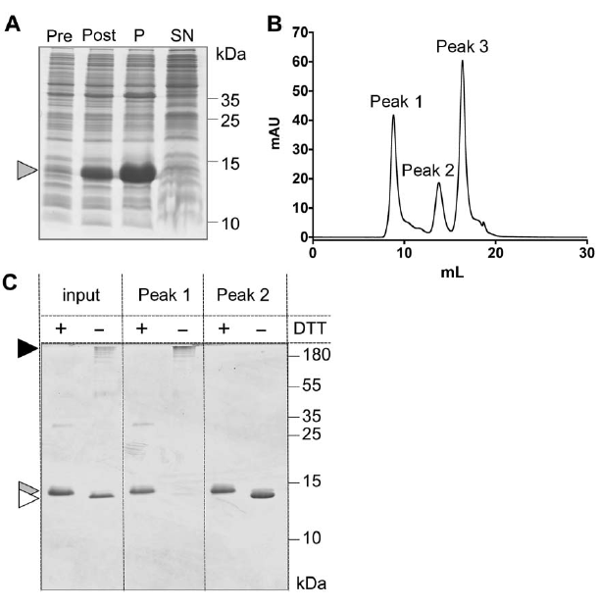
Prokaryotic expression and purification of HsFcµR-Igl
Figure 1. (A) Recombinant HsFcµR-Igl is found in the insoluble fraction of the bacterial lysate. Size exclusion chromatography (B) of refolded HsFcµR-Igl separates correctly folded, functional HsFcµR-Igl (peak 2) from high molecular weight aggregates (peak 1) (C).

Slide 8
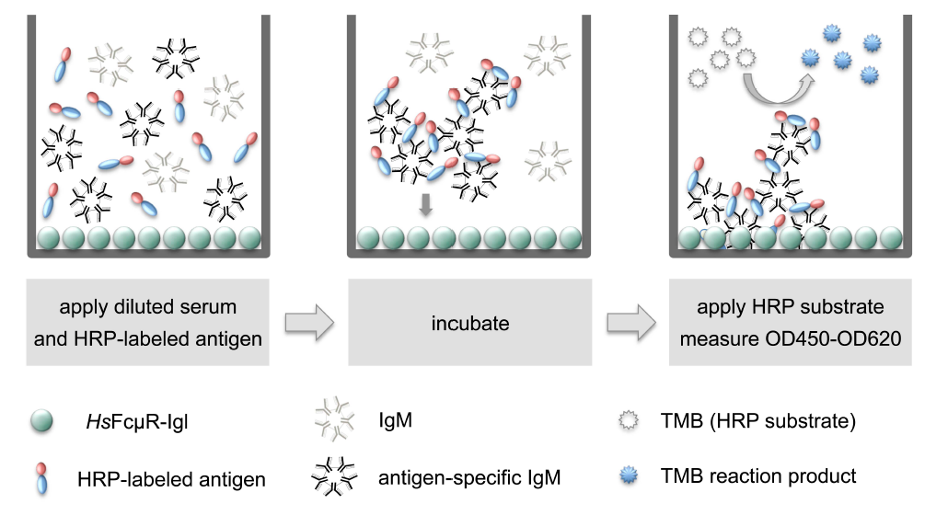
IgM FcµR ELISA principle
Supplemental Figure 2. Plates are coated with HsFcµR-Igl. Serum and HRP-labeled recombinant antigen are applied to the wells. During the following incubation time, ICs form and bind to HsFcµR-Igl. After plate washing, bound ICs are detected by using the colorimetric HRP substrate TMB.

Slide 9
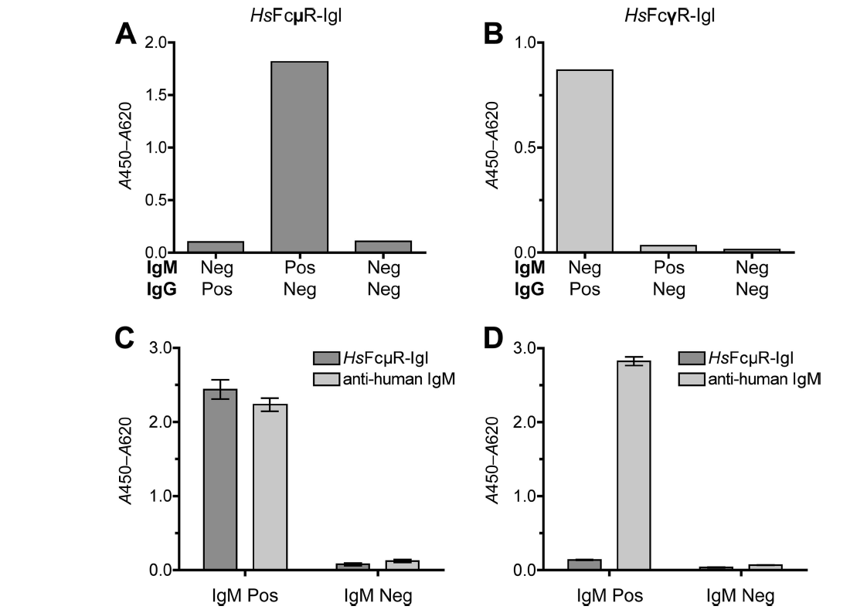
HsFcµR-Igl specifically binds to IgM/antigen ICs
Figure 2. (A, B) Specific binding of CCHFV-NP^{HRP}/IgM ICs to HsFcµR-Igl and CCHFV-NP^{HRP}/IgG ICs to HsFcγR-Igl. (C, D) HsFcµR-Igl does not bind to uncomplexed IgM molecules.

Slide 10
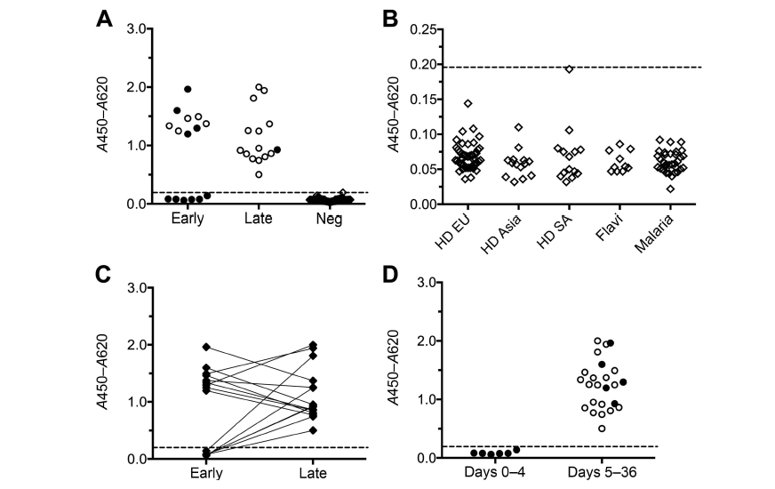
CCHFV IgM FcµR ELISA
Figure 3. (A, B) Absorbance values for early and late patients samples and CCHFV IgM-negative control samples. (C) IgM seroconversion (paired sera). (D) Absorbance values for patient samples stratified according to the day after onset of symptoms on which they were collected.

Slide 11
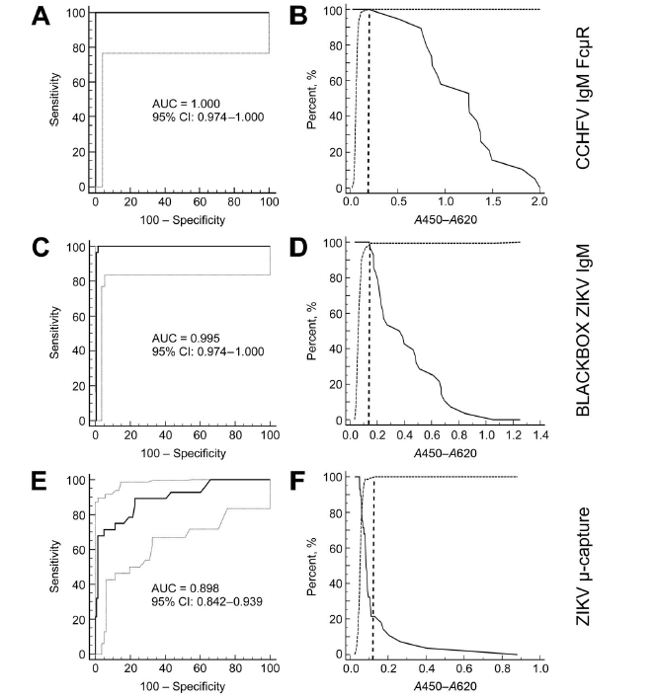
Receiver Operating Characteristic (ROC) analyses
Figure 4. ROC analysis of (A, B) CCHFV IgM FcµR ELISA, (C, D) BLACKBOX ZIKV IgM ELISA and (E, F) ZIKV µ-capture ELISA

Slide 12
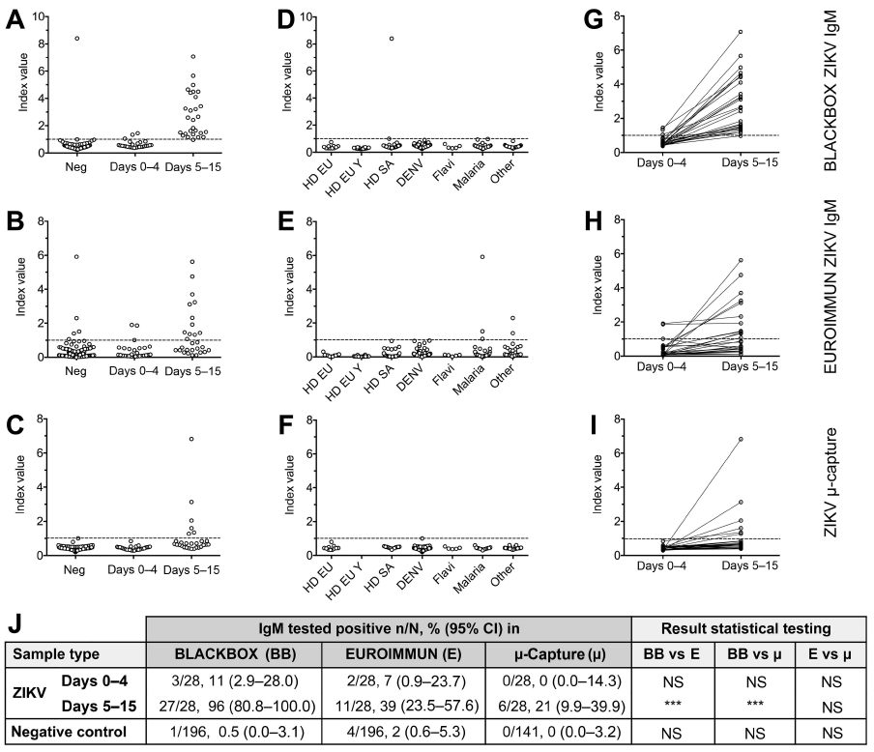
BLACKBOX ZIKV IgM ELISA compared with ZIKV µ-capture ELISA and Euroimmun ZIKV IgM ELISA
Figure 5. (A-C) Index values for patient samples and negative control samples. (D-F) Index values for negative control samples, (G-I) Seroconversion (paired sera). (J) Sensitivities and specificities.

Slide 13
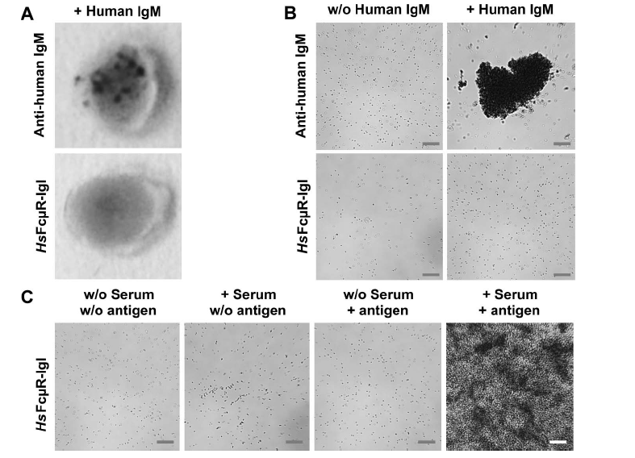
HsFcµR-Igl can be used as a capture molecule in aggregation-based rapid tests.
Figure 6. (A, B) anti-human IgM coated beads, but not HsFcµR-Igl coated beads, aggregate in presence of human IgM. (C) Beads coated with HsFcµR-Igl aggregate in presence of IgM/antigen ICs.

Slide 14
Question on Results
What criteria influence the choice of the cut-off value for an ELISA application?
What substances could interfere with IgM FcµR ELISA performance?

