Slide 1

Evaluation of Sperm DNA Integrity by Mean Number of Sperm DNA Breaks Rather Than Sperm DNA Fragmentation Index
B. Yan, W. Ye, J. Wang, S. Jia, X. Gu, H. Hu, W. Xiang, T. Wu, X. Xiao
April 2022
https://doi.org/10.1093/clinchem/hvab280
© Copyright 2022 by the American Association for Clinical Chemistry

Slide 2
Introduction
Sperm DNA Fragmentation (SDF) test
  Sperm DNA integrity is crucial for fertilization, implantation, and embryo development
  Origin of SDF
    Abnormal spermatogenesis: blocked histone-protamine conversion
    Oxidative stress damage: the main origin, reactive oxygen species cause DNA oxidative damage
    Abnormal sperm apoptosis: damaged sperm escape the normal apoptotic pathway
Methods for SDF detection
  Sperm Chromatin Diffusion Test
  Sperm Chromatin Structure Analysis
  Terminal deoxynucleotide transferase dUTP nick end labeling method
QUESTION: What might be the disadvantages of the current methods for detecting sperm DNA integrity?

Slide 3
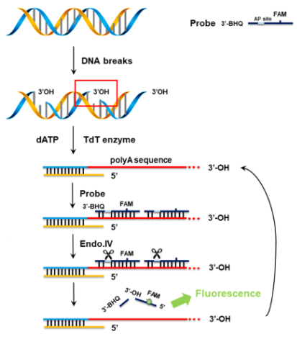
Materials & Methods
DNA probe-based, enzyme-assisted quantitative assay for SDF detection.
  TdT extends polyA at the 3’-OH end of the breakpoint
  Inactivation of TdT at 85ºC
  The fluorescent probe binds to polyA and is hydrolyzed by Endo IV to produce fluorescence
  Another new fluorescent probe binds to polyA and repeats the above process
  The fluorescence intensity will be proportional to the number of DNA breakpoints.

Slide 4
Materials & Methods
Demonstration of the method by linear DNA
  Treatment of lambda DNA with sonication and restriction enzymes
  Treatment of lambda DNA with restriction enzymes
Standard curve (using single-stranded DNA as calibrator)
  Limit of detection
  Dynamic range/Linear range
Evaluation of DNA integrity in 80 sperm samples
  Assessment of DNA Integrity in 80 sperm samples using DNA fragmentation index (DFI) indicators
  Assessment of DNA integrity in 80 sperm samples using mean number of sperm DNA breaks (MDB) indicators
QUESTION: What needs to be carefully considered when performing the MDB test?

Slide 5
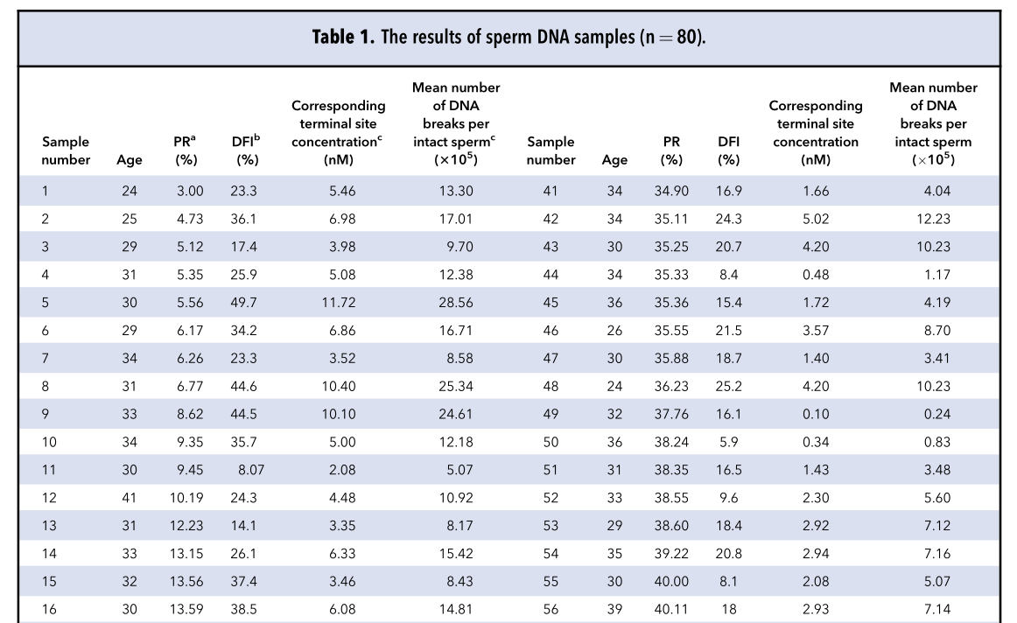
Data on sperm DNA integrity
Table 1. ªProgressive motility (PR) was determined by sperm motility test listed in Methods.
^{b}DFI was assessed using sperm chromatin structure analysis.
^{c}The calculation methods are provided in the Supplemental Material.

Slide 6
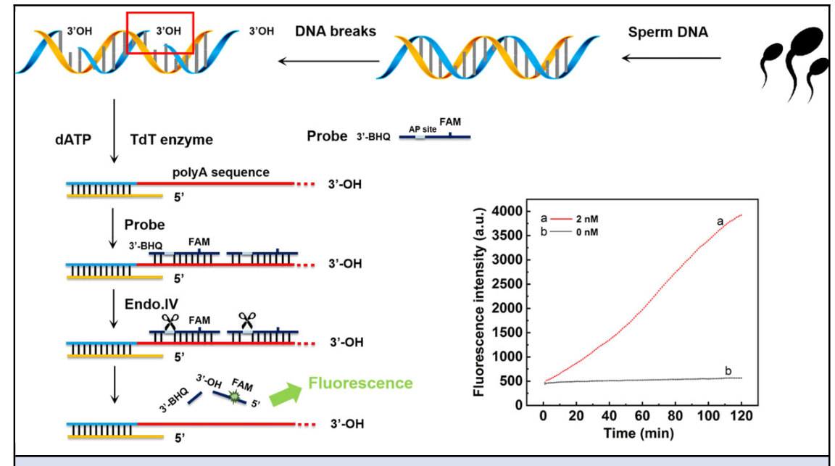
Proof-of-principle
Figure 1. A schematic illustration of TdT/Endo IV-assisted amplification for DNA breaks detection.

Slide 7
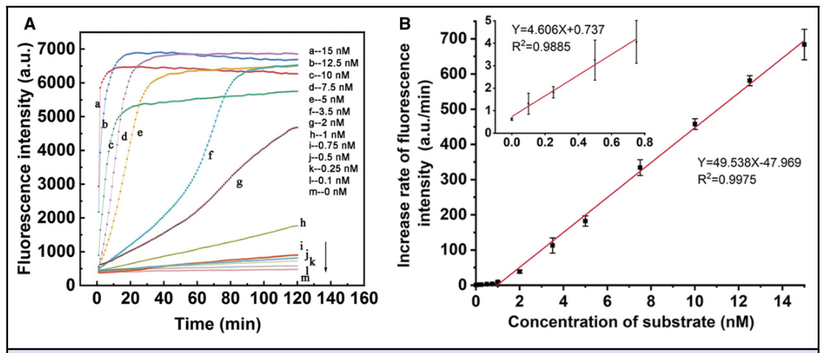
Limit of detection and Dynamic range/Linear range.
Figure 2. (A) Fluorescence responses with different single-stranded DNA concentrations from 0 to 15 nM. (B) The linear regression of the fluorescence increase rate with concentrations of substrate ranging from 0 to 15 nM.The limit of detection was calculated to be 0.032 nM by 3r/K according to the low concentration standard curve.

Slide 8
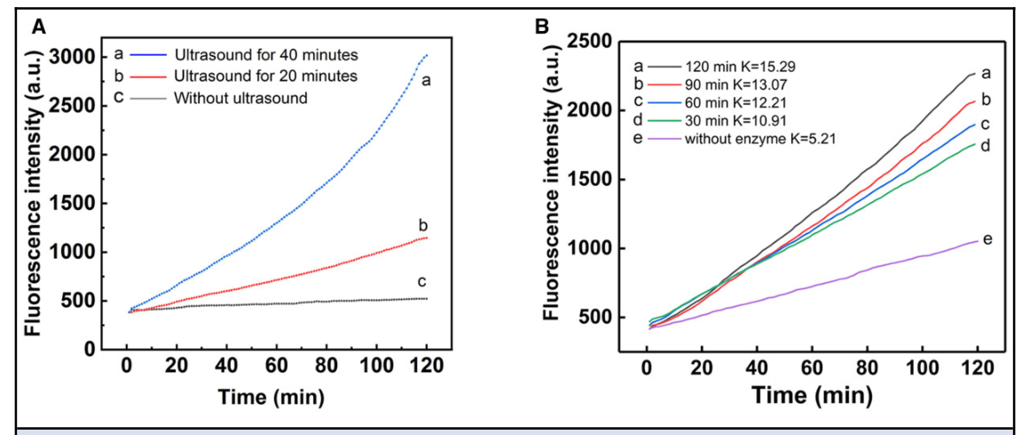
Demonstration of the method by linear DNA
Figure 3. (A) Fluorescence responses of λ DNA with different numbers of ultrasound cycles from 0 to 40 min. (B) Fluorescence responses of λ DNA with an increasing gradient of incubation time from 0 to 120 min. K means the slope of each fluorescence curve.

Slide 9
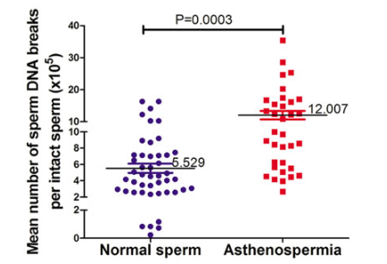
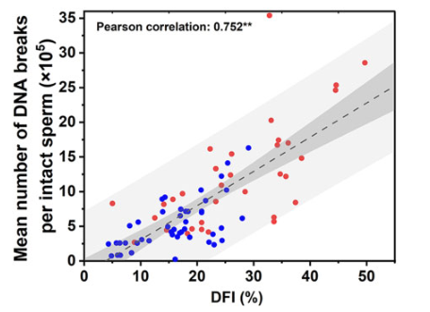
Assessment of DNA Integrity in 80 Sperm Samples Using MDB and DFI
A
B
Figure 4 A-B. (A) The MDB of normal sperm (n=46) and asthenospermia sperm (n=34). (B) Correlation analysis between MDB and DFI. The dark gray band denoted 95% confidence band, and the light gray band denoted 95% prediction band.

Slide 10
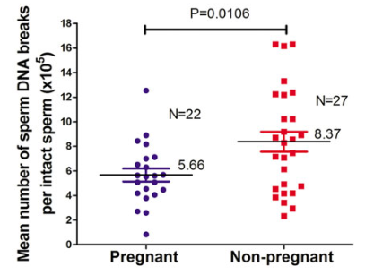
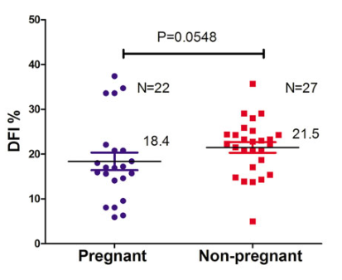
Assessment of DNA Integrity in 80 Sperm Samples Using MDB and DFI
C
D
Figure 4C-D. (C) The MDB of sperm samples of the pregnant group (n=22) and nonpregnant group (n=27). (D) The DFI of sperm samples of the pregnant group (n=22) and nonpregnant group (n=27) on DFI.

Slide 11
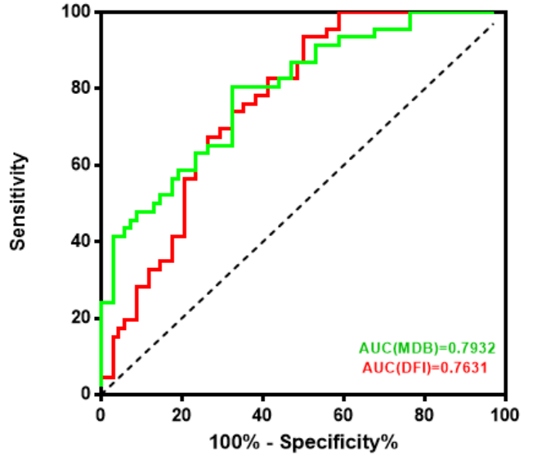
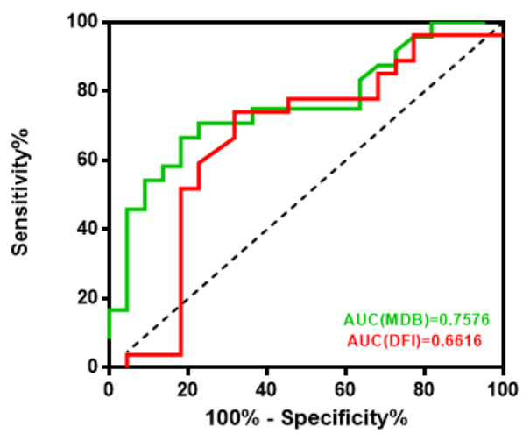
Assessment of DNA Integrity in 80 Sperm Samples Using MDB and DFI
E
F
Figure 4 E-F. (E) The ROC curves of MDB and DFI for differentiating normal sperm samples and asthenospermia sperm samples (n=80). (F) The ROC curves of MDB and DFI for differentiating sperm samples between pregnant group and nonpregnant group (n=49)

Slide 12
Summary
Based on terminal transferase (TdT), endonuclease IV (Endo IV), and DNA fluorescent probes, this study yielded a new method to detect the number of sperm DNA breakpoints and created a new index for the evaluation of sperm DNA integrity: Mean number of DNA breakpoints (MDB).
The method has the advantages of short time consumption, simple operation, high analytical sensitivity, and low requirements for instruments, which is beneficial to clinical application.
The mean number of DNA breakpoints (MDB) is more strongly associated with sperm motility and clinical pregnancy outcomes than the commonly used parameter of DFI.
Question: How might one more accurately determine the threshold of this indicator for judging male fertility?

