Slide 1
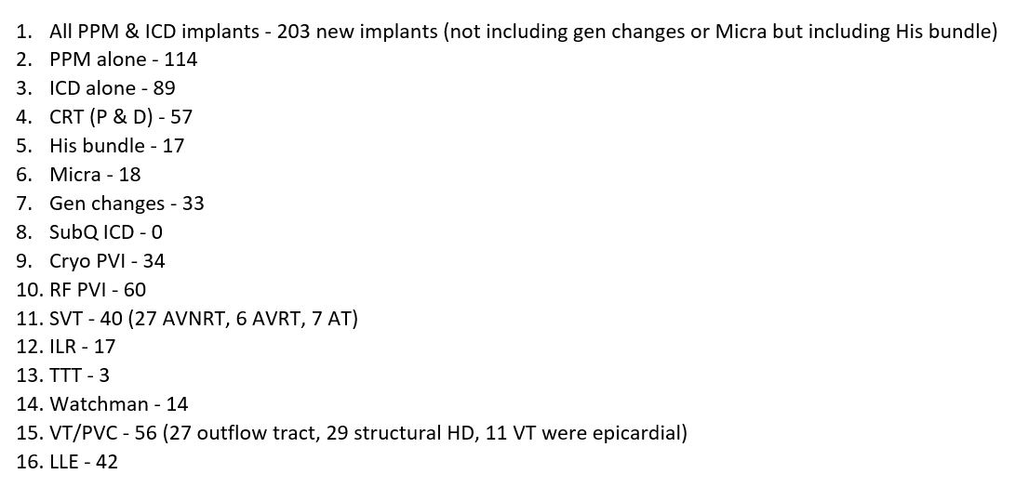
Current EP Fellow First Year Case Numbers
(July 1, 2019- June 30, 2020)

