Slide 1

Enteral Nutrition

Slide 2
Objectives
Understand indications for and benefits of enteral nutrition support in pediatric patients
Recognize varying enteral routes and ways of administering enteral nutrition support
Understand the appropriate initiation and advancement of tube feeds
Identify common complications of enteral nutrition support

Slide 3
Patient Case - Emma
Emma is a 3 month old female who presents to GI clinic for follow-up of Failure to Thrive (FTT) leading to Mild Malnutrition. Despite a medical work up and several interventions in the past few weeks, her weight gain continues to be poor. The GI provider is recommending tube placement to promote catch-up weight gain and growth.
Does Emma meet the criteria for initiating enteral nutrition?
Notes:
Have trainee write down thoughts for this question on worksheet

Slide 4
Indications for Enteral Nutrition (EN)
Functional GI tract – if the gut works, use it!
Oral intake is unsafe, insufficient, or impossible
  Aspiration
  Malnutrition with current oral intake OR concerns that current inadequate oral intake will lead to malnutrition
    Includes developmental delays impacting oral motor skills that allow for efficient eating
  Surgery/trauma/medical condition that doesn’t allow for safe/efficient/appropriate oral feeding
    Examples: cleft lip/palate in need of repair, face trauma, child that requires frequent oral feeds throughout the day to meet their needs (outside of what’s appropriate for age)

Slide 5
EN Indications for Pediatric Population
EN may be needed for the following conditions:
  Necrotizing Enterocolitis (NEC), Congenital Diaphragmatic Hernia, Omphalocele, Meconium Ileus, Intestinal Atresia, Gastroschisis, Short Bowel Syndrome, Malnutrition, Cancer
EN may also be needed:
  Child has a condition that requires increased energy needs
    Cystic Fibrosis, wound healing, certain liver diseases, burns
  Child requires extended period of time to eat to meet nutrition needs
    Cognitive impairment caused by seizures, brain injury, etc
Notes:
Pulled slide from CNSC exam powerpoint

Slide 6
Benefits of Enteral Nutrition
Supports maintenance of functional integrity of the gut
Supports the components of the gut barrier functions
Maintains normal gallbladder function
  Reduces cholestasis risk
Can prevent bacterial translocation
Reduces complications associated with pneumonia, sepsis, IV line sepsis, and intra-abdominal abscess
Cost savings compared to PN

Slide 7
Patient Case - Emma
Emma is a 3 month old female who presents to GI clinic for follow-up of Failure to Thrive (FTT) leading to Mild Malnutrition. Despite a medical work up and several interventions in the past few weeks, her weight gain continues to be poor. The GI provider is recommending tube placement to promote catch-up weight gain and growth.
Does Emma meet the criteria for initiating enteral nutrition?
  Answer: Yes, tube placement is appropriate (continued use of a functional GI tract vs parenteral nutrition)

Slide 8
Patient Case - Emma
What type of tube should be placed?

Slide 9
Feeding Tube Devices – Short term
 | General Information | Pros | Cons
Nasogastric (NG) tube | Tube placed through the nose into the stomach | Can be placed at the beside and/or at home (if trained) Variety of sizes available for patient comfort | Must be replaced every month Not indicated in patients with bleeding disorders, nasal/facial fractures and certain types of esophageal disorders
Orogastric (OG) tube | Tube placed through the mouth into the stomach Used most frequently in the NICU at CW Use with caution in patients with facial trauma | Lower incidence of sinusitis than NG | Not tolerated for long periods of time in alert patients Tube may damage teeth
Nasojejunal (NJ) tube | Tube placed through the nose into the jejunum (small intestines) | May have less discomfort due to smaller tube size Better tolerance for those with delayed gastric emptying | Requires placement in Interventional Radiology (IR)
Notes:
NG tube change frequency varies as it is institutional preference. Some of the gastric contents can break down the tube lining.
NG & NJ tubes can be bridled through the nose in order to prevent the tube from being pulled out. This is most commonly used in infants & young children.
Reference https://gi.org/topics/enteral-and-parenteral-nutrition/#:~:text=Enteral%20nutrition%20generally%20refers%20to,a%20tube%20(tube%20feeding).

Slide 10
Feeding Tube Devices – Long term
 | General Information | Pros | Cons
Gastrostomy (G) tube | Placed surgically (open) or endoscopically (PEG) into the stomach | Ease of care Can be replaced in the home setting (once a button is in place) | Placement is more invasive than oral and nasal routes
Gastrojejunostomy (GJ) tube | Tube placed surgically (open) or endoscopically (PEG) and then additional tube is threaded into the jejunum in IR | Better tolerance for those with delayed gastric emptying or intolerance of feeds into the stomach | Requires initial placement and replacement every 3 months in IR Smaller tube size may make administration of some medications more difficult An infusion pump is required Requires patient to weigh at least 10 kg* (*per IR at CW)
Jejunostomy (J) tube | Tube placed surgically into the jejunum | Better tolerance for those with delayed gastric emptying or intolerance of feeds into the stomach Once switched to a button, can be changed at home and not in IR | Technically more difficult to place Smaller tube size may make administration of some medications more difficult An infusion pump is required
Notes:
After this slide: Pause and allow the trainee to think about what type of tube they would consider placing and have them write their thoughts on the worksheet.
Reference https://gi.org/topics/enteral-and-parenteral-nutrition/#:~:text=Enteral%20nutrition%20generally%20refers%20to,a%20tube%20(tube%20feeding).

Slide 11
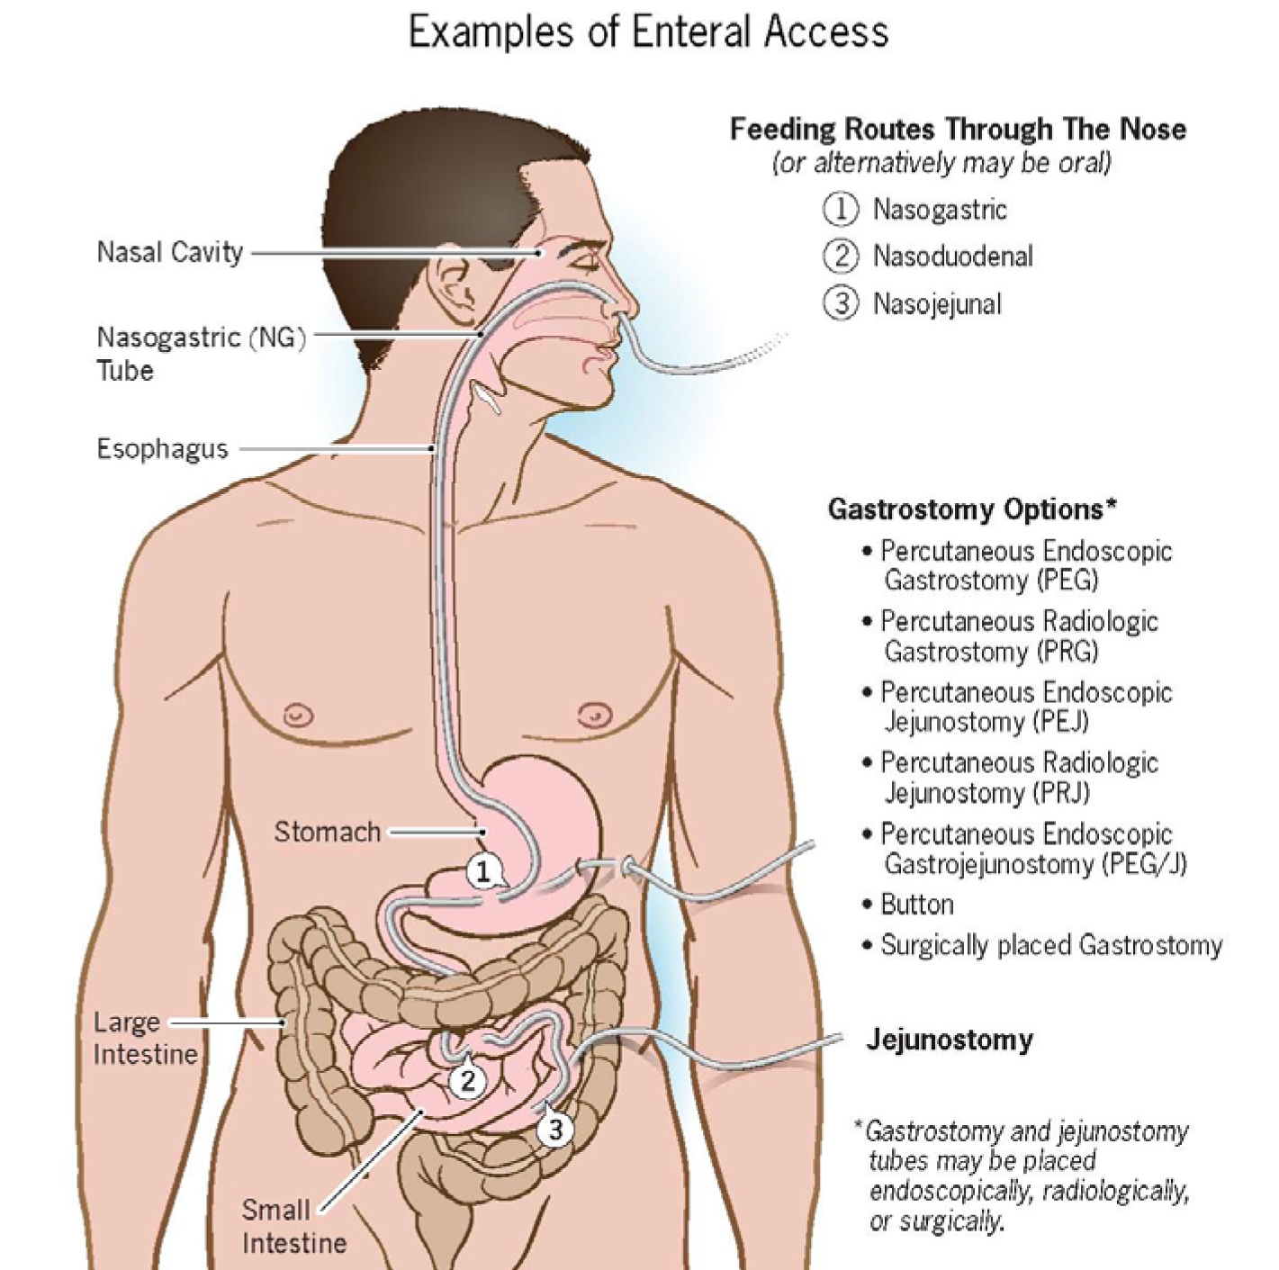
Notes:
Reference: https://gi.org/topics/enteral-and-parenteral-nutrition/#:~:text=Enteral%20nutrition%20generally%20refers%20to,a%20tube%20(tube%20feeding).
Common practice at CW: NG, NJ, (no ND); PEG or surgically placed G, PEG/J or surgically placed J

Slide 12
Patient Case - Emma
What type of tube should be placed?
  Answer: Nasogastric (NG) or Gastrostomy (G) tube
    Does not require post pyloric placement (NJ, GJ, or J-tubes) and OG is not typically used in the outpatient setting

Slide 13
Patient Case - Emma
The team decides to place an NG-tube to see if improving Emma’s overall nutrition status with supplemental NG feeds will lead to improved oral intake. The team would like caregivers to offer Emma fortified expressed breast milk (EBM) by mouth and give the remainder of her goal through her NG-tube.
Emma is currently being offered a bottle of fortified EBM every 3 hours. She takes 15-45 mL at each feed.
Emma is admitted to the hospital and an NG-tube is placed. The caregivers are taught how to use the NG-tube and the dietitian puts together a plan for her feeds upon discharge.

Slide 14
Patient Case - Emma
How would you recommend infusing her NG feeds initially?
Notes:
Have trainee pause and write down initial thoughts using their baseline knowledge up to this point. Once we go through the next slide, have them write down their thoughts again after learning about different types of administration.

Slide 15
Administration
Type of Infusion | Implementation
Bolus | Entire feeding volume given in 30 minutes or less Can be given by enteral feeding pump, gravity bag, or syringe Most physiological way to give feeds Tubes: NG or G-tube
Intermittent | Entire feeding volume given over >30 minutes, but time off in between feedings Given via enteral feeding pump Tubes: NG or G-tube
Continuous | Feeding given at the same rate for several hours of the day Can be less than 24 hours (monitor patient tolerance by starting with 24 hours; increase pump rate & decrease hours as tolerated) Tubes: NG, NJ, G-tube, GJ-tube, J-tube
Notes:
After this slide have the trainee write down thoughts on their worksheet with how they might initiate feeds.

Slide 16
Patient Case - Emma
How would you recommend infusing her NG feeds?
  Answer: Bolus, offering by mouth first with remainder by NG tube (commonly referred to as PO/NG) by enteral feeding pump
Notes:
Emma is safely tolerating some oral intake, just not enough to meet her nutrition needs for appropriate growth. In cases like this, we want the feeding plan to align with what the patient was previously doing, but supplement at the end of a feeding using the NG tube.
Most patient’s with NG feeds use an enteral feeding pump to administer their feeds because the size of the tubing is quite small which makes gravity feeds more difficult (but not impossible)

Slide 17
Patient Case - Emma
How would you recommend initiating and advancing these feedings?
Notes:
Have trainee write down their initial thoughts on how they would recommend initiating and advancing feeds

Slide 18
Initiation & Advancement
Bolus Tube Feedings
Age | Starting Point | Incremental Increases | Goal | Total Volume/Day
Up to 12 months | 30-60 ml q 2-3 hours 8-10 feedings/day | 15-60 ml every feed/ every other feed to goal | 150 ml q 4-5 hours 5-6 feedings/day | 750-900 ml
1-3 years | 60-90 ml q 2-3 hours 8-10 feedings/day | 60 ml every feed/ every other feed to goal | 180 ml q 4-5 hours 5-6 feedings/day | 900-1080 ml
4-10 years | 75-90 ml q 3 hours 8 feedings/day | 60 ml every feed/ every other feed to goal | 210 ml q 4-5 hours 5-6 feeds/day | 1050-1260 ml
11 to 18 years | 90-120 ml q 3 hours 8 feedings/day | 60 ml every feed/ every other feed to goal | 240 ml q 5 hours 5-6 feedings/day | 1200-1440 ml

Slide 19
Initiation & Advancement
Continuous Tube Feedings
Age | Starting Point | Incremental Increases | Goal Rate | Total Volume/Day
Up to 12 months | 1-2 ml/kg/hr | 1-2 ml/kg/hr q 8 hr shift | 5-6 ml/kg/hr | 750-900 ml
1-3 years | 1 ml/kg/hr | 1 ml/kg/hr q 8 hr shift | 4-5 ml/kg/hr | 900-1080 ml
4-10 years | 20-30 ml/hr | 20-30 ml/hr q 8 hr shift | 3-4 ml/kg/hr | 1050-1260 ml
11 to 18 years | 30-60 ml/hr | 30 ml/hr q 8 hr shift | 100-150 ml/hr | 2400-3600 ml
Notes:
Some patient can tolerate rates faster than these goal rates, currently there are no guidelines up max rates/upper limits and it is dependent on each patient’s individual tolerance. It is important to use caution of how fast feedings run when feeding in the intestines to avoid dumping syndrome.

Slide 20
Initiation & Advancement
Cycled Tube Feedings
Age | Incremental Increases | Goal Rate
Up to 12 months | Increase by 1 ml/kg/hr as tolerated | 75 ml/hr x 12-18 hours
1-3 years | Increase by 1 ml/kg/hr as tolerated | 90 ml/hr x 8-16 hours
4-10 years | Increase by up to 20 ml/hr as tolerated | 120 ml/hr x 8-16 hours
11 to 18 years | Increase by up to 30 ml/hr as tolerated | 150 ml/hr x 12 hours
Notes:
Use this guideline when changing from continuous feedings to cycled feedings. Cycled feedings can run over 8-18 hours depending on age and tolerance.
After this slide, pause and allow trainee time to think about how they would initiate and advance feeds on their worksheet.

Slide 21
Patient Case - Emma
How would you recommend initiating and advancing these feedings?
  Answer:
    Volume: 30 mL EBM per feed, increase by 15 mL EBM per feed to goal of
    65 mL per feed every 3 hours
    Pump rate: 90 mL/hr, increase by 5 mL/hr as tolerated up to maximum rate of feeding pump (usually 400 or 600 mL/hr)
      Parents report orally took 15-45 mL EBM in 30 minutes. Pumps run in mL per hour (mL/hr). Take 45 mL EBM ÷ 0.5 hours = 90 mL/hr initial pump rate.
Notes:
Start with Emma’s previous oral intake as a baseline, which was 15-45 mL per feed. You could recommend starting at 30 mL per feed, increase by 15 mL per feed every feed until she’s tolerating her goal of 65 mL per feed.
Because of her age and the plan to continue to offer the feed orally first, you would want to continue feeds every 3 hours.
Run the remainder of her feeds bolus by enteral feeding pump. You ask her caregivers how slowly she previously took her oral feeds. They report that she would take the 15-45 mL EBM in 30 minutes. Pumps run in mL per hour (mL/hr), so take 45 mL ÷ 0.5 hours to get a pump rate of 90 mL/hr. Increase by 5 mL/hour as tolerated up to the maximum rate the feeding pump can run (usually 400 or 600 mL/hr).

Slide 22
Patient Case - Emma
Speech Consult - limit oral feeds to 20 minutes
Concerns about feeding plan once at home
What can you recommend for goal feeds at home?
Notes:
Speech is consulted during Emma’s admission and recommends that her oral feeds be limited to no more than 20 minutes due to significant fatigue after this amount of time feeding.
Emma’s caregivers report to their nurse that because of Emma’s ongoing difficulties with feeding and growing and also having a toddler at home, they are very exhausted. They are wondering if there is any way for Emma’s feeding plan to be simplified.
After this slide, give trainee time to think about recommendations for goal feeds at home on worksheet.

Slide 23
Patient Case - Emma
What can you recommend for goal feeds at home?
  Option #1: PO/NG feeds of 65 mL fortified EBM q 3 hours x 4 feeds per day (9am, 12pm, 3pm, 6pm) with an overnight drip of 260 mL over 8 hours (9pm-6am) at ~29 mL/hr.
    Use for infants that aren’t taking much PO. Still allows for PO feeds during the day, but gives a break to caregivers overnight.
  Option #2: PO/NG feeds of 75 mL fortified EBM q 3 hours x 7 feeds per day (5am, 8am, 11am, 2pm, 5pm, 8pm, 11pm) with no overnight drip.
    Use for infants that are doing well with PO. This is more physiologic and continues to promote oral feeding over tube feeding.
Notes:
This allows Emma’s caregivers to feed her overnight without needing to wake up multiple times to offer oral feeds and then give remainder by NG-tube.

Slide 24
Patient Case - Emma
Does Emma need an advancement plan, giving her more calories to ensure she continues to grow after discharge from the hospital? If so, what advancement plan would you give upon discharge?

Slide 25
Advancement Plans
As children grow, they need more calories and fluid, therefore children (especially infants) need an advancement plan
Consider an advancement plan for all tube-fed infants under 12 months corrected age until the next time they are scheduled to see a dietitian

Slide 26
Advancement Plans
Follow these general guidelines for advancing enteral feeds for infants (use corrected age)
  0-3 months old: increase total volume by 1 ounce every week
  3-6 months old: increase total volume by 1 ounce every other week
  6-9 months old: increase total volume by 1 ounce every 3 weeks
  9-12 months old: increase total volume by 1 ounce every month
Notes:
Give trainee time to write thoughts on worksheet.

Slide 27
Patient Case - Emma
Does Emma need an advancement plan? If so, what advancement plan would you give upon discharge?
  Answer: Yes
  Increase her total feeding volume by 1 oz (30 mL) every other week
Date | Advancement plan
Goal feeds at discharge: Sunday, July 12 | PO/NG 65 mL q 3 hr x 4 feeds/day + NG 260 mL ON by pump at 29 mL/hr (~9pm-6am)
In 2 weeks: Sunday, July 26 | PO/NG 70 mL q 3 hr x 4 feeds/day + NG 270 mL ON by pump at 30 mL/hr (~9pm-6am)
In 4 weeks: Sunday, August 9 | PO/NG 75 mL q 3 hr x 4 feeds/day + NG 280 mL ON by pump at 31 mL/hr (~9pm-6am)
In 6 weeks: Sunday, August 23, First GI follow up appointment | PO/NG 80 mL q 3 hr x 4 feeds/day + NG 290 mL ON by pump at 32 mL/hr (~9pm-6am)
Notes:
Make sure that volume measurements are appropriate for at-home measuring. It’s very difficult to measure to the mL at home, so try to round to the 5 or 10 mL to make it easier for parents.
However, pumps can measure rates to 1 mL/hour.
It is helpful to provide families with actual dates of when to advance so they can follow easily when at home.

Slide 28
Patient Case - Emma
Emma is now 6 months old. Her oral intake has regressed, and she is now almost 100% NG fed. What should be the team’s recommendation at this point?
Notes:
Give training time to write answer on worksheet

Slide 29
Patient Case - Emma
Emma is now 6 months old. Her oral intake has regressed, and she is now almost 100% NG fed. What should be the team’s recommendation at this point?
  Answer: Transition to G-tube as this is more appropriate for long-term enteral feeds
Notes:
It is not uncommon for NG tubes to negatively impact oral intake, especially if patients can feel the sensation of the tube in their throat. In cases like this, you may see improved oral intake after a G-tube is placed because they no longer have that sensation in their throat when eating orally.

Slide 30
Patient Case - Emma
Emma presents to clinic for follow up. She is now 8 months old s/p G-tube placement. She has been vomiting with feedings recently.
  Current feeding plan: 105 mL fortified EBM 4 times/day bolus by pump at 315 mL/hr + 340 mL fortified EBM overnight at 38 mL/hr x 9 hrs.
  She tolerates her night drip better than her daytime bolus feeds.
What should we consider?

Slide 31
Feeding Intolerance
Symptom | Potential Cause | Intervention
Nausea/ Vomiting | Feeding intolerance | Administer feeding at room temperature Change from bolus to continuous feeds Consider formula change
 | Delayed gastric emptying | Reduce narcotic medications Use prokinetic agent Consider feeding into the intestines Can trial lower fat formula but need to ensure energy & fat are still adequate for appropriate growth & to prevent EFAD
Diarrhea | Acute GI illness | If not tolerating regular formula feeds, consider giving Pedialyte/Enfalyte until acute illness resolves
 | Malabsorption | Consider oligo-peptide formula with high MCT Consider change to peptide or elemental formula
 | Unknown cause (other causes of diarrhea ruled out) | Consider formula with added fiber or add modular of soluble fiber Consider change from hypertonic to isotonic formula

Slide 32
Feeding Intolerance
Symptom | Potential Cause | Intervention
Constipation | Inadequate fluid intake | Increase fluids to maintenance if medical status allows Consider discussing addition of a stool softener with medical provider
 | Inadequate fiber intake | Consider formula with added fiber or add modular of soluble fiber Consider discussing addition of a stool softener with medical provider
Abdominal Distention | Concerns for inadequate function of the GI tract (ischemia, ileus, obstruction) | Initial steps: Medical provider to rule out any underlying etiologies Secondary step if no underlying cause: Change formula Peptide, elemental formula or fiber-free formula
 | Decreased tolerance to feeding plan/formula Too rapid formula administration Formula very cold Initiation of fiber | Consider reducing rate of administration Room temperature formula Increase fiber more slowly and make sure patient is getting adequate fluid

Slide 33
Patient Case
What is one change you can recommend to Emma’s daytime feeds to hopefully improve tolerance?
Notes:
Give trainee time to write down thoughts on worksheet.

Slide 34
Patient Case
What is one change you can recommend to Emma’s daytime feeds to hopefully improve tolerance?
  Answer:
    Slow down pump rate of daytime feeds
    If vomiting continues, switch to continuous feeds
    If vomiting still continues, discuss with provider medications that may help alleviate nausea/vomiting

Slide 35
Patient Case
After your adjustments, Emma continues to have emesis multiple times each day with feeds.
What kind of tube may Emma require with continued emesis?

Slide 36
Patient Case
After your adjustments, Emma continues to have emesis multiple times each day with feeds.
What kind of tube may Emma require with continued emesis?
  Answer: GJ-tube
Should Emma’s formula automatically be changed if feeding into the jejunum?
Notes:
A GJ-tube will bypass the pylorus, feeding directly into her jejunum.

Slide 37
Patient Case
After your adjustments, Emma continues to have emesis multiple times each day with feeds.
What kind of tube may Emma require with continued emesis?
  Answer: GJ-tube
Should Emma’s formula automatically be changed if feeding into the jejunum?
  Answer: No
Notes:
Standard formulas, as well as breast milk, can be fed into the jejunum. If intolerance continues OR dumping syndrome occurs characterized by diarrhea after the change to GJ-feeds, then a more broken down formula may need to be considered.

Slide 38
Summary of Enteral Feeding Initiation
Follow these steps:
1. Obtain a diet history, as able
2. Determine route (decision often made by medical team)
3. Determine calorie & fluid needs
4. Determine formula
  Age, medical status
5. Begin infusion
  Do you have to start with continuous feedings?
    NO, if patient tolerated adequate volumes of oral intake prior to tube placement, you can consider starting with bolus or intermittent feedings
    Ensure route - if jejunal feeding, then YES continuous is required
Notes:
Remove?

Slide 39
Resources
Clinical Nutrition Handbook for Healthcare Professionals
Resource Binder

