Slide 1

General Feeding Guidelines
Notes:
In this module, we are going to discuss the topic of General Feeding Guidelines in the pediatric population

Slide 2
Objectives
Learn basic feeding guidelines for pediatrics
Understand specific considerations for each age group
Notes:
The objectives of this learning module include: learning the basic feeding guidelines for the pediatric population and understanding specific considerations at each age

Slide 3
Content
General Feeding Guidelines across all age groups
Infants
The first 6 months
Solid food introduction
6 to 12 months
Toddlers
School Age Kids
Preteens/Teens
Notes:
In this module, we’ll be discussing the following content

Slide 4
General Feeding Guidelines
Some basic guidelines span across all age groups
Ellyn Satter’s Division of Responsibility in Feeding
Parents are in charge of what, when, and where food is offered
Child is responsible for how much* and whether food is consumed
Basic principles
Appropriate seating (high chair, booster, table)
Limited distractions (no screens)
Structured meal and snack times (typically no sooner than every 3 hours)
Consume nothing with calories in between set meal and snack times, encouraging water drinking
Notes:
There are a few guidelines for feeding that span all age groups, even into adulthood. Ellyn Satter, a well-known dietitian and internationally-recognized author, talks about the Division of Responsibility when it comes to feeding children. The principle states that parents and caregivers are in charge of what food is offer, when that food is offered, and where that food is offered; then, the child is responsible for whether they consume this food and how much of the food they eat.
Note the asterisk by how much. In most instances, children will consume enough to meet their nutrition needs for promoting age-appropriate growth without manipulation of how much the child is eating. However, in the settings in which we often provide nutrition care to patients, interventions may need to be implemented in order for a child to eat enough to meet their nutrition needs or to avoid overconsumption.
Some other basic principles of a healthful feeding routine include appropriate seating with limited distractions, as well as structured meal and snacks times with no consumption of calories in between these times. These strategies help promote healthy eating habits and allow the child to come to their next meal or snack with a good hunger drive.

Slide 5
Infants
The first 6 months of life
Notes:
Now we will be discussing guidelines specific to the child’s age. We will start with infants during their first 6 months of life. Remember, these guidelines are based on children that were born full term from a healthy pregnancy and are typically developing. At times, deviations from these guidelines are made, specific to a child’s developmental delays or medical diagnoses.

Slide 6
Infants – The first 6 months
Exclusively feed human milk for about the first 6 months of life
Continue to feed human milk through at least the first year of life, and longer if desired
Feed iron-fortified infant formula when human milk is unavailable
Provide infants with supplemental vitamin D soon after birth if they are fed any volume of human milk
Recommended dose: 10 mcg (= 400 International Units)
Human milk and/or formula meet all of the needs of an infant until about 6 months old
In general, they should not be given water or other foods or liquids unless directed by a medical professional
Infants fed human milk from a vegan mother
Supplement infant with vitamin B12 OR
Supplement mother with vitamin B12
Notes:
Human milk is the ideal form of nutrition for about the first 6 months of life. When human milk is not available, infants should be fed iron-fortified commercial infant formula. When infants are developmentally ready, typically around 6 months of age, they can start consuming foods and liquids to complement their intake of human milk and/or formula until 1 year of age. Human milk feeding can continue past 1 year of age if mutually desired by caregiver and child.
Infants fed any volume of human milk should be supplemented with 10 micrograms of Vitamin D per day within the first few days of life. Vitamin D supplements can be given from a syringe like a medication, added directly to the breast nipple prior to a feeding, or added to a bottle.
Human milk or formula meet all of the needs of a full term infant until about 6 months of age, except for needing to supplement Vitamin D in human milk fed infants and the need to supplement Vitamin B12 if feeding human milk from a vegan mother.

Slide 7
Infants – The first 6 months
Follow cue-based feeding:
2. Expected outcomes for infants fed:
Human milk:
6+ wet diapers/day
8-12 feedings/day
Infant formula:
Signs a Child is Hungry or Full – Birth through 6 months old
A child may be hungry if he/she: | A child may be full if he/she:
- Puts hands to mouth | - Closes mouth
- Turns head toward breast or bottle | - Turns head away from breast or bottle
- Puckers, smacks, or licks lips | - Relaxes hands
- Has clenched hands
Birth to 6 months | 6-7 months | 8-9 months | 10-12 months
Birth: 2-3oz per feeding every 3-4 hours By 1-2 months: 4oz per feeding every 4 hours | 4-5 feedings 6-8oz formula per feeding | 3-4 feedings 7-8oz formula per feeding | 3-4 feedings 24-32oz formula per day
Revised table from Dietary Guidelines for Americans 2020-2025
Source: AAP’s healthychildren.org “Amount and Schedule of Formula Feedings”
Notes:
Responsive feeding, or cue-based feeding, emphasizes recognizing and responding to the hunger or fullness cues of an infant. This allows them to learn self-regulation. This style of feeding should lead to appropriate growth in a typically developing infant.
Parents can be rather anxious about how much milk or formula an infant is taking, especially when the infant is directly fed from the breast and thus they are unable to measure how much is going in. In these instances, we instead look to what is coming out to determine that the infant is getting enough. By day of life 5-7, infants fed human milk should be making 6 or more wet diapers per day and feeding 8 to 12 times per day.
For infants fed formula, it is a little easier to determine how much they usually take in. See the table for guidelines of typical volumes and frequency of feedings for formula fed infants based on their age. However, if an infant is not meeting these guidelines but is still urinating and growing appropriately, there is no cause for alarm. The infant is likely regulating what they need as an individual.

Slide 8
Case Study #1
Owen is a 2 month old male, born full term. Owen is exclusively formula fed. He is offered 3 ounces every 3-4 hours and he always finishes the entire bottle. This is mom’s first child, and she reports that after finishing the bottle, Owen puts his clenched hands to his mouth and smacks his lips.
Answer questions 1-3 on the Worksheet for Case Study #1.
Notes:
Please read and complete Case Study 1 on your Learning Module Worksheet, then continue to the next slide.

Slide 9
Infants
Solid food introduction
Notes:
Next, we will review the guidelines for how solid food introduction occurs in infancy.

Slide 10
Infants – Solid Food Introduction
What age to start?
“Around 6 months of age”
Not before 4 months of age and not after 6 months of age
Developmental readiness is the determining factor
Signs of developmental readiness include:
Good head and neck control
Sitting up alone or with support
Bringing objects to the mouth
Trying to grasp small objects
Swallowing food rather than pushing it back out of the mouth
Notes:
In the past decade, we have moved away from recommending an exact age of when to introduce solid foods to infants, and moved toward looking at the infant’s developmental readiness instead. Overall, an infant should be introduced to foods around 6 months of age. Introducing prior to 4 months of age is concerning for choking as the infant may not have the skills to consume anything except thin liquids. Introducing after 6 months of age can lead to food aversions and potentially iron deficiency in infants exclusively fed human milk. Don’t forget to correct for prematurity – if an infant was born 2 months early, they shouldn’t start solid foods until around 8 months chronological age which would be 6 months corrected gestational age.
An infant shows that they are ready to start solid foods by demonstrating the following signs: good head and neck control, sitting up alone or with minimal support, bringing objects to their mouth, trying to grasp small objects, and swallowing food rather than pushing it back out of their mouth. When they demonstrate the majority of these skills, they are likely ready to try solid foods.

Slide 11
Infants – Solid Food Introduction
What is the goal?
Initial: oral skill development as a building block to weaning from human milk and/or formula
Continue: human milk and/or formula as the primary source of infant’s nutrition intake
Traditional baby food purees have very little caloric value, including minimal protein and fat
By 12 months old: consume enough food to be able to wean from human milk and/or formula as primary source of nutrition
Notes:
What is the goal of solid food introduction?
Eventually human milk won’t meet all the needs of the child, so introducing solid foods is a way to start weaning them from their exclusive dependence on milk or formula.
The first goal of solid food introduction is to learn the skill of managing foods in their mouth that aren’t thin liquids. Eventually, they master this skill and can start substituting nutrition from milk or formula to nutrition from nutrient dense foods. Until this time, it is important to focus on human milk and/or formula as their primary source of nutrition because infants don’t take in enough volume from nutrient dense foods to substitute the nutrition from milk or formula.
But around12 months of age, they can typically take in enough nutrition from a variety of nutrient-dense foods to “wean” from human milk and/or formula as their primary source of nutrition.

Slide 12
Infants – Solid Food Introduction
What to offer?
Nutrient-dense foods from all of the food groups
Include potentially allergenic foods
Be sure to include foods rich in iron and zinc for infants fed human milk
Iron-rich foods: meats and seafood rich in heme iron, iron-fortified infant cereals
Zinc-rich foods: meats, beans, zinc-fortified infant cereals
At the start…
Offer food in between usual feeds of human milk or formula
Offer single ingredient foods
Introduce a new ingredient every 3 to 5 days and watch for allergic reactions
Notes:
What foods should be offered?
Nutrient-dense foods from all of the food groups. Exposing infants to a variety of flavors is important at this age as it improves their likelihood of continuing to accept those foods as they get older. For infants fed primarily human milk, it’s important to offer foods rich in iron and zinc, as the infant’s stores from birth have been depleted and their intake from human milk can no longer meet their needs. If there is a concern that the infant isn’t able to meet their iron needs through food, consider adding an iron supplement to meet those needs.
At the start of introducing foods, offer the food in between the infant’s usual feeds of human milk or formula so they are alert and interested, and not overly hungry or tired. Offer single ingredient foods, waiting to introduce the next new food ingredient for 3 to 5 days in order to watch for any allergic reactions.
Reference for introducing foods every 3 to 5 days: https://www.aaaai.org/Tools-for-the-Public/Conditions-Library/Allergies/prevention-of-allergies-and-asthma-in-children

Slide 13
Infants – Solid Food Introduction
Introduction of allergenic foods may decrease the infant’s risk of developing allergies
Generally, once the infant is eating food, foods containing common allergens can also be offered
Include safe forms of peanut, wheat, egg, and fish
If the infant has food allergies, encourage the parent to talk to their doctor
Ideas for safely introducing these allergens:
Add 2 teaspoons of creamy peanut butter or peanut powder to a jar of smooth baby food, like bananas
Peanut puffs
Whole wheat infant cereal
Jarred or other premade infant foods that contain these common allergens
For older babies (10 months or older): scrambled eggs, small pieces of flaky fish
Notes:
Research over the past decade has shown the importance of offering potentially allergenic foods at younger ages versus the previous belief of waiting to introduce these foods until older ages. Offering allergenic foods early on may decrease the infant’s risk of developing that food allergy.
Once solid foods are introduced, any of the allergenic foods can be offered in texture-appropriate forms. However, if the infant already has known food allergies, it’s important for them to discuss the introduction of allergenic foods with their doctor first.
Some allergenic foods can pose a choking risk, so it’s important to offer them in texture-appropriate forms, such as peanut butter mixed into a smooth food or small pieces of egg or fish that are cooked soft enough to be tongue-mashed.

Slide 14
Infants – Solid Food Introduction
How often and how much to offer?
Start by offering food once a day and over time increase to 3 times per day by the child’s 1st birthday
Infants are not typically taking solid foods 3 times per day until closer to 9 months old
Start with 1-2 Tbsp food per feeding, offering more if interested, and increase to up to 4 Tbsp food per feeding as the baby gets use to eating solids
By 12 months of age, infants can consume about ¼ cup (4 Tbsp) of 2-4 foods at most meals
Notes:
How often and how much food should be offered?
Again, responsive or cue-based feeding should be followed once the infant has transitioned to taking solid foods.
How often? Start by offering once a day, offer until the infant is no longer interested, and then increase to offering at least 3 times per day by the infant’s first birthday. Most infants aren’t eating solid foods 3 times per day until closer to 9 months of age.
How much? Start by offering 1 to 2 Tablespoons per feeding, offering more if they’re interested. Increase to up to 4 Tablespoons per feeding as the infant gets use to taking solids. By their first birthday, infants can usually consume a quarter cup or 4 Tablespoons of 2 to 4 foods at most meals.
UNICEF:
https://www.unicef.org/parenting/food-nutrition/feeding-your-baby-6-12-months#:~:text=Feeding%20non%2Dbreastfed%20babies&text=Start%20to%20give%20your%20baby,nutrients%20she%20needs%20without%20breastmilk.
Source for volumes of food in infancy: Greenlight: https://www.greenlight-program.org/toolkit-components/booklets/browse/us/

Slide 15
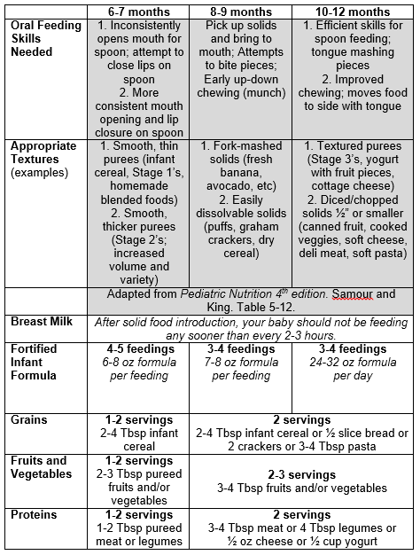
Infants – Solid Food Introduction
Notes:
Here is the table that summarizes infant feeding from Children’s “Feeding Your Baby” teaching sheet.

Slide 16
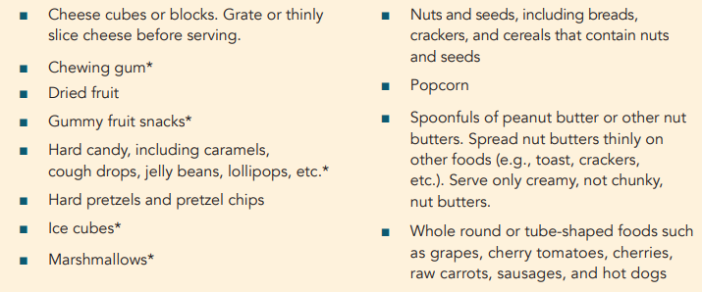
Infants – Solid Food Introduction
What should not be offered?
Juice (even 100% fruit juice)
Unpasteurized foods and beverages
Choking hazards, including:
Table from WIC Works “Reducing Risk of Choking in Young Children”
Notes:
What foods should not be offered?
Juice, even when it’s 100% fruit juice, any foods or beverages that are unpasteurized as this presents a food safety risk, and any choking hazards.
Here is a table from WIC of some of the common choking hazards for infants and young children. In general, avoid foods that are marble-sized, hard, or sticky.
WIC also has a great resource on how to modify foods so they aren’t choking hazards. You can find the link to the resource in this training’s Module Template under Supplemental resources.

Slide 17
Infants – Solid Food Introduction
What should wait to be offered until after 12 months of age?
Cow’s milk, or comparable milk alternative, as the infant’s primary beverage
Honey
Notes:
What foods should we wait to offer until an infant is at least 12 months old?
Cow’s milk or a comparable milk alternative, shouldn’t be introduced as the infant’s primary nutritious beverage until 12 months old. If a family wishes to, they can offer this in small tastes from cups at meals or snacks to get the infant use to drinking this once they are 12 months old.
Honey should not be given until an infant turns 12 months old, as it poses a risk of botulism at young ages.

Slide 18
Infants – Solid Food Introduction
Baby Led Weaning
What is it?
Skipping purees, offering soft table foods as first foods
Notes:
More recently, some families have opted to introduce foods in a manner other than the typical purees. This approach is commonly referred to as “baby led weaning” because the baby is leading how much they consume versus being fed by a spoon. These families often skip purees and start offering soft table foods as the baby’s first foods.

Slide 19
Infants – Solid Food Introduction
Baby Led Weaning
Perceived Benefits | Potential Concerns
Self-regulation of calorie intake | Safety of consuming foods with higher choking risk
Lower obesity risk | Lack of caregiver involvement in feeding
Better diet quality | Under-nutrition
Fine motor skill development | Poor nutrient intake
Greater texture exposure | Lack of learning the use of utensils/eating purees
Notes:
Why are families choosing the baby led weaning approach to feeding their infants? This table reviews the perceived benefits that families are drawn to with this approach, including a baby self regulating their own calorie intake, potentially lowering their risk of obesity, improving their diet quality and fine motor skill development, and exposing them to a greater variety of food textures early on.
Some pediatric health professionals have concerns that baby led weaning poses these potential risks, including consuming foods that are a choking risk, having caregivers that are less involved and attentive to the infant’s feeding, potentially causing undernutrition or poor nutrient intake, and the lack of learning the skill of using utensils and eating purees.
Note that these are perceived benefits and potential risks of baby led weaning. Let’s review what the research tells us on the next slide.

Slide 20
Infants – Solid Food Introduction
Baby Led Weaning
Perceived Benefits | Potential Concerns
Self-regulation of calorie intake | Safety of consuming foods with higher choking risk
Lower obesity risk | Lack of caregiver involvement in feeding
Better diet quality | Under-nutrition
Fine motor skill development | Poor nutrient intake
Greater texture exposure | Lack of learning the use of utensils/eating purees
BLISS Study results: (Taylor et al Pediatrics 2017)
Modified BLW group
Less food fussiness and greater enjoyment of food
Exclusively breastfed longer
Higher fruit and vegetable variety at 24 months old
Notes:
Based on the BLISS study from 2017, baby led weaning does not lead to better self regulation of calorie intake or decrease obesity risk. It also doesn’t pose a choking risk when caregivers are educated on foods that are a high choking risk for infants. It also didn’t prove that infants following baby led weaning were at increased risk of under nutrition or poor nutrient intake.
Between the traditionally fed infant group and the baby led weaning infant group, there were no differences in BMI at their follow up at 2 years of age and no differences in growth throughout the study. There was also no increased risk of choking on foods in the BLW group and they did not have higher rates of iron deficiency anemia when compared to the traditionally fed infant group. Of note, the BLW group was educated on foods to avoid that were a high choking risk.
There were a few benefits noted in the BLW group, including infants with less fussiness and greater enjoyment of food, infants that were exclusively breastfed longer, and at their follow-up appointment at 2 years of age, they had a greater variety of fruits and vegetables they were willing to eat.

Slide 21
Infants – Solid Food Introduction
Baby Led Weaning
What to recommend?
Educate on high risk choking hazards
Engagement in feeding
Infants receiving human milk will likely need an iron supplement
Keep in mind
Feeding from a spoon is a life-long skill that everyone needs to develop
BLW doesn’t have to be all or nothing – a family can choose to offer some soft solids alongside purees as they introduce foods
Notes:
Based on the information we have at this time, what can we recommend if a family is choosing to following baby led weaning?
Educate the family on foods that are a high risk of choking. Encourage the caregivers to continue to be engaged in feeding their infant, even though they aren’t having to spoon feed the child. And recommend an iron supplement for infants receiving human milk, as they likely won’t be able to meet their iron needs without the intake of an iron-fortified baby cereal.
Remember to keep in mind for yourself and when educating families on this approach: eating from a spoon is a life-long skill that everyone needs to develop, so it’s still important to offer some foods by spoon at some point. Also, families don’t have to solely choose baby led weaning versus feeding purees. They can still offer some soft solids along with the purees as they work on introducing foods.

Slide 22
Infants
6 to 12 months old
Notes:
Now we’ll discuss the progression of infant feeding once solid foods have been started.

Slide 23
Infants – 6 to 12 months old
Continue to offer nutrient-dense foods
Start offering an age-appropriate cup at meals with water, human milk, or formula
Limit water to no more than 4-8 ounces per day
Notes:
From 6 to 12 months old, infants should continue to be offered nutrient-dense foods, along with an age-appropriate cup at meals. The cup can have water, human milk, or formula in it. Intake from the cup will be minimal, especially at first, but helps set the stage for eventually weaning from the bottle after they’ve turned 1 year old.
While drinking water is an important skill to develop, at this age, infants should not be drinking any more than 4-8 ounces water per day to ensure they don’t become hyponatremic or displace human milk or formula with water intake.
Source: AAP Healthy Children https://www.healthychildren.org/English/healthy-living/nutrition/Pages/Recommended-Drinks-for-Young-Children-Ages-0-5.aspx

Slide 24
Infants – 6 to 12 months old
Weaning from human milk and/or infant formula at 12 months of age
Can continue to give human milk beyond 12 months as desired
Wean to whole cow’s milk or equivalent
Toddler formulas typically are not needed
Added vitamins and minerals
Often higher calories/oz than whole milk
Can fill up on extra calories, leading to less food consumption
Notes:
Around 12 months old, an infant can be transitioned from human milk and/or infant formula to whole cow’s milk or an alternative equivalent. It’s important to remember that infants can continue to be given human milk if mutually desired by the caregiver and infant. Infants don’t typically need to continue on infant formula or transition to a toddler formula, as they are likely meeting most of their vitamin and mineral needs from foods. Toddler formulas are usually higher in calories per ounce than whole milk and may lead to an infant filling up on the calories from the formula, leading to consuming less volume of food. If it’s determined that an infant would benefit from additional vitamin and mineral supplementation at this age, they can be given a multivitamin/mineral supplement along with whole milk instead of giving them a more costly toddler formula.

Slide 25
Case Study #2
Emily is an 8 month old female, born at 36 weeks. She is breastfed and nurses 4-5 times per day. Parents introduced purees at 6 months of age. Emily eats Stage 1 or Stage 2 baby food 2-3 times per day and she really enjoys it.
Answer questions 1-3 on the Worksheet for Case Study #2.
Notes:
Please read and complete Case Study 2 on your Learning Module Worksheet, then continue to the next slide.

Slide 26
Toddlers/Preschoolers
1 to 5 years old
Notes:
Next, we’ll discuss General Feeding Guidelines for Toddlers and Preschoolers.

Slide 27
Toddlers/Preschoolers
Continue basic feeding guidelines
Offer 3 meals and 2-3 snacks each day
Meals and snacks no sooner than every 2 ½ to 3 hours
Limit distractions
Booster seats and/or high chairs are helpful
Limit feedings to no longer than 20 minutes
Notes:
In this population, we continue the basic feeding guidelines of 3 meals and 2-3 snacks each day, making sure that there is at least 2 and a half hours between these feeding times. Distractions should be avoided at these feeding times and the child should be in a high chair or booster seat or another age-appropriate seat. Buckles can be helpful to keep the child in one place during their meals and snacks. Feedings shouldn’t last more than 20 minutes unless the child is continuing to actively eat past the 20 minute mark. Most kids at these ages struggle with having an attention span that allows them to sit for longer than this amount of time, so most naturally won’t eat past the 20 minute mark. All food and beverages besides water should be removed at the end of the meal or snack.

Slide 28
Toddlers/Preschoolers
What to offer?
Family foods (with texture modification as needed)
Food from all food groups
Nutrient-dense foods
Toddler-friendly meats: shredded meats, deli meat, fish, crock pot/slow cooked meats
Do not limit fats
Important for brain development
Continue whole milk until at least 2 years old
Milk at meals (and snacks if not excessive)
Limit to no more than 16-24 oz milk per day unless advised by provider
Excessive intake tends to displace other foods/nutrients and causes anemia
Transition from bottle to age-appropriate cup
Notes:
What should be offered at this age?
Most of the foods that the rest of the family is eating can be offered to the child, with some texture modifications when needed, especially in harder to chew meats for example.
Foods should still be offered from all of the food groups and should be nutrient dense. Because meats are one of the more difficult textures to chew, children at these ages often struggle to take in adequate volumes in order to meet their iron and zinc needs. Some ideas for more toddler-friendly meats from a texture standpoint include shredded & chopped meats, deli meat, fish or other soft seafood, and crock pot or slow cooked meats.
Intake of healthy fats should not be limited, as fats are important for continuing brain development. Unless otherwise directed by a health care provider, children should continue on whole milk until the age of 2 years at least because of the importance of continuing brain development.
Milk should be offered with meals and can also be offered at snacks as long as their total daily intake doesn’t exceed 16 to 24 ounces. Excessive intake of milk can displace other foods and nutrients from those foods, and at times can cause or exacerbate iron-deficiency anemia. It’s also important to note that excessive milk intake can lead to constipation as well.
At 12 months old, children should start transitioning to a cup at mealtimes, if they haven’t already, as this will set the stage for weaning from an infant bottle by 18 months of age ideally.

Slide 29
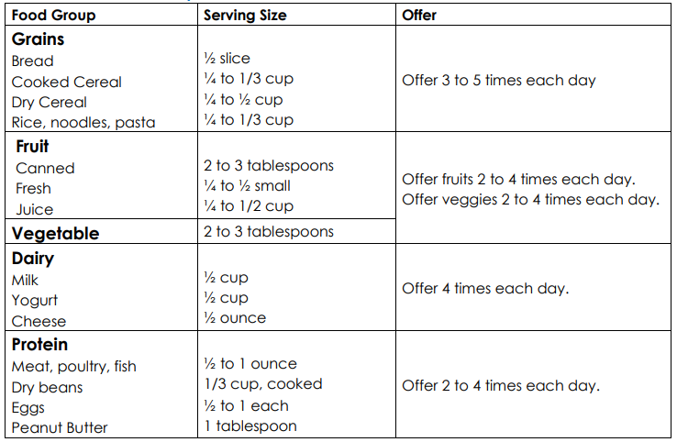
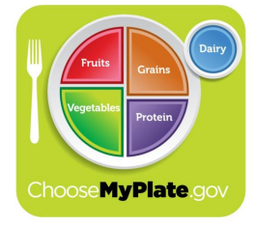
Toddlers/Preschoolers
Notes:
This chart is pulled from Children’s “Feeding Your Toddler” teaching sheet. On the left, you’ll see a few examples in most of the food groups followed by an example of a typical serving size for this age group. Lastly, you’ll see how often these foods should be offered each day.

Slide 30
Toddlers/Preschoolers
What should not be offered?
Juice
Limit to no more than 4 ounces per day; offer whole fruit instead
Unpasteurized foods and beverages
Choking hazards, including:
Notes:
What foods should not be offered at these ages?
Juice really should not be offered, but if it is, it should only be 100% fruit juice and limited to no more than 4 ounces per day. Whole fruit is always preferred as a source of a child’s fruit intake over fruit juice.
Unpasteurized foods and beverages should continue to be avoided due to food safety concerns.
Most foods are considered choking hazards until the age of 4 years, so the same choking hazards from infancy should continue to be avoided until 4 years old.

Slide 31
Toddlers/Preschoolers – Picky Eating
Common in this age group
Many toddlers eat well at one or two meals a day and not as well at the rest
Stick with General Feeding Guidelines
Offer nutrient dense foods at all meals and snacks
Make trying new foods fun and low pressure
Food jags – only accepts a few foods for a few weeks
Do not short-order cook
Offer options within reason
Ensure options/family meals include at least one preferred food, such as a preferred fruit or vegetable
Notes:
A common question that comes up in this age group is related to picky eating. This occurrence is very common and age-appropriate. Toddlers are figuring out ways that they can demonstrate their independence, and food is one of those places. While the child may only eat well at one or two meals a day, it’s important to stick with the General Feeding Guidelines and know that they will likely make up for poor intake at the next meal or snack. Continue to offer nutrient dense foods and don’t give in just because they’re refusing to accept the foods offered or didn’t eat well at the last meal.
Parents and caregivers can help by making it fun to try new foods with minimal pressure involved. Having all family members, especially older siblings, join in can help motivate toddlers.
Most children in this age group will go through food jags, where they only want to accept one or a few foods for several days or even a few weeks in a row. Caregivers need to stick with the General Feeding Guidelines, and they also need to avoid becoming short order cooks, which gives into the child’s food jag. Within reason, the caregiver can offer other options such as a deli sandwich if they don’t want a peanut butter & jelly sandwich today or an orange instead of the apple. It also helps if at least one food provided at each meal is a more preferred food that the child is likely to at least accept that without complaint or battle. Remind parents that this is a phase and that it will pass with time, especially if they stick to the General Feeding Guidelines and don’t become short order cooks.

Slide 32
Toddlers/Preschoolers – Picky Eating
Red flags
Refuses all foods in an entire food group(s)
Very brand specific and/or particular about seeing food prepared/presented
Consuming most of their intake from liquids and/or purees
Presence of ongoing gagging/vomiting with non-preferred foods
Notes:
How do we know when a child is more than just your typical “picky eater”?
Here are some red flags to look for that may indicate bigger issues than just the average picky eater.

Slide 33
Case Study #3
Katie is a 2 year old female. She transitioned appropriately from infant formula to whole cow’s milk at 1 year of age. She eats 3 meals and 1 snack daily consisting of table foods. Katie accepts food from all food groups, but has difficulty chewing beef and poultry. For snack, Katie likes popcorn, mandarin oranges, or fruit snacks. Mom reports that Katie loves milk and drinks 3-4 8oz sippy cups of whole cow’s milk daily.
Answer questions 1-3 on the Worksheet for Case Study #3.
Notes:
Please read and complete Case Study 3 on your Learning Module Worksheet, then continue to the next slide.

Slide 34
School Age Kids
5 to 11 years of age
Notes:
Next, we’ll discuss General Feeding Guidelines for School Age children.

Slide 35
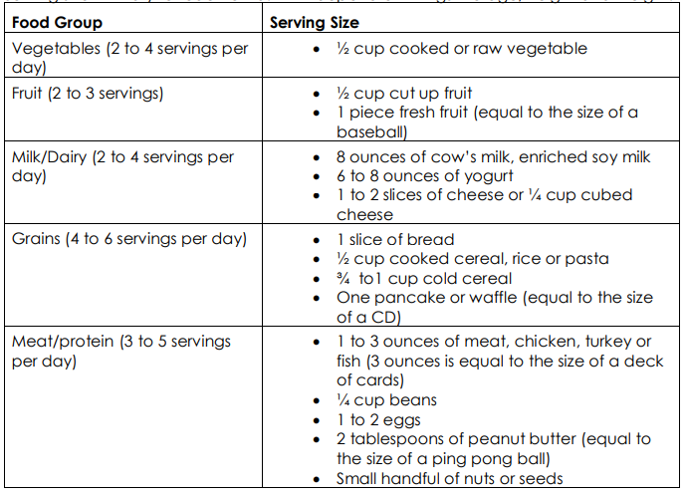
School Age Kids
Notes:
This table is pulled from Children’s “Feeding Your School Age Child” teaching sheet. It breaks out each food group on the left hand side along with how many servings per day are needed. On the right hand side, it gives recommended serving sizes of some example foods from each food group.

Slide 36
School Age Kids
3 meals each day
Healthy snacks if needed
Set a good example and make healthy choices
Eat family meals seated at the table
Limit distractions (no screens)
Encourage the child to participate in grocery shopping and meal preparation
Limit sugar-sweetened beverage including sports drinks
Notes:
General Feeding Guidelines continue to apply in this age group. At these ages, you may find that kids don’t need as many, if any, snacks during the day, but they should continue to each 3 meals per day.
Family meals should be encouraged whenever the family’s schedule allows. Meals on the go or eating out should be limited as much as possible. When meals at home aren’t feasible, packing a healthy meal for on the go is a good replacement for eating out or fast food.
Screens should not be present at mealtimes.
At this age, kids can participate in grocery shopping and meal prep which gives them more ownership over the foods being consumed.
It’s especially important to emphasize limiting sugar-sweetened beverages as many kids at this age drink them outside of the home or during sports activities.

Slide 37
Preteens/Teens
11 to 18 years of age
Notes:
Lastly, we’ll discuss Feeding Guidelines for Preteens and Teenagers.

Slide 38
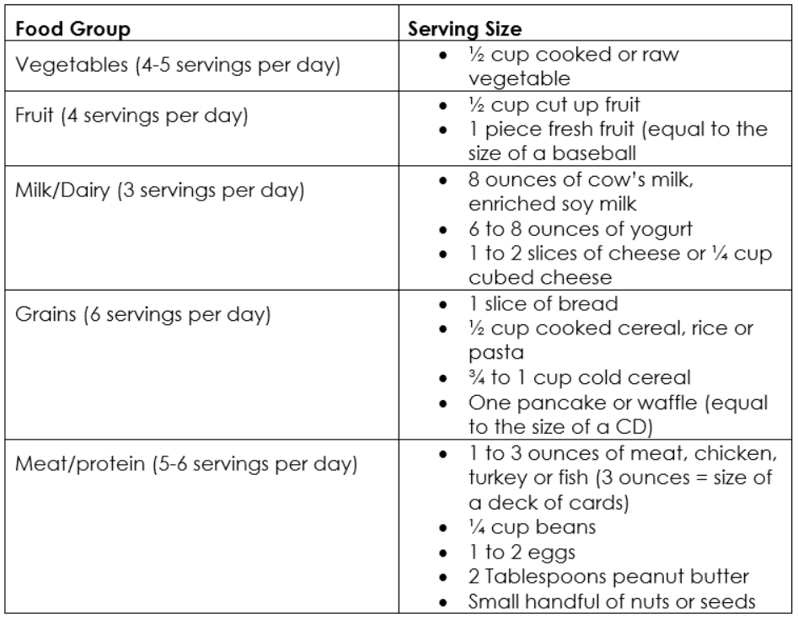
Preteens/Teens
Notes:
This table has the same serving size examples as the previous age group, but the number of servings per day increases. Kids at these ages are transitioning into puberty and likely need more calories to promote appropriate growth and development during this time.

Slide 39
Preteens/Teens
3 meals each day
Stress the importance of breakfast
Healthy snacks if needed
Family meals whenever able
New challenges with child making their own food choices
Discuss the importance of healthful food choices in building a strong and healthy body
Do not focus on weight
Continue to limit sugar-sweetened beverages
Notes:
Preteens and teens should be encouraged to consume 3 meals per day, stressing the importance of breakfast as this is often a skipped meal during busy mornings before school. Kids can have snacks as needed, but the emphasis should be on healthy foods, such as fruits, vegetables, low-fat dairy, and lean protein sources.
As with the previous age group, the family should sit down for meals together whenever possible.
Many kids at these ages are getting to make their own choices about the foods they’re consuming, whether it’s at school, with friends, or during after school activities. It’s important to discuss healthy food choices that build strong, healthy bodies, and not to focus on weight or weight gain. Before and during puberty, kids grow rapidly and at differing rates, so solely focusing on weight and body image can lead to an unhealthy relationship with food.
Continue to discourage consumption of sugar-sweetened beverages.

Slide 40
Preteens/Teens
Calcium
Many preteens/teens are not meeting their calcium needs as they go through puberty
Ensure adequate intake of calcium fortified foods throughout the day OR recommend a calcium supplement (taken separate from any iron-fortified foods or iron supplements)
Notes:
Adequate intake of calcium is especially important during these preteen and teen when kids are laying down bone mass with growth spurts in puberty.
Encourage calcium intake from foods, especially nutrient dense foods, or recommend a calcium supplement if they don’t consume adequate amounts of calcium containing foods. Remember to always give a calcium supplement separate from an iron supplement as they will compete for absorption in the GI tract.

Slide 41
Preteens/Teens
Vegetarian and Vegan considerations
Include food from all food groups
Nutrients
Calcium
Iron
Vitamin D
Vitamin B12
May require vitamin and mineral supplementation
Vitamin B12 supplementation required for vegans
Notes:
It’s not uncommon for some kids in this age group to decide to follow a vegetarian or vegan diet. It is possible to do this while still meeting all of their nutrition needs for appropriate growth, there are some special considerations.
Ensure the child is continuing to consume foods from all the food groups and replacing meats with dairy or plant-based proteins. Specific nutrients of concern include calcium, iron, Vitamin D, and Vitamin B12. If the child is vegetarian and is consuming adequate dairy, they are likely meeting their calcium, vitamin D, and vitamin B12 needs. However, it can be difficult to meet their iron needs without the use of a supplement. This is especially important to consider in females who have had their first period, also referred to as reaching menarche.
In kids following a vegan diet, they will absolutely have to supplement vitamin B12 as true vegans are not able to consume adequate amounts of this from food. They often also need to supplement iron to meet their needs.

Slide 42
Preteens/Teens
Fad diets
Many restrict or avoid food from one or more food groups
Often not evidence-based nor recommended for children
If following a fad diet:
Ensure adequate growth and adequate intake of all macro & micro nutrients
Have a discussion about the child’s reason for following the fad diet and the nutrition concerns you have
Notes:
Fad diets can also be common in this age group. Keep in mind that a lot of fad diets restrict or avoid foods from one if not more food groups. This puts the child at risk for deficiencies from that food group and overall at risk for not meeting their nutrition needs to promote appropriate growth. Many of these fad diets are not evidence-based and even if they are, aren’t usually recommend for kids. If a preteen or teen is following one of these diets, educate them on the risks, ensure they are having adequate growth and meeting all of their macro & micro nutrient needs.

Slide 43
General Feeding Guidelines
Some basic guidelines span across all age groups
Ellyn Satter’s Division of Responsibility in Feeding
Parents are in charge of what, when, and where food is offered
Child is responsible for how much and whether food is consumed
Basic principles
Appropriate seating (high chair, booster, table)
Structured meal and snack times (typically no sooner than every 3 hours)
Limited distractions (no screens)
Consume nothing with calories in between set meal and snack times, encouraging water drinking
Notes:
Remember these Feeding Basics that allow most kids to consume what they need to thrive.

Slide 44
Case Study #4
Evan is an 8 year old male. Evan follows a lacto-vegetarian diet along with the rest of his family. The family usually eats dinner in the living room in front of the TV, and sometimes Evan watches his tablet. He likes to drink soda or Gatorade.
Answer questions 1-3 on the Worksheet for Case Study #4.
Notes:
Please read and complete Case Study 4 on your Learning Module Worksheet.

